Slide 1
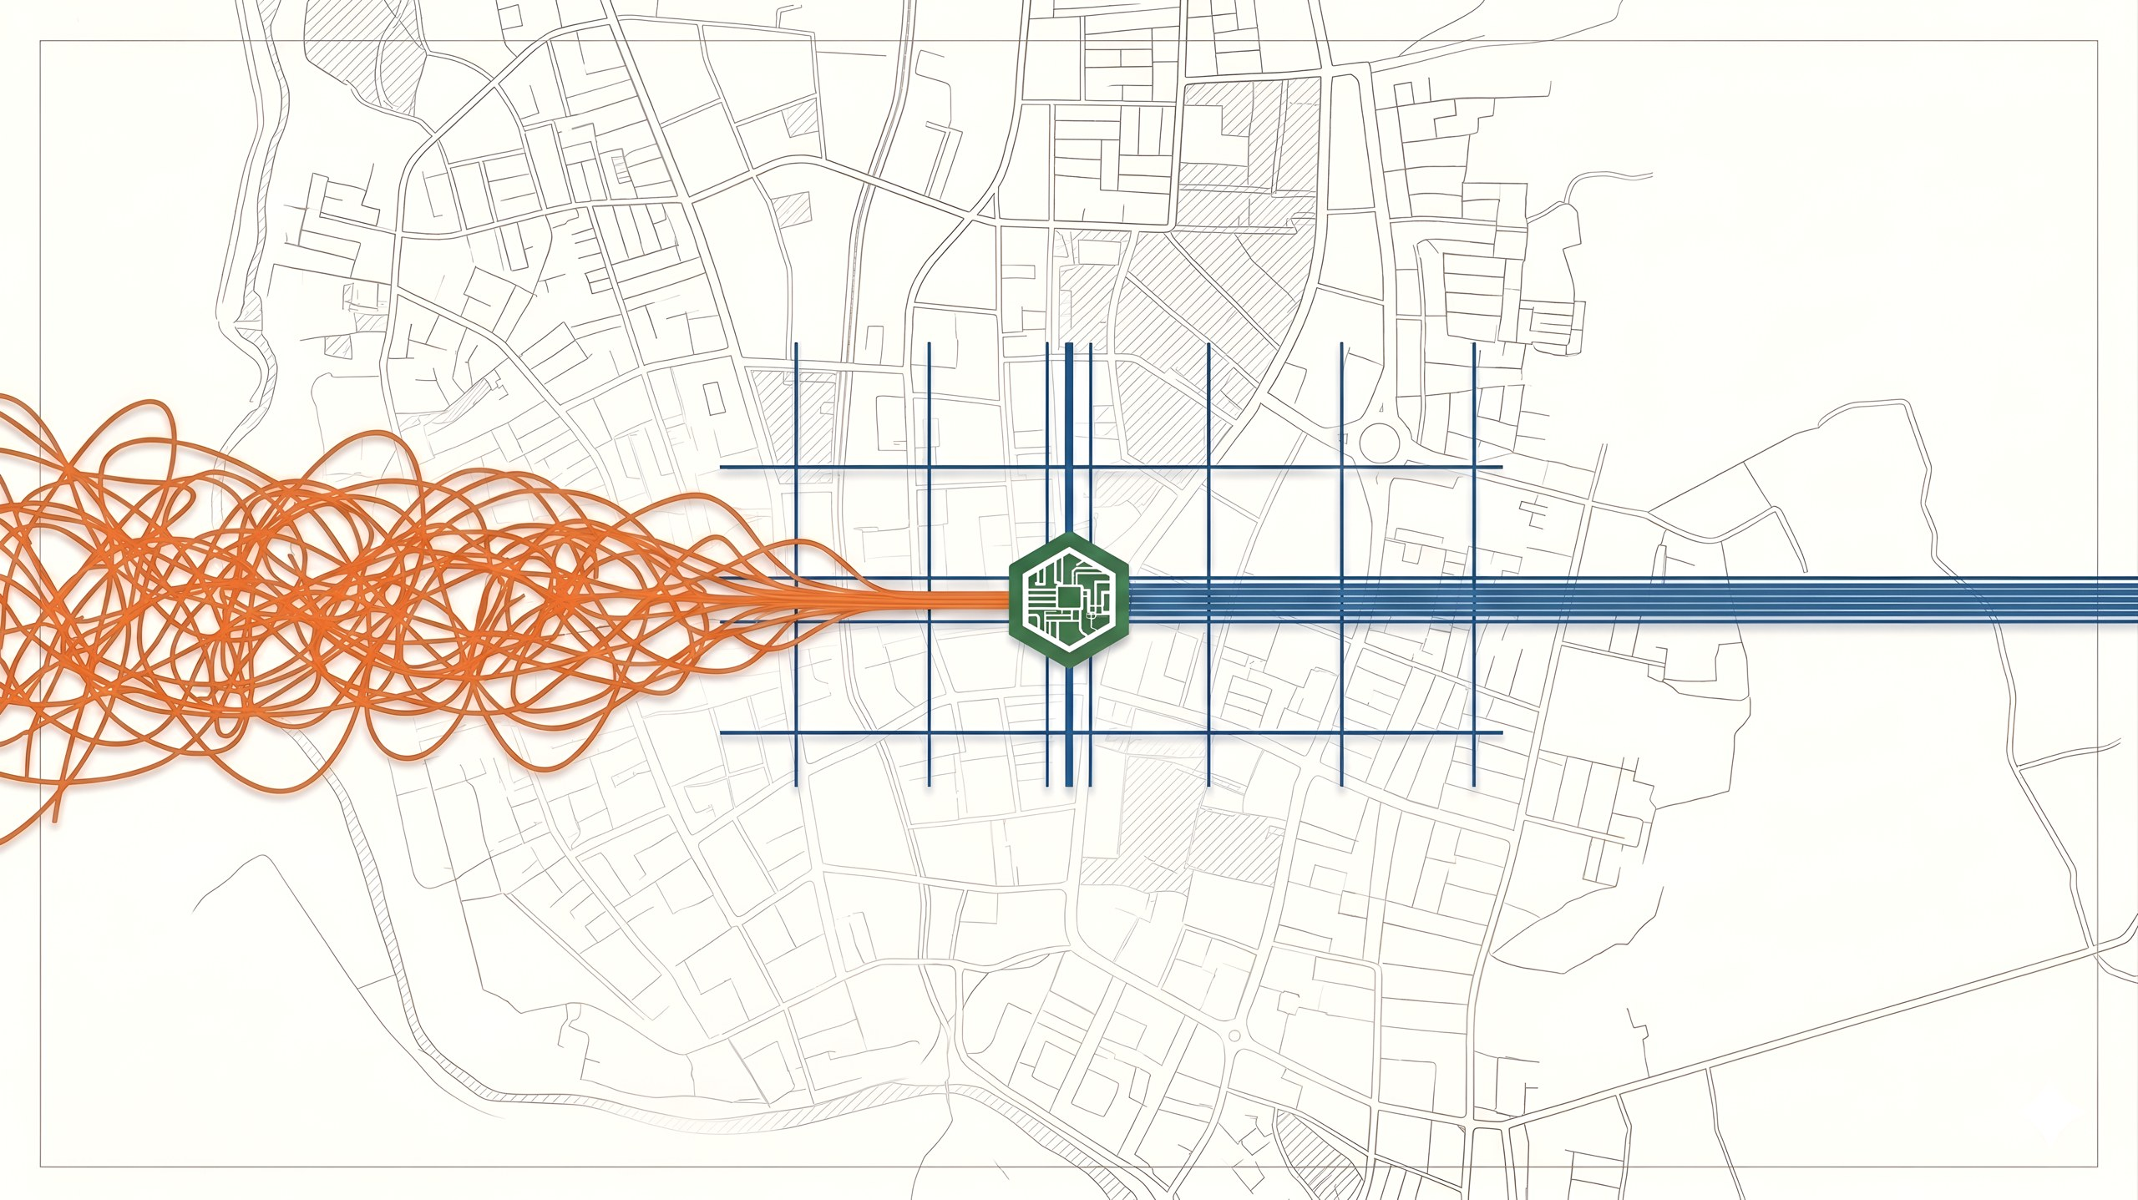
CityPulse
Intelligent Parking & Traffic Control Platform
CSE499B Review Presentation
CSE499B · Section 15 · Project Group 03
Md. Rahad Hossain
ID: 2211316642
Md. Yousuf
ID: 2211461642
MD. Rokib Hasan Oli
ID: 2211950642
Safayat Ibrahim
ID: 2131174642
Group 03 · Md. Rahad Hossain · Md. Yousuf · MD. Rokib Hasan Oli · Safayat Ibrahim
CSE499B · Section 15 1 / 16
Notes:
[~1 min] Introduce all four members by full name (course rule). The talk has four parts: ML and backend, mobile app, web frontend, then engineering scope and plan. One line: CityPulse finds free parking from existing CCTV; today we review 499A and present the 499B plan.

Slide 2

Problem Statement
7 km/h
Existing parking services in Bangladesh
Service | Availability updated by | Uses cameras | Serves
DNCC Smart Parking [2] | booth operators, by hand | No | drivers
Parking Koi [3] | space owners, by hand | No | drivers, owners
CityPulse | camera + model, automatic | Yes | drivers, owners, authorities
average traffic speed in Dhaka [1]; illegal roadside parking is a major cause
Drivers cannot see free parking before they arrive, so they circle or stop on the road.
Availability is typed by hand in every local service, which does not scale.
Authorities cannot identify vehicles in a slot without being physically there.
Prices are fixed, so busy lots fill up while nearby ones stay empty.
Closest research: Prova et al. [4] (NSU, 2022) reached 86.1% indoor and 90.5% outdoor on Dhaka CCTV without any local training data, and list local fine-tuning and manual slot marking as open problems.
Group 03 · Md. Rahad Hossain · Md. Yousuf · MD. Rokib Hasan Oli · Safayat Ibrahim
CSE499B · Section 15 · Part 1 · ML & Backend 2 / 16
Notes:
[~1.5 min] Four problems. The first two were the focus of 499A; the last two (vehicle identification, pricing) are new in 499B. The table shows the gap: nobody senses availability automatically. The NSU paper is our baseline to beat.

Slide 3
Review of 499A: Proposed vs. Delivered
Of the 8 objectives in our 499A proposal: 3 done, 4 partial, 1 not done
# | 499A proposal objective | Status | What exists / what is missing
1 | Driver app: search, find and navigate | Done | Map search, booking, hand-off to Google Maps
2 | CV module on live CCTV feeds | Partial | Model at 99.18%, but runs on still images, not live streams
3 | Owner registration portal | Done | Space, photo and camera onboarding on the live API
4 | Real-time updates to the app | Partial | Backend refreshes every 10 minutes; nothing is pushed
5 | Authority occupancy view | Partial | Interface designed and built, but no backend data yet
6 | Push notifications | Not done | Only the database table exists
7 | LPR / jam detection study and datasets | Partial | Papers reviewed; no plate images collected
8 | System architecture | Done | Architecture document, 21-model schema, OpenAPI docs
Built although not in the proposal: slot booking with reservation-aware availability, and a reproduction of VPS-Net (98.53%).
Group 03 · Md. Rahad Hossain · Md. Yousuf · MD. Rokib Hasan Oli · Safayat Ibrahim
CSE499B · Section 15 · Part 1 · ML & Backend 3 / 16
Notes:
[~1.5 min] Walk the table quickly. Be direct about partial items: they are exactly what 499B completes. Booking was only 'future work' in the proposal and we built it anyway.

Slide 4
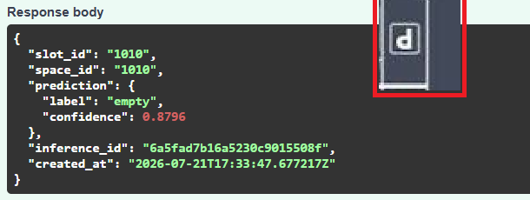
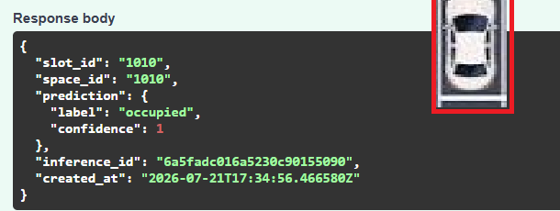
499A Result: Parking Occupancy Model
MobileNetV2, trained on 808,991 slot images (PKLot + CNRPark+EXT), validated on a lot never used in training
Phase | Trained layers | Learning rate | Best accuracy
1 | new head only | 1e-3 | 97.28%
2 | whole network | 1e-5 | 99.18%
Error rate fell from 2.72% to 0.82%
VPS-Net occupancy stage reproduced: 98.53%
Not yet tested on Dhaka footage (O1 in 499B)
Live API test (21 Jul 2026)
empty, confidence 0.88
occupied, confidence 1.00
P1 = phase 1 (head only), P2 = phase 2 (full fine-tune). Best checkpoint: P2 epoch 9.
Group 03 · Md. Rahad Hossain · Md. Yousuf · MD. Rokib Hasan Oli · Safayat Ibrahim
CSE499B · Section 15 · Part 1 · ML & Backend 4 / 16
Notes:
[~1.5 min] Cross-lot: the validation lot UFPR05 never appears in training, so this reflects a newly registered facility. Epoch 7 dip shows why we select by validation accuracy. Be honest: this is an international lot; Dhaka is the first 499B objective.

Slide 5
From 499A Gaps to 499B Objectives
Every limitation listed in our 499A final report maps to a 499B objective
Limitation at the end of 499A | 499B objective | Result we will report
No Bangladeshi evaluation data | O1 Dhaka dataset + Phase 3 fine-tuning | Accuracy before/after fine-tuning; precision, recall, F1
Still images every 10 minutes, not video | O2 Live RTSP pipeline | Time from camera to app update
Licence plates and jams only surveyed | O3 Bangla licence plate recognition | Detection mAP, character error rate, plate accuracy
Authority views not connected to data | O3 Live authority dashboard | Occupancy and plate log on live data
Pricing rules exist only in the schema | O4 Demand-aware pricing | Surge and time-based prices in bookings
No precision, latency or load tests | Final sprint: full evaluation | Metrics, Raspberry Pi latency, load test
Group 03 · Md. Rahad Hossain · Md. Yousuf · MD. Rokib Hasan Oli · Safayat Ibrahim
CSE499B · Section 15 · Part 1 · ML & Backend 5 / 16
Notes:
[~1.5 min] This is the bridge between the two halves. We did not invent the 499B scope; it comes directly from the limitations section of our own 499A report.

Slide 6
499B: System Design, Dataset and Live Pipeline
Driver app
Flutter
Owner portal
Next.js
Authority dashboard
Next.js
O1 Dhaka dataset + Phase 3
Footage from 2–3 Dhaka parking sites (day, night, rain)
3,000–5,000 labelled slot images
Test the 499A model first, then fine-tune a third phase
One Dhaka site kept out for validation; baseline to beat is 86–90% [4]
WebSocket push
Backend API
NestJS
Redis Pub/Sub
AI service
FastAPI
Pricing
Stream worker
Plate LPR
O2 Live pipeline
A frame every 2–3 s; only changed slots are pushed to the apps
Camera online/offline status and automatic reconnect
Replaces the 10-minute still-image refresh from 499A
Latency measured on a Raspberry Pi
PostgreSQL · MongoDB · S3
CCTV (RTSP)
new in 499B
Group 03 · Md. Rahad Hossain · Md. Yousuf · MD. Rokib Hasan Oli · Safayat Ibrahim
CSE499B · Section 15 · Part 1 · ML & Backend 6 / 16
Notes:
[~2 min] Same 499A architecture; three new components in teal (pricing, stream worker, plate LPR). Redis + WebSocket was already in our 499A design document, 499B builds it. O1 is the key experiment: how does the 499A model do on Dhaka data before and after fine-tuning.

Slide 7
499B: Bangla Licence Plates and Pricing
O3 Bangla licence plate recognition
O4 Demand-aware pricing
Detect plates with YOLOv8
Read the two lines (district/class, serial)
Store plate, time, camera in MongoDB
Show in the authority enforcement log
ঢাকা মেট্রো-গ
১২-৩৪৫৬
two-line Bangla plate
Data: public Bangla plate sets [5][6] + 100–200 of our own photos. Reported: detection mAP, character error rate, full-plate accuracy.
Privacy
If occupancy ≥ 80%: rate = base × 1.5, kept between a floor and a ceiling
Only the authority role can see plate data
Every lookup is logged; records are deleted after a fixed period
Required once the Personal Data Protection Ordinance (2025) is enforced in May 2027
Base rate per slot type: standard, motorcycle, disabled, EV
Peak and off-peak hours
Price fixed at booking time; owner revenue page
Uses the existing pricing_rules table (today: flat rate × hours)
Group 03 · Md. Rahad Hossain · Md. Yousuf · MD. Rokib Hasan Oli · Safayat Ibrahim
CSE499B · Section 15 · Part 1 · ML & Backend 7 / 16
Notes:
[~2 min] LPR reuses the O2 stream. Bangla plates have two lines, which is why OCR is the hard part. Privacy comes from our 499A legal review. Pricing: the chart is an example with a 40 BDT base; the input is live occupancy from the vision model, so pricing depends on O2.

Slide 8
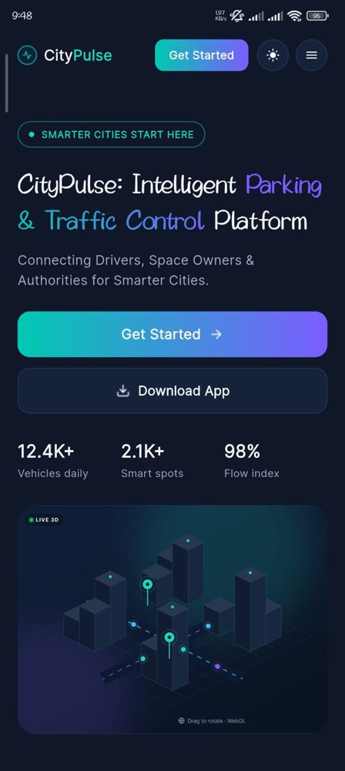
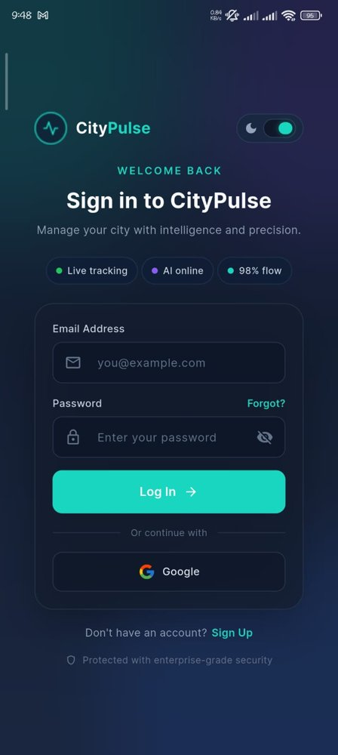
Mobile App: Architecture and Stack
Flutter driver app: sign in, find nearby parking, book and manage bookings
Layer | What it contains
Screens + widgets | landing, sign in / sign up, dashboard map, new booking sheet, bookings, booking details, profile, settings
State | Provider / ChangeNotifier
Services | API, auth, session, booking, location, places, profile
Models | user, auth response, booking, parking
Theme + utils | light / dark theme, map style, BDT currency formatter, responsive layout
Packages
provider · http · shared_preferences · google_maps_flutter · geolocator · permission_handler · location · url_launcher · intl
The app talks only to the NestJS REST API; the JWT session is stored with shared_preferences so the user stays signed in.
Landing
Sign in
Group 03 · Md. Rahad Hossain · Md. Yousuf · MD. Rokib Hasan Oli · Safayat Ibrahim
CSE499B · Section 15 · Part 2 · Mobile App 8 / 16
Notes:
[~1.5 min] Mobile part. The app is layered: screens only call services, services call the REST API, models carry the JSON. Session persists across launches.

Slide 9
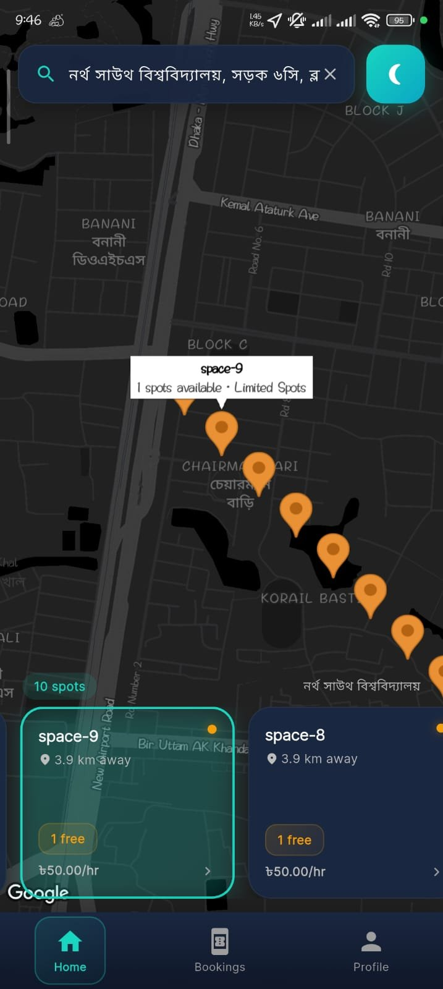
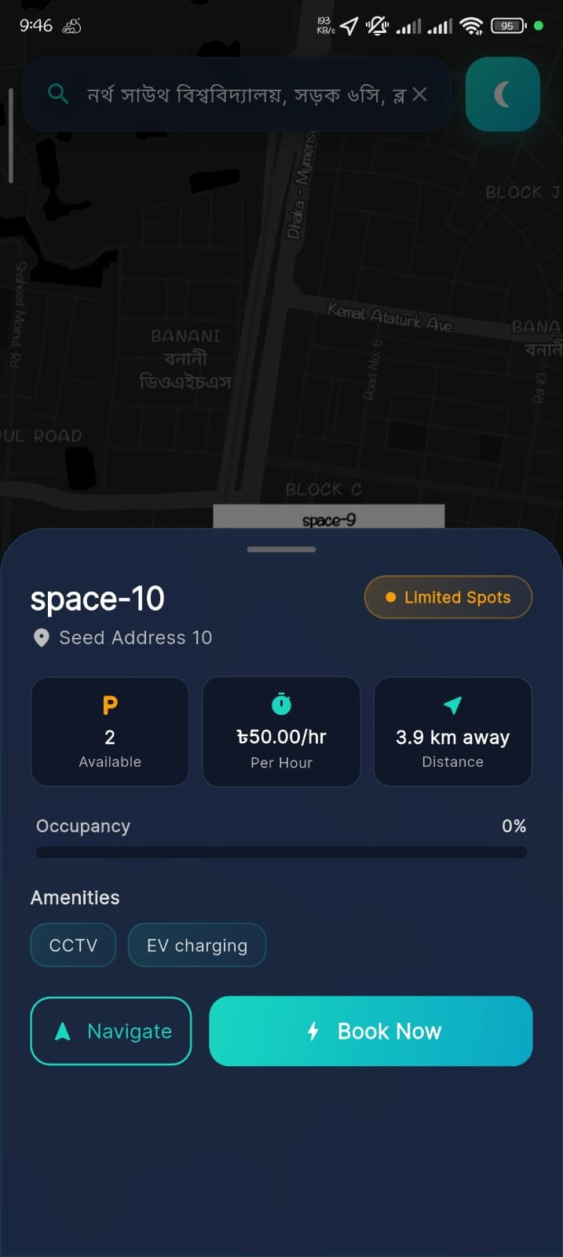
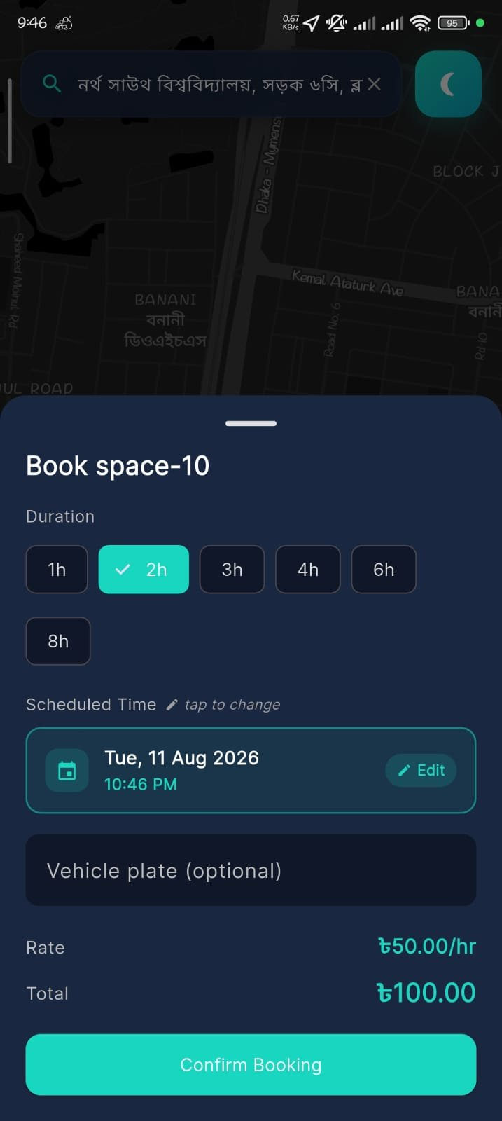
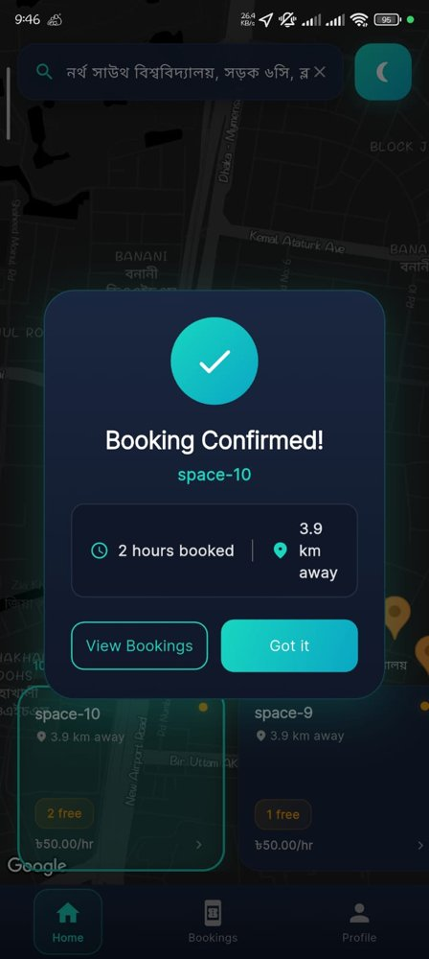
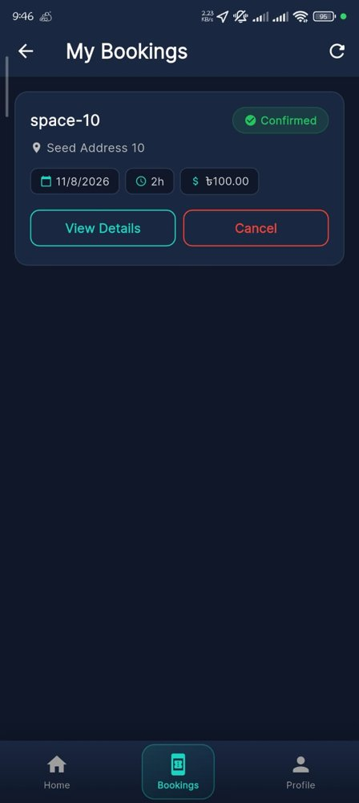
Mobile App: Driver Journey Built in 499A
Screenshots from the 499A demo build, connected to the live backend
1. Nearby parking
2. Space details
3. Choose duration
4. Booking confirmed
5. My bookings
Working end to end: current location and map markers, nearby search, booking with price in BDT, booking history with cancel, profile and logout.
Group 03 · Md. Rahad Hossain · Md. Yousuf · MD. Rokib Hasan Oli · Safayat Ibrahim
CSE499B · Section 15 · Part 2 · Mobile App 9 / 16
Notes:
[~1.5 min] Walk left to right: the driver sees nearby lots, opens one, picks a duration, gets a confirmation, and can manage the booking later. All of this calls the real backend.

Slide 10
Mobile App: Plan for 499B
Feature | Change in 499B
Live availability | slot counts update over WebSocket, no manual refresh
Dynamic price | show peak / surge rate; price fixed when the booking is made
Settings module | theme, notification and privacy preferences
Refactoring | split the large dashboard screen into smaller widgets
Testing | unit, widget and integration tests
Security + release | API keys out of the app, production config, error handling, monitoring
Today: availability and price change only on refresh
Group 03 · Md. Rahad Hossain · Md. Yousuf · MD. Rokib Hasan Oli · Safayat Ibrahim
CSE499B · Section 15 · Part 2 · Mobile App 10 / 16
Notes:
[~1.5 min] Two items come from the system objectives: live slot updates (O2) and dynamic prices (O4). The rest is the app's own maturity work listed as future scope at the end of 499A.

Slide 11
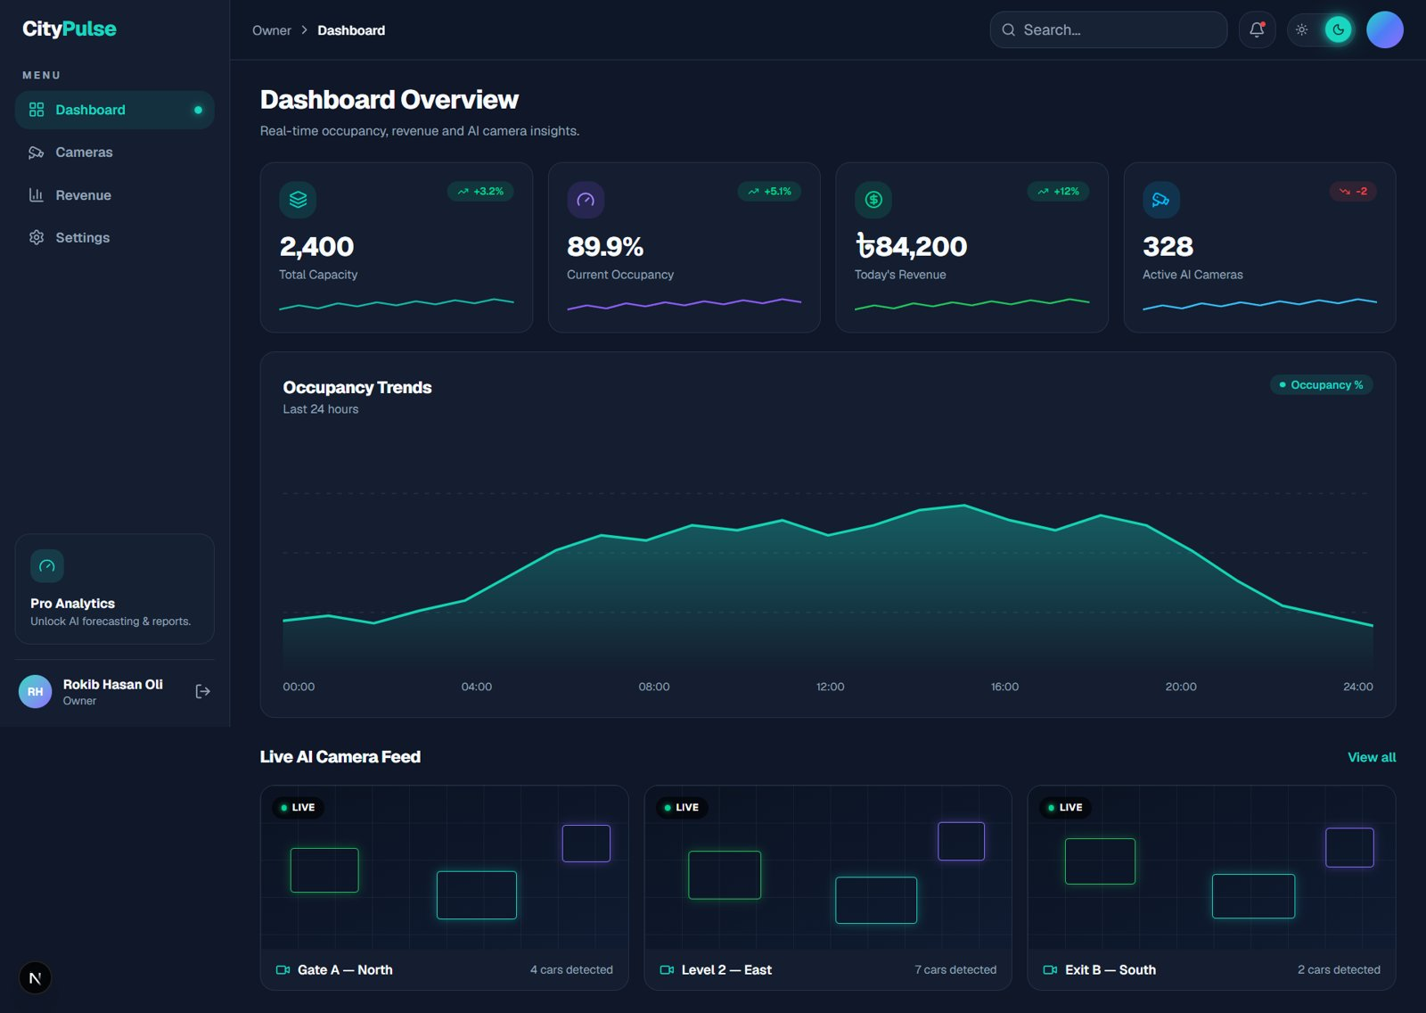
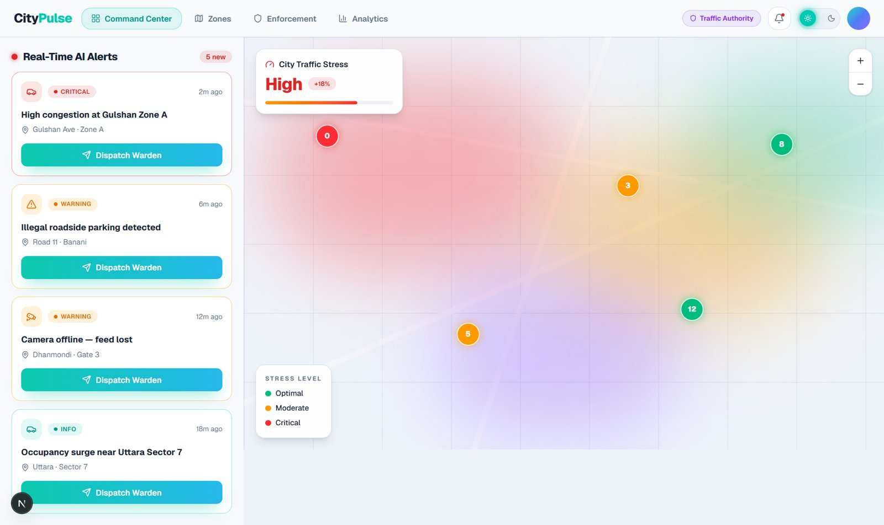
Web Portal: Owner and Authority in 499A
Next.js 16 · React 19 · TypeScript · Tailwind CSS · shadcn/ui · live at 499-ab-frontend.vercel.app
Owner dashboard
Authority command center
Connected to the API | Built with demo data (wired in 499B)
sign up / login for all roles, token refresh, role-based routing, owner parking lots (GET / POST /spaces) | cameras, revenue, analytics, zones, enforcement log
Group 03 · Md. Rahad Hossain · Md. Yousuf · MD. Rokib Hasan Oli · Safayat Ibrahim
CSE499B · Section 15 · Part 3 · Web Frontend 11 / 16
Notes:
[~1.5 min] Frontend part. One Next.js app serves owners and authorities with role-based routing. Be clear about what is live (auth, owner lots) and what still uses demo data, which is exactly the 499B work.

Slide 12
Web Portal: Code Quality and Login Flow
Evidence from the end of 499A
15 / 15
unit tests pass
From sign-in to the right portal
Step | What happens
1. Input | email or phone and role are normalised before sending
2. Request | one fetch layer sends JSON and turns errors into a typed ApiError
3. Token | JWT is decoded for role and expiry
4. Session | stored in sessionStorage, or localStorage with Remember me
5. Refresh | access token renewed within 30 s of expiry
6. Routing | owner → owner portal, authority → command center
96.5%
line coverage of the tested modules (API, session, routing)
20
route entries; production build passes
Coverage is for the tested modules, not the whole frontend.
If a refresh or logout fails, the session is cleared and the user returns to a safe page; no signed-in screen is left open.
Group 03 · Md. Rahad Hossain · Md. Yousuf · MD. Rokib Hasan Oli · Safayat Ibrahim
CSE499B · Section 15 · Part 3 · Web Frontend 12 / 16
Notes:
[~1.5 min] Frontend quality from 499A: tests, coverage of the tested modules, and a login flow that cannot leave a stale signed-in screen after a failed refresh or logout.

Slide 13
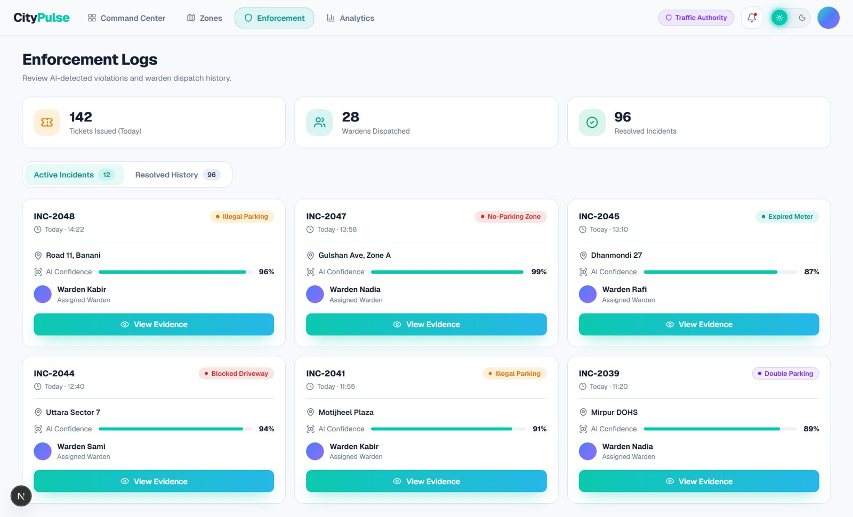
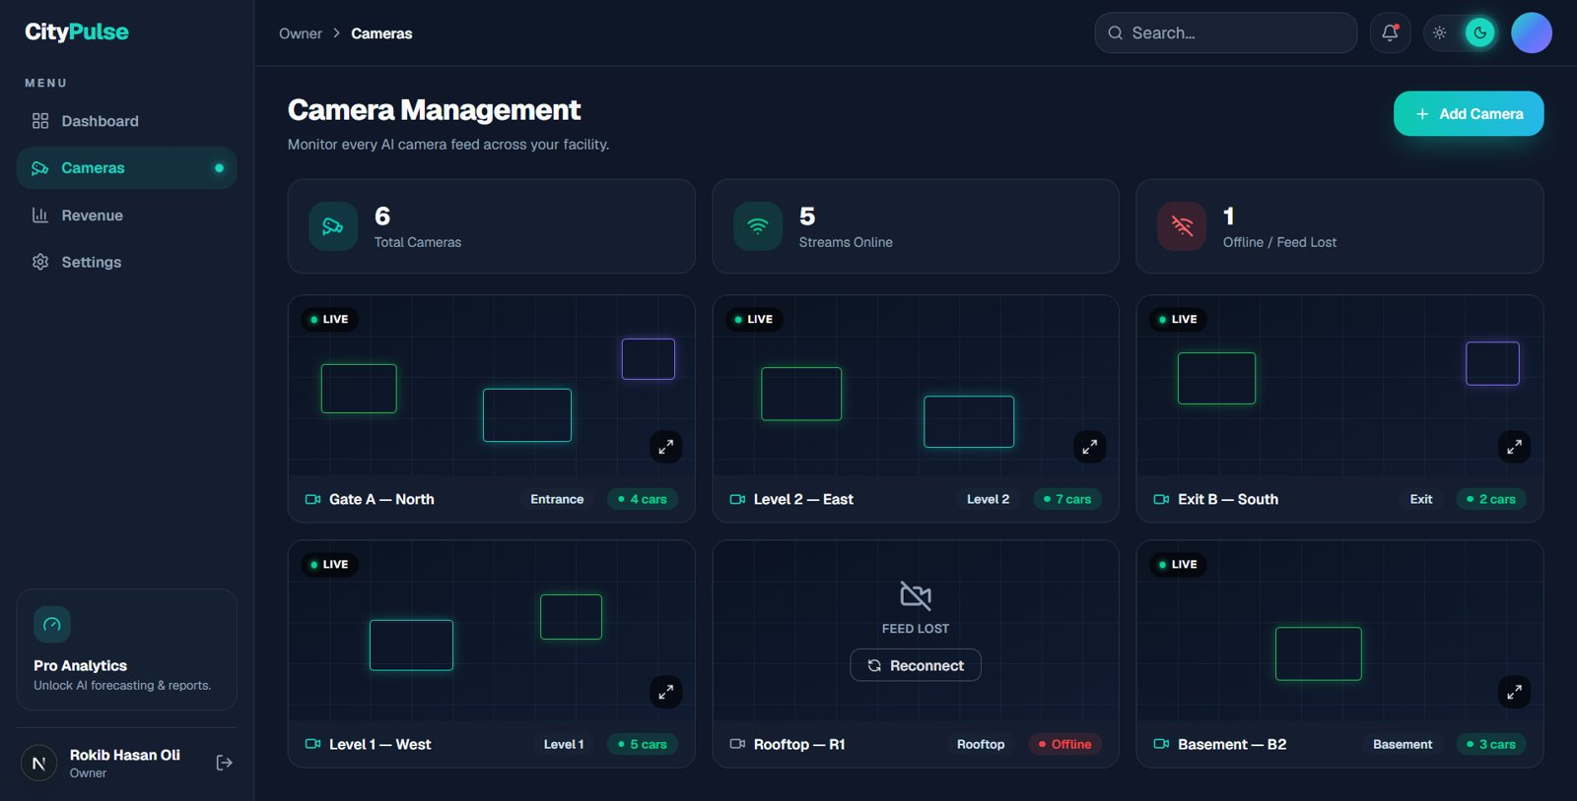
Web Portal: Plan for 499B
Area | Change in 499B
Command center | occupancy, zones and analytics from live backend data
Enforcement log | plate search over LPR records, authority role only
Camera setup | camera online/offline status and stream health from live data
Revenue + pricing | revenue from real bookings; owners set base and peak rates
Live updates | WebSocket / SSE instead of page reloads, with retry
Accounts | password reset and profile completion
Testing | API contract, end-to-end and accessibility tests
Enforcement log design (demo data today)
Camera management design (demo data today)
Group 03 · Md. Rahad Hossain · Md. Yousuf · MD. Rokib Hasan Oli · Safayat Ibrahim
CSE499B · Section 15 · Part 3 · Web Frontend 13 / 16
Notes:
[~1.5 min] Most of the 499B frontend work is wiring the existing designs to real data: the authority side gets plate search from O3, owners get slot review from O2 and pricing from O4.

Slide 14
Complex Engineering Problem and Activities
Required: P1 and at least two of P2–P7; at least two of A1–A5
 | Attribute | How CityPulse addresses it | Evidence
P1 | Depth of knowledge | K3–K6, K8: databases and networks, deep learning, system design, modern tools, research papers | 499A + 499B
P2 | Conflicting requirements | Accuracy vs. edge hardware; camera vs. bookings; surveillance vs. privacy; revenue vs. driver cost | 499A + 499B
P3 | Depth of analysis | Classification vs. detection; cross-lot testing; phased fine-tuning; transfer to Dhaka footage | 499A + 499B
P4 | Unfamiliar issues | Two-line Bangla plates; unmarked Dhaka lots; no public local data | 499B
P6 | Stakeholders | Drivers, owners and authorities need different data access | 499A + 499B
P7 | Interdependence | Stream, occupancy, plates, backend, pricing and apps depend on each other | 499A + 499B
A1 | Range of resources | Team of four, 0.8M-image dataset, GPUs, cameras, Raspberry Pi, field data | 499A + 499B
A3 | Innovation | Extends the NSU baseline [4] with 10× data, cross-lot testing and Dhaka fine-tuning | 499A + 499B
A4 | Impact on society | Less circling and roadside parking (SDG 11); privacy protected by design | 499B
Group 03 · Md. Rahad Hossain · Md. Yousuf · MD. Rokib Hasan Oli · Safayat Ibrahim
CSE499B · Section 15 · Part 4 · Scope & Plan 14 / 16
Notes:
[~1.5 min] P1 is mandatory. We claim five of P2–P7 and three activities, more than the minimum. P4 and A4 only become true through the 499B work, which is part of why we chose these objectives. To be confirmed with the supervisor.

Slide 15
499B Work Plan
W1
W2
W3
W4
W5
W6
W7
W8
W9
W10
W11
W12
Sprint 1 Review, data collection
Sprint 2 Dhaka dataset, live stream
Sprint 3 Phase 3 fine-tuning
Sprint 4 Bangla LPR
Sprint 5 Authority view, pricing
Sprint 6 Evaluation, demo video
light = study week, dark = build week
If something goes wrong
No camera access at a site: record our own footage
Real-time load: a frame every 2–3 s, push only changed slots
Bangla OCR weak: read the two lines separately, fine-tune
Short on time: drop payments and notifications first
Thank you. Questions?
Group 03 · Md. Rahad Hossain · Md. Yousuf · MD. Rokib Hasan Oli · Safayat Ibrahim
CSE499B · Section 15 · Part 4 · Scope & Plan 15 / 16
Notes:
[~1 min] Six two-week sprints, same study-then-build rhythm as 499A; each weekly update shows one sprint's result. Code and the one-minute video go on GitHub before class 10. Close: 499A proved the idea on benchmarks; 499B proves it in Dhaka for all three stakeholders.

Slide 16
References
[1] World Bank, Dhaka: Improving Living Conditions in the City. Washington, DC: World Bank Group, 2018.
[2] Dhaka North City Corporation, “Smart parking: DNCC debuts app in Gulshan,” Press Xpress, Nov. 2023.
[3] R. Rahman, “Building a parking solution for Bangladesh,” Future Startup, Jul. 2019.
[4] R. R. Prova, T. Shinha, A. B. Pew, and R. M. Rahman, “A real-time parking space occupancy detection using deep learning model,” in Proc. IEEE IEMTRONICS, 2022, doi: 10.1109/IEMTRONICS55184.2022.9795771.
[5] A. Ashrafee, A. M. Khan, M. S. Irbaz, and M. A. A. Nasim, “Real-time Bangla license plate recognition system for low resource video-based applications,” arXiv:2108.08339, 2021.
[6] N. Hasin, M. A. R. Nishat, M. Islam, K. S. A. Hasan, and A. Newaz, “A robust deep learning framework for Bangla license plate recognition using YOLO and vision-language OCR,” arXiv:2603.10267, 2026.
[7] P. R. L. de Almeida, L. S. Oliveira, A. S. Britto Jr., E. J. Silva Jr., and A. L. Koerich, “PKLot – A robust dataset for parking lot classification,” Expert Syst. Appl., vol. 42, no. 11, pp. 4937–4949, 2015.
[8] G. Amato, F. Carrara, F. Falchi, C. Gennaro, C. Meghini, and C. Vairo, “Deep learning for decentralized parking lot occupancy detection,” Expert Syst. Appl., vol. 72, pp. 327–334, 2017.
[9] M. Sandler, A. Howard, M. Zhu, A. Zhmoginov, and L.-C. Chen, “MobileNetV2: Inverted residuals and linear bottlenecks,” in Proc. IEEE/CVF CVPR, 2018, pp. 4510–4520.
[10] W. Li, L. Cao, L. Yan, C. Li, X. Feng, and P. Zhao, “Vacant parking slot detection in the around view image based on deep learning,” Sensors, vol. 20, no. 7, p. 2138, 2020.
[11] G. Jocher, A. Chaurasia, and J. Qiu, Ultralytics YOLOv8, 2023. [Online]. Available: https://github.com/ultralytics/ultralytics
Group 03 · Md. Rahad Hossain · Md. Yousuf · MD. Rokib Hasan Oli · Safayat Ibrahim
CSE499B · Section 15 · Part 4 · Scope & Plan 16 / 16

