Slide 1


Exploratory Data Analysis
Yasser Kaoor
Rahaf Alturbaq
Abdullatif Alsabr

Slide 2

In this presentation
1
2
3
4
5
6
Dataset Information
Introduction
Inspiration
Algorithms
Tools
conclusion

Slide 3

Introduction
This dataset of Airbnb that allows people to rent and rent accommodation in different cities. The host creates his own profile page, and a profile page for his rental property that also contains recommendations from other people, reviews from the property's guests, and an evaluation of the property.

Slide 4

Problem statement
Knowing clients' preferences in housing to make successful investments to develop and publish our services.

Slide 5

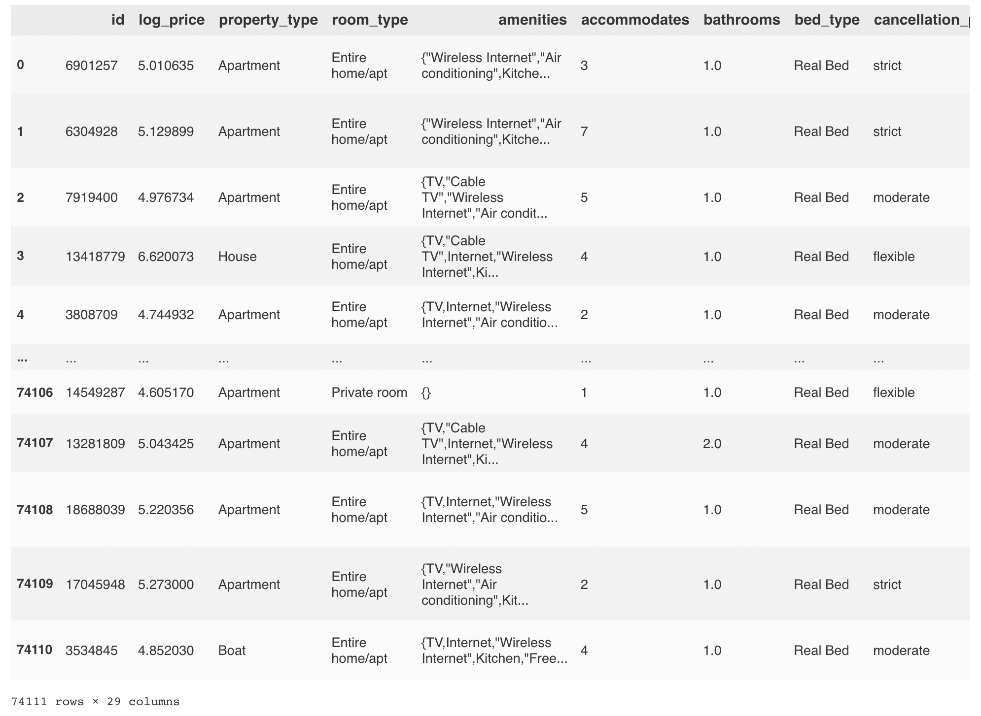
Before cleaning

Slide 6

Challenges
Missing
& Duplicate data
Clean Data
Removing Whitespace
outliers
Missing value
Duplicate or unnecessary data
Inconsistent text and typos
Removing Whitespace
Outliers

Slide 7

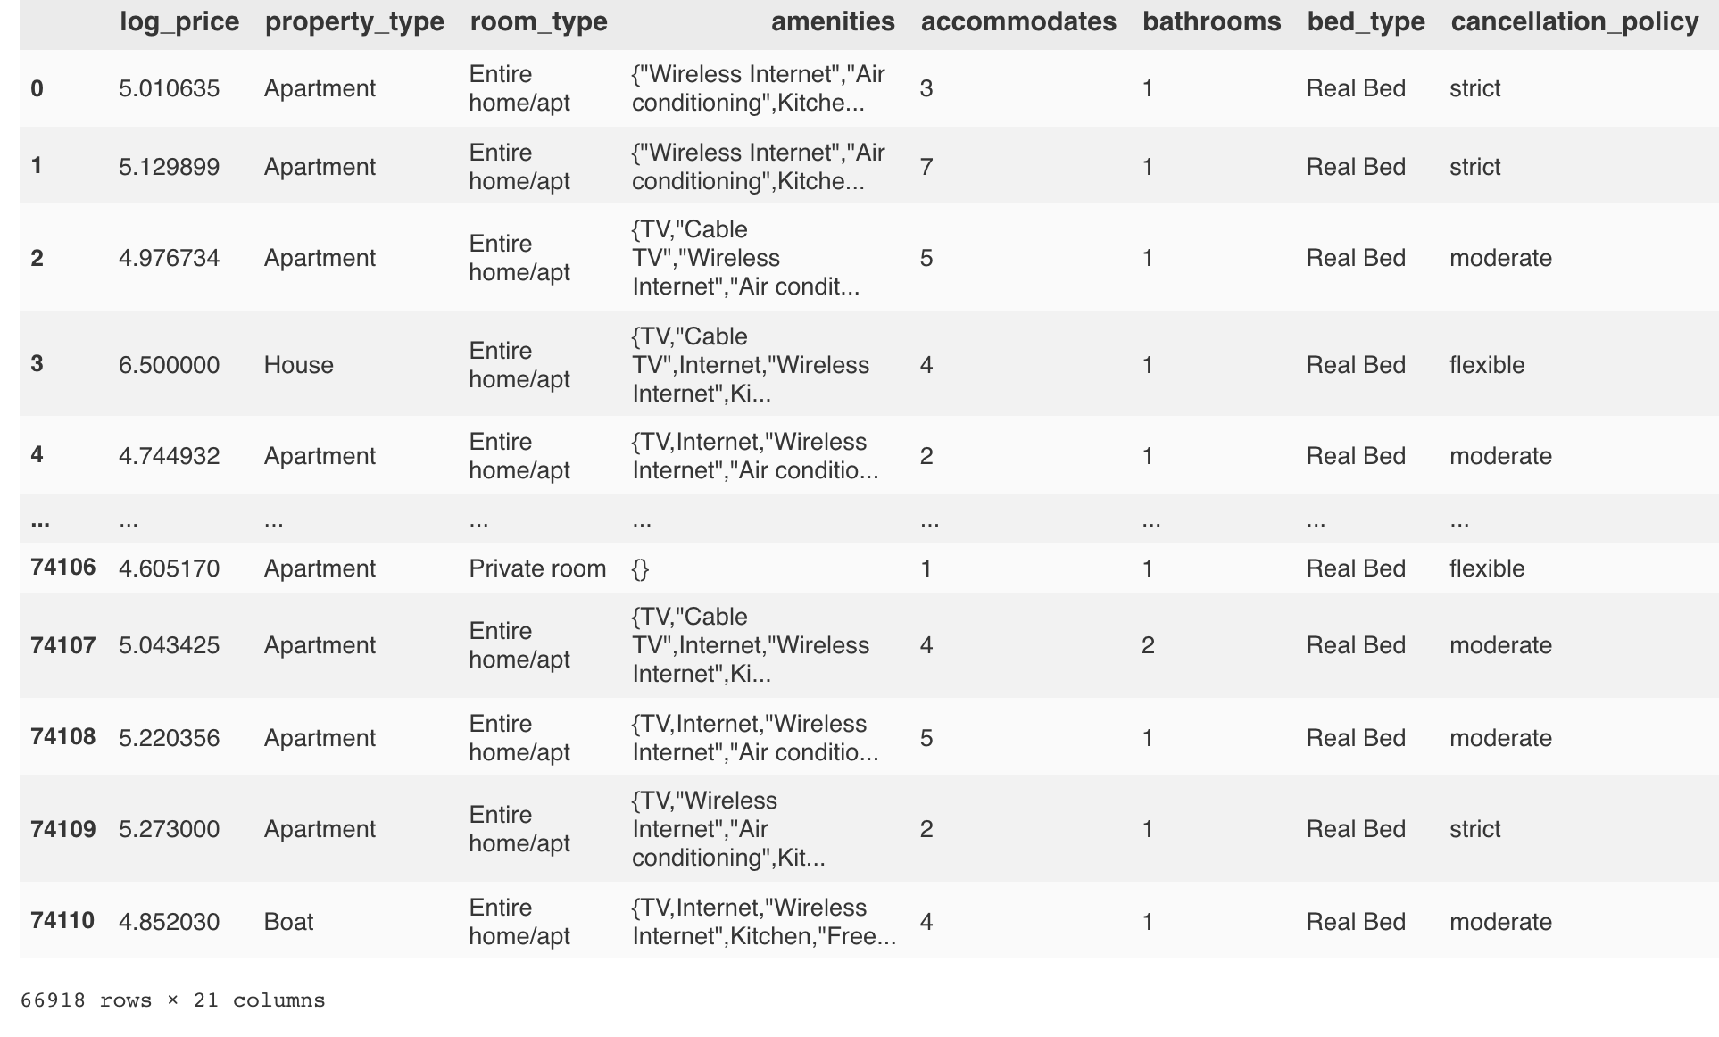
After cleaning

Slide 8

Inspiration
1. What are the most income cities ?
2. What is the most expensive neighborhood?
3. What type of property is most in demand?
4. What type of room is most requested?
5. What is the percentage of the cleaning fee?
6. What is the policy ratio?

Slide 9
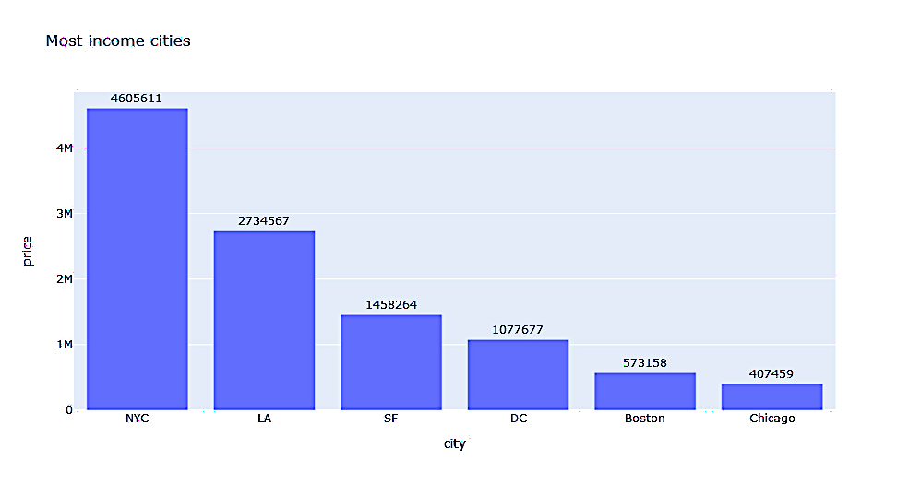
1. Most income cities

Slide 10
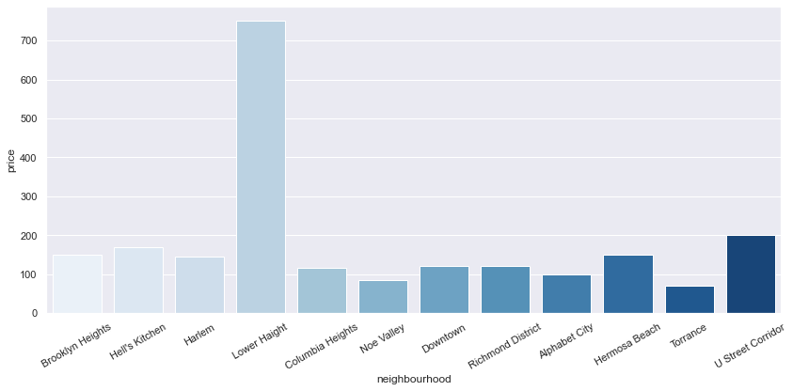
2. What is the most expensive neighborhood?

Slide 11
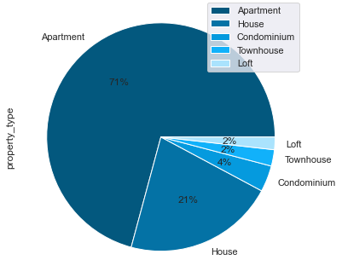
3. What type of property is most in demand?

Slide 12
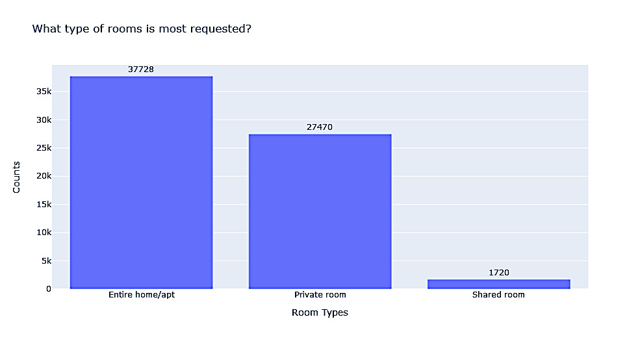
4. What type of room is most requested?

Slide 13
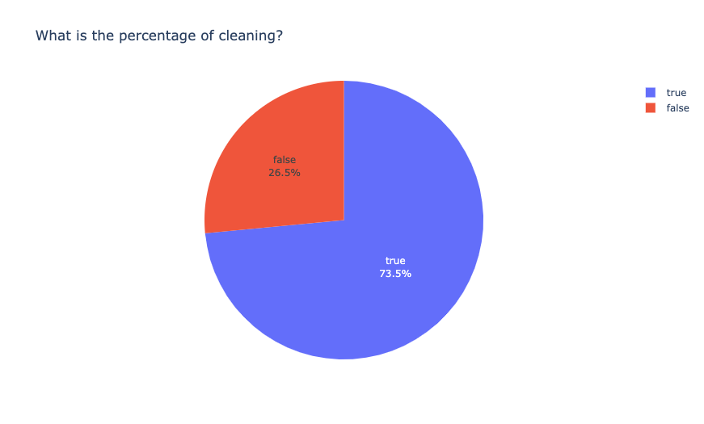
5. What is the percentage of the cleaning fee?

Slide 14
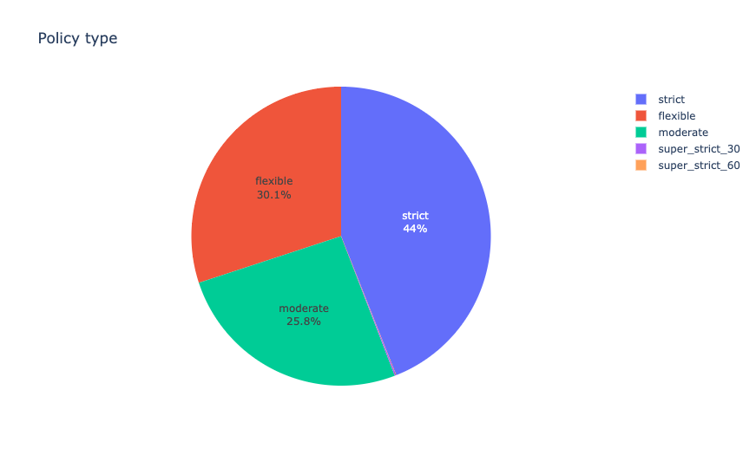
6. What is the policy ratio?

Slide 15
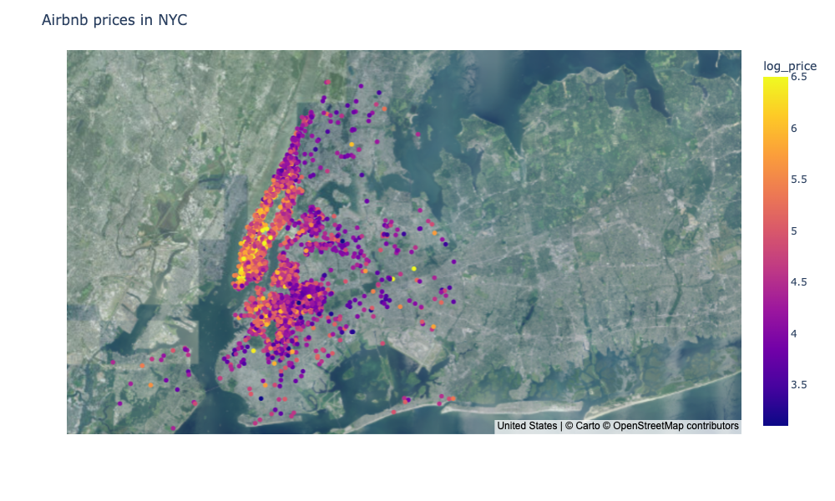
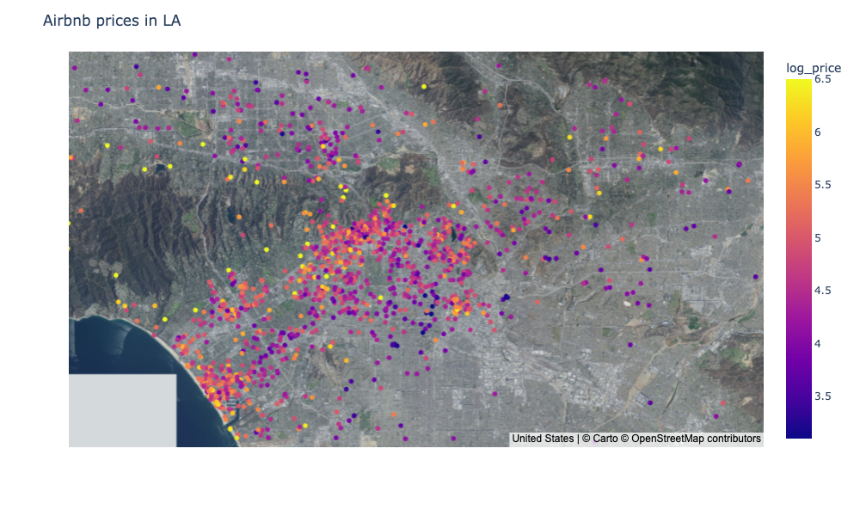
Visualization for most cities has real estate

Slide 16

Algorithms
Model | RMSE |  | SCORE
 | X_train | y_test | X_train | y_test
Linear Regression | 0.40 | 0.40 | 0.64 | 0.64
Lasso Regression | 0.41 | 0.41 | 0.63 | 0.62
Decision Tree Regression | 0.33 | 0.44 | 0.76 | 0.58
Random Forest Regression | 0.41 | 0.44 | 0.54 | 0.53
Ridge Regression | 0.41 | 0.44 | 0.64 | 0.63
Xgboost Regression | 0.40 | 0.44 | 0.64 | 0.63

Slide 17









Tools
NumPy
Library
Matblot
Library
Seaborn
Library
Jupyter
Notebook
Plotly
Library
Pandas
Library
Scikit learn
Library

Slide 18

Conclusion
Supporting hosts who have properties that suit clients interests
Host Benefits:
Loans
Full income for a year
Our benefits:
Long-term contract
Attract more hosts

Slide 19

THANK YOU

