Slide 1

Circuit Breaker Pattern
Team Incognito
Notes:
https://www.youtube.com/watch?v=ADHcBxEXvFA
https://www.youtube.com/watch?v=5_Bt_OEg0no
https://bhaveshpraveen.medium.com/implementing-circuit-breaker-pattern-from-scratch-in-python-714100cdf90b

Slide 2
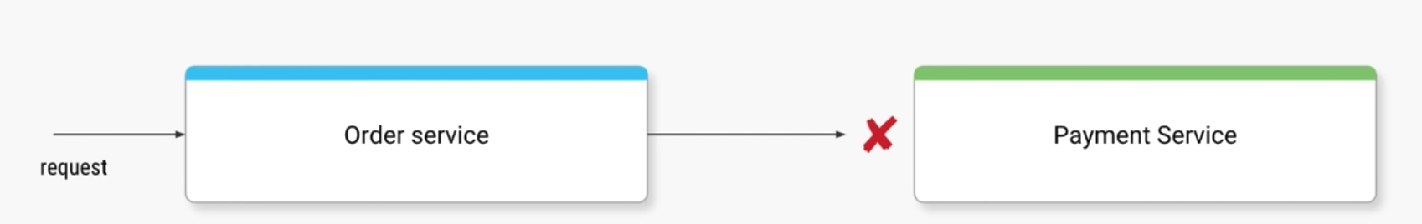
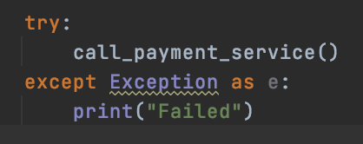
The Problem – Immediate Failures
Problem: - Remote calls can fail, or hang without a response until some timeout limit is reached
- If you have many dependent micro-services, you can run out of resources leading to cascading failures
Immediate Failures:
Example:
If call failed 10 times, why should we try to call it for the 11th time?

Slide 3
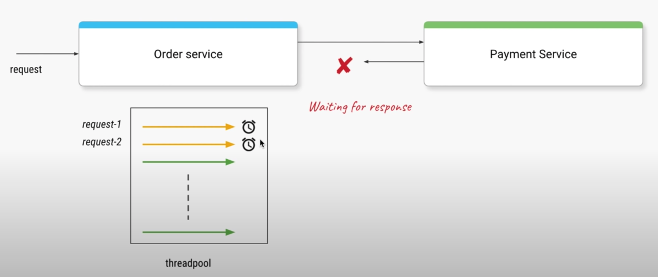
The Problem – Timeout Failures
Timeout Failures:
Order service make a call to Payment service
Payment service take a long time to send a response
Eventually all threads from Order Service will be waiting
Order service won’t be able to handle any requests
Failure in Payment Service caused a failure in Order Service!

Slide 4
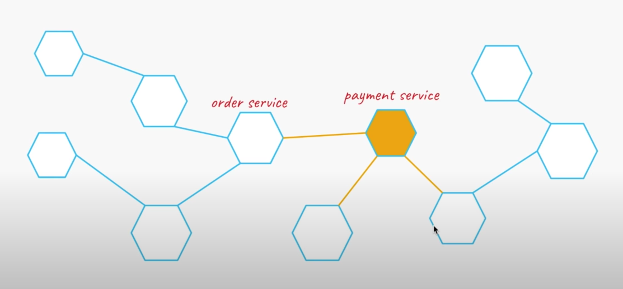
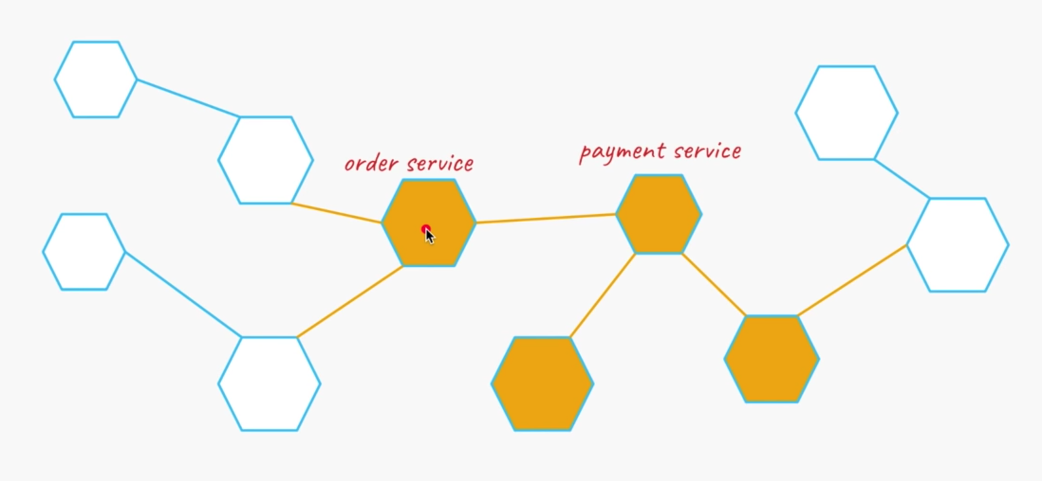
The Problem - Cascading Failures

Slide 5
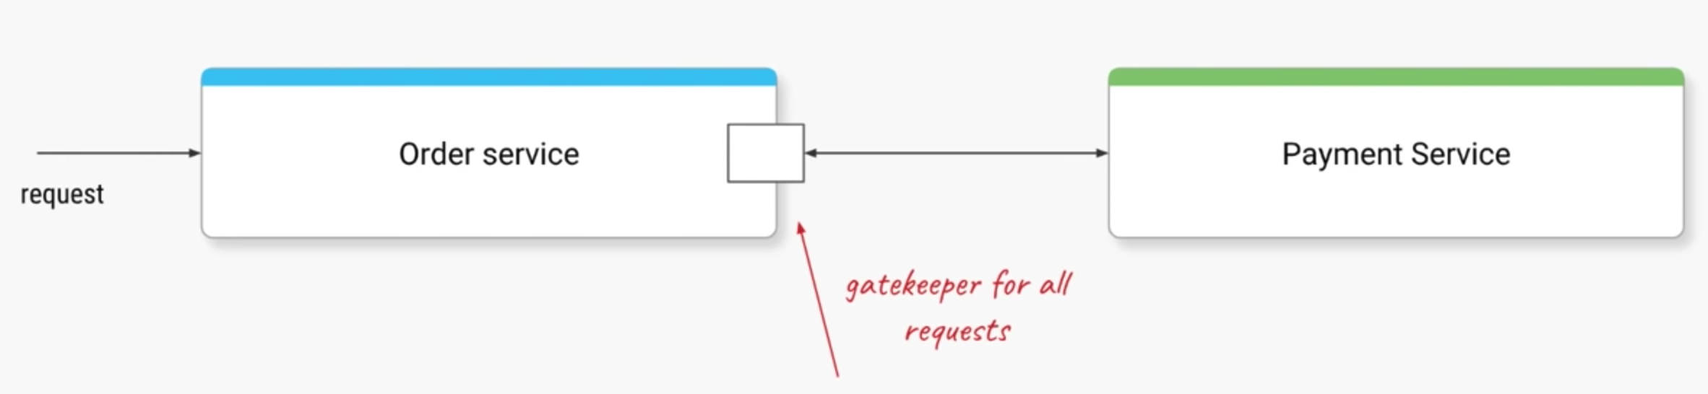

Solution: Circuit Breaker
All requests go through the interceptor module (Circuit Breaker)
Initially all requests pass through (CLOSED state)
When failures are detected stop for some time (OPEN state)
Periodically check if system is back online (HALF-OPEN)

Slide 6
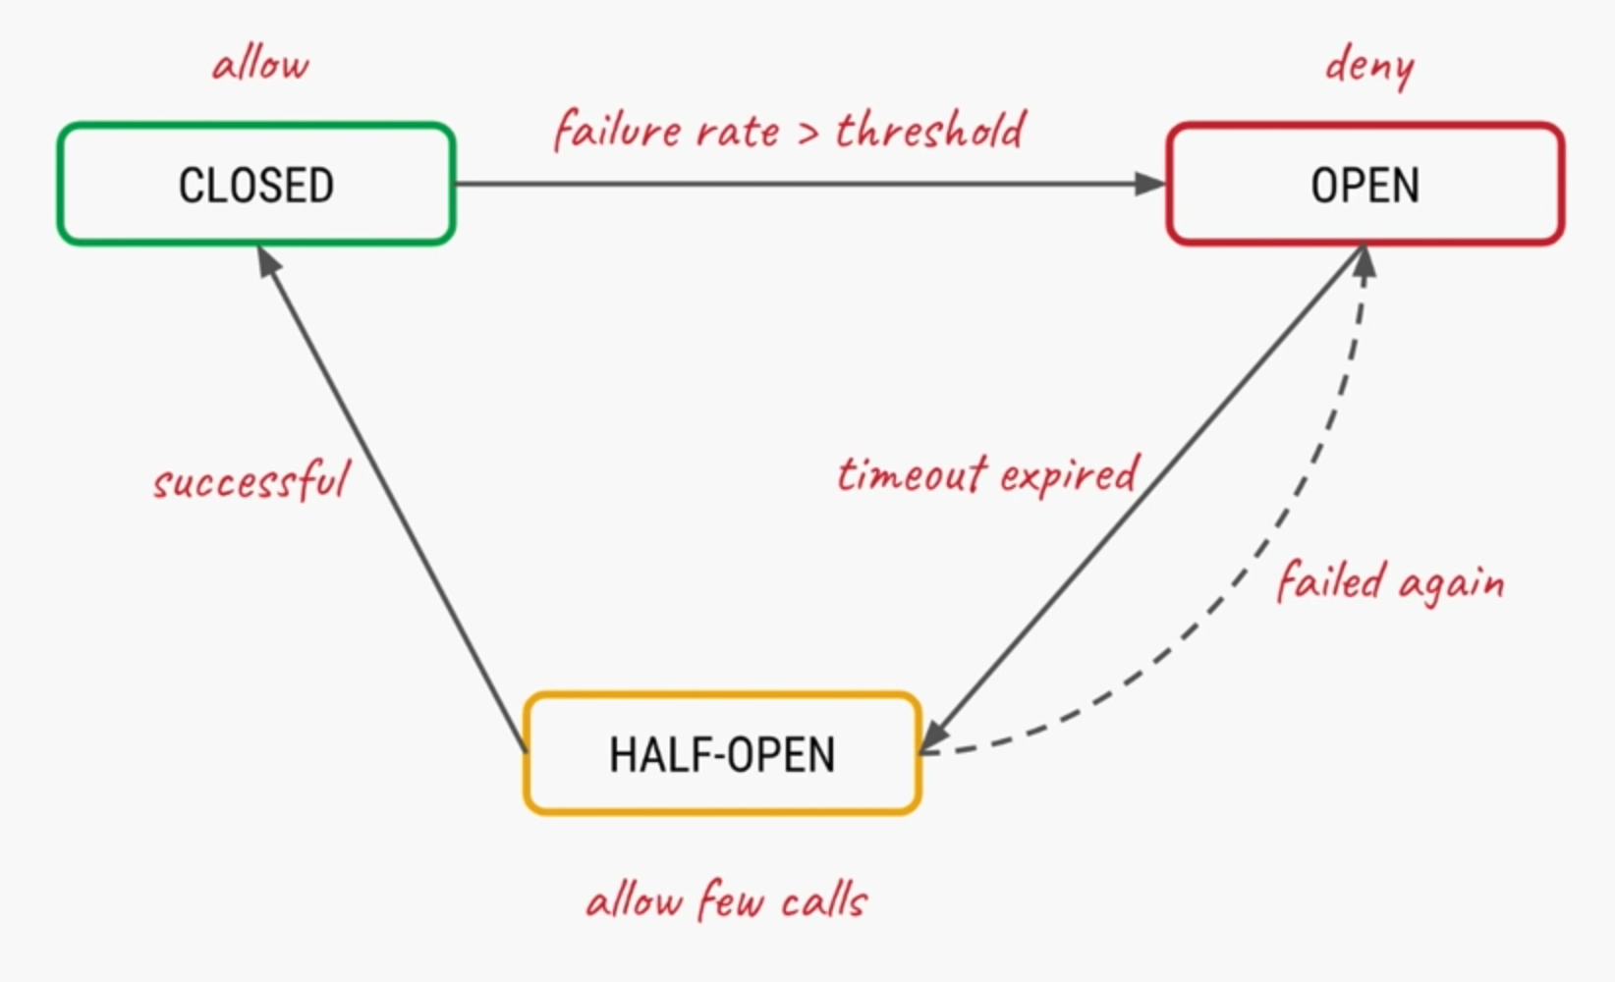
Circuit Breaker

Slide 7
Title
DEMO

Slide 8
Title
Questions

