Slide 1
LOAN CASE STUDY SUBMISSION
Group Name: “Gang of 4 Analysts”
Padma Priya Mallela
Tulasiram Gudladona
Rahamtullah Noorbhasha
Bhakti kumar Bengani

Slide 2
Loans - Objective
Consumer finance company is the largest online loan marketplace, facilitating personal loans, business loans, and financing of medical procedures. Borrowers can easily access lower interest rate loans through a fast online interface.
To identify risky loan applicants, then such loans can be reduced thereby cutting down the amount of credit loss.
Company wants to understand the driving factors (or driver variables) behind loan default, i.e. the variables which are strong indicators of default. The company can utilise this knowledge for its portfolio and risk assessment.

Slide 3
Loan – Data Cleaning
Identify the columns with Null values
Remove the columns which has more than 90% Null value
Identify and remove the columns which has post Loan approved details

Slide 4
Loan – Data Analysis
There are broadly three types of variables
Those which are related to the applicant (demographic variables such as age, occupation, employment details etc.)
Loan characteristics (amount of loan, interest rate, purpose of loan etc.) and
Customer behaviour variables (those which are generated after the loan is approved such as delinquent 2 years, revolving balance, next payment date etc.).
Now, the customer behaviour variables are not available at the time of loan application, and thus they cannot be used as predictors for credit approval.
Thus, going forward, we will use only two types of variables and remove the behavioural columns.
There are 32145 loans which are Fully Paid and 5399 loans which are Charged Off.

Slide 5
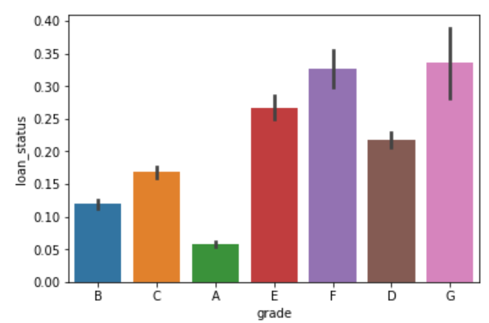
Univariate Analysis – Charged off Loans
Grade Vs Loan Status
Clearly, as the grade of loan goes from A to G, the default rate increases. This is expected because the grade is decided by Lending Club based on the riskiness of the loan.

Slide 6
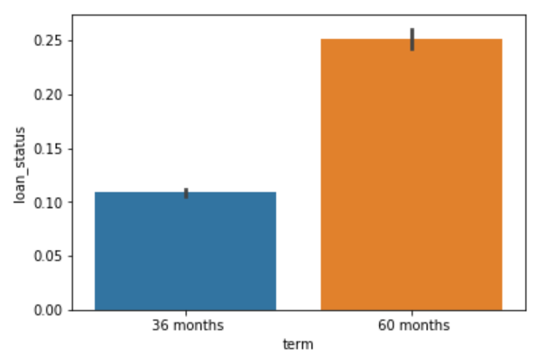
Loan Status VS Tenure
As the tenure of the loan increases, default rate increases. Higher the loan tenure higher are the chances of defaulting the loan.

Slide 7
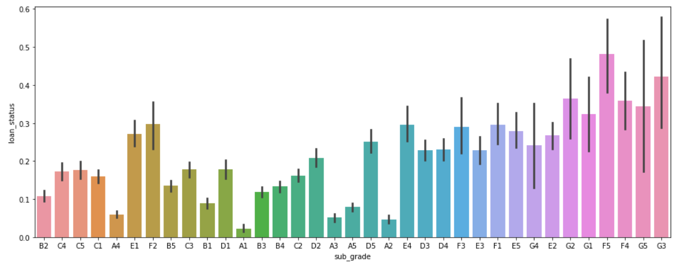
Loan Status VS Sub Grade
The customer with sub-grade goes from A-G, the default rate is higher in the lower category.

Slide 8
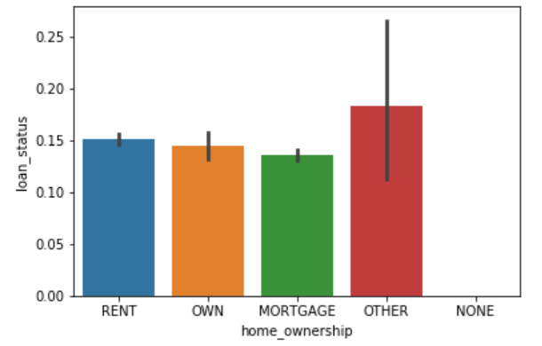
Loan Status VS Home Owner
There is no significant difference among defaulters between Home Owner and others.

Slide 9
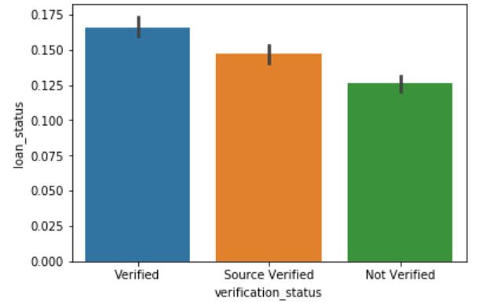
Loan Status VS Verification Status
Surprisingly there are more defaulters who are verified customers.

Slide 10
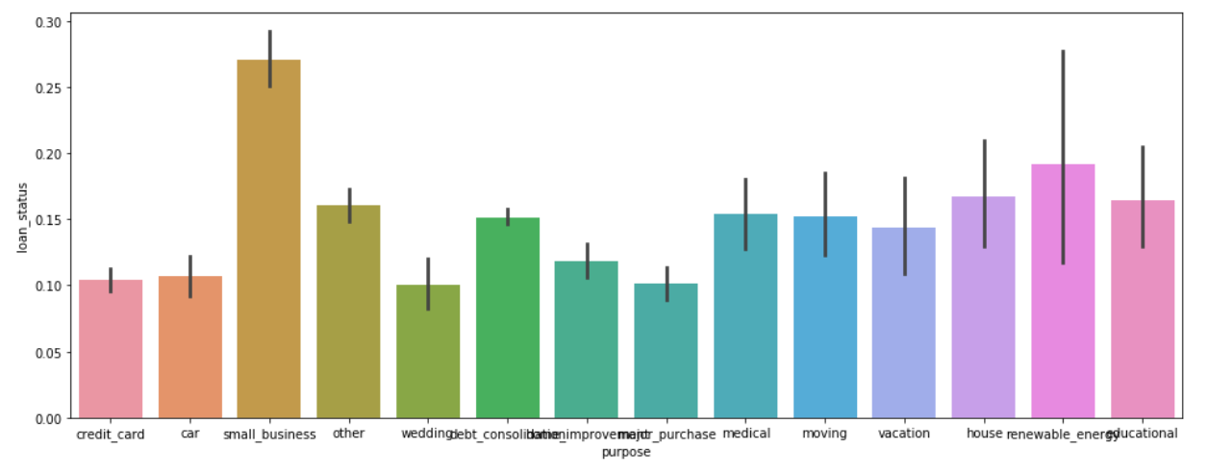
Loan Status VS Purpose
Loan for Small Business are highest defaulter.

Slide 11
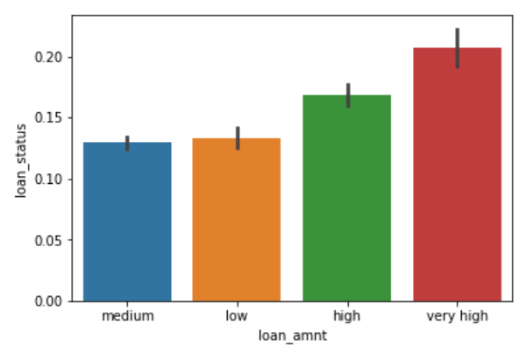
Loan Status VS Loan Amount
Higher the loan higher are the chances of defaulters

Slide 12
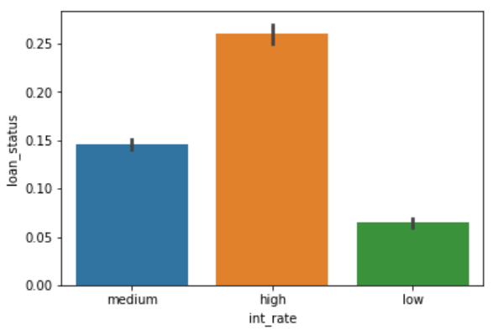
Loan Status VS Interest Rate
Higher the loan interest rate, higher are the chances of defaulters

Slide 13
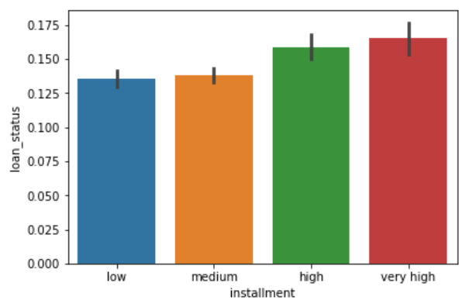
Loan Status VS Instalment amount
Higher the Instalment amount, higher are the chances of defaulters

Slide 14
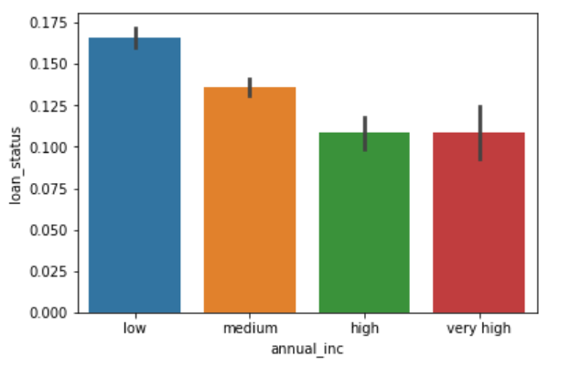
Loan Status VS Annual Income
Lower the Annual Income, higher are the chances of defaulters

Slide 15
Conclusion of Univariate Analysis
Following are the observation :
Defaulter rate is higher for below type of customers:
Higher Grade leads to higher defaulters
Higher Tenure months leads to higher defaulters
Verified Customers are higher defaulters
Small Business Loan are higher defaulters
Higher Instalment leads to higher defaulters
Higher loan amount leads to higher defaulters
Lower Income customers leads to higher defaulters
Higher Interest Rate leads to higher defaulters

Slide 16
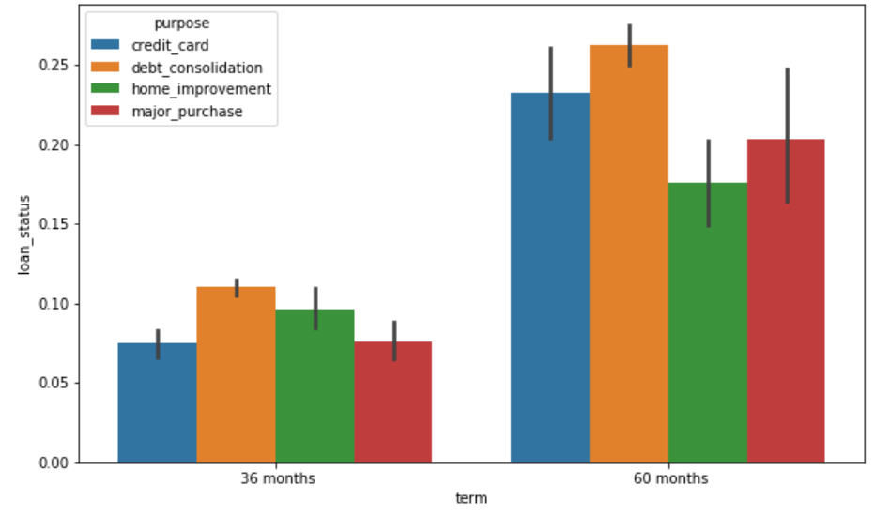
Segmented Univariate Analysis
Loan Status Vs Tenure Vs Highest purpose of defaulters

Slide 17
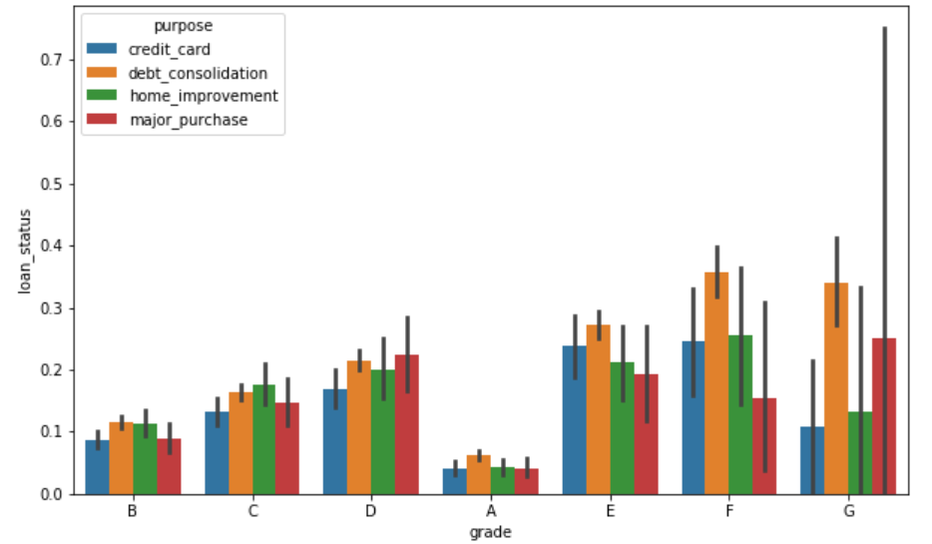
Loan Status Vs Grade Vs Highest purpose of defaulters

Slide 18
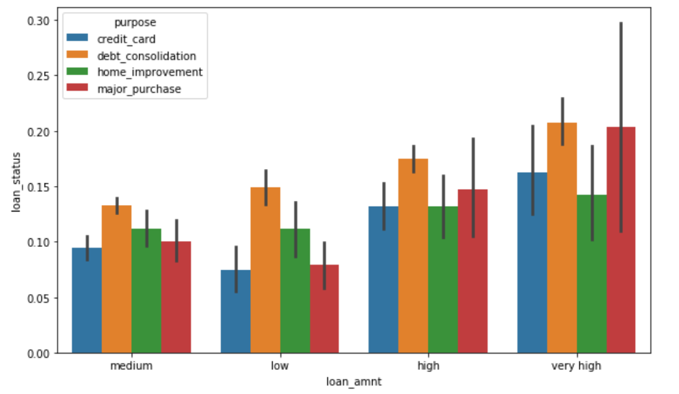
Loan Status Vs Loan Amount Vs Highest purpose of defaulters

Slide 19
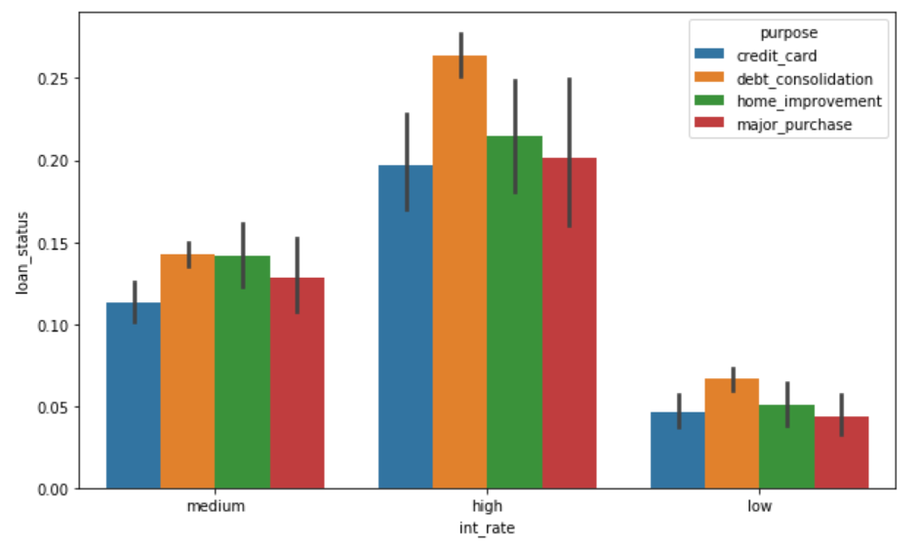
Loan Status Vs Int Rate Vs Highest purpose of defaulters

Slide 20
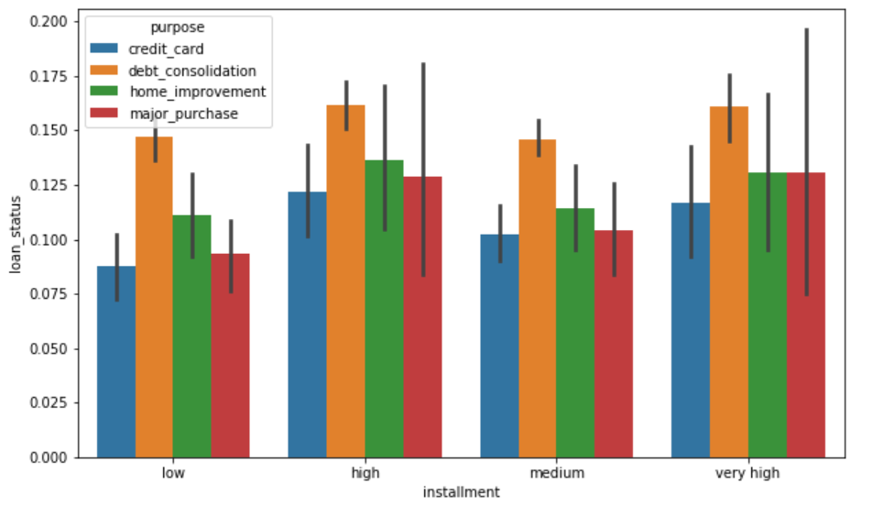
Loan Status Vs Instalment Vs Highest purpose of defaulters

Slide 21
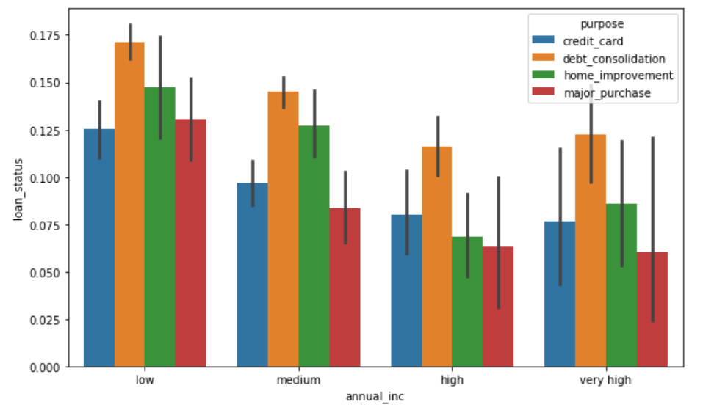
Loan Status Vs Annual Income Vs Highest purpose of defaulters

Slide 22
Conclusion of Segmented Univariate Analysis
Following are the observation :
Defaulter rate is higher for below type of customers:
Debt Consolidation
Credit Card
Home Improvement
Major Purchases

Slide 23
Summary
Riskiest Customer are the one who meets below criteria :
Low income,
High interest rate,
High Instalment amount,
Low Grade,
High Loan amount and
Loan take for Debt consolidation, Credit Card, Home Improvement and Major purchases

