Slide 1
Installing Jenkins
First, add the repository key to the system:
wget -q -O - https://pkg.jenkins.io/debian-stable/jenkins.io.key | sudo apt-key add -
When the key is added, the system will return OK. Next, append the Debian package repository address to the server’s sources.list:
sudo sh -c 'echo deb http://pkg.jenkins.io/debian-stable binary/ > /etc/apt/sources.list.d/jenkins.list'
When both of these are in place, run update so that apt will use the new repository:
sudo apt update
Finally, install Jenkins and its dependencies:
sudo apt install jenkins
Setting Up Jenkins
$ hostname -I
192.168.28.129
http://192.168.28.129:8080/
You should see the Unlock Jenkins screen, which displays the location of the initial password:
$ sudo cat /var/lib/jenkins/secrets/initialAdminPassword
The next screen presents the option of installing suggested plugins or selecting specific plugins:
Enter the name and password for your user:
http://192.168.28.129:8080/restart

Slide 2
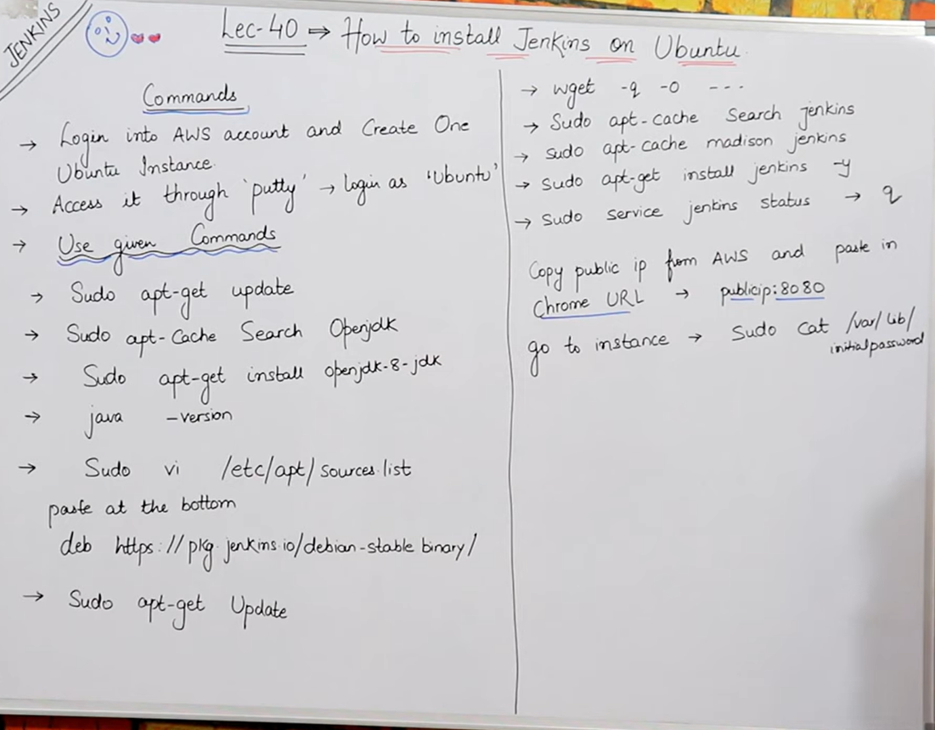

Slide 3
Overview on Continuous integration (CI) & Continuous Deployment (CD)
What is Jenkins Pipeline
How to Create Pipeline in Jenkins
How to view Pipeline
what is CI & CD
What is Jenkins pipeline
How many way we can create Jenkins pipeline
Create Jenkins pipeline using Grovy script / Jenkins file

Slide 4
Jenkins is a continuous integration (CI) = Build + Test + Deploy
Continuous enhancement is a continuous delivery (CD) => Release process is called Delivery
Continuously build, test and deploys is called as continuous integration, once deployment done release/delivery will start this complete process is called as CI/CD.
build + Test + Deploy + Release will achieve by using Jenkins's pipeline
In Jenkins, a pipeline is a group of events or jobs which are interlinked with one another in a sequence.

Slide 5
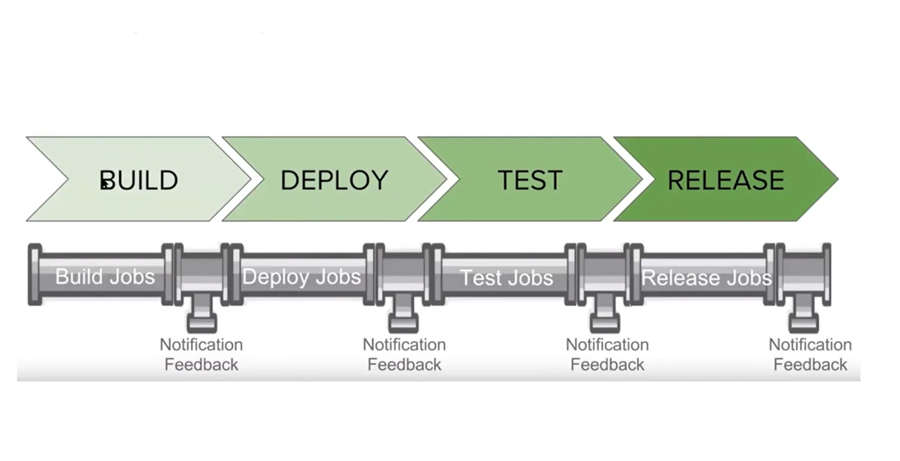

Slide 6
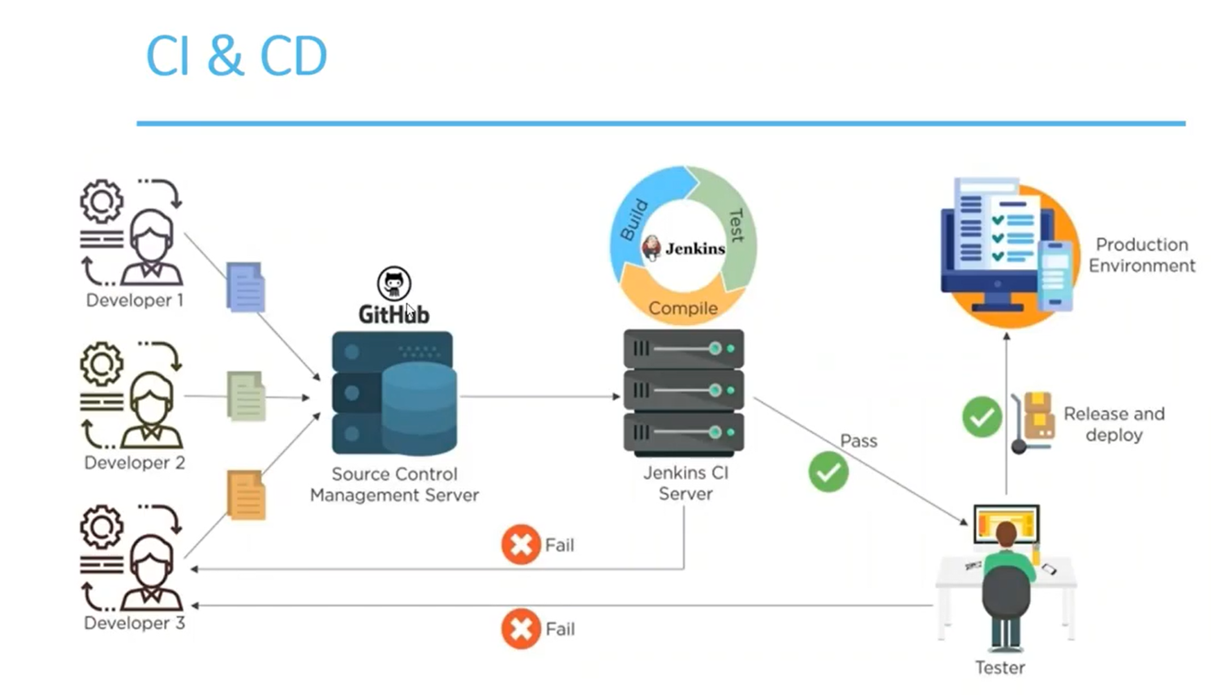

Slide 7
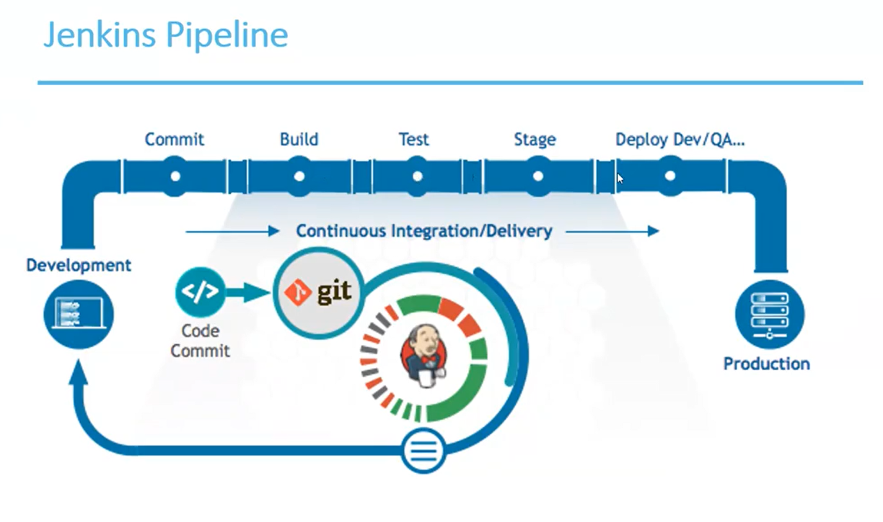

Slide 8
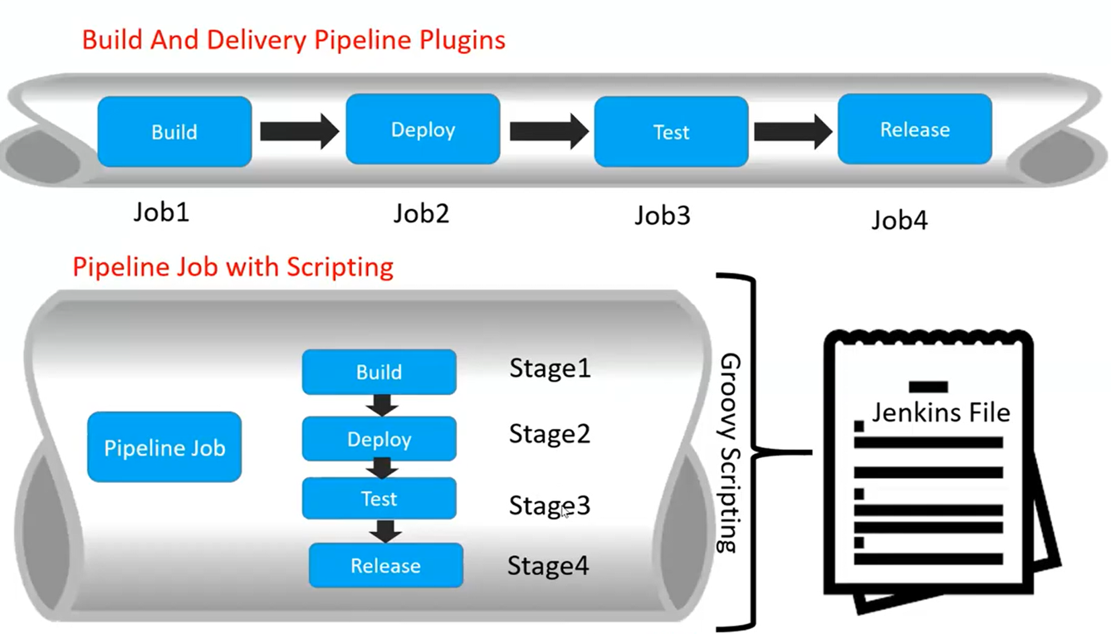
Types of Pipeline
1.Scripted Pipeline 2. Declarative Pipeline
https://www.jenkins.io/doc/book/pipeline/jenkinsfile/

Slide 9
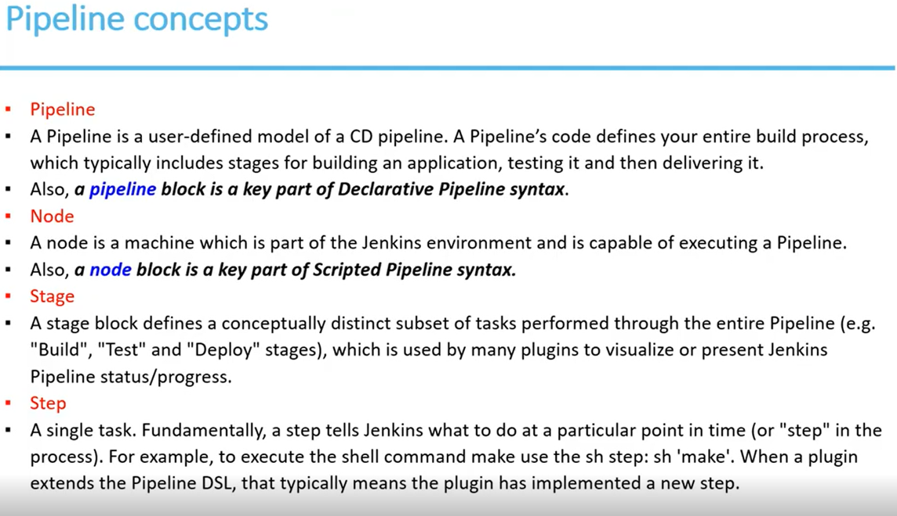

Slide 10
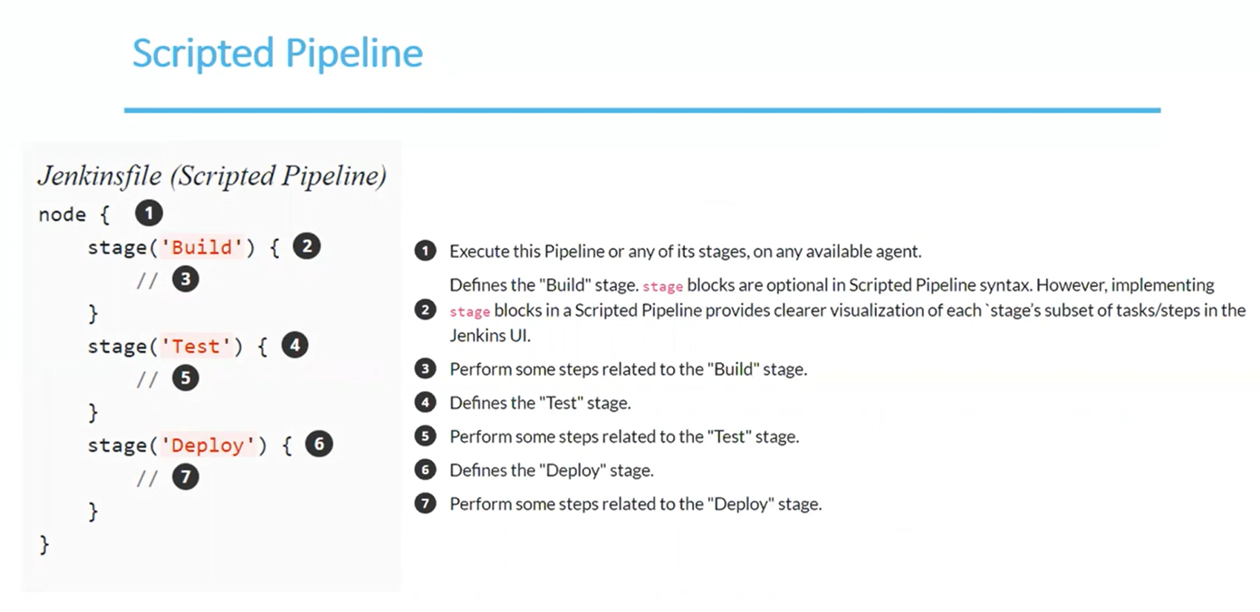

Slide 11
Creating a Jenkinsfile / Jenkinsfile (Declarative Pipeline)
pipeline {
agent any
stages {
stage('Build') {
steps {
echo 'Building..'
}
}
stage('Test') {
steps {
echo 'Testing..'
}
}
stage('Deploy') {
steps {
echo 'Deploying....'
}
}
}
}

Slide 12
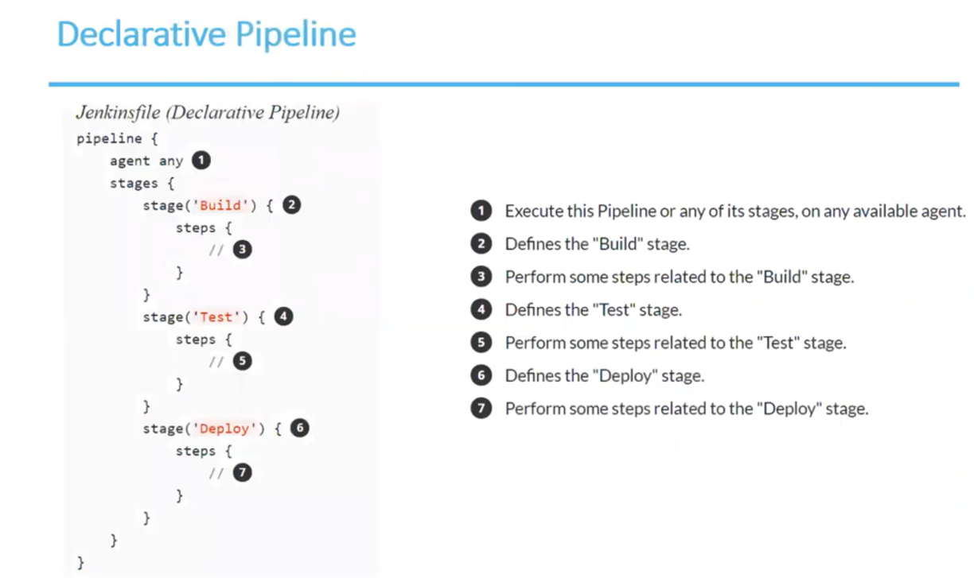

Slide 13
Creating a Jenkinsfile / Jenkinsfile (Scripted Pipeline)
Node {
stage('Build')
{
echo "Build the Project..................."
}
stage('Test')
{
echo "Test the Project..................."
}
stage('Deploy')
{
echo "Deploy the Project..................."
}
stage('Release')
{
echo "Build the Project..................."
}
}

Slide 14
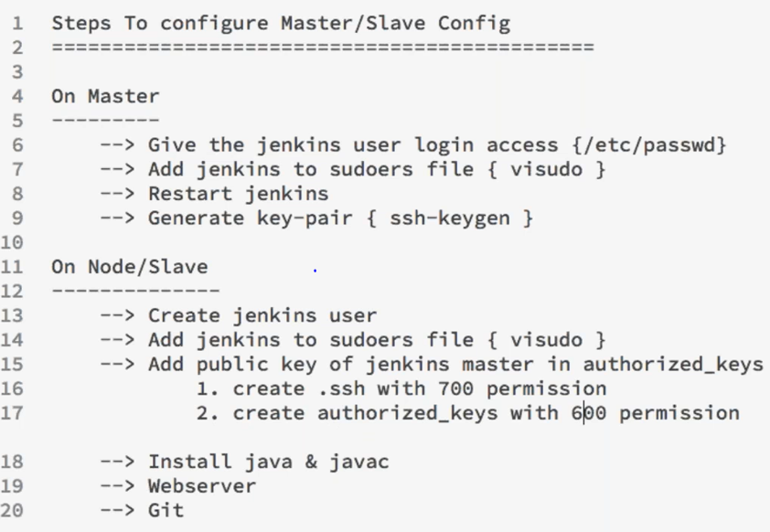

Slide 15
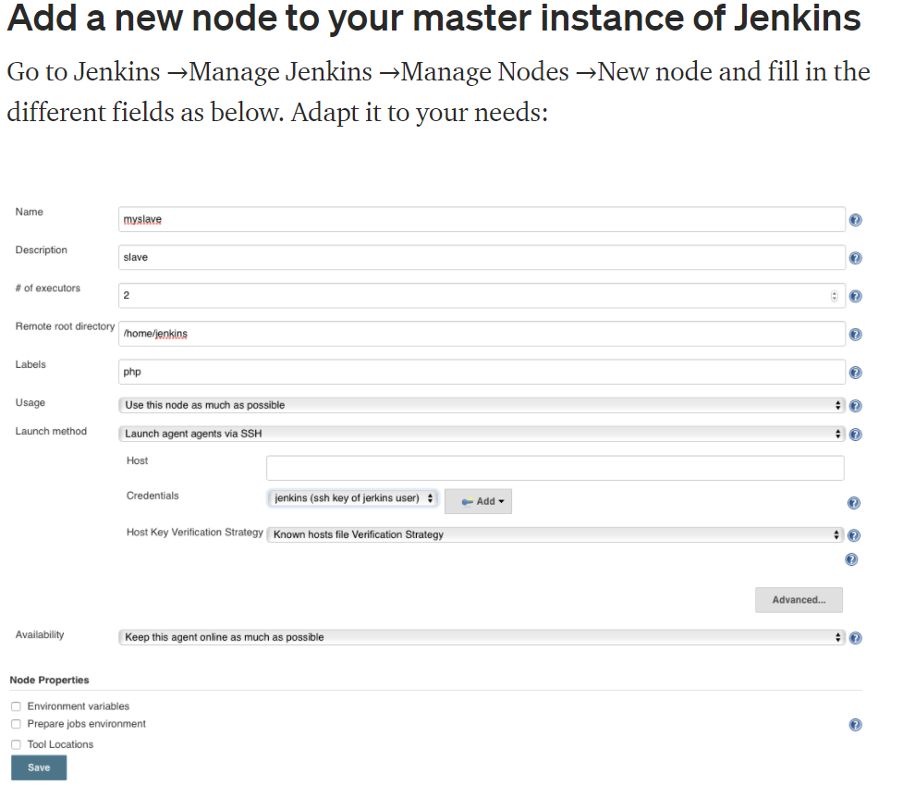

Slide 16
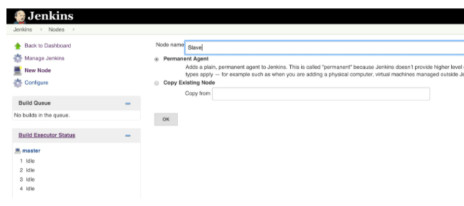
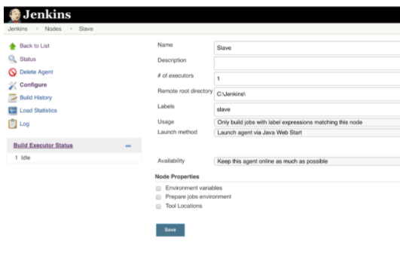
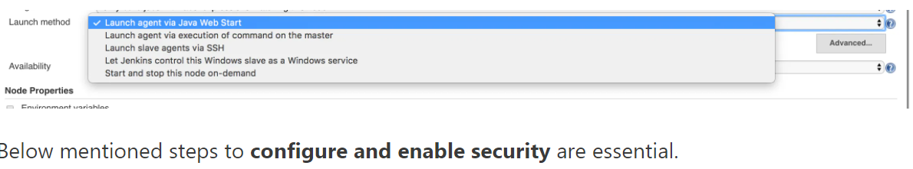
Jenkins Windows Slave Configuration 1- Login to Jenkins and click on Manage Jenkins 2- To create a new Slave – Click on New Node 3- Name the node

Slide 17
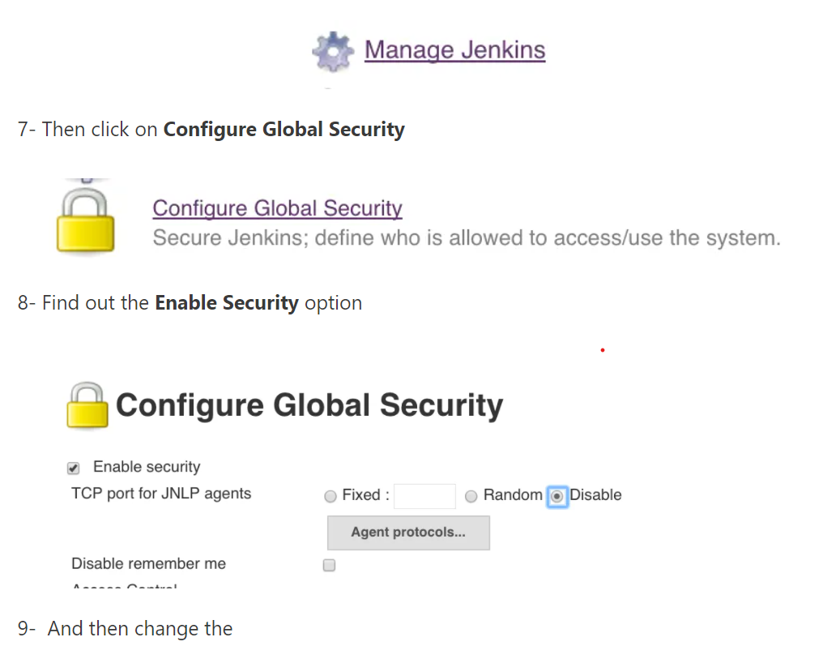
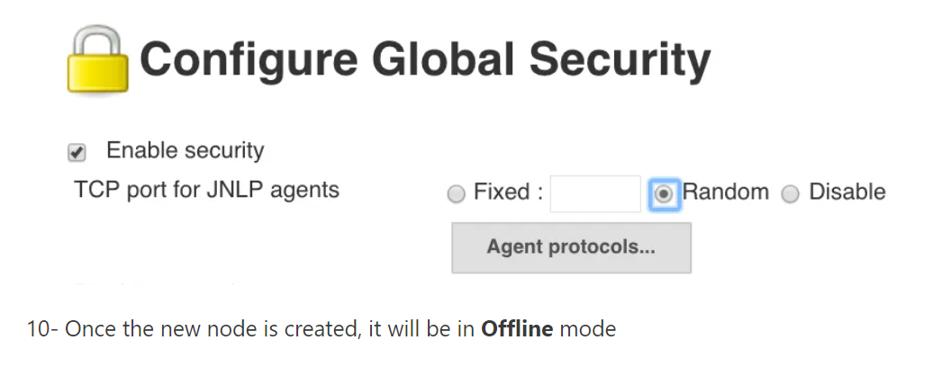

Slide 18
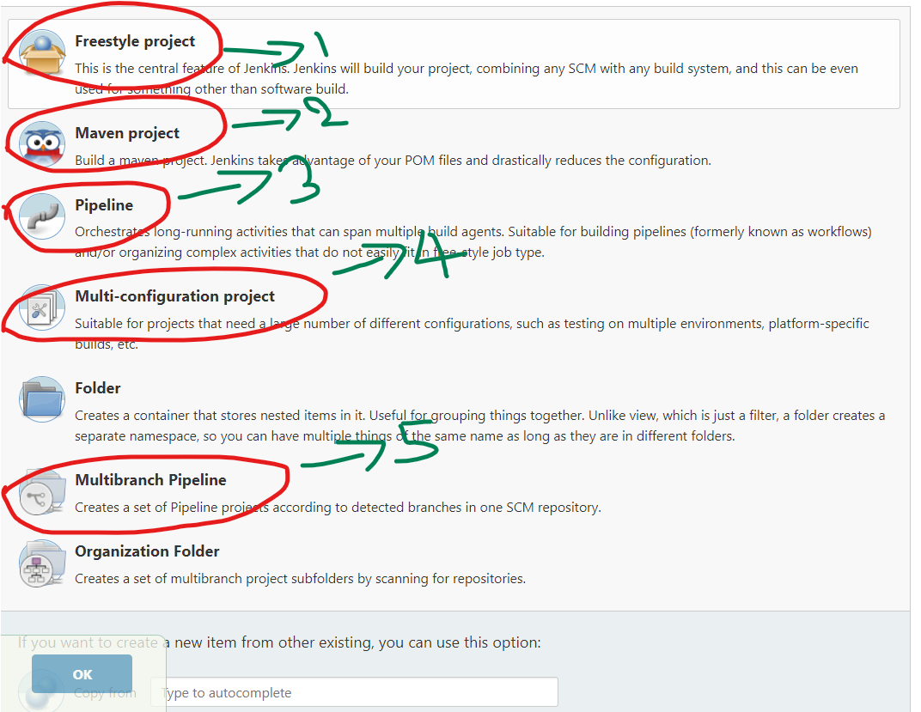
How many types of Jenkins jobs have you created? Two types of job creation we are fallowing 1. JJB creation create the yaml templates and submit 2. Manual job creation a. Copying the existing job b. freestyle jobs c. maven jobs d.multi-configuration jobs e.pipeline job f. multi- pipeline jobs

