Slide 1
GIT

Slide 2
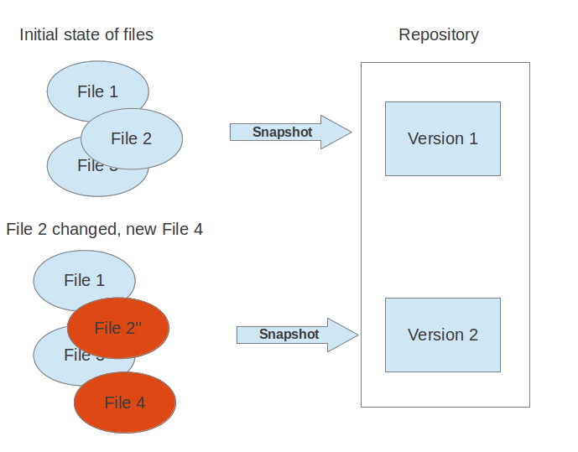
What is a version control system ?
A version control system allows you to track the history of a collection of files and includes the functionality to revert the collection of files to another version. Each version captures a snapshot of the files at a certain point in time

Slide 3
creating a new repository
create a new directory, open it and perform the operations. $: git init $: git init <directory>
Ex: $:git init –u
The git init command creates a new Git repository. It can be used to convert an existing, unversioned project to a Git repository or initialize a new empty repository.

Slide 4
checkout a repository
create a working copy of a local repository by running the command $: git clone /path/to/repository when using a remote server, your command will be $: git clone username@host:/path/to/repository
Ex: git clone git://review.sonyericsson.net/platform/frameworks/base
it clones and stores the base git repository in your local.

Slide 5

your local repository consists of three "trees" maintained by git. the first one is your Working Directory which holds the actual files. the second one is the Index which acts as a staging area and finally the HEAD which points to the last commit you've made.

Slide 6
add & commit
You can propose changes (add it to the Index) using $: git add <filename> $: git add * This is the first step in the basic git workflow. To actually commit these changes use $: git commit -m "Commit message" Now the file is committed to the HEAD, but not in your remote repository yet.

Slide 7
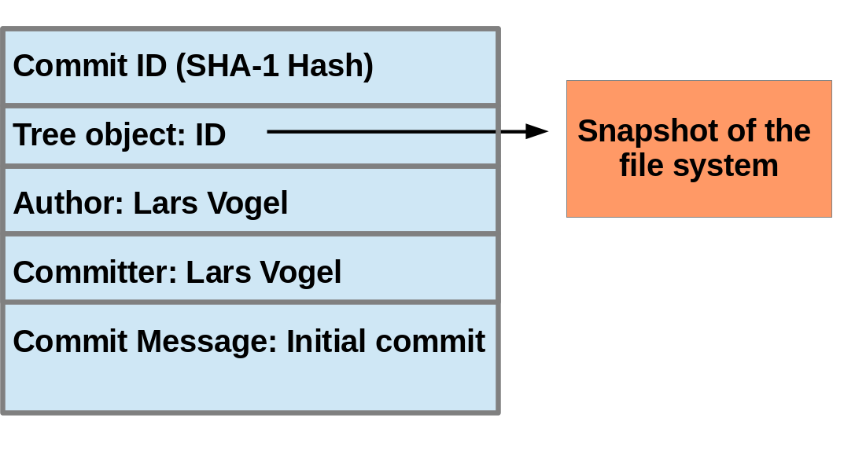
Commit object (commit)
Conceptually a commit object (short:commit) represents a version of all files tracked in the repository at the time the commit was created
Git commit object is identified by its hash (SHA-1 checksum). SHA-1 produces a 160-bit (20-byte) hash value. A SHA-1 hash value is typically rendered as a hexadecimal number, 40 digits long.
Ex: commit 30605803fcbd507df36a3108945e02908c823828

Slide 8
pushing changes
Your changes are now in the HEAD of your local working copy. To send those changes to your remote repository, execute $: git push origin master Change master to whatever branch you want to push your changes to.
$: git push origin HEAD:refs/for/l-shinano-verizon/
These changes are pushed to gerrit server for review.
After reviewing the changes, we do submit the changes.
$: git commit

Slide 9
branching
Branches are used to develop features isolated from each other. The master branch is the "default" branch when you create a repository. Use other branches for development and merge them back to the master branch upon completion.
create a new branch named "feature_x" and switch to it using $: git checkout -b feature_x switch back to master $: git checkout master and delete the branch again $: git branch -d feature_x a branch is not available to others unless you push the branch to your remote repository $: git push origin HEAD:refs/for/l-shinano-docomo/<topic-name>

Slide 10
Sharing commits
Tom’s Repo
Matt’s Repo
A
B
C
A
B
C
My Local Repo
Tracey’s Repo
A
B
C
A
B
C
Notes:
Since everyone on the team has a complete copy of the repository you can do things like this.
But no one wants to keep track of changes this way

Slide 11
Sharing commits
Tom’s Repo
Matt’s Repo
A
B
C
D
A
B
C
D
Remote Repo
A
B
C
D
My Local Repo
Tracey’s Repo
A
B
C
D
A
B
C
D
Notes:
There really is nothing special about the remote server. You can have more than one. But it enables a nice integration location, just like you are used to in the centralized version control

Slide 12
update & merge
to update your local repository to the newest commit, execute $: git pull in your working directory to fetch and merge remote changes. merge another branch into your active branch (e.g. master), use $: git merge <branch>
in both cases git tries to auto-merge changes. Unfortunately, this is not always possible and results in conflicts. You are responsible to merge those conflicts manually by editing the files shown by git.
After changing, you need to mark them as merged with $: git add <filename> before merging changes, you can also preview them by using $: git diff <source_branch> <target_branch>

Slide 13
log
in its simplest form, you can study repository history using.. git log You can add a lot of parameters to make the log look like what you want. To see only the commits of a certain author: $: git log --author=bob
To see a very compressed log where each commit is one line: $: git log --pretty=oneline
Or maybe you want to see an ASCII art tree of all the branches, decorated with the names of tags and branches: $: git log --graph --oneline --decorate --all See only which files have changed: $: git log --name-status
These are just a few of the possible parameters you can use. For more, see
$: git log --help

Slide 14
replace local changes
In case you did something wrong (which for sure never happens ;) you can replace local changes using the command $: git checkout -- <filename> this replaces the changes in your working tree with the last content in HEAD. Changes already added to the index, as well as new files, will be kept.
If you instead want to drop all your local changes and commits, fetch the latest history from the server and point your local master branch at it like this $: git fetch origin
$: git reset --hard origin/master

Slide 15
Term | Description
Change | The unit of review. Results in a single commit when merged to the Git repository. Change numbers are unique and never change.
Patch Set | A revision of a Change. Each time a Change is modified, it will receive a new Patch Set. Patch Set numbering starts from 1. Technically, a Patch Set is a unique Git commit.
Approval Category | Name for a scope that is checked during review process. Qt is using the categories Code Review and Sanity Review.
Score | A value in an Approval Category. Indicates if a Change is approved and can be submitted to the Git repository.
Submit | An action that allows Gerrit to merge a Change to the Git repository.
Abandon | Action that archives a Change. An abandoned Change can be restored later.
Project | A Git repository.

Slide 16
GERRIT
At initially we install gitlab or gitweb in the server(remote server)where all the git repositories are present.
The git repositories in the server will be configured to gerrit .
The targets for the gerrit will be the repositories in the server.
So, when we try to push the changes or review the changes in gerrit,
it connects to the review.sonyericsson.net server.
In SOMC to clone the git repositories and reviewing using gerrit,
it uses the same url review.sonyericsson.net server url.
To access the git using gerrit, git should know your identity. so you have
to configure as below.
git config --global user.name "Firstname X Lastname"
git config --global user.email " Firstname X Lastname @sonymobile.com"

Slide 17


GERRIT & GIT server configuration :
Fetch
Push
submit
Git
repositories

Slide 18
GERRIT
Gerrit is a code review tool, to analyse or to review the changes done.
The default gerrit server in SOMC.
http://review.sonyericsson.net
We have to use your SOMCID to login to gerrit.
After logging, verify username is preconfigured.
Generate SSH Public Key
Start a terminal/shell. Type the text below with your SOMC-id and press enter to generate SSH key.
$ ssh-keygen -t rsa -C <SOMCID>(IF AND ONLY IF id_rsa.pub key is empty)
Add SSH Public Key
Open the file called id_rsa.pub with a text editor by typing this in a terminal and add SSH key.
$ gedit ~/.ssh/id_rsa.pub
It is now configured and we are able to push the changes onto gerrit.

