Slide 1
From Natural Language to SQL
A Hybrid Approach for Non-Technical Database
Querying
Chetan Rajendra Rahane
Kunal Prakash Koshti
Omkar Suresh Kadam
Prof. Tatiana Erekhinskaya
CS6320 - Spring 25

Slide 2
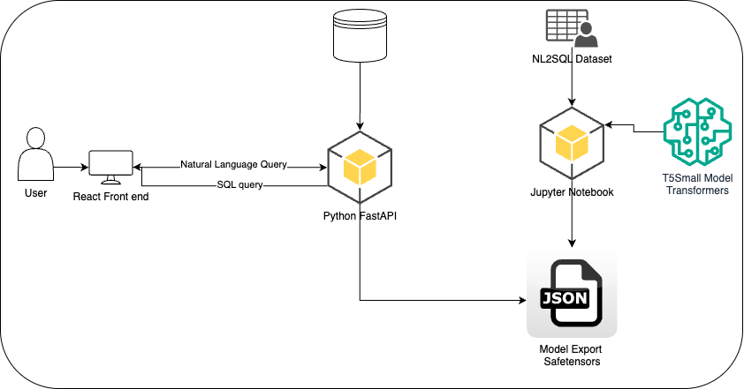
Architecture

Slide 3


Dataset
NL2SQL
WikiSQL
Self-generated using Python Script

Slide 4
Model selection
Model | Pros | Cons | Why Not Chosen
T5-small | Fast inference, 60M params, seq2seq architecture | Limited context window | Chosen for balance of speed/accuracy
T5-base | Better accuracy (220M params) | Resource-intensive | Rejected due to GPU constraints
BERT | Strong text understanding | Not seq2seq architecture | Requires separate decoder
GPT-3.5 | State-of-the-art | API costs, closed-source | Rejected for budget reasons
Codex | SQL-specific | Proprietary model | Not accessible for customization

Slide 5

Live Demo

Slide 6
Future work
RAG integration
Specific schema based system build
Improved data quality for training of model

Slide 7
Thank you!!!

