Slide 1
Vision-Pointer: Controlling Your Computer with Hand Gestures
Real-Time Two-Handed Hand Tracking for Virtual Mouse Emulation
Chetan Rahane Dhairya Saxena
(CRR220000) (DXS220092)
May 7, 2026
CS6384

Slide 2
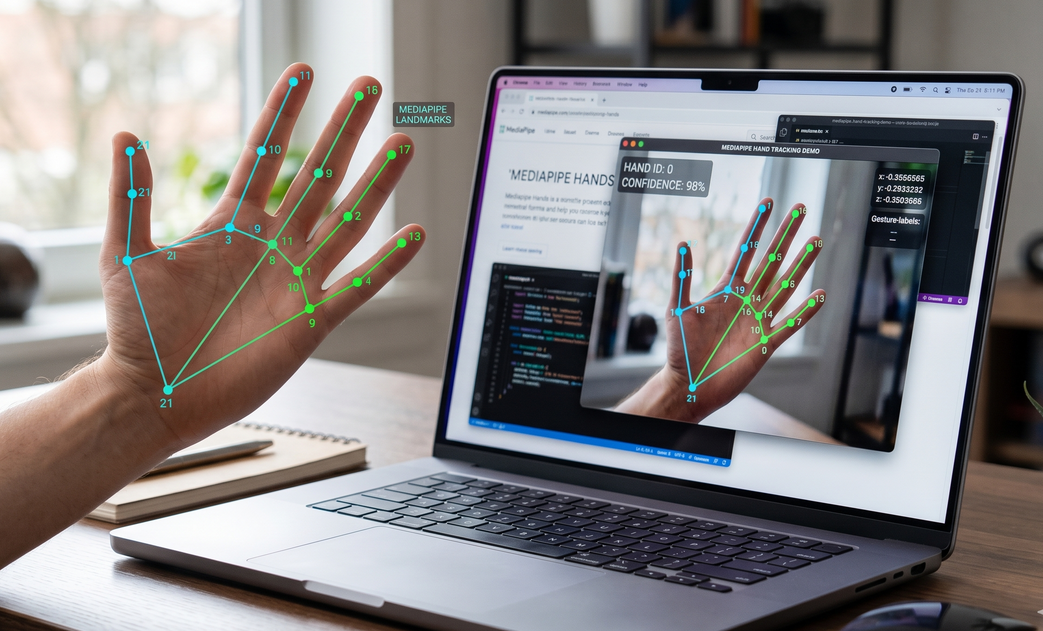
The Goal
Turn a standard webcam into a high-precision input device
Track 21 hand landmarks using MediaPipe → map to screen coordinates
Distinguish intentional gestures (click, scroll) from accidental hand movement
Target: 30+ FPS, feel as natural as a real touchpad
Leveraging standard consumer webcams without expensive depth sensors.

Slide 3
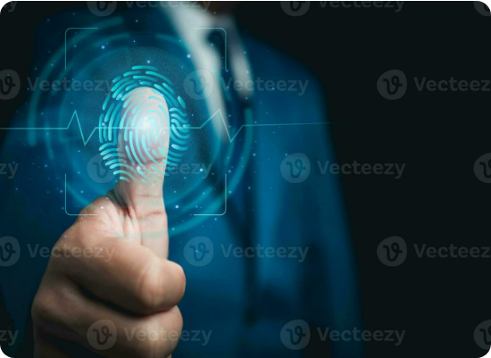
The Midas Touch Problem
"The Problem Nobody Warns You About”
Our first prototype: point with index finger → pinch to click.
What actually happened: When you close your hand to click, your pointing finger physically moves. The cursor slides off the button at the exact moment you click.
This is the Midas Touch problem — documented in HCI research. This caused failure in several single-hand gesture we tried:
# | Gesture | Why It Failed
1 | Pinch (thumb→index) 🤏 | Thumb movement shifts the index — cursor drifts
2 | OK Sign (pinch + 3 fingers up) 👌 | MediaPipe hallucinates occluded finger positions
3 | Crossed Fingers 🤞 | Same occlusion — random phantom triggers
4 | Thumb-to-Pinky 🤙 | Best detection! But the stretch jerks the index the most
Irony: The most reliable gesture caused the most cursor drift. The problem isn't detection — it's biomechanics.

Slide 4
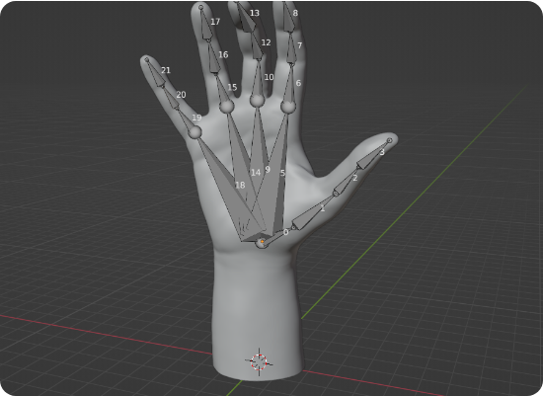
Technical System Overview
A real-time Python pipeline processing 42 skeletal landmarks across dual hands.
Backend: OpenCV & MediaPipe Vision API
Smoothing: Exponential Moving Average (EMA)
Actuation: PyAutoGUI OS Integration
Mapping: Active Zone geometric normalization

Slide 5
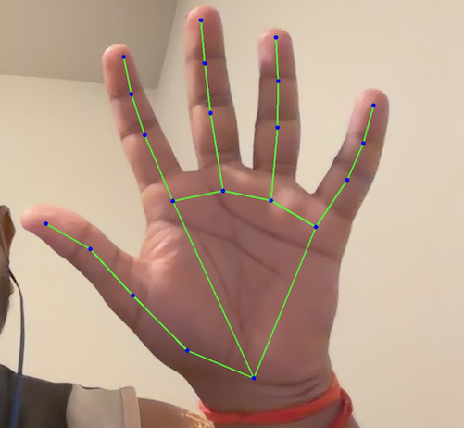
Two-Handed Segregation
Solving the Midas Touch by physically decoupling the Anchor from the Actuator.
The Core Concept
Right Hand = Spatial Anchor (Move/Scroll)
Left Hand = Event Trigger (Click/Zoom)
Zero displacement of the tracking hand during command execution.

Slide 6
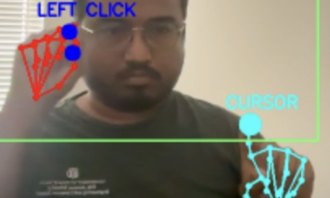
RIGHT HAND (Driver) | LEFT HAND (Action Center)
☝️ Index only → cursor | ✊ Fist → left click
✌️ Index+Middle → scroll | 👍 Thumbs up → right click
🖐️ All fingers → FREEZE | ✌️ Peace sign → double click
 | 🤏 Thumb+Index → zoom in/out
t
Zero artificial latency — cursor moves in real-time with EMA smoothing (α=0.3) for jitter
Clicking with your left hand physically cannot move the cursor
Freeze gesture = open palm on right hand (extending fingers keeps index stable)
Gesture state machine: each action fires once, must reset to open palm

Slide 7
Demo
YouTube Link: https://youtu.be/bYaszyozb3A

Slide 8
Results and Future work
Results:
25–30 FPS real-time on Apple M3
Midas Touch eliminated via two-hand separation
Reliable gesture recognition after hardening
Drag-and-drop (fist + right hand movement)
Speed-sensitive smoothing (dynamic α based on velocity)
KNN classifier for custom gesture → OS shortcut mapping
Future Work:

Slide 9

Thank you!
Q&A

Slide 10
References
C. Lugaresi, J. Tang, H. Nash, et al. Mediapipe: A framework for building perception pipelines. arXiv preprint arXiv:1906.08172, 2019. 1
R. Szeliski. Computer Vision: Algorithms and Applications. Springer Science & Business Media, 2010.
R. J. Jacob. What you look at is what you get: eye movement-based interaction techniques. Proceedings of the SIGCHI conference on Human factors in computing systems, 11-18, 1990.
Y. Zhang, C. Cao, J. Cheng, and H. Lu. EgoGesture: A New Dataset and Benchmark for Egocentric Hand Gesture Recognition. IEEE Transactions on Multimedia, 20(4):1036-1050, 2018.
Al Sweigart. PyAutoGUI Documentation. https://pyautogui.readthedocs.io/, accessed: 2026.

