Slide 1

GANDAKI COLLEGE OF ENGINEERING AND SCIENCE MINOR PROJECT 1
YC KICKS

Slide 2
OUR TEAM MEMBERS
Sushant Rahapal
Susant Basnet
Bigyan Bista
OUR SUPERVISOR
Er. Ashim Khadka
PROJECT HEAD
Er.Sujan Tamrakar

Slide 3
INTRODUCTION
YC Kicks is a website for e-commerce purpose. In this website, different brands of shoes are available with high durability and quality.
Customers who visits and wants to buy need to log in
This business runs smoothly on certain cities right now (Kathmandu and Pokhara).

Slide 4
PROBLEM STATEMENT
In our country, we hardly see websites and shops that focus on different brands of shoes. So people need to order from international market which is costly and time consuming method.
Customers will be able to get their desired shoes quicker and on handsome price.

Slide 5
OBJECTIVES
To provide high quality and affordable shoes.
To save the valuable time of people.

Slide 6
IMPLICATION
YC Kicks will help people to find best shoe products in our country.
It will help to save valuable time and economy of customers.
Customers do not need to visit any store as we provide cash on delivery feature for every product.

Slide 7


LITERATURE REVIEW

Slide 8
Reviewing the above projects ,YC KICKS differ as:
Specifically based on trending shoes.
Focused especially in Nepal.
Time saving and economic for customers.

Slide 9
TOOLS AND METHODOLOGY
FRONT END
HTML
CSS
JavaScript
BACK END
PHP
DATABASE
MYSQL
OTHERS
Git and Github
Sublime Text

Slide 10
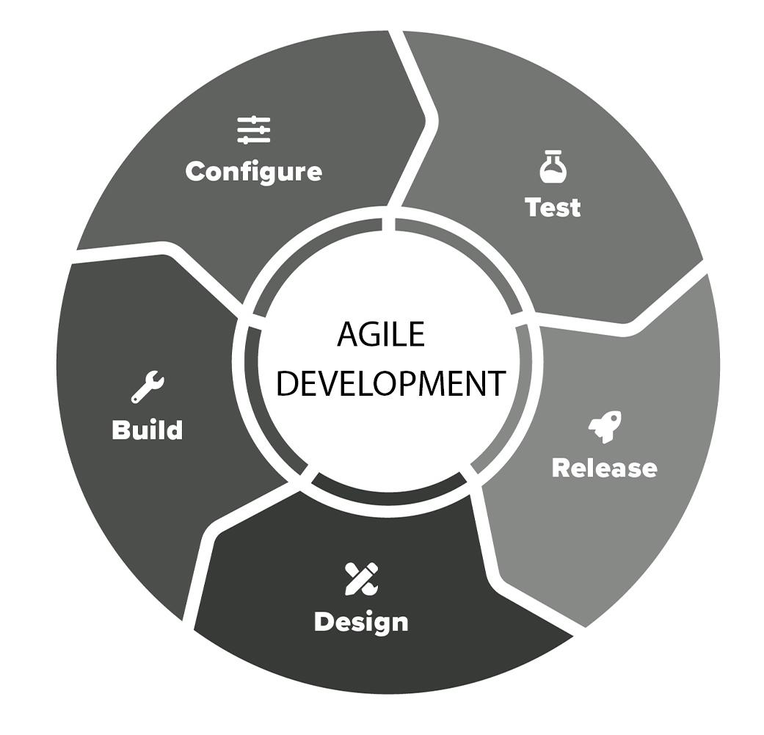
Approach Used

Slide 11
DIAGRAM

Slide 12
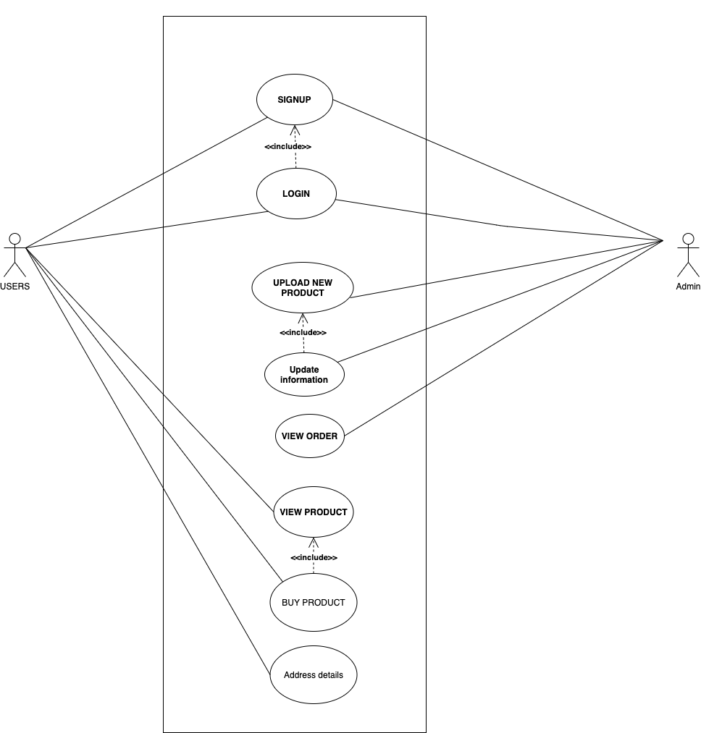
Fig:Use Case Diagram of YC_KICKS

Slide 13
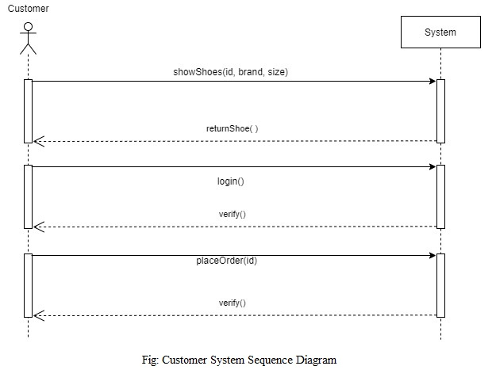
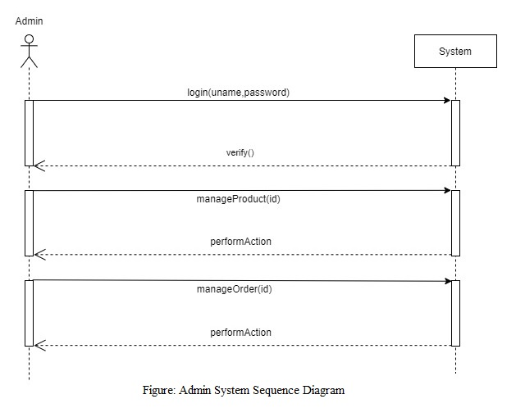
Fig: System Sequence Diagram of YC_KICKS

Slide 14
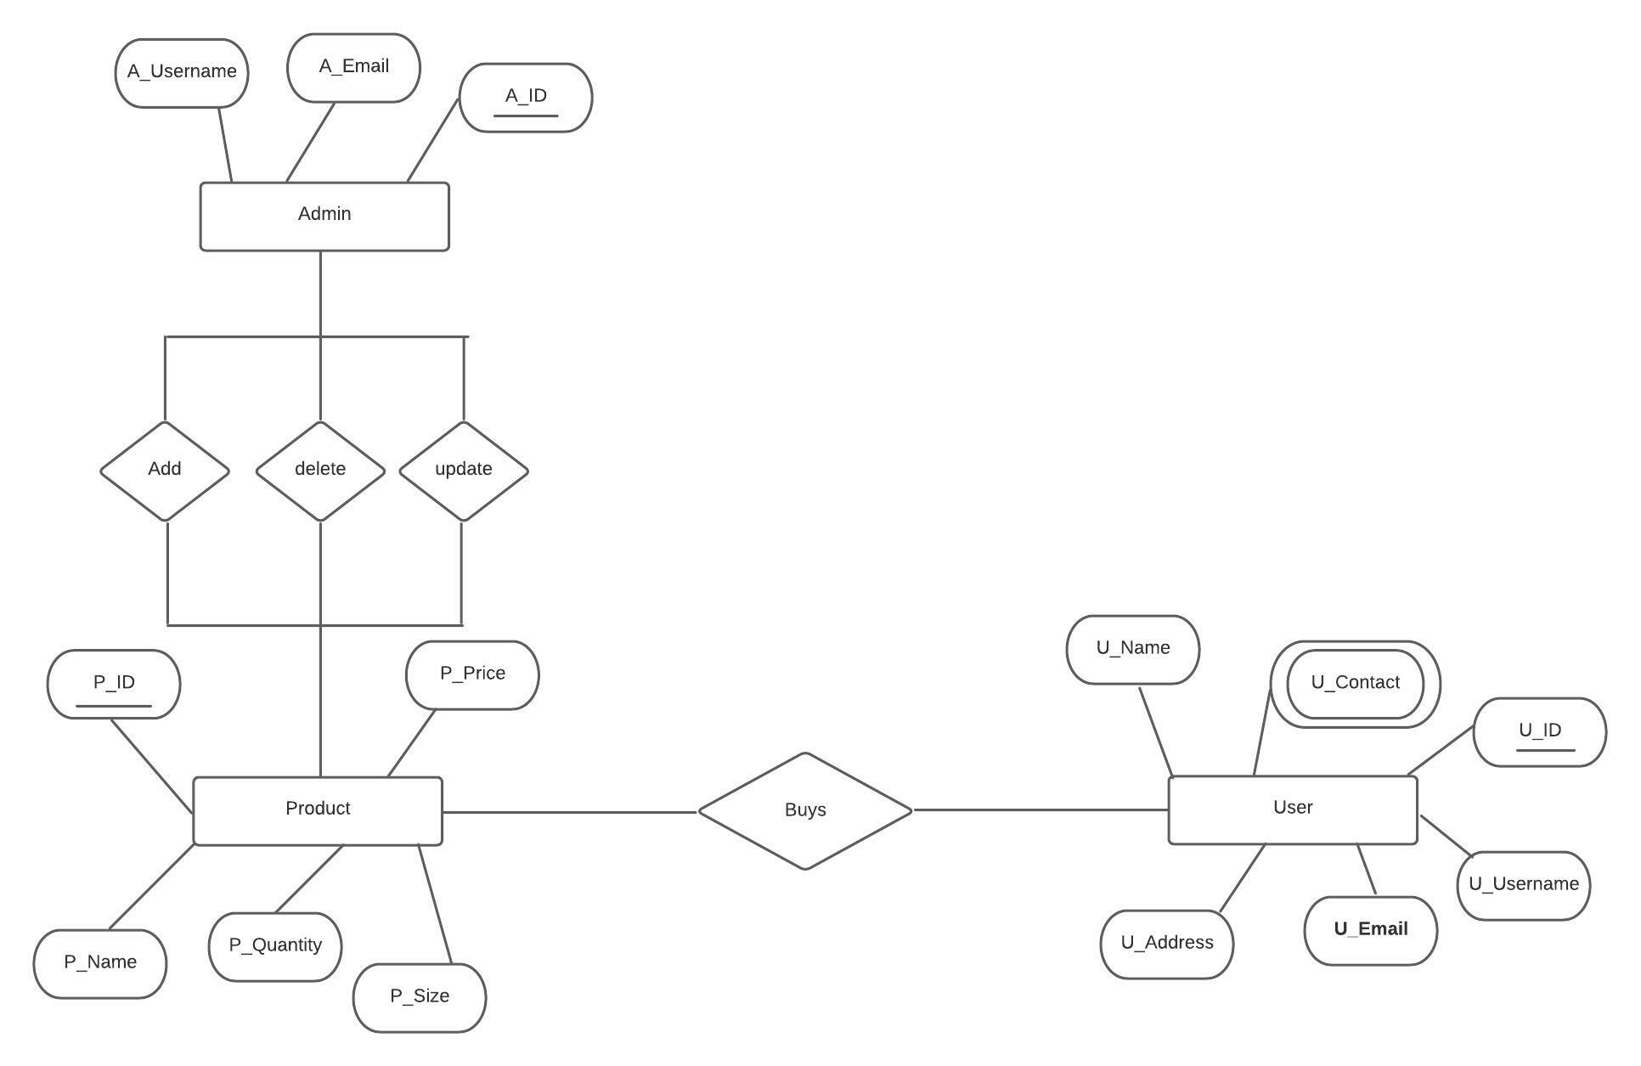
Fig: Entity Relationship Diagram of YC_KICKS

Slide 15
Future Enhancement
Some improvements that will be required for our project are:-
Online payment.
Proper Categorization.
Organization of size and quantity in appropriate manner.
Use of better and newer technology for faster processing.

Slide 16
CONCLUSION
YC_KICKS is a website for buying high copy trendy and fancy shoes easily in Nepal.
This website provides a platform for users to buy shoes that are famous in the world and the shoes mostly worn by celebrities, at low cost.
Overall, YC_KICKS is a website that helps people to buy a trendy shoes and also maintain sneaker culture in Nepal.

Slide 17
<?php
echo “THANK YOU!”;
?>

