Slide 2
Particle Rendering w/ Sensors
Pipeline:
Ultrasonic sensor connected to ESP8266
ESP8266 sends data to MQTT broker
MQTT subscriber (w/ certain Topic) receives sensor data
Sensor data is translated into:
Particle intensity (from low to high)
Particle position (left to right)
Particle color (red <-> blue)

Slide 3

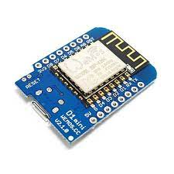
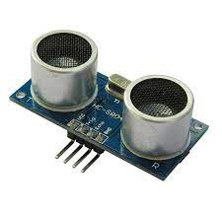



Nodemcu + ultrasonic
MQTT subscirber + Art server
Art Server -> Display
MQTT broker

