Slide 1
Anonimity in e-Voting

Slide 2
e-Voting Requirements
Not ONLY anonimity
Must have:
Anonimity
Verifiability
Legibility

Slide 3
Process
Real ID
Pseudo ID / Visual Crypto ID
Voting Ballot
Vote

Slide 4
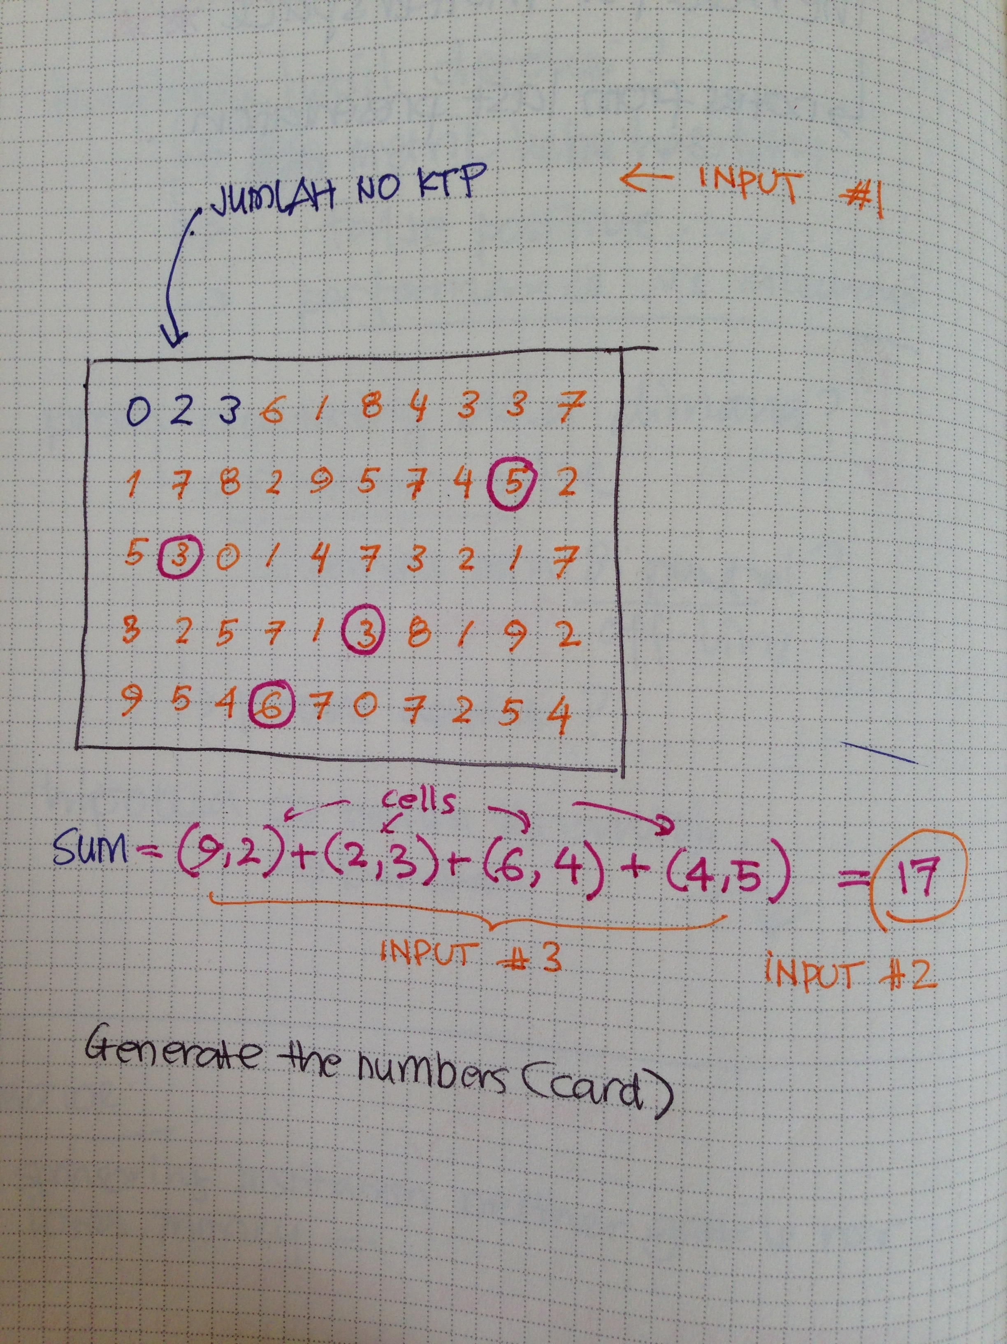

Slide 5
Generate Card
Generate random array
Put sum of ID / hash
Generate set of factorization of sum cells
Substitute cells with one entries from previous set
Print card

Slide 6
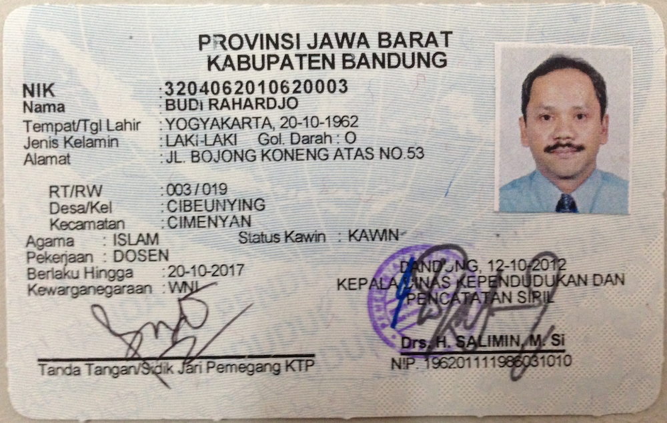
Contoh kasus
Jumlah = 29

Slide 7
Factorization
This is a “subset sum” problem
An equivalent problem is this: given a set of integers and an integer s, does any non-empty subset sum to s?
NP-complete problem
https://en.wikipedia.org/wiki/Subset_sum_problem

