Slide 1
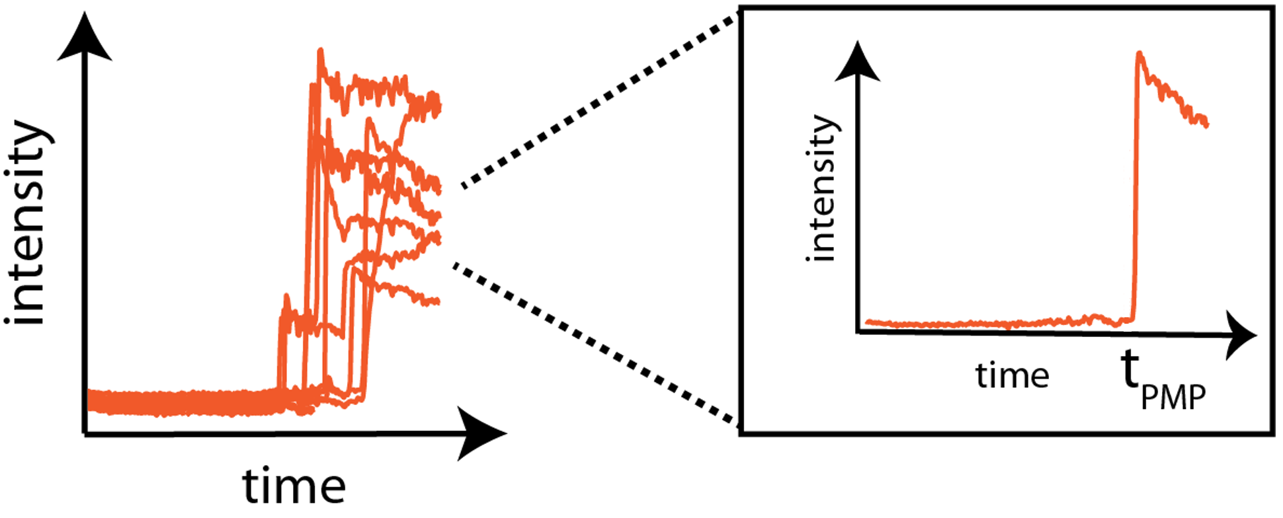




a
b
t3
t4
t2
t1
c (t1)
d (t2)
e (t3)
f (t4)

