Slide 1
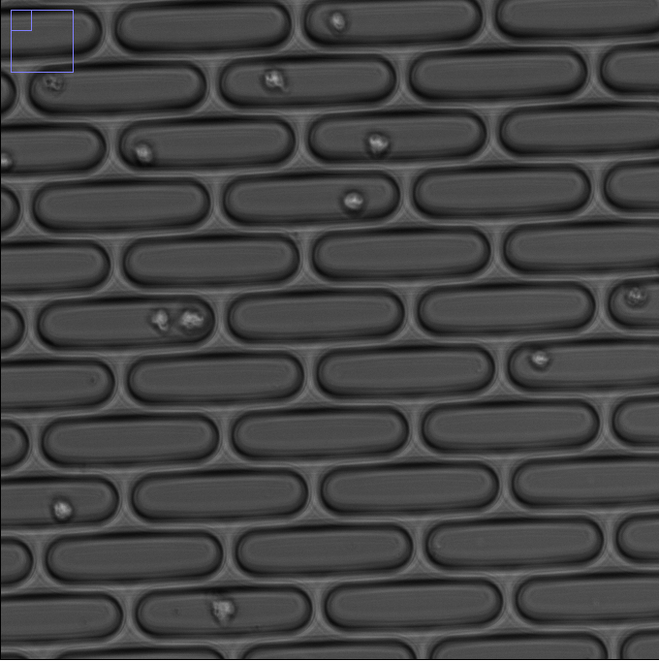

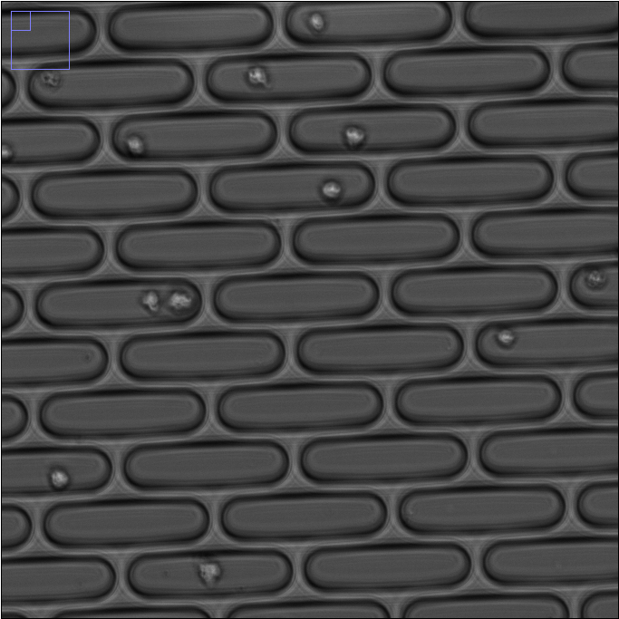
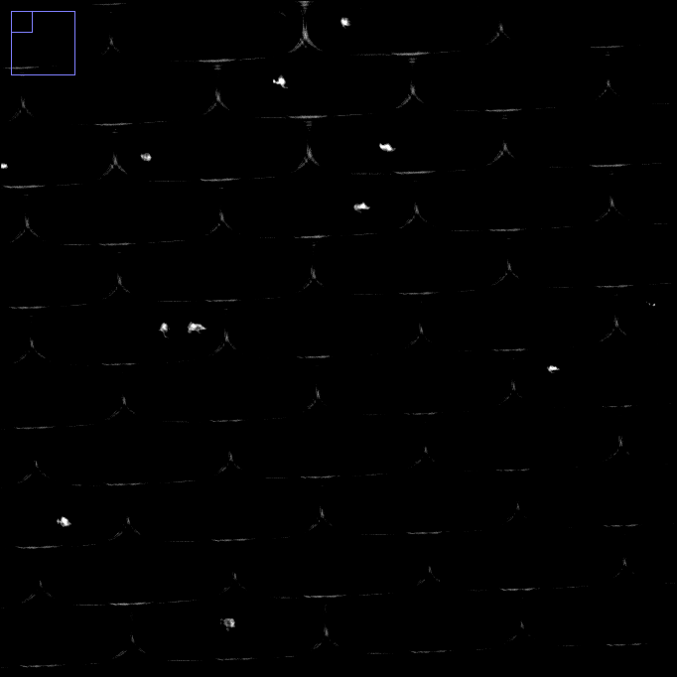
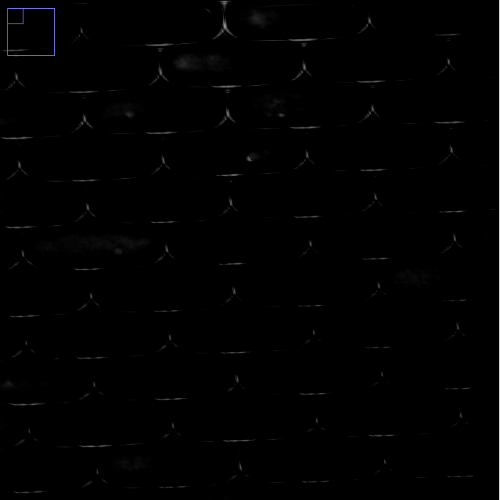
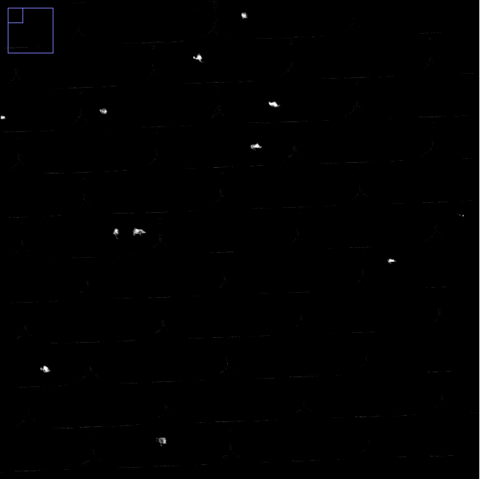
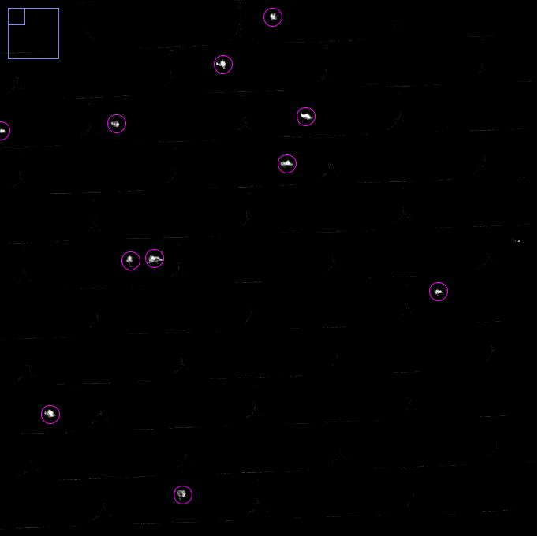
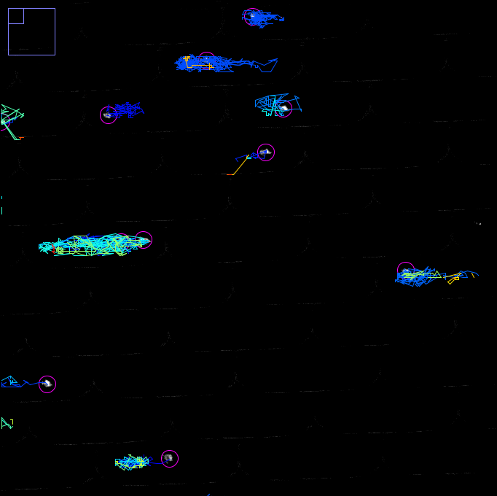
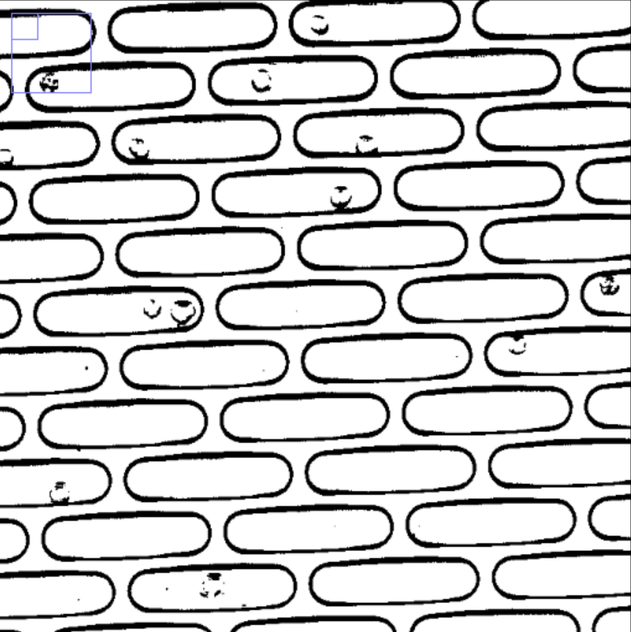
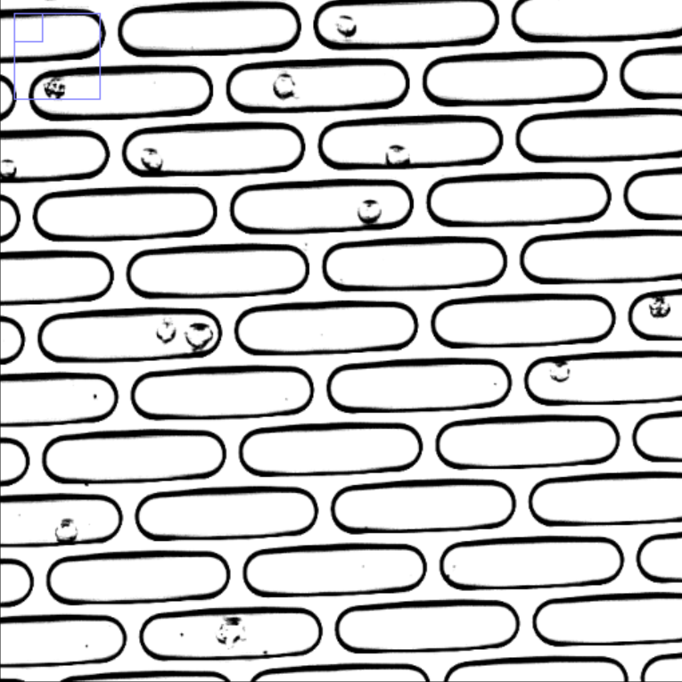

Out-of-focus image
Image pre-processing and cell tracking:
a
Brightness and contrast adjustment
b
c
d
e
Background correction
(division by
Gaussian blurred image)
8-bit
Robust automatic threshold selection
100 um
Normalization
of local contrast
binary
f
g
h
i
Fill holes
Static correction
(subtraction by pixel-wise average image)
Cell recognition
Micro-trench masking:
j
k
l
m
Cell tracking
Micro-trench separated single-cell tracking data
Figure S1
Subplot A
Real pictures for brightfield pipeline
Figure S1
Subplot B

Slide 2
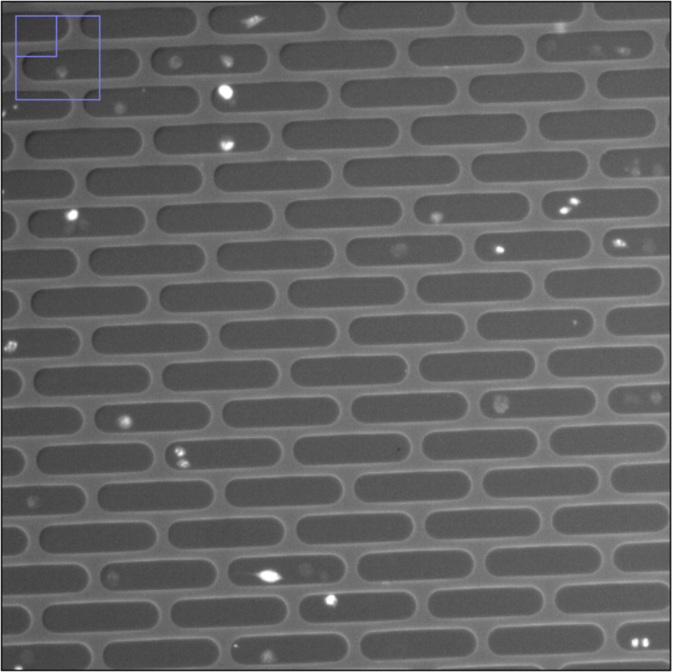
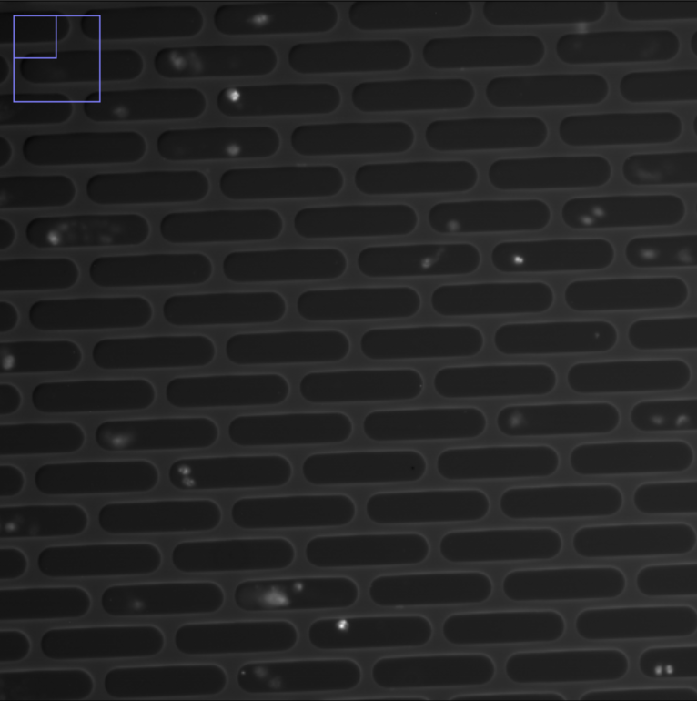
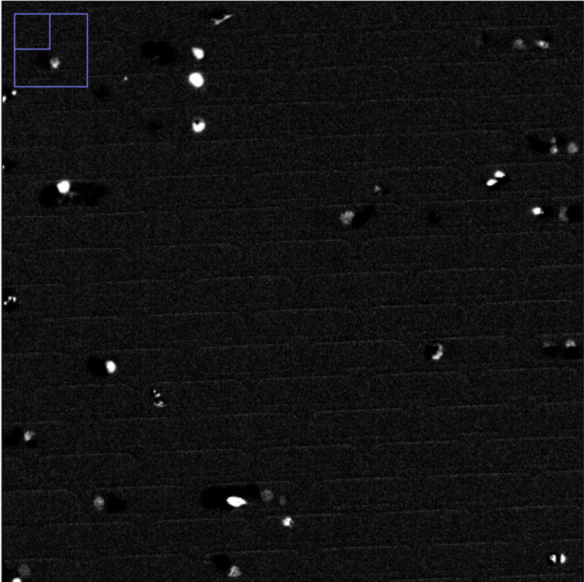
Fluorescence image pre-processing:
Fluorescent image (brightness adjusted)
a
Out-of-focus image
b
Static correction
(subtraction by pixel-wise average image)
Brightness and contrast adjustment
8-bit
100 um
Robust automatic threshold selection
c
Cell recognition
binary
Fill holes
Cell tracking
d
Micro-trench separated single-cell tracking data (death signal)
Figure S2
Real pictures of fluorescence pipeline

Slide 3
Microtrench separated single-cell tracking data (death signal)
Figure S3
Microtrench separated single-cell tracking data
Cell death onset determination
Further analyses (image and tracking data)

