Slide 1
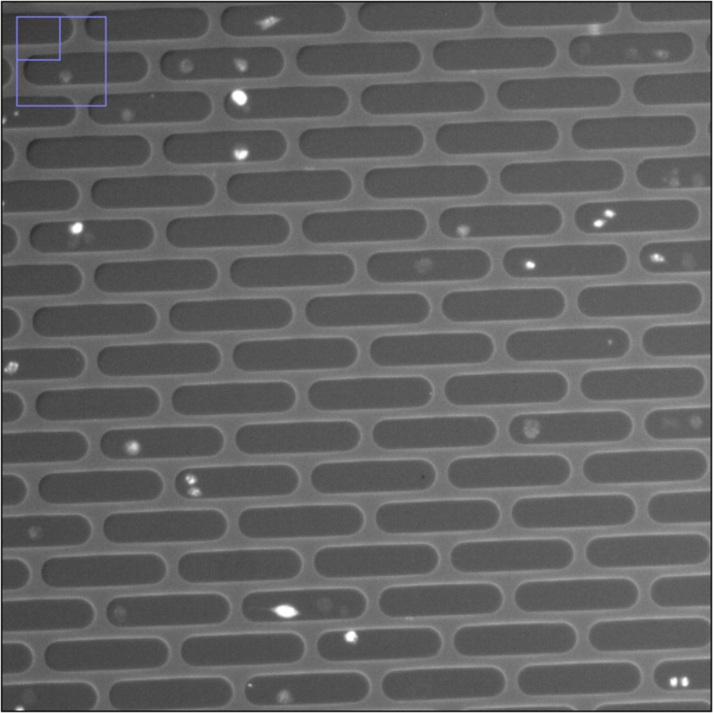
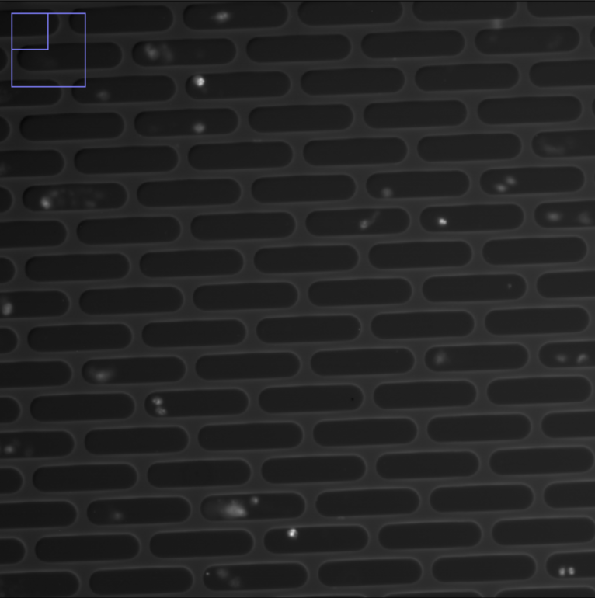
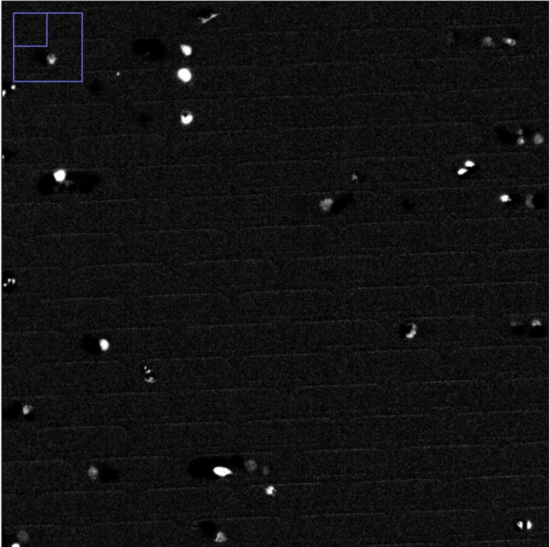
Fluorescence image pre-processing:
Fluorescent image (brightness adjusted)
a
Out-of-focus image
b
Static correction
(subtraction by pixel-wise average image)
Brightness and contrast adjustment
8-bit
100 um
Robust automatic threshold selection
c
Cell recognition
binary
Fill holes
Cell tracking
d
Micro-trench separated single-cell tracking data (death signal)

