Slide 1
How to create a Blockchain Lottery
Team Fancypants
Munich, 13.11.2016

Slide 2

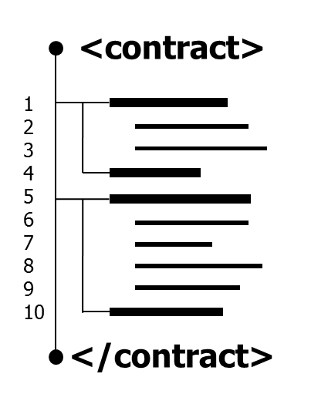
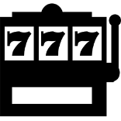

The Challenge: Write a “Lottery” Smart Contract
Challenge Description:
„Write a Lottery-Smart-Contract using the Ethereum platform. It has to be possible that several players participate in the lottery (the contract). In the end only one of the participants should be marked as the winner.“
play the Lottery
Win
or lose
11
Notes:
Talk:
Mention that there will be an introduction to Ethereum for those who never worked with the platform.
„If you ever wanted to get the blockchain and smart contract technology better, here is your chance. For beginners we offer a tutorial in the form of hello world examples and an introduction to the tools. We also prepared an introduction to Ethereum‘s solidity language. If you are already an Etheruem you don‘t have to bother with the introduction. You can start with the challange immediately.“

Slide 3
Why using Blockchain?
Decentralized
Democratic network
No trusted third party needed

Slide 4
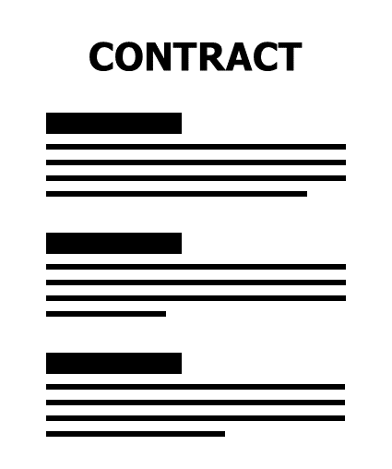
Smart Contracts
11/13/2016

Slide 5
MIST
Browser
Slack Chat
Join
with phone
number
Deploy
Contract
Slack Bot
SMS
Listen to Participants
participant
Contract
Creation
Node JS
Twilio
Send
message
to client
Register
Participant
Request
Winner
Web3 API
Web3 API
Ethereum Client
Ethereum
Lottery
Contract
Smart
Contract Lottery
Blockchain
Sync
Blockchain
Contract State
Contract State

Slide 6
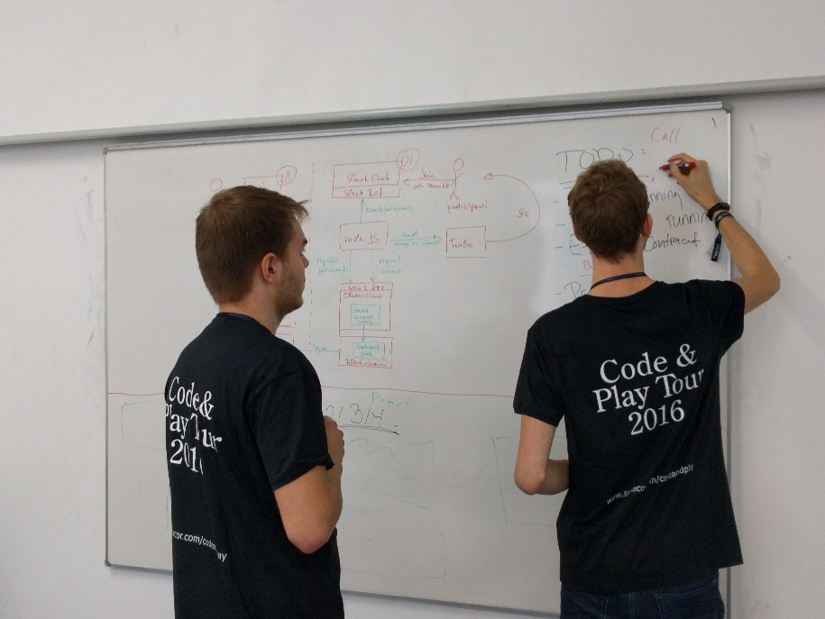
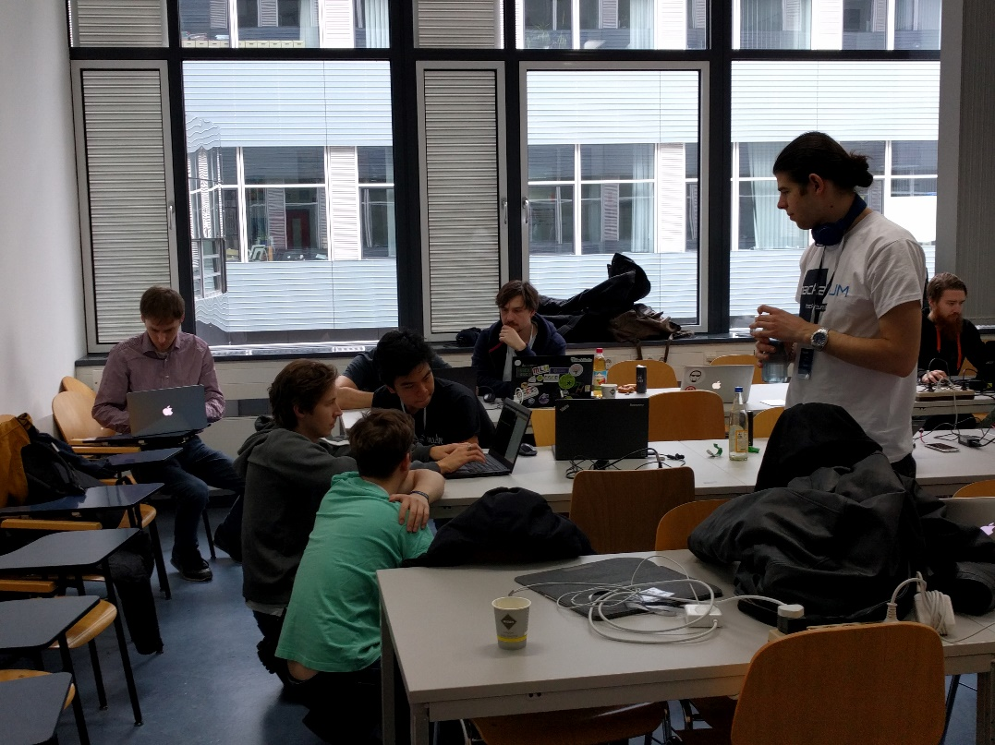
Thanks for your attention!!!

