Slide 1
Mapping Housing Ownership Type and Demographic Profile of the U.S.
Department of Community and Regional Planning
Rakibul Ahasan
Webmapping Final Project- Spring 2019

Slide 2
Background
Housing price is increasing, and the supply inventory has been decreasing
Median housing price increased by 7% in past year
Renter percentage is the highest since 1965
37% people rent their houses, which increase by 6% in the past decade

Slide 3
Objective
To examine the distribution of renter-owned housing in all the states
To explore the relationship between median income and house ownership distribution

Slide 4
Data
The data used was collected from the US Census Bureau website (American Factfinder and from HUD website)
Webmapping technology used
Excel
GeoJSON.io
HTML, CSS, JavaScript, and JQuery
Leaflet
HighMaps

Slide 5
Maps Prepared
Percentage of Renter-Occupied Housinng in each States
Population in each Major Races in Each States
Median Income of each of the States
Highmap showing the Population Density in Each States.

Slide 6
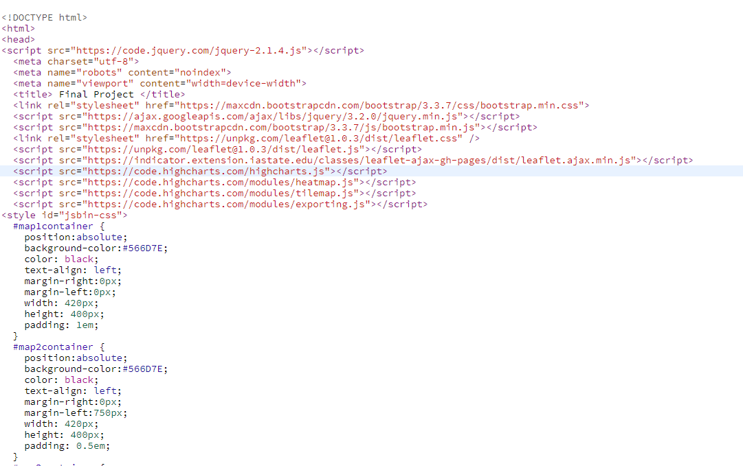
Using containers

Slide 7
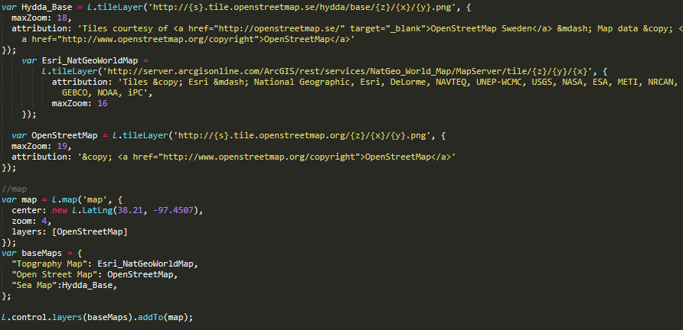
Leaflet and overlay
Leaflet maps were used to visualize-
The base maps, legend creation and overlaying multiple layers

Slide 8
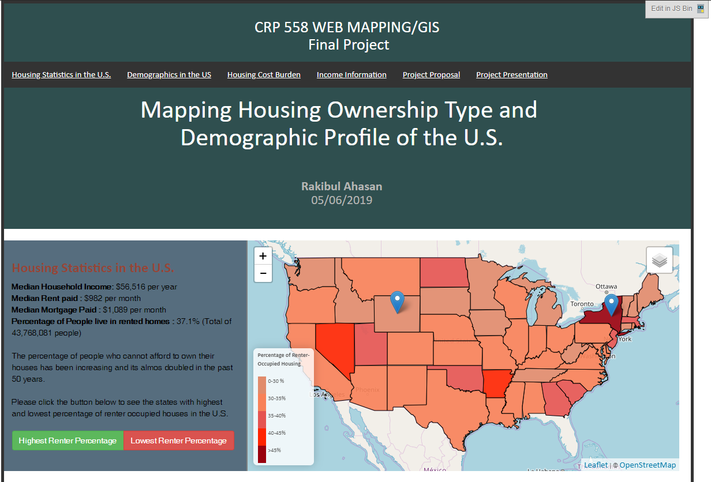
Header, and First map

Slide 9
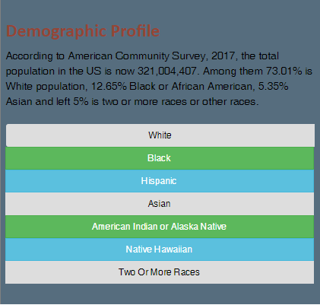
Using Bootstrap buttons

Slide 10
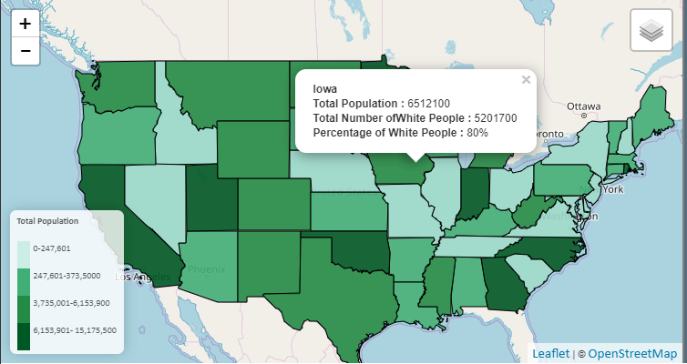
Legend, Pop up and Layer Control

Slide 11
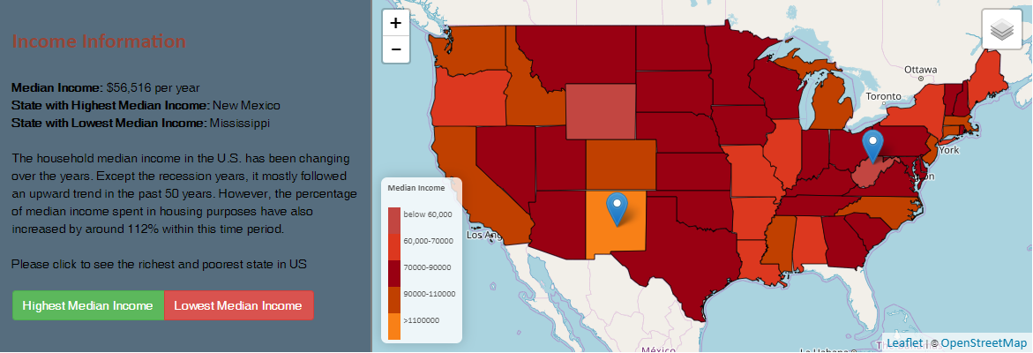
Markers and Buttons

Slide 12
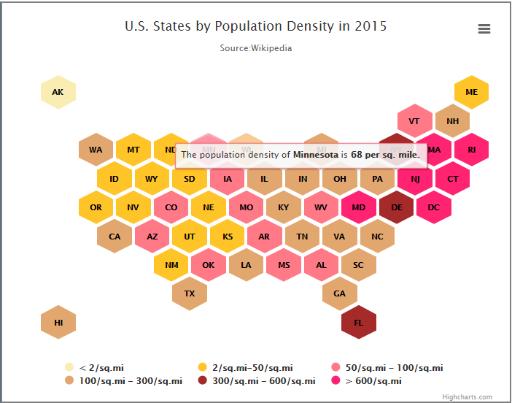
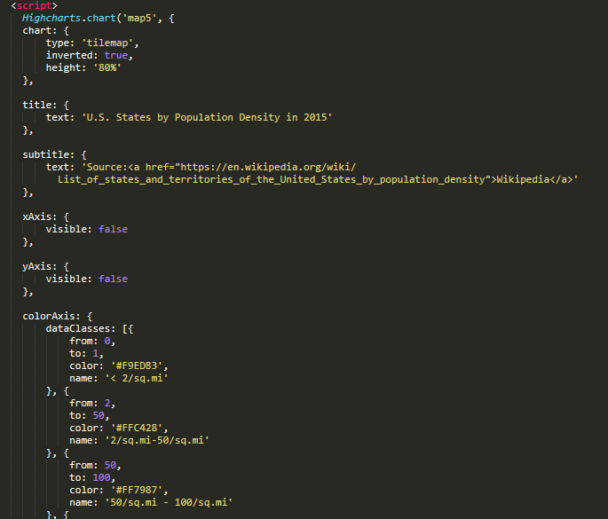
Highmaps

Slide 13
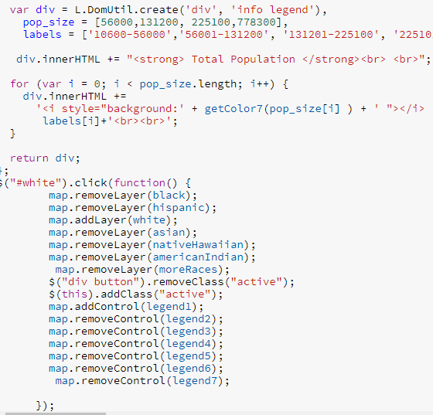
Data Filtering
JQuery codes for data filtering

Slide 14
Challenges and Limitations
I was not sure how to incorporate multiple leaflet maps in one layout. It was really confusing and difficult for me to find out the way to use containers
Use of multiple legends in one map was interesting and way difficult to implement than I thought it would be
I wanted to show the City of Des Moines the same way. But the data quality and lack of time did not allow me to do that

Slide 15
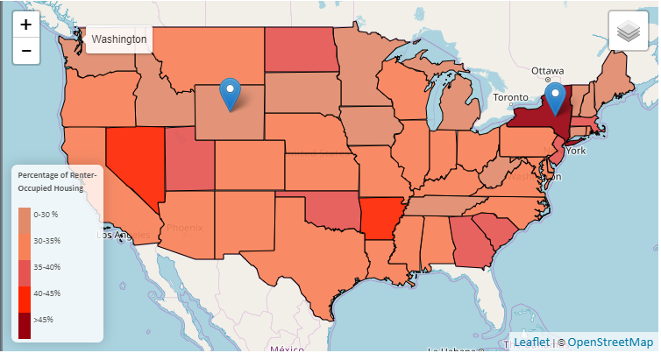
Final Maps (1)

Slide 16
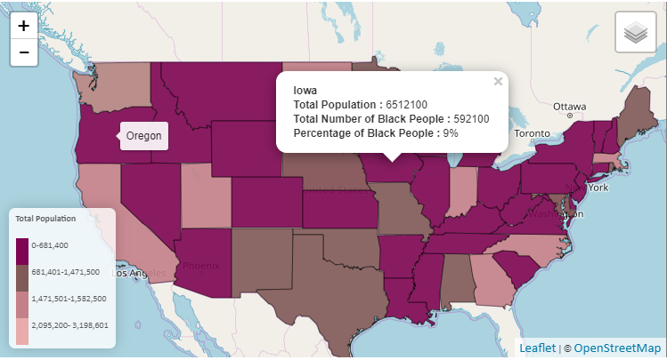
Final Maps (2)

Slide 17
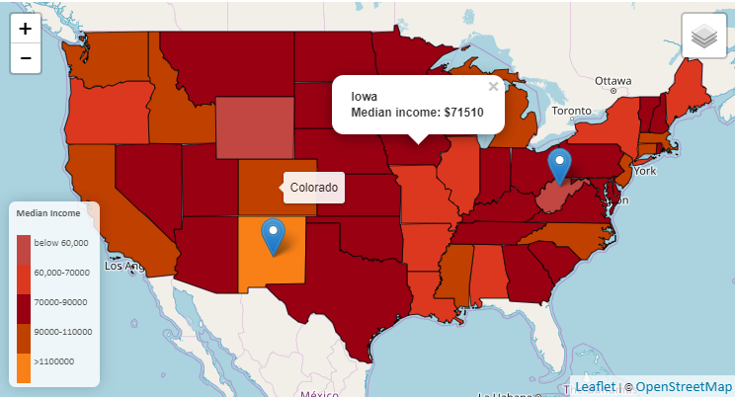
Final Maps (3)

Slide 18
Final Maps (4)

Slide 19
Thank you

