Slide 1
AGENTIC AI PLATFORM
ScholarAI
Workforce
10
specialist agents
+ one Supervisor
Supervisor-orchestrated scholarship evaluation with live controls, evidence, memory, and human oversight
Notes:
[Sources]
- README.md
- src/scholarai/application/agents/supervisor.py

Slide 2
DESIGN INTENT
This is an AI workforce—not a chatbot
The review problem
The operating principle
Scholarship decisions combine documents, eligibility rules, academic performance, financial need, achievements, policy, and cross-document verification.
Agents perform bounded specialist work. Deterministic services compute every score. Evidence supports every claim. A human owns the final decision.
Outcome: faster review without surrendering accountability
02
Notes:
[Sources]
- README.md sections 1–3
- docs/ARCHITECTURE.md

Slide 3
MULTI-AGENT ARCHITECTURE
One Supervisor coordinates ten specialists
10
Evidence intake
Specialist scoring
Synthesis & control
specialist agents
Document Analysis
Eligibility
Verification
Academic
Financial Need
Achievement
Policy / RAG
Evaluation
SOP Writer
Critic
The Supervisor builds the plan, skips unnecessary work, routes failures, and starts targeted revisions from Critic feedback.
03
Notes:
[Sources]
- docs/AGENTS.md
- src/scholarai/application/agents/supervisor.py

Slide 4
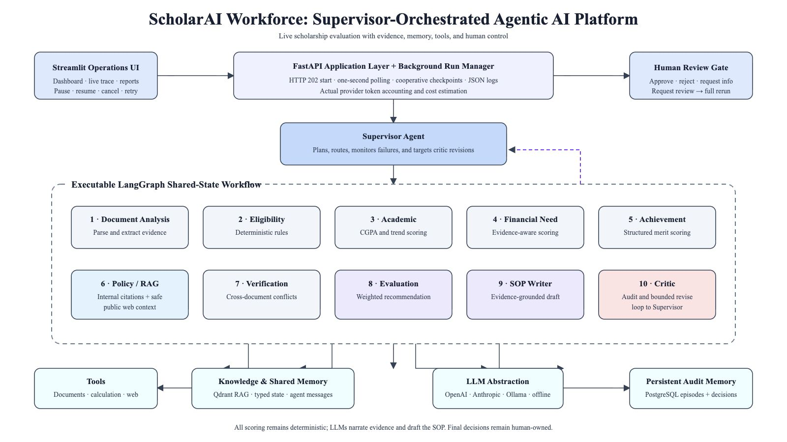
Notes:
[Sources]
- docs/assets/scholarai-workforce-architecture.svg
- src/scholarai/application/orchestration/graph.py

Slide 5
LANGGRAPH WORKFLOW
The graph plans, executes, critiques, and reruns
Supervisor
plan
Specialist
agents
Evaluation
+ SOP
Critic
audit
Human
review
REVISE: bounded targeted rerun
The UI reads the topology directly from CompiledStateGraph.get_graph(); it does not maintain a separate hand-drawn workflow.
05
Notes:
[Sources]
- src/scholarai/application/orchestration/graph.py
- GET /applications/workflow/topology

Slide 6
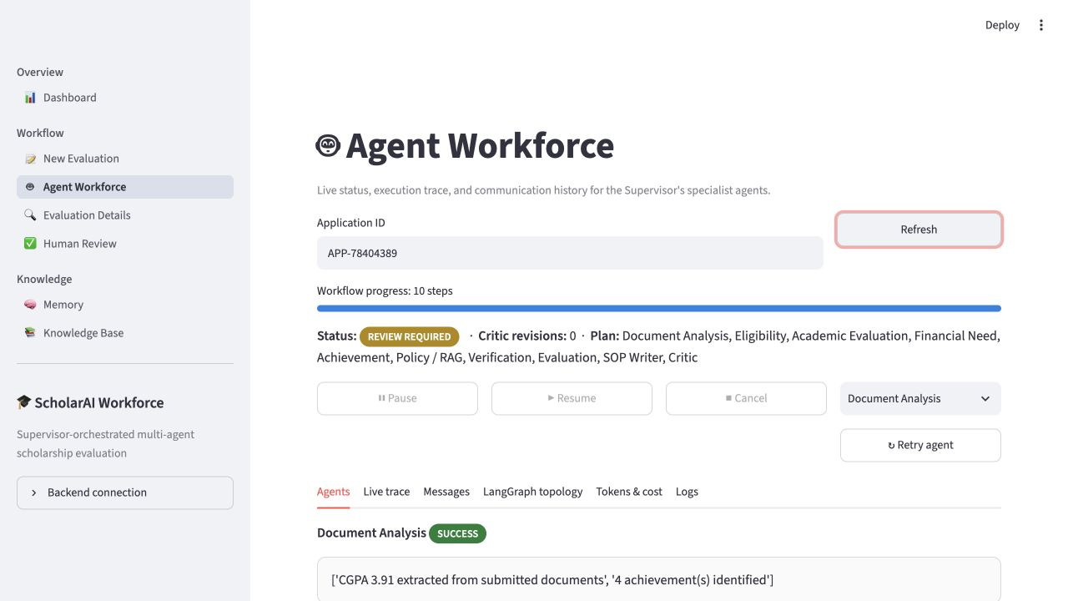
INTERACTIVE UI
Operators control a genuinely live background run
One-second polling
Progress and active actor update without blocking the request.
Real controls
Pause · resume · cancel · retry-agent · full Supervisor rerun
Downloadable logs
Execution logs and error reports export as JSON.
06
Notes:
[Sources]
- ui/streamlit_app/pages/3_Agent_Workforce.py
- src/scholarai/application/orchestration/runtime.py

Slide 7
TOOL INTEGRATION
Tools add evidence without leaking applicant data
Internal evidence path
Public web context
Document readers
Deterministic Python scoring
Policy RAG over Qdrant
SQL episode lookup
DuckDuckGo works without a key; Tavily is optional. Only a generic scholarship-policy query leaves the system—never student documents, achievements, names, or identifiers.
07
Notes:
[Sources]
- src/scholarai/application/agents/policy_rag.py
- src/scholarai/infrastructure/web_search/tavily_client.py

Slide 8
SHARED AND LONG-TERM MEMORY
Memory makes every decision inspectable
No human decision → no final recommendation
Working state
Audit episode
Semantic recall
Typed LangGraph state carries facts, evidence, results, trace, and messages.
PostgreSQL stores the evaluation timeline and human decision.
Qdrant retrieves similar prior cases for future review.
08
Notes:
[Sources]
- docs/MEMORY.md
- src/scholarai/application/use_cases/apply_human_decision.py

Slide 9
LOGGING AND COST
Provider usage is captured at the source
Every LLM call is scoped to an application and agent. Provider response metadata supplies input tokens, output tokens, model, provider, and calculated cost.
Tokens
Cost
Logs
Actual response usage
Model-aware estimate
Trace + messages + errors
09
Notes:
[Sources]
- src/scholarai/infrastructure/llm/usage.py
- GET /applications/{id}/usage
- GET /applications/{id}/logs

Slide 10
QUALITY ASSURANCE
The final build is verified, not just demonstrated
Unit, integration, end-to-end, UI-control, runtime, rerun, and retry tests all execute offline in CI.
110
117
0
tests passed
typed source modules
mypy errors
10
Notes:
[Sources]
- Local verification: pytest 110 passed
- Local verification: mypy checked 117 source files with no issues

Slide 11
RELEASE PATH
Deployment is reduced to four explicit steps
1
2
3
4
Run locally
Connect GitHub
Create Render blueprint
Verify live demo
Docker Compose or uv
Push the verified repository
API + UI + PostgreSQL
Health, controls, logs, SOP
Credentials and official approval evidence remain user-owned inputs.
11
Notes:
[Sources]
- render.yaml
- Dockerfile
- docs/DEPLOYMENT.md

Slide 12
READY FOR LIVE DEMO
ScholarAI Workforce
A real multi-agent system with evidence, control, and accountability
Next: attach Teams approval evidence, push to GitHub, and deploy the prepared blueprint
Notes:
[Sources]
- README.md
- docs/PROJECT_APPROVAL.md
- docs/WEEKLY_PROGRESS.md

