Slide 1

Ovarian Cancer Prediction Using Whale Optimization–based XGBoost Algrithom
Presented By
Supervised By
Dr. Uzzal Biswas
Professor
MD. Zeehad Bin Salim Ameer
Student ID : 210911
External Member
Dr. Mizanur Rahman
Professor
Md. Rahat Ahmed Khan
Student ID : 210929
Board Member
Dr. Abdullah-Al Nahid
Professor
Electronics and Communication Engineering Discipline
Khulna University
Khulna, Bangladesh
December 2025

Slide 2
Overview
01
Introduction
02
Literature Review
03
Materials & Method
04
Result & Discussion
05
Conclusion

Slide 3
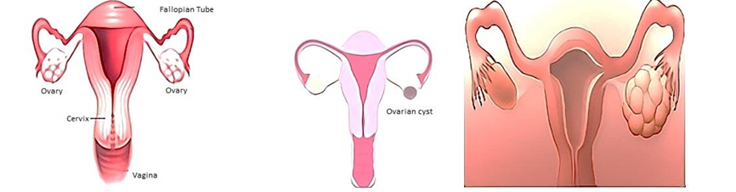
Ovarian Cancer (OC)
Ovarian cancer, a gynecological malignancy that occurs in the ovary of women [1].
Figure 1: Normal ovary, Ovarian Cyst, Polycystic Ovary

Slide 4
1
Increased amount of mortality rate.
2
Mental and physical damage
Background
3
Treatment challenges during the traditional tests.
4
Increased expenditure .

Slide 5
Motivation
Rising cases of ovarian Cancer
Silent and late diagnosis of ovarian cancer
Limitation of existing models
Ability to help the clinician with decision support

Slide 6
Objective
1
Dataset investigation and model selection.
2
Feature selection
3
Hyperparameter optimization using whale optimization algorithm .
4
Model development and analyze the performance of the optimized XGBoost algorithm
5
Performance comparison between proposed and related works.

Slide 7

Literature Review

Slide 8
Literature Review
Systematic Literature Review
Semi-systematic Literature Review
Bibliographic Literature Review
Figure 2: Literature review types
These are the main types of literature review process. In our study we have used Systematic literature review

Slide 9
Overview of Systematic
Literature Review
Feature Selection
HyperparameterOptimization
Classification
Figure 3: Overview of Systematic Literature review

Slide 10
Systematic Literature Review: Feature Selection
Table 1: Summary table based on feature selection
Author Name | Dataset | Method | Selected features | Result
T. Oznacar and T. Guiler [2] | Sample:349 Feature: 49 Benign: 178 Malignant:171 | Boruta feature selection based Catboost classifier | AFP, age, ALB, ALP, AST, CA125, CA19-9, CA72-4, CEA, GLO, HE4, IBIL, LYM#, LYM%, MCH, NEU, Na, PCT, PLT, TBIL and TP | Accuracy: 89.52% Precision : 90.73% Recall: 89.52% F1-score: 90.73%
B. Wickramasinghe and G. Regisford [3] | Sample:335 Feature: 49 Positive: 171 Negative:164 | Chi-square test with Logistic regression | AFP, AG, ALB, ALP, AST, CA125, CA19-9, CA72-4, CEA, GGT, HE4, IBIL, LYM%, LYM#, UA, HGB, MNP, NEU, PLT, TBIL, and PDW | Accuracy:89.52% Recall: 99 %

Slide 11
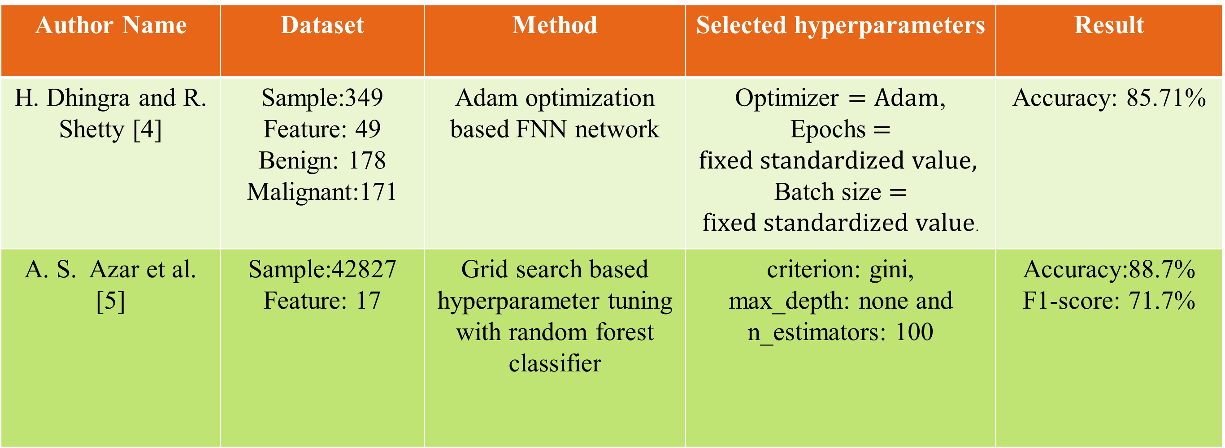
Systematic Literature Review: Hyperparameter Tuning
Table 2: Summary table based on hyperparameter tuning
Author Name | Dataset | Method | Selected hyperparameters | Result
H. Dhingra and R. Shetty [4] | Sample:349 Feature: 49 Benign: 178 Malignant:171 | Adam optimization based FNN network | Optimizer $=Adam$, Epochs$=fixed standardized value,$ Batch size $=$ $fixed standardized value$. | Accuracy: 85.71%
A. S. Azar et al. [5] | Sample:42827 Feature: 17 | Grid search based hyperparameter tuning with random forest classifier | criterion: gini, max_depth: none and n_estimators: 100 | Accuracy:88.7% F1-score: 71.7%

Slide 12
Systematic Literature Review: Classification
Table 3: Summary table based on classification
Author Name 88 | Dataset | Method | Result
S. D. Patil , P. J. Deore and V. B. Patil [6] | Sample:187 Benign: 112 Malignant:75 | Binary Segmentation based random forest classifier | Accuracy: 86 %
S.M. Ayyoubzadeh et al. [7] | Sample:349 Feature: 49 Benign: 178 Malignant:171 | Random forest classifier | Accuracy: 86.75 % Specificity : 81.36% Recall: 91.6 % F1-score: 88.01 %

Slide 13

Materials and Methods

Slide 14
Overall Methodology
Data Acquisition
Data
Preprocessing
Model Selection
Feature Selection
Performance Analysis
Model Training
Hyperparameter Tuning
Figure 5: Overall methodology of the study

Slide 15
Description of Dataset
Dataset Collected from Mendeley Data Repository [8]
Number of patients : 349
Number of Features : 49
Balanced
Ethically approved
Benign: 178
Malignant:171

Slide 16



Dataset Preprocessing
Data
Data Preprocessing
Preprocessed Data
Filled missing values with the column mean

Slide 17
Feature Selection
Selected Features (20-stable)
Data
Features (49)
Feature Reduction

Slide 18
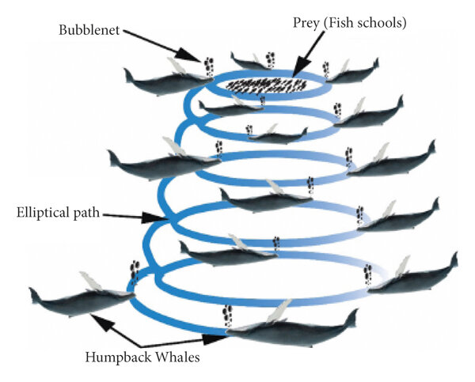
Feature Selection
Whale Optimization Algorithm
  Nature-inspired meta-heuristic optimization algorithm
  Mimics the hunting behavior of humpback whales
Figure 6: Bubble net hunting strategy [9]

Slide 19
CC
Whale Optimization Algorithm
TWO PHASES: EXPLORATION AND EXPLOITATION.
  Exploration phase (Search for Prey)
  Exploitation phase (Encircling and Attacking Prey)

Slide 20
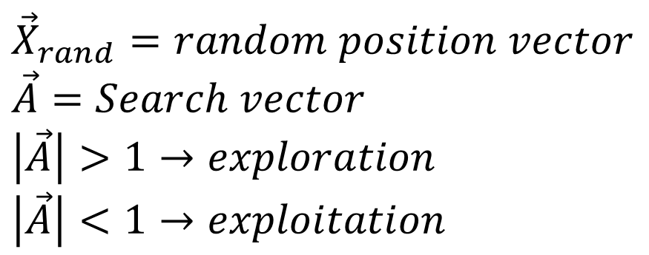
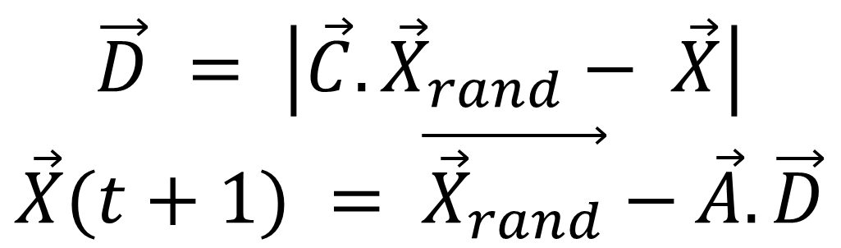
CC
Search for Prey (Exploration)
$$\vec{D} = \left|\vec{C}.{\vec{X}}_{rand}− \vec{X}\right|$$
$$\vec{X}(t+1) = \vec{{\vec{X}}_{rand}}−\vec{A}.\vec{D}$$
$${\vec{X}}_{rand}=random position vector$$
$$\vec{A}=Search vector$$
$$\left|\vec{A}\right|>1→exploration$$
$$\left|\vec{A}\right|<1→exploitation$$

Slide 21
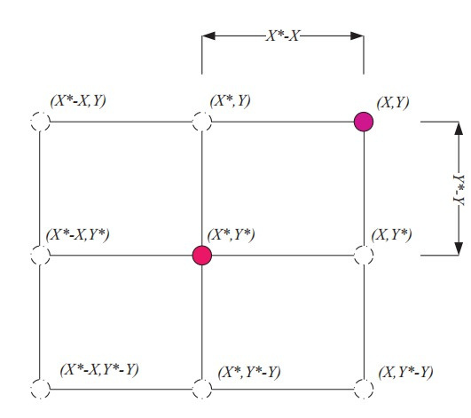
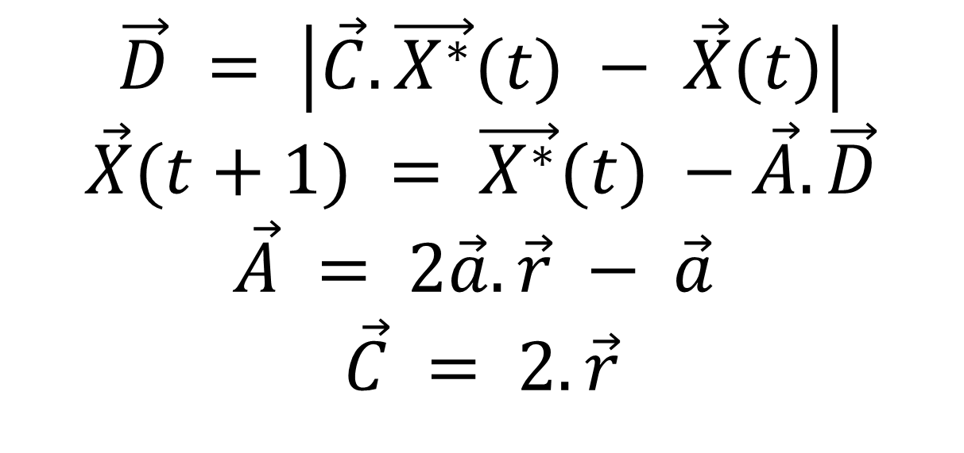
Encircling Prey (Exploitation)
$$\vec{D} = \left|\vec{C}.\vec{X^{∗}}(t) − \vec{X}(t)\right|$$
$$\vec{X}(t+1) = \vec{X^{∗}}(t) −\vec{A}.\vec{D}$$
$$\vec{A} = 2\vec{a}.\vec{r} − \vec{a}$$
$$\vec{C} = 2.\vec{r}$$
Figure 7: 2D encircling prey

Slide 22
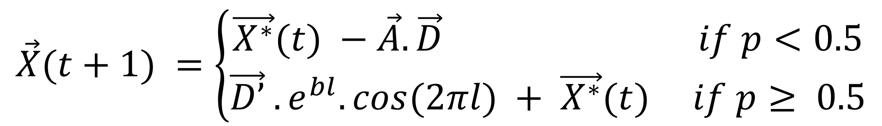
Attacking Method (Shrinking or Spiral)
$$\vec{X}(t+1) =\left\{\begin{aligned}\vec{X^{∗}}(t) −\vec{A}.\vec{D} if p<0.5 \\ \vec{D’} .e^{bl}.cos(2πl) + \vec{X^{∗}}(t) if p≥ 0.5\end{aligned}\right.$$
Where p = random number in [0,1]

Slide 23
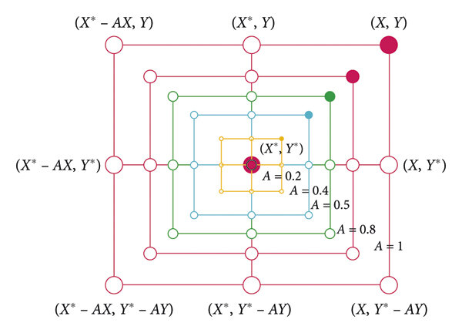
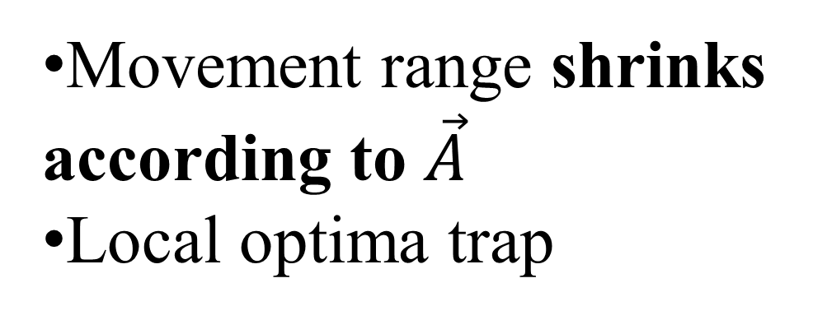
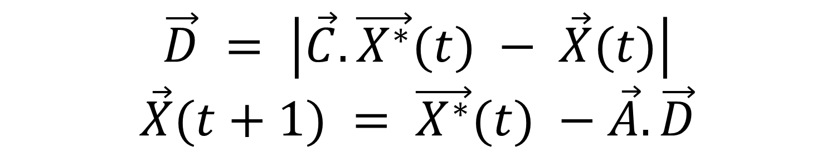
Shrinking Encircling
$$\vec{D} = \left|\vec{C}.\vec{X^{∗}}(t) − \vec{X}(t)\right|$$
$$\vec{X}(t+1) = \vec{X^{∗}}(t) −\vec{A}.\vec{D}$$
Movement range shrinks according to $\vec{A}$
Local optima trap
Figure 8: Shrinking encircling mechanism [10]

Slide 24
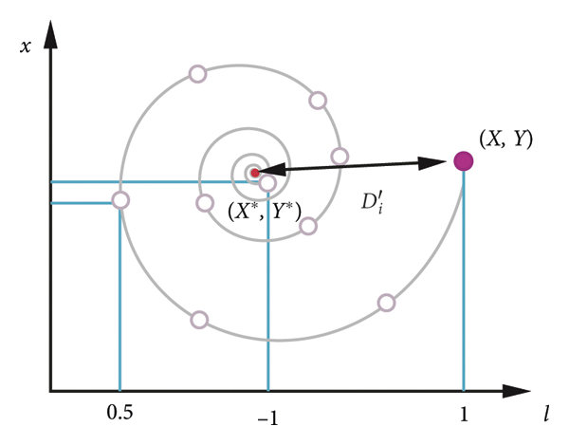

Spiral Updating Position
$$\vec{X}(t+1) = \vec{D’} .e^{bl}.cos(2πl) + \vec{X^{∗}}(t)$$
b=constant for defining the shape of the logarithmic spiral,
✔ Explores nearby regions
Figure 9: Spiral updating position [10]

Slide 25
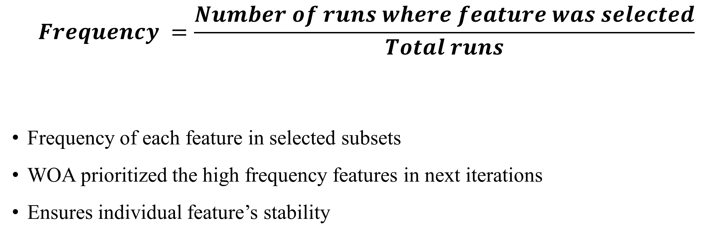
Stability Management
$$Frequency =\frac{Number of runs where feature was selected}{Total runs}$$
Frequency of each feature in selected subsets
WOA prioritized the high frequency features in next iterations
Ensures individual feature’s stability

Slide 26
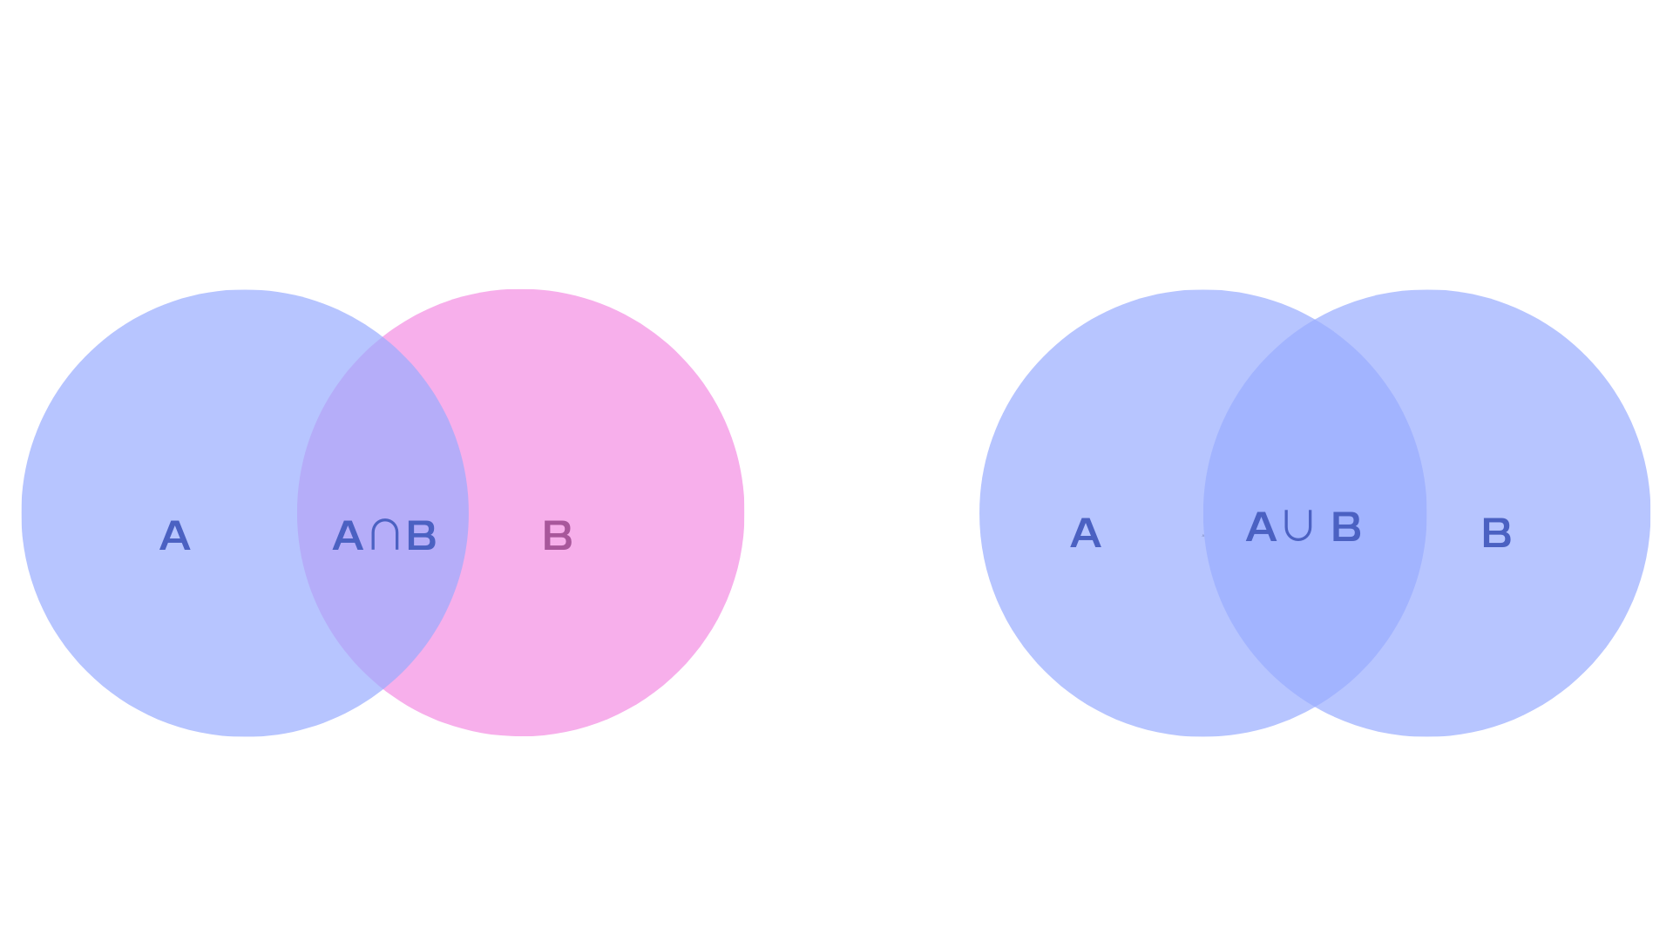
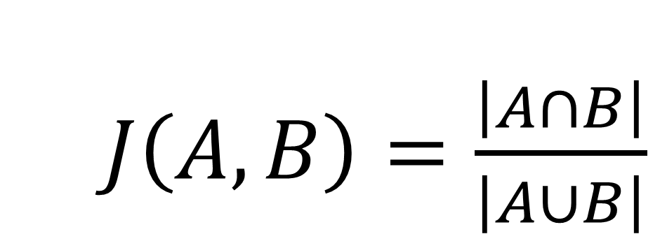
Jaccard Similarity
$J\left(A,B\right)=\frac{\left|A∩B\right|}{\left|A∪B\right|}$
Checks consistency between the feature subsets
High stability score → feature selection is consistent
Low score → unstable, unreliable selection
Figure 10: Jaccard Similarity Venn diagram

Slide 27
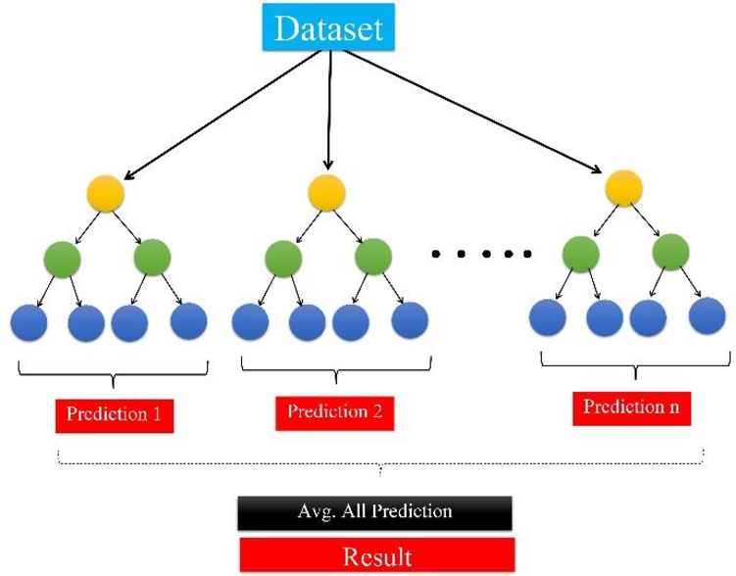
XGBoost Model
Prediction 1
Prediction 2
Prediction 3
Result
Figure 11: Schematic view of XGBoost model [11]

Slide 28

Hyperparameter Tuning
  max_depth=7
  learning_rate=0.07
  n_estimators=498
Moderate depth → avoid overfitting
Low learning rate → stable learning
High number of trees → progressively correct prediction errors.

Slide 29
Result and Discussion

Slide 30
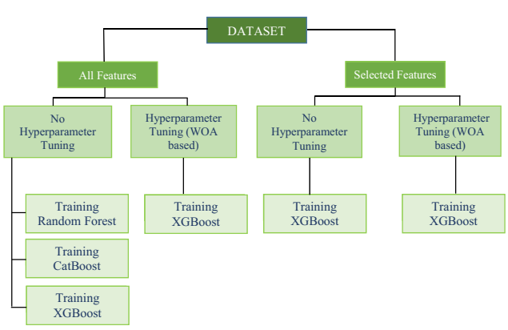
Model Training
Figure 12: Visualization of model training process

Slide 31
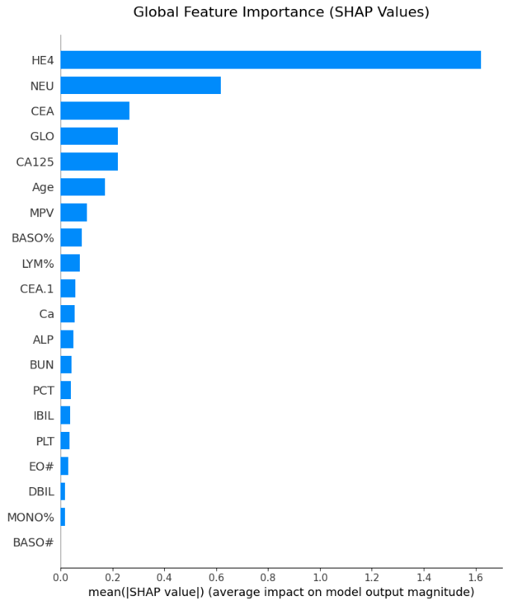
Feature Selection Outcome
5 sets of feature
20 features from union
HE4→Human Epididymis Protein 4
NEU→Neutrophil ratio
CEA→Carcinoembryonic antigen
Figure 13: Importance of selected features

Slide 32
Performance Comparison of Different Models
Table 1: Model performance comparison between three different models
Hyperparameter | Model | Accuracy | F1 | Precision | Recall | AUC
Untuned | Random Forest | 0.8969 | 0.8964 | 0.9028 | 0.8969 | 0.9458
 | CatBoost | 0.8711 | 0.8701 | 0.8813 | 0.8711 | 0.9595
 | XGBoost | 0.8969 | 0.8965 | 0.9009 | 0.8969 | 0.9485

Slide 33
Performance Comparison of XGBoost
Table 2: Model performance comparison between different variants of XGBoost classifier
Features | Hyperparameter | Model | Accuracy | F1 | Precision | Recall | AUC
All | Untuned | XGBoost | 0.8969 | 0.8965 | 0.9009 | 0.8969 | 0.9485
 | Tuned | XGBoost | 0.9027 | 0.9025 | 0.9049 | 0.9027 | 0.9544
Selected | Untuned | XGBoost | 0.8769 | 0.8765 | 0.8801 | 0.8769 | 0.9528
 | Tuned | XGBoost | 0.8969 | 0.8967 | 0.9004 | 0.8969 | 0.9536
12/17/2025
33

Slide 34
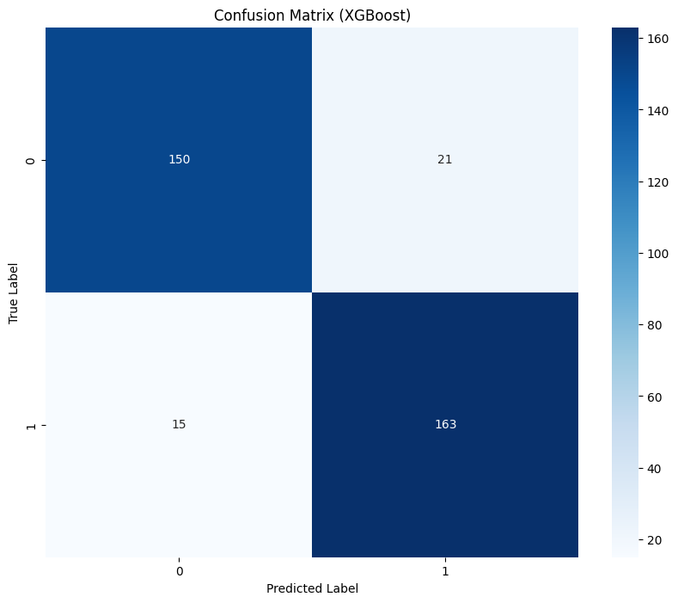
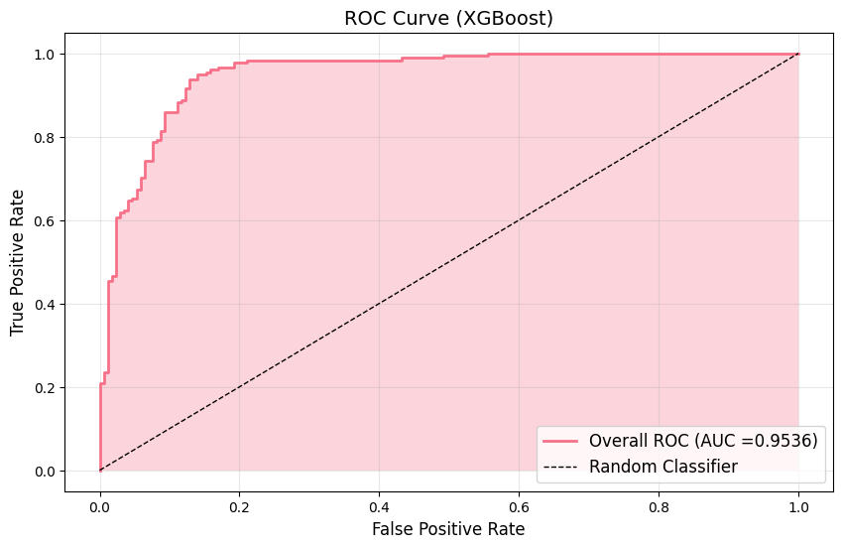
Result of Best Performing Model
Figure 14: Confusion matrix of optimized XGBoost model
Figure 15: ROC of modified XGBoost

Slide 35
Comparison with Previous Works
Table 2: Comparison with the related previous works
Work | Dataset Used | Method used for Feature Selection/Importance | Classifier Used | Accuracy | F1-score | Precision | Recall | AUC
[12] | [8] | Boruta | CatBoost | 0.8952 | 0.8945 | 0.9073 | 0.8952 | 0.9502
[13] | [8] | Information gain indices and the Gini index. | RF | 0.8675 | 0.8801 | - | 0.9160 | 0.9250
[14] | [8] | Student’s t-test and the Mann–Whitney U-test | RF, GBM | 0.88 | 0.89 | - | 0.97 | 0.87
Our Study | [8] | Whale Optimization Algorithm | XGBoost | 0.8969 | 0.8967 | 0.9004 | 0.8969 | 0.9536

Slide 36



Conclusion and Future Work

Slide 37
Final Outcome
Extracted important features for predicting Ovarian cancer using WOA
Ensured feature stability using feature frequency and Jaccard Similarity
Opimized the XGBoost classifier by hyperparameter tuning using WOA
Achieved the accuracy of 90.27 % with all features and 89.69 % with selected features

Slide 38
Future Works
1
Increase model robustness by training it with other large datasets and
2
Addition of other clinical and molecular parameters (Gene expression, DNA mutations)
3
Other optimizers such as Chaotic WOA, Hybird WOA-PSO can be used for enhanced exploratiion
4

Slide 39
References
[1] S. D. Patil, P. J. Deore, and V. B. Patil, “An Intelligent Computer Aided Diagnosis System for Classification of Ovarian Masses using Machine Learning Approach,” International Research Journal of Multidisciplinary Technovation, pp. 45–57, Apr. 2024, doi: 10.54392/irjmt2434.
[2] T. Öznacar and T. Güler, “Prediction of Early Diagnosis in Ovarian Cancer Patients Using Machine Learning Approaches with Boruta and Advanced Feature Selection,” Life, vol. 15, no. 4, p. 594, Apr. 2025, doi: 10.3390/life15040594.
[3] B. Wickramasinghe and G. Regisford, “A Comparative Study to Predict Ovarian Cancer,” Journal of the South Carolina Academy of Science, vol. 22, no. 2, Sept. 2024, [Online]. Available: https://scholarcommons.sc.edu/jscas/vol22/iss2/8
[4] H. Dhingra and R. Shetty, “Comparative Study of Machine Learning and Deep Learning Models for Early Prediction of Ovarian Cancer,” IEEE Access, vol. 13, pp. 87336–87349, 2025, doi: 10.1109/ACCESS.2025.3567081.
[5] A. Sorayaie Azar et al., “Application of machine learning techniques for predicting survival in ovarian cancer,” BMC Med Inform Decis Mak, vol. 22, no. 1, p. 345, Dec. 2022, doi: 10.1186/s12911-022-02087-y.
[6] S. D. Patil, P. J. Deore, and V. B. Patil, “An Intelligent Computer Aided Diagnosis System for Classification of Ovarian Masses using Machine Learning Approach,” International Research Journal of Multidisciplinary Technovation, pp. 45–57, Apr. 2024, doi: 10.54392/irjmt2434.

Slide 40
References
[7] S. M. Ayyoubzadeh, M. Ahmadi, A. B. Yazdipour, F. Ghorbani-Bidkorpeh, and M. Ahmadi, “Prediction of ovarian cancer using artificial intelligence tools,” Health Science Reports, vol. 7, no. 7, p. e2203, 2024, doi: 10.1002/hsr2.2203.
[8] Q. Mi, “Data for: USING MACHINE LEARNING TO PREDICT OVARIAN CANCER.” Mendeley, 2020. doi: 10.17632/TH7FZTBRV9.11.
[9]J. Ababneh, “A Hybrid Approach Based on Grey Wolf and Whale Optimization Algorithms for Solving Cloud Task Scheduling Problem,” Math. Probl. Eng., vol. 2021, pp. 1–14, Sept. 2021, doi: 10.1155/2021/3517145.
[10]M. Sharawi, H. M. Zawbaa, E. Emary, H. M. Zawbaa, and E. Emary, “Feature selection approach based on whale op-timization algorithm,” in Proceedings of the Ninth International Conference on Advanced Computational Intelligence(ICACI), Doha, Qatar, February 2017
[11] S. H. Godasiaei, “A Study on Machine Learning Models’ Capability as an Alternative for CFD in Modeling Heat Transfer,” Aug. 06, 2024, In Review. doi: 10.21203/rs.3.rs- 4690809/v1.

Slide 41
References
[12] T. Öznacar and T. Güler, “Prediction of Early Diagnosis in Ovarian Cancer Patients Using Machine Learning Approaches with Boruta and Advanced Feature Selection,” Life, vol. 15, no. 4, p. 594, Apr. 2025, doi: 10.3390/life15040594.
[13] S. M. Ayyoubzadeh, M. Ahmadi, A. B. Yazdipour, F. Ghorbani‐Bidkorpeh, and M. Ahmadi, “Prediction of ovarian cancer using artificial intelligence tools,” Health Sci. Rep., vol. 7, no. 7, p. e2203, July 2024, doi: 10.1002/hsr2.2203.
[14] Md. M. Ahamad et al., “Early-Stage Detection of Ovarian Cancer Based on Clinical Data Using Machine Learning Approaches,” J. Pers. Med., vol. 12, no. 8, p. 1211, July 2022, doi: 10.3390/jpm12081211.

Slide 42
Acknowledgement
•Thanks to our supervisor, Dr. Uzzal Biswas for his continuous guidance
•Also thanks to our board member, Dr. Abdullah-Al Nahid for his support and advice.

Slide 43
THANK YOU

