Slide 1
Arguments of C++ Applications g++ options, Libraries ifstream Using ROOT Libraries
Roma, 27 April 2008

Slide 2
Options of g++
$ man g++
GCC(1) GNU GCC(1)
NAME
gcc - GNU project C and C++ compiler
SYNOPSIS
gcc [-c|-S|-E] [-std=standard]
[-g] [-pg] [-Olevel]
[-Wwarn...] [-pedantic]
[-Idir...] [-Ldir...]
[-Dmacro[=defn]...] [-Umacro]
[-foption...] [-mmachine-option...]
[-o outfile] infile...
Only the most useful options are listed here; see below for the remainder.
g++ accepts mostly the same options
as gcc.
DESCRIPTION
When you invoke GCC, it normally does preprocessing, compilation, assembly and linking.
The ``overall options'‘allow you to stop this process at an intermediate stage.
For example, the -c option says not to run the linker.
Then the output consists of object files output by the assembler.
Other options are passed on to one stage of processing. Some options control the
preprocessor and others the compiler itself. Yet other options control the assembler
and linker; most of these are not documented here, since you rarely need to use any
of them.

Slide 3
Some Already Familiar Options
$ ls -l color.*
-rw-r--r-- 1 rahatlou None 601 May 22 13:10 color.cpp
-E : stop after running pre-compiler to resolve pre-compiler directives
Don’t compile nor link the binary
-c : stop after compilation
Doesn’t link so no executable is produced
-o : specify name of the output
$ g++ -E -o color.pre-compiler color.cpp
$ ls -l color.*
-rw-r--r-- 1 rahatlou None 601 May 22 13:10 color.cpp
-rw-r--r-- 1 rahatlou None 681002 May 23 11:19 color.pre-compiler
$ g++ -c color.cpp
$ ls -lrt color.*
-rw-r--r-- 1 rahatlou None 601 May 22 13:10 color.cpp
-rw-r--r-- 1 rahatlou None 681002 May 23 11:19 color.pre-compiler
-rw-r--r-- 1 rahatlou None 29489 May 23 11:21 color.o
$ g++ -c color.cpp
$ ls -lrt
-rw-r--r-- 1 rahatlou None 601 May 22 13:10 color.cpp
-rw-r--r-- 1 rahatlou None 681002 May 23 11:19 color.pre-compiler
-rw-r--r-- 1 rahatlou None 29489 May 23 11:21 color.o
-rwxr-xr-x 1 rahatlou None 524423 May 23 11:22 a.out
Default name of binary

Slide 4
Increasing Warning Level
// app1.cpp
#include <string>
#include <iostream>
int index() {
int i = 27;
}
std::string name() {
std::string str("test of g++ options");
return str;
// text after return
int j = 56;
}
int main() {
int i = index();
std::string st = name();
std::cout << “i: “ << i
<< “st: “ << st
<< std::endl;
return 0;
}
Very often simple warnings are a clear signal there is something seriously wrong
$ g++ -o app1 app1.cpp
$ g++ -o app1 -Wall app1.cpp
app1.cpp: In function `int index()':
app1.cpp:6: warning: unused variable 'i'
app1.cpp:7: warning: control reaches end of non-void function
app1.cpp: In function `std::string name()':
app1.cpp:14: warning: unused variable 'j'
$ ./app1
i:0 st: test of g++ options
Value of index() is always 0! ignores completely you implementation!

Slide 5
Debug Symbols with -g
Produce debugging information to be used by debuggers, e.g. GDB
larger binary
Extremely useful when first developing your code
You can see the high level labels (your function names and variables)
It slows down a bit the code but might pay off in development phase
Once code fully tested you can remove this option and fully optimize
-g Produce debugging information in the operating system's native format (stabs, COFF, XCOFF, or DWARF). GDB
can work with this debugging information.
On most systems that use stabs format, -g enables use of extra debugging information that only GDB can use;
this extra information makes debugging work better in GDB but will probably make other debuggers crash or
refuse to read the program. If you want to control for certain whether to generate the extra information,
use -gstabs+, -gstabs, -gxcoff+, -gxcoff, or -gvms (see below).
Unlike most other C compilers, GCC allows you to use -g with -O. The shortcuts taken by optimized code may
occasionally produce surprising results: some variables you declared may not exist at all; flow of control
may briefly move where you did not expect it; some statements may not be executed because they compute con-
stant results or their values were already at hand; some statements may execute in different places because
they were moved out of loops.
Nevertheless it proves possible to debug optimized output. This makes it reasonable to use the optimizer
for programs that might have bugs.

Slide 6
Libraries of Compiled Code
Libraries are simple archives that contain compiled code (object files)
Two types of libraries
Static Library: used by linker to include compiled code in the executable at linking time.
Larger executable since includes ALL binary code run during execution
Does not require presence of libraries at runtime since all code already included in the executable
Shared Library: used by executable at runtime
The binary holds only references to functions in the libraries but the code is not included in the executable itself
Smaller executable size but REQUIRES library to be available at runtime
We will discuss shared libraries in a future lab session

Slide 7
Creating and Using Static Libraries
$ g++ -c Datum.cc
$ g++ -c Result.cc
$ g++ -c InputService.cc
$ g++ -c Calculator.cc
$ ar -r libMyLib.a Datum.o Result.o InputService.o Calculator.o
ar: creating libMyLib.a
$ ar tv libMyLib.a
rw-r--r-- 1003/513 1940 May 23 12:21 2006 Datum.o
rw-r--r-- 1003/513 748 May 23 12:21 2006 Result.o
rw-r--r-- 1003/513 4482 May 23 12:21 2006 InputService.o
rw-r--r-- 1003/513 22406 May 23 12:21 2006 Calculator.o
$ g++ -o wgtavg wgtavg.cpp -lMyLib -L.
$ ./wgtavg

Slide 8
Commonly Used g++ Options with External Libraries
Usually when using external libraries you are provided with
path to directory where you can find include files
path to directory where you can find librararies
NO access to source code!
But you don’t need the source code to compile. Only header files. Remember only interface matters!
-L : path to directory containing libraries
-L /usr/local/root/5.08.00/lib
-I : path to directory containing header files
-I /usr/local/root/5.08.00/include
-l : specify name of libraries to be used at link time
-l Core –lHbook
you don’t have to specify the prefix “lib” nor the extension “.a”

Slide 9
Optimizing Your Executable
g++ offers many options to optimize your executable and reduce execution time
Compiler analyzes your code to determine the best execution path
Takes longer to compile with optimization
It’s harder to debug an optimized program
Remember: your optimized and non-optimized executables MUST give the same results or you have a bug!
Options That Control Optimization
These options control various sorts of optimizations.
Without any optimization option, the compiler's goal is to reduce the cost of compilation and to make debugging
produce the expected results. Statements are independent: if you stop the program with a breakpoint between
statements, you can then assign a new value to any variable or change the program counter to any other statement
in the function and get exactly the results you would expect from the source code.
Turning on optimization flags makes the compiler attempt to improve the performance and/or code size at the
expense of compilation time and possibly the ability to debug the program.
The compiler performs optimization based on the knowledge it has of the program. Using the -funit-at-a-time
flag will allow the compiler to consider information gained from later functions in the file when compiling a
function. Compiling multiple files at once to a single output file (and using -funit-at-a-time) will allow the
compiler to use information gained from all of the files when compiling each of them.
Not all optimizations are controlled directly by a flag. Only optimizations that have a flag are listed.

Slide 10
Levels of Optimization
-O1 Optimize. Optimizing compilation takes somewhat more time, and a lot more memory for a large function.
With -O, the compiler tries to reduce code size and execution time, without performing any optimizations
that take a great deal of compilation time.
-O turns on the following optimization flags: -fdefer-pop -fmerge-constants -fthread-jumps -floop-optimize
-fif-conversion -fif-conversion2 -fdelayed-branch -fguess-branch-probability -fcprop-registers
-O also turns on -fomit-frame-pointer on machines where doing so does not interfere with debugging.
-O2 Optimize even more. GCC performs nearly all supported optimizations that do not involve a space-speed
tradeoff. The compiler does not perform loop unrolling or function inlining when you specify -O2. As com-
pared to -O, this option increases both compilation time and the performance of the generated code.
-O2 turns on all optimization flags specified by -O. It also turns on the following optimization flags:
-fforce-mem -foptimize-sibling-calls -fstrength-reduce -fcse-follow-jumps -fcse-skip-blocks -fre-
run-cse-after-loop -frerun-loop-opt -fgcse -fgcse-lm -fgcse-sm -fgcse-las -fdelete-null-pointer-checks
-fexpensive-optimizations -fregmove -fschedule-insns -fschedule-insns2 -fsched-interblock -fsched-spec
-fcaller-saves -fpeephole2 -freorder-blocks -freorder-functions -fstrict-aliasing -funit-at-a-time
-falign-functions -falign-jumps -falign-loops -falign-labels -fcrossjumping
Please note the warning under -fgcse about invoking -O2 on programs that use computed gotos.
-O3 Optimize yet more. -O3 turns on all optimizations specified by -O2 and also turns on the -finline-func-
tions, -fweb and -frename-registers options.
-O0 Do not optimize. This is the default.
You should notice the difference in your application when using –O3

Slide 11
Passing Arguments to C++ Applications
// app2.cpp
#include <iostream>
using namespace std;
int main(int argc, char* argv[]) {
cout << "# of cmd line arguments argc: " << argc << endl;
cout << "argv[0]: " << argv[0] << endl;
cout << "Running " << argv[0] << endl;
return 0;
}
$ g++ -o app2 app2.cpp
$ ./app2
# of cmd line arguments argc: 1
argv[0]: ./app2
Running ./app2
argc is number of command line arguments
it includes the name of the application as well!
argv is vector of pointers to characters
interprets each set of disjoint characters as a token

Slide 12
Passing non-string values
// args.cpp
#include <iostream>
using namespace std;
int main(int argc, char* argv[]) {
cout << "# of cmd line arguments argc: " << argc << endl;
cout << "argv[0]: " << argv[0] << endl;
if(argc < 4 ) {
cout << "Error... not enough arguments!" << endl;
cout << "Usage: args <integer> <double> <string>" << endl;
cout << "now exiting..." << endl;
return -1; // can be used by user to determine error condition
}
int index = atoi( argv[1] );
double mean = atof( argv[2] );
std::string name( argv[3] );
cout << "Running " << argv[0]
<< " with "
<< "index: " << index
<< ", mean: " << mean
<< ", name: " << name
<< endl;
return 0;
}
atoi: converts char to int
atof: converts char to double
User responsibility to check validity of arguments provided at runtime
$ ./args
# of cmd line arguments argc: 1
argv[0]: ./args
Error... not enough arguments!
Usage: args <integer> <double> <string>
now exiting...
$ ./args 34
# of cmd line arguments argc: 2
argv[0]: ./args
Error... not enough arguments!
Usage: args <integer> <double> <string>
now exiting...
$ ./args 34 3
# of cmd line arguments argc: 3
argv[0]: ./args
Error... not enough arguments!
Usage: args <integer> <double> <string>
now exiting...
$ ./args 34 3.1322 sprogrammazione
# of cmd line arguments argc: 4
argv[0]: ./args
Running ./args with index: 34, mean: 3.1322, name: sprogrammazione

Slide 13
Input from file with ifstream
// readfile.cc
#include <iostream>
#include <fstream> // both input and output streams
#include <string>
using namespace std;
int main() {
// file name
const char filename[30] = "input.txt";
// create object for input file
ifstream infile(filename); //input file object
// string to hold each line
string line;
// make sure input file is open otherwise exit
if(!infile.is_open()) {
cerr << "cant open input file" << endl;
return -1;
}
You need to create an output stream object which communicates with the file
Better than a plain file! You can ask the object if the file is actually there

Slide 14
Parsing input lines with sscanf
// readfile.cc -- continued
// variables to read in from file at each line
char nome[30];
double val, errpos;
float errneg;
// loop over file until end-of-file
while(! infile.eof() ) {
// get current line
getline(infile,line);
if( line == "\n" || line == "" ) continue;
// parse line with the provided format and put data in variables
// NB: USING POINTERS TO VARIABLES
// format: %s string %f float %lf double
sscanf(line.c_str(),"%s %lf %lf %f",nome,&val,&errpos, &errneg);
// print out for debug purposes
cout << "nome: " << nome
<< "\tvalore: " << val << "\terr pos: " << errpos
<< "\terr neg: " << errneg << endl;
} // !eof
infile.close(); // close input file before exiting
return 0;
}
Boolean method tells you whether end-of-file has been reached yet

Slide 15
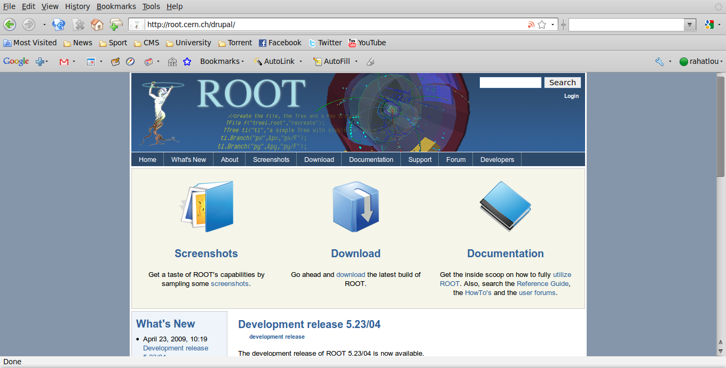
Using external Libraries: ROOT

Slide 16
How you can use ROOT
ROOT provides extensive set of tools for data analysis
Use 1D histograms to plot your data
Use canvas provided by root to store the histogram as output in a file (eps or gif)
Use root functionalities to make your plot nicer
Change color, labels, names, fonts
Become familiar with using external libraries without access to source files

Slide 17
root: An object oriented data analysis framework
http://root.cern.ch
Reference guide is all you need!

Slide 18
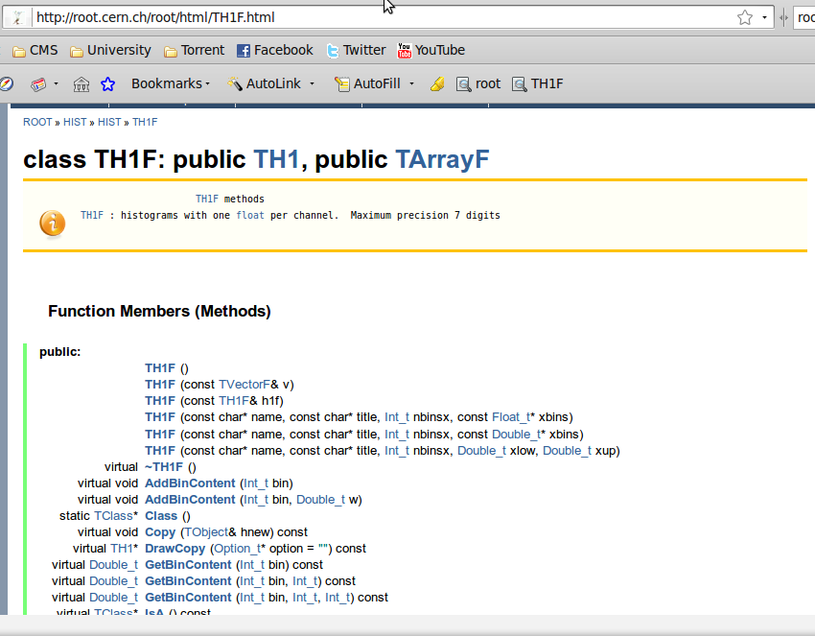
Interface and Libraries are All You Need!
Reference Guide -> Class and Members Reference Guide -> Your Favorite Class
You can also the complete html reference guide to your machine for offline access (~300 MB)

Slide 19
Documentation During Our Lab Sessions
From outside use root.cern.ch or http://labcalc.phys.uniroma1.it/home/rahatlou/root/5.22.00/htmldoc/ClassIndex.html
From your working stations: http://server/home/rahatlou/root/5.22.00/htmldoc/ClassIndex.html

Slide 20
Using root libraries and header files
// app1.cpp
#include "TH1F.h"
int main() {
TH1F h1;
h1.Print();
return 0;
}
$ setenv ROOTSYS /home/rahatlou/root/5.22.00
$ setenv LD_LIBRARY_PATH $ROOTSYS/lib on tcsh $ export LD_LIBRARY_PATH=$ROOTSYS/lib on bash
$ g++ -o app1 app1.cpp `$ROOTSYS/bin/root-config --cflags --libs`
$ ./app1
TH1.Print Name = , Entries= 0, Total sum= 0
Needed at runtime to find libraries
Provide path to header files and libraries

Slide 21
root-config
$ $ROOTSYS/bin/root-config --cflags --libs
-pthread -I/pool/home/rahatlou/root/5.11.02/include
-L/pool/home/rahatlou/root/5.11.02/lib
-lCore -lCint -lHist -lGraf -lGraf3d -lGpad -lTree -lRint
-lPostscript -lMatrix -lPhysics -pthread -lm -ldl -rdynamic
provides you with all options needed to compile and/or link your application
Use at on command line with `` quotes instead of writing manually
We will soon use makefiles to make such settings easier for users

Slide 22
Classes To Use in Your Application
TH1F: 1D histogram
look at constructors
public methods to add data to histogram
public methods to add comments or change labels of axes
TCavnvas: canvas to draw your histogram
how to make one
changing properties such as color
drawing 1D histogram on a canvas
storing the canvas as a graphic file, e.g. eps or gif
TGraph: dealing with asymmetric errors
more general than Histogram
Allows asymmetric errors but similar graphic functionalities as 1D histo

Slide 23
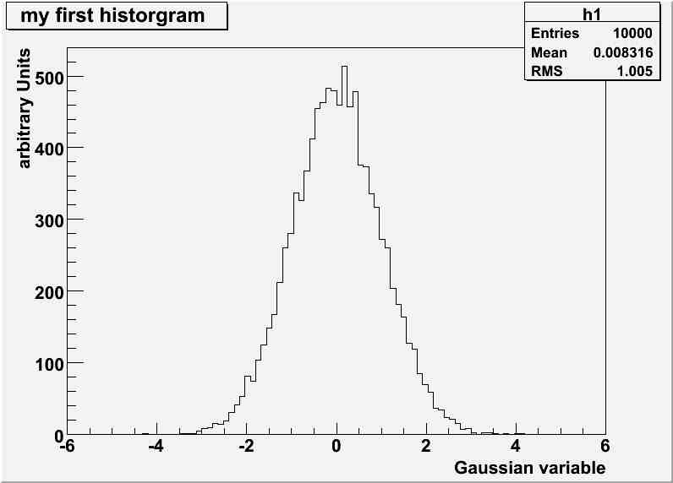
Simple Example with TH1
// app2.cpp
#include "TH1F.h"
#include "TCanvas.h"
int main() {
// create histogram
TH1F h1("h1","my first historgram",100,-6.0,6.0);
// fill histogram with 10000 random gaussian numbers
h1.FillRandom("gaus",10000);
// add labels to axis
h1.GetXaxis()->SetTitle("Gaussian variable");
h1.GetYaxis()->SetTitle("arbitrary Units");
// create a canvas to draw tour histogram
TCanvas c1("c1","my canvas",800,600);
// draw the histogram
h1.Draw();
// save canvas a JPG file
c1.SaveAs("canvas.jpg");
return 0;
}
$ g++ -Wall -o app2 app2.cpp `root-config --libs --cflags`
$ ./app2

Slide 24
A Few Tips about Using ROOT
Look at the reference guide to find out what is provided by the interface
Look at examples in http://labcalc.phys.uniroma1.it/home/rahatlou/root/5.22.00/tutorials/
Start by simply creating new objects and testing them before making fancy use of many different classes

Slide 25
Common Mistakes in your Code

Slide 26
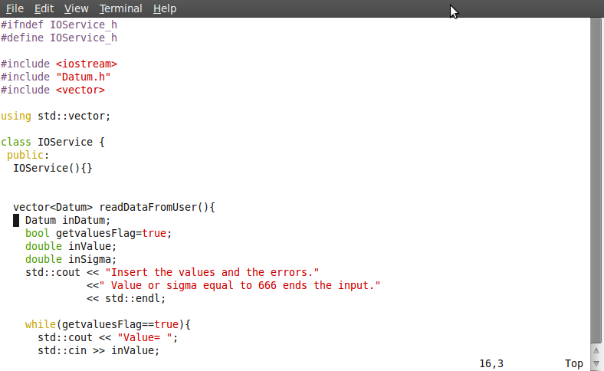
Where is the Mistake?
Never put using statements in header files!

Slide 27
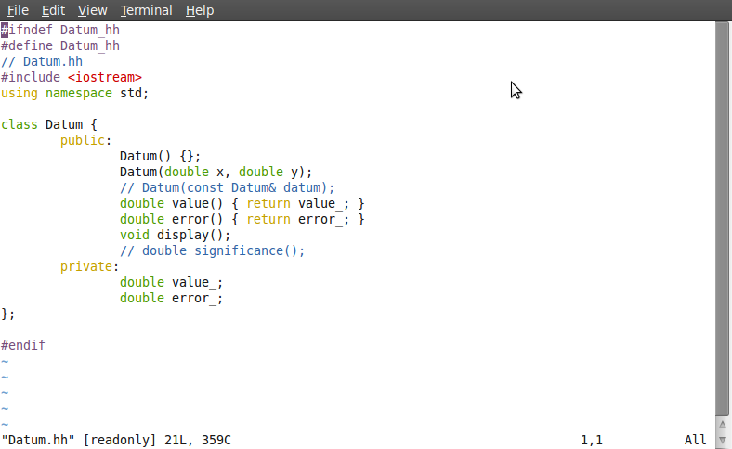
Find the Mistake
Never put using statements in header files!

Slide 28
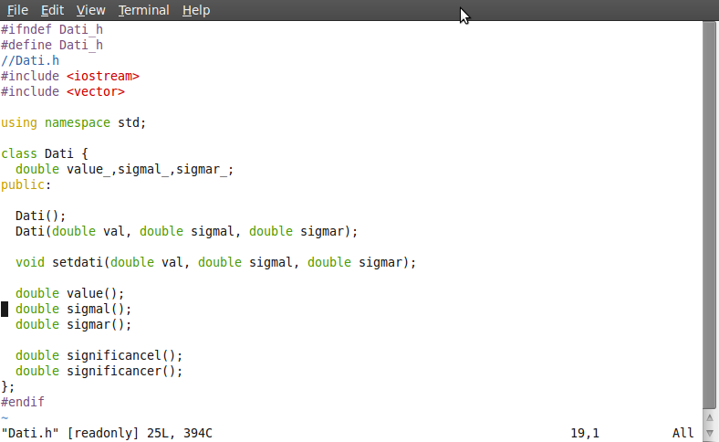
Never put using statements in header files!
Two methods with almost exactly the same name
How can I understand what they do??

