Slide 1
More on Templates
Standard Template Library exception in C++
Roma, 15 June 2008

Slide 2
Today’s Lecture
More on Template
  Inheritance
  static data members
  friend and Template
  example: auto_ptr<T>
  Standard template library
Error handling in applications
  Typical solutions
    advantages and disadvantages
  C++ exception
    What is it?
    How to use it

Slide 3
Template and Runtime Decision
Fundamental difference between Template and Inheritance
All derived classes share common functionalities
  Can point to any derived class object via base-class pointer
No equivalent of base-class pointer for class-template specializations
    Dummy<string> and Dummy<double> are different classes
    No polymorphism at run time!

Slide 4
Template and Inheritance
Inheritance provides run-time polymorphism
Templates provide compile-time polymorphism
  Code generated by compiler at compilation time using the Template class or function and the specified parameter
  All specialized templates are identical except for the data type
  Template-class specialization is equivalent to any regular non-template class
But remember…
  Class template NOT EQUIVALENT to base class
  No base-class pointer mechanism for different specializations
  No runtime polymorphism
  Different specializations are different classes with no inheritance relation

Slide 5
Difference between Template and Inheritance
int main() {
Person* p = 0;
int value = 0;
while(value<1 || value>10) {
cout << "Give me a number [1,10]: ";
cin >> value;
}
cout << flush; // write buffer to output
cout << "make a new derived object..." << endl;
if(value>5) p = new Student("Susan", 123456);
else p = new GraduateStudent("Paolo", 9856, "Physics");
cout << "call print() method ..." << endl;
p->print();
delete p;
return 0;
}
Same base-class pointer used
to initialize data based on user input
one call to ::print()
no if statement
no checking for null pointer
int main() {
Dummy<std::string>* d1 = 0;
Dummy<double>* d2 = 0;
int value = 0;
while(value<1 || value>10) {
cout << "Give me a number [1,10]: ";
cin >> value;
}
cout << flush;
if(value>5) d1 = new Dummy<std::string>( "string" );
else d2 = new Dummy<double>( 1.1 );
if( d1 != 0 ) d1->print();
if( d2 != 0 ) d2->print();
return 0;
}
Need as many pointers as possible
outcomes of input by user
No base-class pointer → No polymorphism
Check specific pointers to be non-null
before calling DIFFERENT ::print() methods
$ ./example0
Give me a number [1,10]: 3
Dummy<T>::print() with type T = d, *data_: 1.1
$ ./example0
Give me a number [1,10]: 7
Dummy<T>::print() with type T = Ss, *data_: string

Slide 6
Template and Inheritance
Can use specializations as any other class
  But can’t inherit from a class template
A class template can be derived from a non-template class
  template<class T> class GenericPerson : public Person { };
A class template can be derived from a class-template specialization
  template<class T> class MyString : public Dummy<std::string> {};
A class-template specialization can be derived from a class-template specialization
  class Dummy<Car> : public Vector<Object> { };
A non-template class can be derived from a class-template specialization
  class Student : public Dummy<std::string> { };

Slide 7
Template and static
All specializations of a class template have their copy of own static data
  Treat class-template specialization as equivalent to normal non-template class
// example1.cpp
#include <iostream>
#include <string>
#include <typeinfo>
using namespace std;
#include "Dummy.h"
int main() {
Dummy<std::string> d1( "d1" );
Dummy<std::string> d2( "d2" );
Dummy<std::string> d3( "d3" );
Dummy<double> f1( 0.1 );
Dummy<double> f2( -56.45 );
cout << "Dummy<std::string>::total(): " << Dummy<std::string>::total() << endl;
cout << "Dummy<double>::total(): " << Dummy<double>::total() << endl;
cout << "Dummy<int>::total(): " << Dummy<int>::total() << endl;
return 0;
}
$ g++ -Wall -o example1 example1.cpp
$ ./example1
Dummy<std::string>::total(): 3
Dummy<double>::total(): 2
Dummy<int>::total(): 0

Slide 8
Static data with Dummy<T>
template< typename T >
class Dummy {
public:
Dummy(const T& data);
~Dummy();
void print() const;
static total() { return total_; }
private:
T* data_;
static int total_;
};
template<class T>
int Dummy<T>::total_ = 0;
template<class T>
Dummy<T>::Dummy(const T& data) {
data_ = new T(data);
total_++;
}
template<class T>
Dummy<T>::~Dummy() {
total_--;
delete data_;
}
template<class T>
void
Dummy<T>::print() const {
std::cout << "Dummy<T>::print() with type T = "
<< typeid(T).name()
<< ", *data_: " << *data_
<< std::endl;
}
All code in Dummy.h
Remember no source file!

Slide 9
Template and friend Functions
All usual rules for friend methods and classes are still valid
You can declare functions to be friends of
  all specializations of a template-class or specific specializations
  Your Favorite combination of template classes and functions
template< typename T >
class Foo {
public:
Foo(const T& data);
~Foo();
void print() const;
// friend of all specializations
friend void nicePrint();
// friend of specialization with same type
friend void specialPrint( const Foo<T>& obj);
// member function of Bar friend of all specializations
friend void Bar::printFoo();
// member function of Dummy with same type
friend void Dummy<T>::print(const Foo<T> & f )
private:
T* data_;
};
nicePrint() friend of
Foo<int> and Foo<string>
specialPrint(string) friend of
Foo<string> but NOT friend of Foo<int>
Bar::printFoo() friend of
Foo<int> and Foo<string>
Dummy<int>::print(int) friend of
Foo<int> but NOT friend of Foo<string>

Slide 10
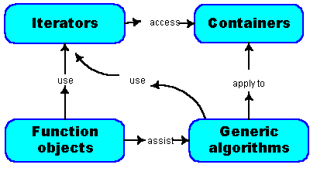
Standard Template Library
Library of container classes, algorithms, and iterators
  Covers many of basic algorithms and data structures of common use
  Very efficient through compile-time polymorphism achieved by using Template
Containers: classes whose purpose is to contain any type of objects
  Sequence containers: vector, list,
  seq, deque
  Associative containers: set, multiset,
  map, multimap
Algorithms: methods used to manipulate container items
  Finding, sorting, reverting items
Iterators: generalization of pointer
to provide access to items in a container

Slide 11
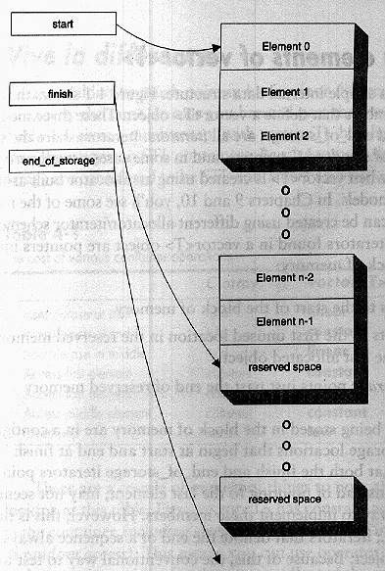
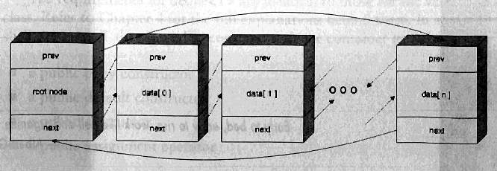
containers
Address different needs with different perfmance
Vector: fast random access. Rapid insertion
and deletion at the end of vector
List: rapid insertion and deletion
anywehere
  No sequential storage of data
vector
list

Slide 12
Requirements for type T objects in containers
Any C++ type and class can be used but a minimum set of functionality required
Inserting an object of type T corresponds to copying object into the container
Sequential containers require a proper copy constructor and assignment operator (=) for class T
  Default implementations is fine as long as non-trivial data members are used
Associative containers often perform comparison between elements
  Class T should provide equality (==) and less-than (<) operators

Slide 13
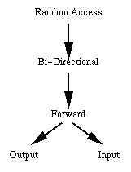
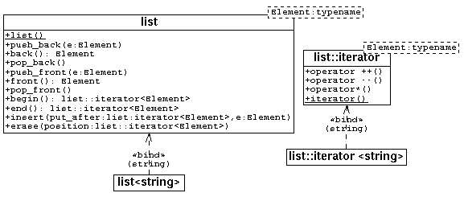
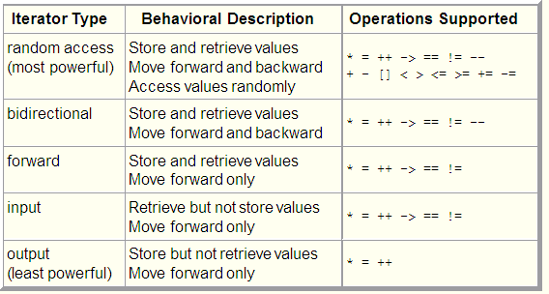
iterators
Allows user to traverse through all elements of a container regardless of its specific implementation
  Allow pointing to elements of containers
Hold information sensitive to particular containers
  Implemented properly for each type of container
  Five categories of iterators

Slide 14
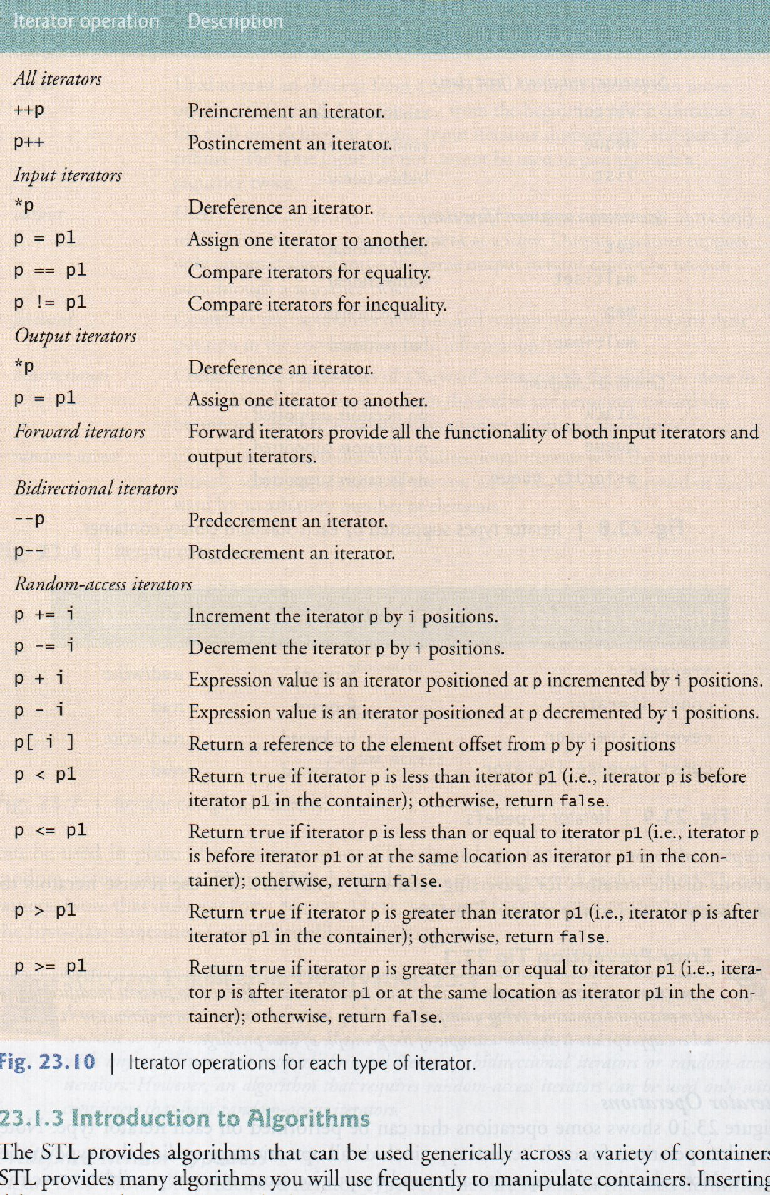
iterator Operations
Predefined iterator typedef’s found in class
definitions
iterator
  Forward read-write
const_iterator
  Forward read-only
reverse_iterator
  Bacward read-write
const_reverse_iterator
  backward read-only

Slide 15
Using iterators
vector<Student> v1; // declare vector
// create iterator from container
vector<Student>::const_iterator iter;
// use of iterator on elements of vector
for( iter = v1.begin();
iter != v1.end();
++iter) {
cout << iter->name() << endl;
(*iter).print();
}
Two member functions begin() and end() returning iterators to beginning and end of container
  begin() points to first object
  end() is slightly different. Points to NON-EXISTING object past last item

Slide 16
Algorithms
Almost 70 different algorithms provided by STL to be usedu generically with variety of containers
Algorithms use iterators to interact with containers
  This feature allows decoupling algorithms from containers!
  Implement methods outside specific containers
  Use generic iterator to have same functionality of many containers
Many algorithms act on range of elements in a container identified by pair of iterators for first and last element to be used
Iterators used to return result of an algorithm
  Points to element in the container satisfying the algorithm

Slide 17
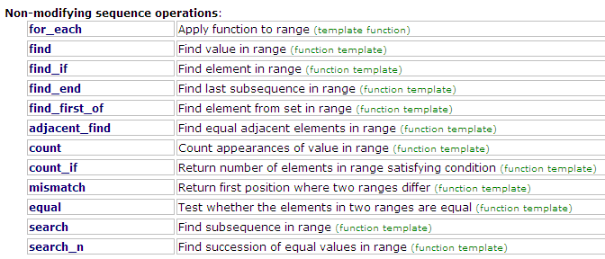
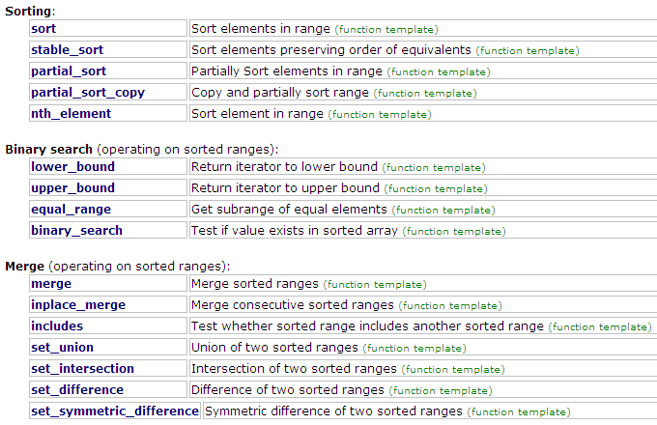
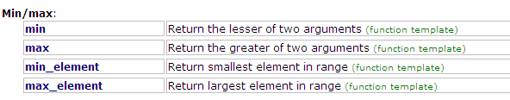
Non-modifying Algorithms

Slide 18
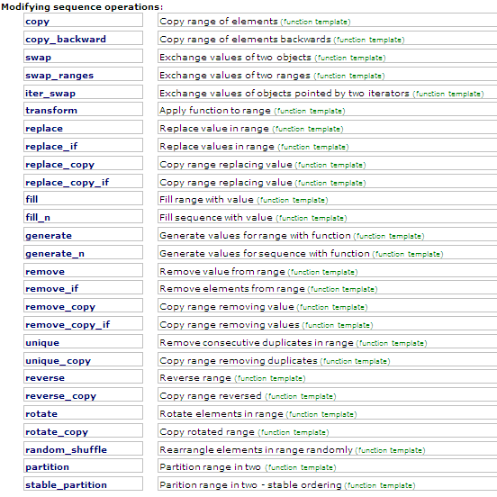
Modifying algorithms
swap() allows fast and
non-expensive copy
of elements between
containers
Commonly used to optimize
performance and minimize
unnecessary copy
operations

Slide 19
Comments and Criticism to STL
Heavy use of template make STL very sensitive to changes or capabilities of different compilers
Compilation error messages can be hard to decipher by developer
  Tools being developed to provide indention and better formatting of improved error messages
Generated code can be very large hence leading to significant increase in compilation time and memory usage
  Careful coding necessary to prevent such problems
Common problem with invalid pointers when element deleted from a container
  Iterator not update hence pointing to non-existing element

Slide 20
Error Handling in C++

Slide 21
Exception Handling: What does it mean?
Under normal circumstances applications should run successfully to completion
Exceptions: special cases when errors occur
  ‘exception’ is meant to imply that such errors occur rarely and are an exception to the rule (successful running)
  Warning: exceptions SHOULD NEVER be used as replacement for conditionals!
C++ Exceptions provide mechanism for error handling and writing fault-tolerant applications
  errors can occur deep into the program or in third party software not under our control
Applications use exceptions to decide if terminate or continue execution

Slide 22
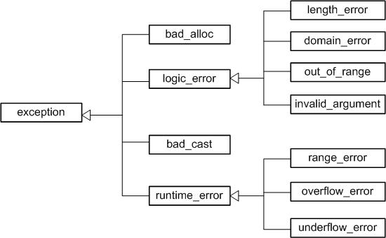
Hierarchy of C++ STL Exceptions

Slide 23
C++ Exceptions
#include <iostream>
#include <stdexcept>
using std::cin;
using std::cout;
using std::endl;
using std::runtime_error;
double ratio(int i1, int i2) {
if(i2 == 0) throw std::runtime_error("error in ratio");
return i1/i2;
}
int main() {
int i1 = 0;
int i2 = 0;
cout << "enter two numbers (ctrl-D to end): ";
while( cin >> i1 >> i2 ) {
try {
cout << "ratio: " << ratio(i1,i2) << endl;
} catch(std::runtime_error& ex) {
cout << "error occured..." << ex.what() << endl;
}
cout << "enter two numbers (ctrl-Z to end): ";
}
return 0;
}
throw an exception when error
condition occurs
exception is a C++ object!
include code that can throw
exception in a try{} block
$ g++ -Wall -o example3 example3.cpp
$ ./example3
enter two numbers (ctrl-D to end): 7876 121
ratio: 65
enter two numbers (ctrl-D to end): 34 14
ratio: 2
enter two numbers (ctrl-D to end): 56 0
error occured...error in ratio
enter two numbers (ctrl-D to end):
use catch() {} to catch possible
exceptions thrown within the try{}
block

Slide 24
Exceptions Defined by Users
// example4.cpp
#include <iostream>
#include <stdexcept>
using std::cin;
using std::cout;
using std::endl;
using std::runtime_error;
class MyError : public std::runtime_error {
public:
MyError() : std::runtime_error("dividing by zero") {}
};
double ratio(int i1, int i2) {
if(i2 == 0) throw MyError();
return i1/i2;
}
int main() {
int i1 = 0;
int i2 = 0;
cout << "enter two numbers (ctrl-Z to end): ";
while( cin >> i1 >> i2 ) {
try {
cout << "ratio: " << ratio(i1,i2) << endl;
} catch(MyError& ex) {
cout << "error occured..." << ex.what() << endl;
}
cout << "enter two numbers (ctrl-Z to end): ";
}
return 0;
}
New exceptions can be
implemented by users
Inherit from existing exceptions
and specialize for use case relevant
for your application
$ g++ -Wall -o example4 example4.cpp
$ ./example4
enter two numbers (ctrl-Z to end): 6 5
ratio: 1
enter two numbers (ctrl-Z to end): 5 0
error occured...dividing by zero
enter two numbers (ctrl-Z to end):

