Slide 1
Error Handling in C++
26 May 2008

Slide 2
Exception Handling: What does it mean?
Under normal circumstances applications should run successfully to completion
Exceptions: special cases when errors occur
  ‘exception’ is meant to imply that such errors occur rarely and are an exception to the rule (successful running)
C++ Exceptions provide mechanism for error handling and writing fault-tolerant applications
  errors can occur deep into the program or in third party software not under our control
Applications use exceptions to decide if terminate or continue execution

Slide 3
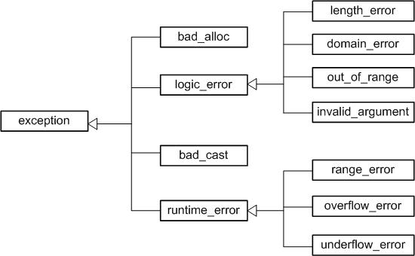
Hierarchy of C++ STL Exceptions

Slide 4
C++ Exceptions
#include <iostream>
#include <stdexcept>
using std::cin;
using std::cout;
using std::endl;
using std::runtime_error;
double ratio(int i1, int i2) {
if(i2 == 0) throw std::runtime_error("error in ratio");
return i1/i2;
}
int main() {
int i1 = 0;
int i2 = 0;
cout << "enter two numbers (ctrl-D to end): ";
while( cin >> i1 >> i2 ) {
try {
cout << "ratio: " << ratio(i1,i2) << endl;
} catch(std::runtime_error& ex) {
cout << "error occured..." << ex.what() << endl;
}
cout << "enter two numbers (ctrl-Z to end): ";
}
return 0;
}
throw an exception when error
condition occurs
exception is a C++ object!
include code that can throw
exception in a try{} block
$ g++ -Wall -o example3 example3.cpp
$ ./example3
enter two numbers (ctrl-D to end): 7876 121
ratio: 65
enter two numbers (ctrl-D to end): 34 14
ratio: 2
enter two numbers (ctrl-D to end): 56 0
error occured...error in ratio
enter two numbers (ctrl-D to end):
use catch() {} to catch possible
exceptions thrown within the try{}
block

Slide 5
Exceptions Defined by Users
// example4.cpp
#include <iostream>
#include <stdexcept>
using std::cin;
using std::cout;
using std::endl;
using std::runtime_error;
class MyError : public std::runtime_error {
public:
MyError() : std::runtime_error("dividing by zero") {}
};
double ratio(int i1, int i2) {
if(i2 == 0) throw MyError();
return i1/i2;
}
int main() {
int i1 = 0;
int i2 = 0;
cout << "enter two numbers (ctrl-Z to end): ";
while( cin >> i1 >> i2 ) {
try {
cout << "ratio: " << ratio(i1,i2) << endl;
} catch(MyError& ex) {
cout << "error occured..." << ex.what() << endl;
}
cout << "enter two numbers (ctrl-Z to end): ";
}
return 0;
}
New exceptions can be
implemented by users
Inherit from existing exceptions
and specialize for use case relevant
for your application
$ g++ -Wall -o example4 example4.cpp
$ ./example4
enter two numbers (ctrl-Z to end): 6 5
ratio: 1
enter two numbers (ctrl-Z to end): 5 0
error occured...dividing by zero
enter two numbers (ctrl-Z to end):

