Slide 1
Elements of Unified Modeling Language
Roma, 22 June 2009

Slide 2
Today’s Lecture
Introduction to UML
  object modeling language
Class diagrams
Relations between classes
Suggestions for further reading

Slide 3
Object Oriented Analysis (OOA)
Build a system composed of objects
Behavior of system defined by collaboration between objects through sending messages to each other
State of system defined by states of individual collaborating objects
Does not take into account implementations constraints such as distribution and persistency
Result of OOA is a conceptual model focused on ideas and concepts to be implemented

Slide 4
Object Oriented Design (OOD)
Start from conceptual model provided by OOA and add implementation constraints, e.g. specific programming language
Treat the objects as instances of collection of classes within a class hierarchy
Typically four stages in Design:
  Identify classes and objects
  Identify their responsibilities
  Identify their relationship
  Provide class interface and implementation

Slide 5
Object Modeling Language
Standardized set of symbols and relations between them to model object oriented design
Visual and graphical representation provides higher level of abstraction important in early analysis and design stage
  Focus on interaction and relation between objects
  Define interface rather than internal structure
Software modeling tools can be used to implement code from visual modeling diagrams

Slide 6
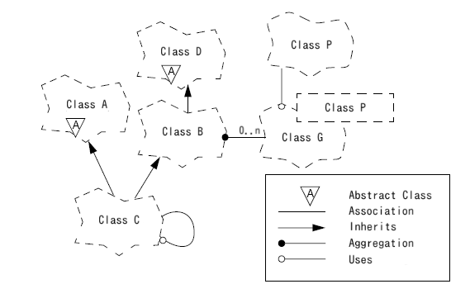


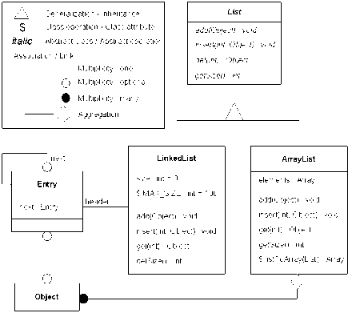

Brief History of Object Modeling Language
Booch Method
  Developed by Grady Booch
  Better for design
Object modeling technique (OMT)
  Developed by Jim Rumbaugh
  Better for analysis
Objectory
  Developed by Ivar Jacobsen
  Treat Use Cases
    Use case: interaction between system and end user
    to achieve a specific goal
Class-Responsibility-Collaboration Cards
  Proposed by Ward Cunningham

Slide 7
Booch Method

Slide 8
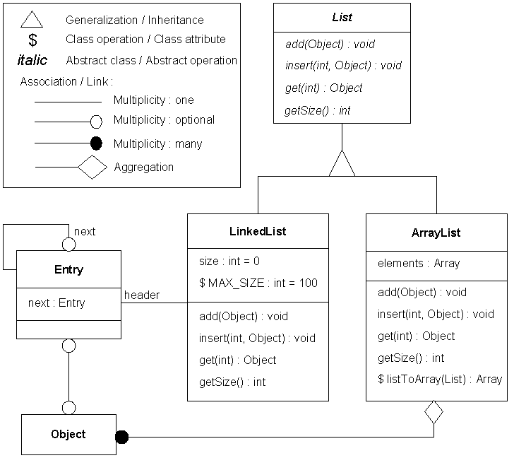
Object Modeling Technique

Slide 9

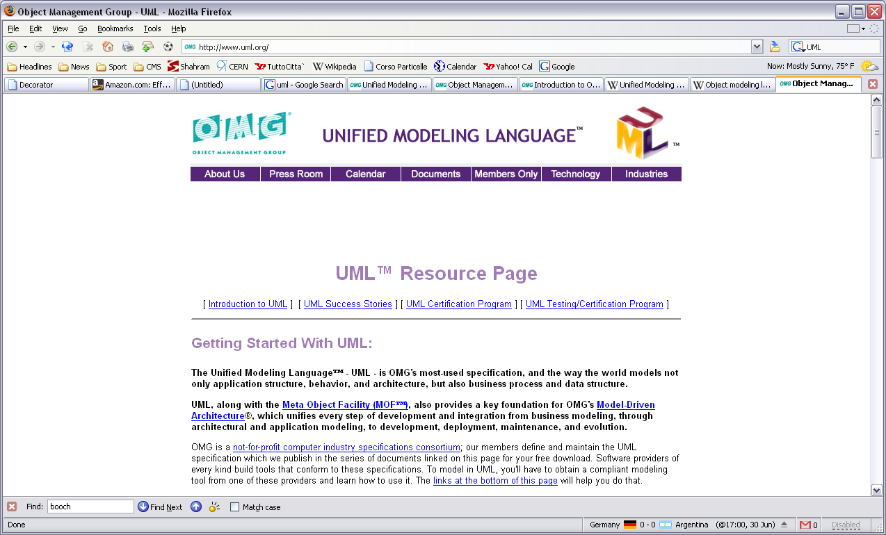
Unified Modeling Language (UML)
Many approaches on the market by mid 1990s
Object Management Group (OMG) called for development of a unified approach
Consortium including Booch, Jacobsen, and Rumbaugh has developed what today is called Unified Modeling Language
http://www.uml.org/

Slide 10
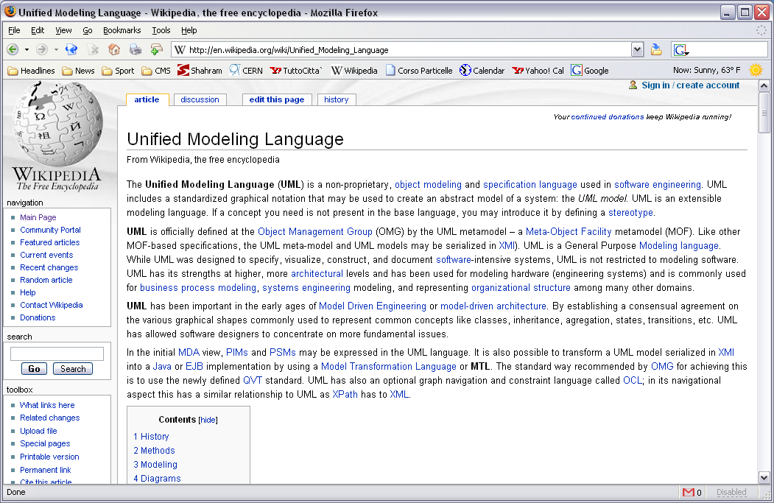
Unified Modeling Language (UML)

Slide 11
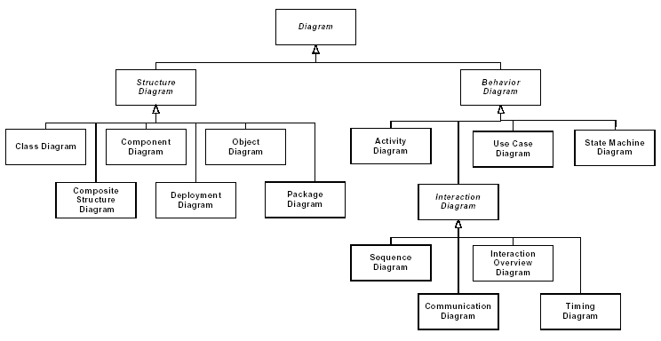
UML Diagrams
Thirteen diagrams in UML 2.0 organized

Slide 12
Categories of Diagrams
Structure diagrams: emphasize what things must be in the system
    Class diagram
    Component diagram
    Object diagram
    Composite structure diagram
    Deployment diagram
    Package diagram
Behavior diagrams: emphasize what must happen in the system
    Activity diagram
    Use case diagram
    State Machine diagram
Interaction Diagrams: subset of behavior diagrams, emphasize flow of control and data among the things in the system
    Sequence diagram
    Collaboration (UML 1.x)/Communication diagram (UML 2.0)
    Interaction overview diagram (UML 2.0)
    Timing diagram (UML 2.0)

Slide 13
Class Diagram
Type of static structure diagram describing structure of a system by showing
  system's classes
  relationships between classes
Graphical representation: box with 3 compartments for
  Name of class
  attributes or data members
  operations or methods
class Person {
public:
Person(const std::string& name);
~Person();
std::string name() const { return name_; }
void print() const;
private:
std::string name_;
};
Name
of class
Person
− name_ : std::string
+ name() : string + print()
Attributes
Operations
+ public
− private
# protected

Slide 14
Relations between Classes
Generalization or Inheritance
  an is-a relationship
Association
  can be mutual or uni-directional
Aggregation
  Whole/part relationship. no lifetime control
Composition
  Aggregation with lifetime control
Dependence
  uni-directional association
  only B knows about A
B
A
B
A
B
A
B
A
B
A

Slide 15
Generalization or Inheritance
Is-A relationship between A and B: B is also an A
  relationship between a base class
  (super-type, parent) and a
  derived class (sub-type, child)
B
A
Person
- name_ : std::string
+ name() : string + print()
Student
- id_ : int
+ id() : int
GraduateStudent
- major_ : string
+ major() : string

Slide 16
Association
A and B exchange messages
  Call methods of each other
B
A
Department
- myUniv_ : University - name_ : string
+ print() +name() : string
University
- myDep_ : Department
+ print() +department() : string
class Department {
private:
University* myUniversity_;
public:
void print() {
cout << “My University is: : <<
<< myUniv_->name()
<< endl;
}
}
class University {
private:
Department* myDep_;
public:
string department() {
return myDep_->name();
}
}

Slide 17
Aggregation
Whole/part association with
no lifetime control
  B contains a pointer to A
  B does not control lifetime of A
    A exists regardless of B
B
A
University
- students_ : vector<Student*>
+ print() +students() : vector<Student*> + addStudent(Student)
Student
- id_ : int
+ id() : int
class University {
private:
vector<Student*> students_;
public:
vector<Student*> students() {
return students_;
}
void addStudent(Student* s) {
students_->push_back(s);
}
}
All instances of Student exist regardless
of the instance of University
Only keeps pointers but does not control
lifetime of objects pointed to

Slide 18
Composition
Whole/part association with
lifetime control
  B contains instance of A
  B is responsible for creation of its copies of A and their destruction
  B can transfer ownership of it’s a to others
B
A
University
- myDeps_ : vector<Department>*
+ print() +departments() : vector<Department>
Department
- name_ : string
+ print() +name() : string
class University {
private:
vector<Department>* deps_;
public:
University() {
deps_ = new vector<Department>;
deps_->push_back(“physics”);
}
~University() { delete deps_; }
vector<Departments> departments() {
return *deps_;
}
}
class Department {
private:
string name_;
public:
string name() { return name_; }
}

Slide 19
Dependence
B knows about A but A has no knowledge of B
  Mostly when A is used in definition of A
B
A
University
- myDeps_ : vector<Department>*
+ print() +departments() : vector<Department>
class University {
private:
vector<Department>* deps_;
public:
University() {
deps_ = new vector<Department>;
deps_->push_back(“physics”);
}
~University() { delete deps_; }
vector<Departments>* departments() {
return *deps_;
}
}
vector<T>

Slide 20
Multiplicity (a.k.a Cardinality)
Multiplicity of a role describes number of instances participating in the association
  * or 0..* : zero to many
  1..* : one to many
  0..1 : zero or one
  1 : one and only one
  n..m : n or m
University might have no student
University
1
0..*
Student
1
1..*
Department
Each University has at least 1 department

Slide 21


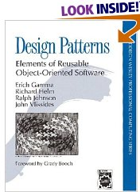
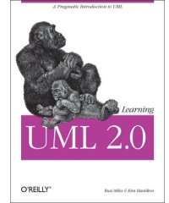
Additional Readings
Few very good books to improve your skills and learn more about object oriented programming techniques
Effective C++ : 55 Specific Ways to Improve Your
Programs and Designs, Scott Meyers
More Effective C++: 35 New Ways to Improve Your
Programs and Designs, Scott Meyers
Design Patterns: Elements of Reusable
Object-Oriented Software, E. Gamma et al.
Learning UML 2.0, K. Hamilton, R. Miles

