Slide 1
Avyndor Airlines Ticket Management System
Mudassar Khalid 22i-1072
Daud Cheema 22i-0875
Rahat Shafi 22i-1061

Slide 2
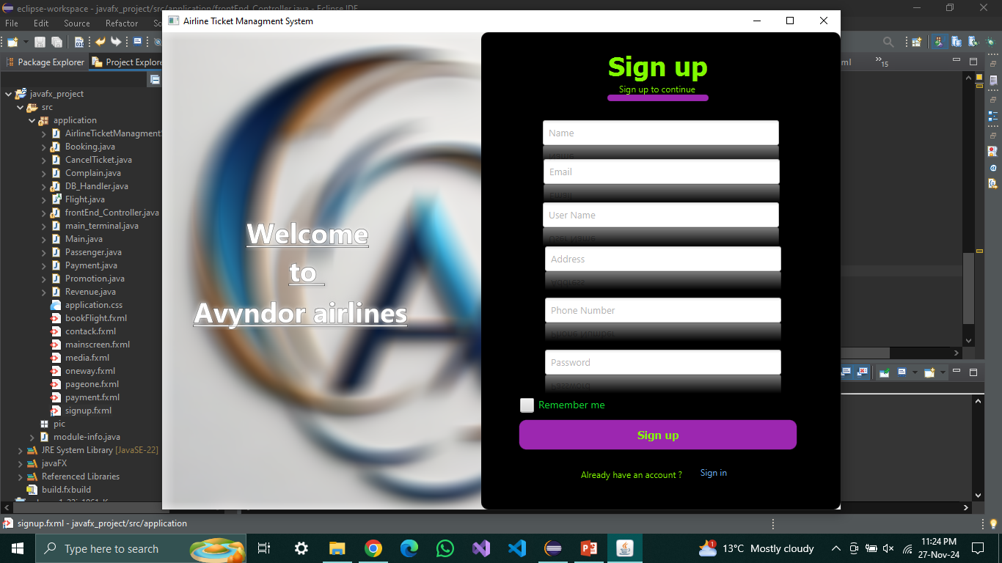
SIGN_UP Page

Slide 3
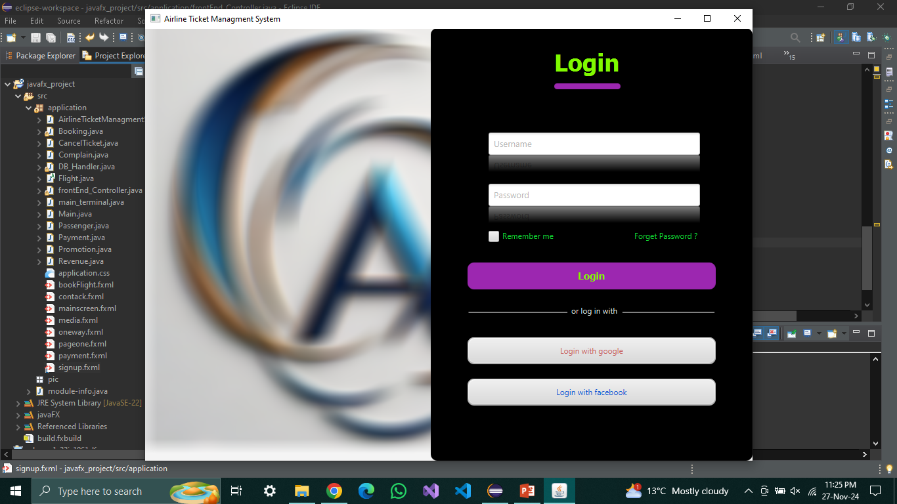
Login-Page

Slide 4
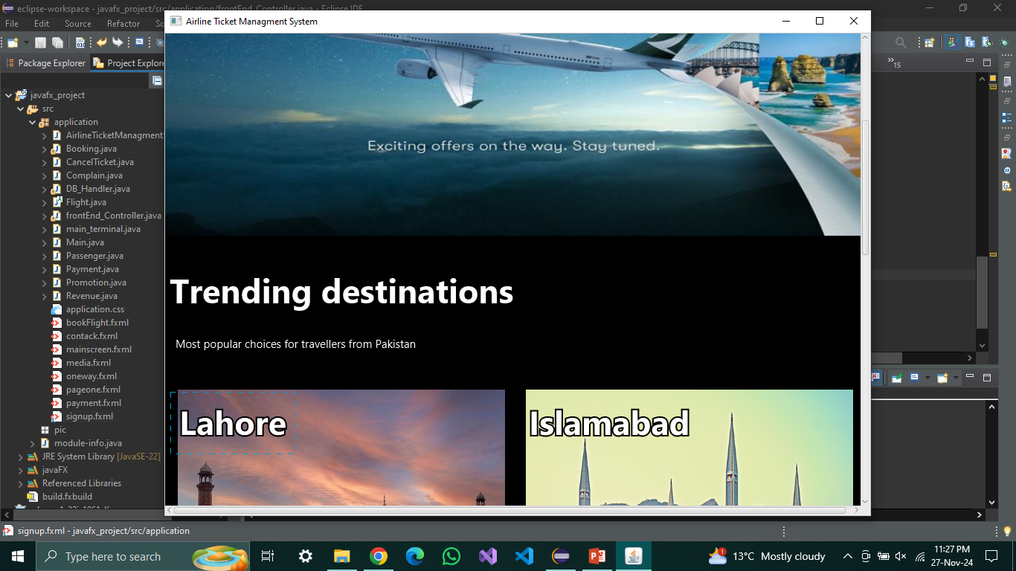
Main-Page

Slide 5
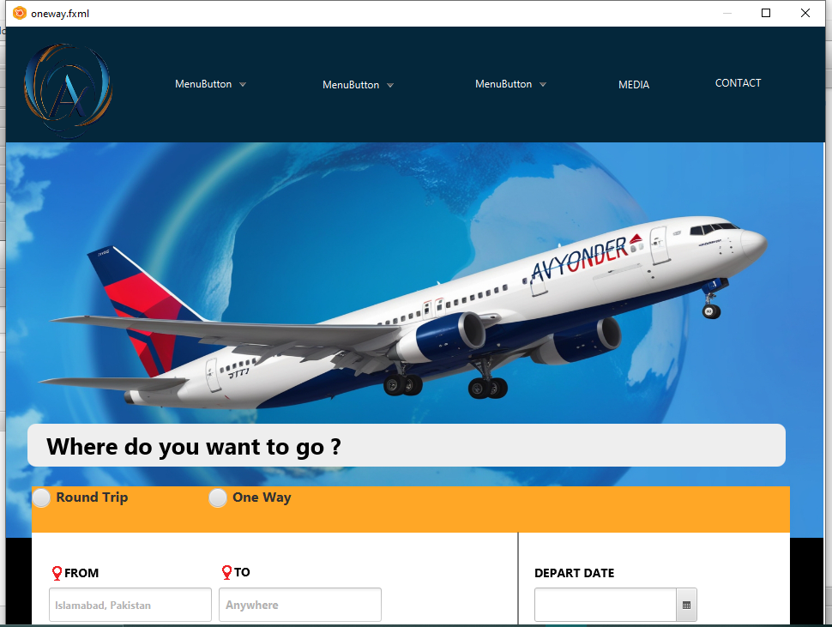
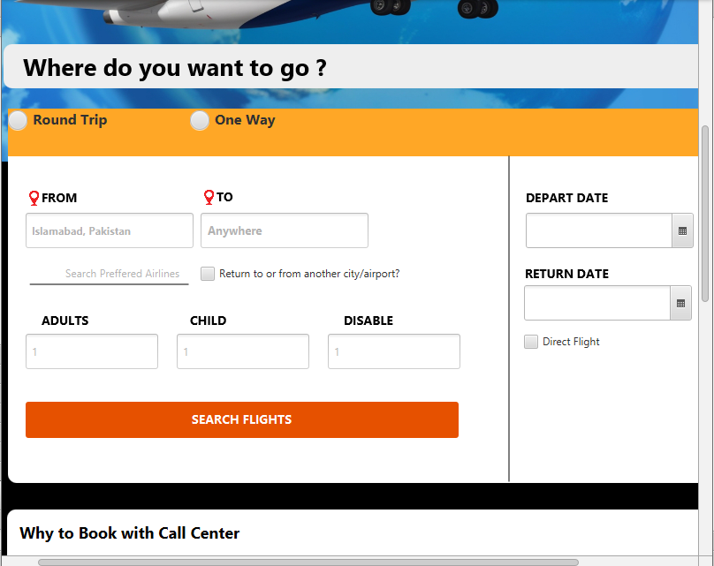
Book-Flight

Slide 6
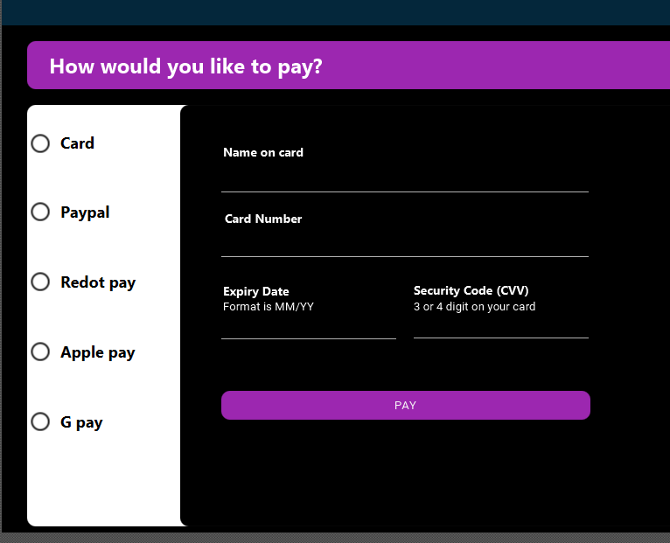
Payment Page

Slide 7
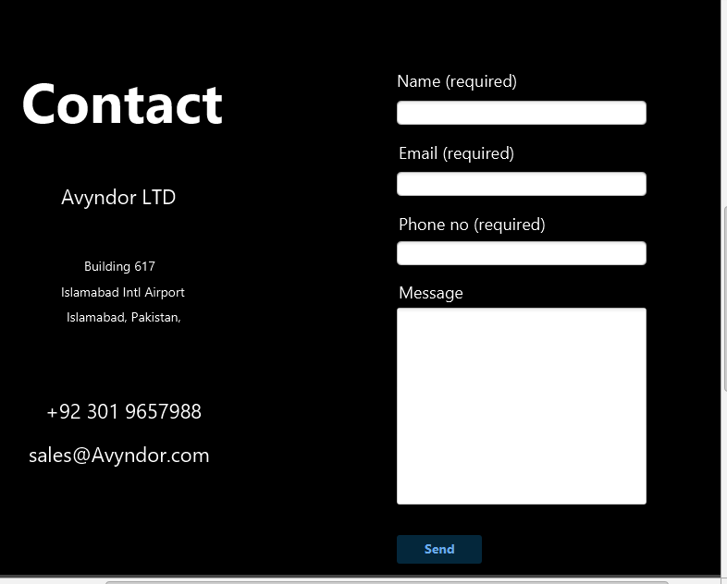
Contact us

Slide 8


