Slide 1
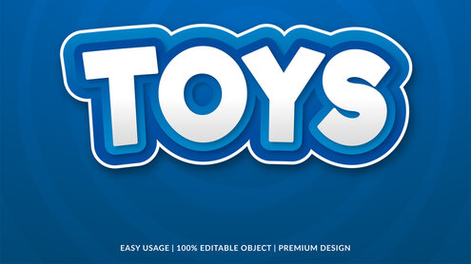
WELCOME
Itamar Tzarfati – Itzik Maman – Rahav Haham

Slide 2
business questions :
Where is the most profitable location to open a store?
When is the best time in the year to open a store?
Which toys category you should have in your store.

Slide 3
Action Items :
New stores should be opened in airport, due to relatively large sales in airports compare to other locations
The best time to open a store is in March or April
To increase sales we should follow sales patterns changes by categoty, and to respond to that changes.
Bundles of various products from the same category, can be very profitable, increase sales and answer the sales patterns changes

Slide 4
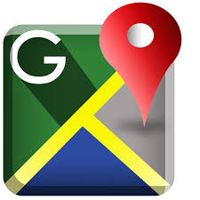


Data Description :
Locations & num Stores
Games
Airport 6%
Downtown 58%
Commercial 24%
Residential 12%
Toys
Art & Crafts
Electronics
Sports & Outdoors
Range of Months by Year
2017
Have12 Months
2018
Have 9 Months

Slide 5
Locations profit comparisons :
Comparison between three first quarters of every year
As we can see in the graph the airport stores earn 50% more then their proportion in store sections

Slide 6

Best Location for a New Store in the chain:
In the Data there are only 3 stores in Airport locations
Cuidad de Mexico
Guadalajara
Monterrey
Do you know that Mexico has more than 50 different International Airports ?

Slide 7
Cities ranking by profit with airport stores
The rank of Guadalajara goes up to the second place if we conclude the sales of airports

Slide 8

Possible cities to open a new store in the airport :
City : | City residents : | Yearly airport passengers traffic :
Cancun | 915,000 | 25,000,000
Tijuana | 2,050,000 | 7,800,000
Hermasilo | 6,115,000 | 2,700,000
Guanajuato | 6,120,000 | 250,000
Hermasilo and Guanajuato has three stores each. None of them are not in airport locations.
In Cancun and Tijuana there are no stores at all.
The passengers traffic is due to the year 2018.
https://en.wikipedia.org/wiki/List_of_the_busiest_airports_in_Mexico

Slide 9
Comparison between three first quarters
We can see changes in sales by segments compering different years

Slide 10
TOTAL SALES PER MONTH BY PERCENTAGE FROM AVERAGE
THE BEST TIME TO OPEN A STORE IS BEFORE MARCH, AND AVOID OPENNING A STORE IN JULY OR AUGUST

Slide 11
Toys is the most requested category and Electronics is the last one
But!
Electronics is the second most profitable

Slide 12
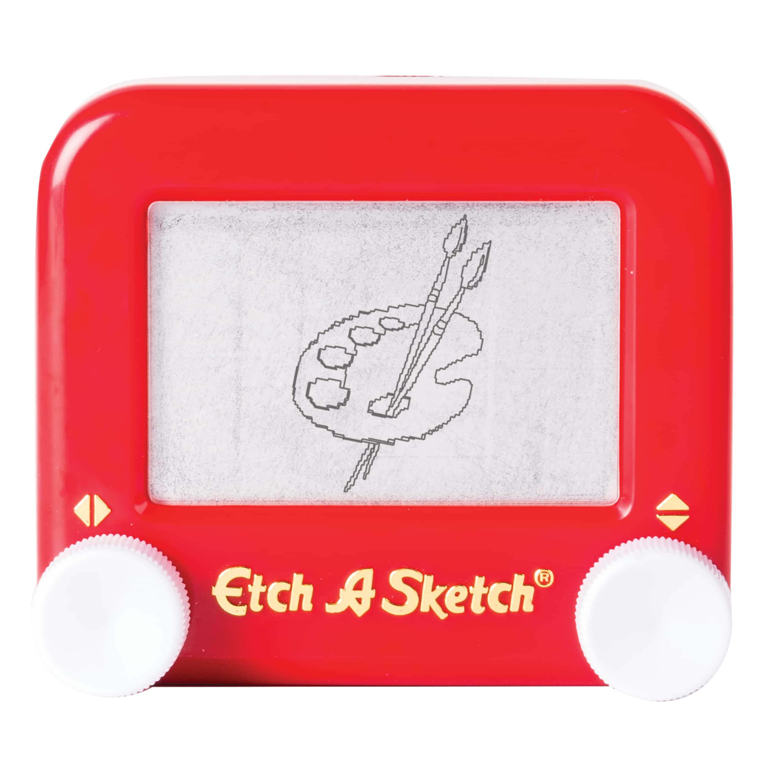

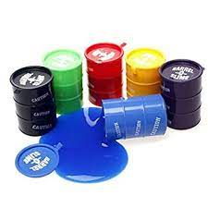
Possible bundles to increase sales :
profit_% | profit_$ | Product_Price | Product_Cost | Product_Category | Product_Name | Product_ID
91% | $ 10.00 | 20.99 | 10.99 | Art & Crafts | Etch A Sketch | 11
175% | $ 7.00 | 10.99 | 3.99 | Art & Crafts | Playfoam | 28
 |  |  | sales-2
40% | $ 6.00 | 20.99 | 14.99 | Electronics | Gamer Headphones | 13
114% | $ 8.00 | 14.99 | 6.99 | Electronics | Colorbuds | 6
 |  |  | sales-3
175% | $ 7.00 | 10.99 | 3.99 | Art & Crafts | Playfoam | 28
101% | $ 2.00 | 3.99 | 1.99 | Art & Crafts | Barrel O' Slime | 3

Slide 13
conclusions
The most profitable locations are airports. With other considerations it should be considerable to open there a new stores.
There is a significance to the time of year to open a store.
Smart selling decisions can increase sales and profitability.
More data should be collected in order to conclude sound action items.

