Slide 1
Fanorona AI
Youngjoo Lee, Borah Shin
Notes:
매카니즘보다 성능이 중요함. 의미보다 결과에 집중하기!!!

Slide 2
Index
Overview
SelectMinmaxStone
CanMakeCapturingChainMove
Notes:
배경(기존의연구와 거기의 문제점:허들. 기존의 사과는 맛나는데 먹기불편하다 ). 목표(이 허들을 극복하기위한 목표. 작게만들자). 가설(목표를 저자가 그동안 생각한 ~일것이다의 가설. 자르면 작아질것이고 먹기편할것이다). 데이터 결과(가설증명실험, 이때 메써드도 결론마다조금씩넣고. 가로도잘라보고 세로로도잘라보고) 이실험의 결론 (8등분했을때 먹기 제일편하더라) 토의 (이 논문의 약점과장점을 저자생각과 질문자님의 발표자 생각이 ppt 인턴쉽발표라면 꼭넣어야함. 젤중요 별표 3개. 저자는 8등분이 젤 좋다고하는데 나는 무슨무슨 근거로 4등분도 나쁘지 않고 나중에기회가되면 토마토를가지고해보고싶다)

Slide 3
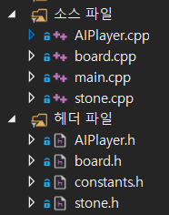
Overview
There are 4 cpp files and 4 header files.
The main strategies are in two recursive functions : SelectMinmaxStone and CanMakeCapturingChainMove
Funtion SelectMinmaxStone
Funtion CanMakeCapturingChainMove

Slide 4
Overview
Main
Turn(black or white)
Depth
Alpha, beta
Board state
a stone which is going to be moved
List of coordinates that the stone will pass through during its chain move
List of actions that the stone will take during its chain move
Score for corresponding node of the minimax tree
INPUT
SelectMinmaxStone
OUTPUT
Selected stone
Depth
Board state
List of coordinates that the stone will pass through during its chain move
List of actions that the stone will take during its chain move
Highest number of opposing stones taken by chain move of the selected stone
INPUT
CanMakeCapturingChainMove
OUTPUT

Slide 5
SelectMinmaxStone
Get turn(black or white) and board state as inputs.
Find available stones with ‘GetFreeStones’ function. Then do the followings for each stone using ‘for’ loop.
Call ‘CanMakeCapturingChainMove’ function using a stone as a parameter.
Get as returns.
If not reached depth limit yet, call itself recursively using the board status after a chain move, and opposing player’s stone color as parameters.
Get the score of a child node as return.
Calculate the score of current node. If Max, ((c) from ② + score from ④). If Min, (- (c) from ② + score from ④).
List of coordinates that the stone will pass through during its chain move
List of actions that the stone will take during its chain move
Highest number of opposing stones taken by chain move of the stone
Notes:
움직일 수 있는 돌 찾기
CanMakeCapturingChainmove로
그 돌로 체인무브해서 먹을 수 있는 가장 큰 점수, 리스트 두개 구하기
Depth limit에 도달하지 않았을 경우, 체인무브한 이후의 보드상태와 다음 차례인 돌 색깔를 매개변수로 자기자신 호출
자기자신을 호출해 받아온 점수를
이용해 점수 산출. Max일 땐 자기 + 이후 점수, min일 땐 –자기 +이후 점수
지금이 max라면 이 점수가 여태 중 최대 신기록이라면 갱신, 그냥 최대값이랑 같으면 리스트에 추가
지금이 min이라면 이 점수가 여태 중 최소라면 갱신
알파베타 프루닝을 이용해 다른 움직일수 있는 돌을 계속 체크해야 하는지 판단. 아니라면 break;
리스팅 된 체인무브에서 랜덤하게 고르기
돌과 리스트 두 개와 점수 리턴

Slide 6
SelectMinmaxStone
If Max, and if the score is equal to the highest score so far, add the (a) and (b) to the list of candidates for final selection.
If Max, and if the score is the highest new record so far, clear the list of candidates and add (a) and (b) for final selection.
If Min, and if the score is equal to the lowest score so far, add the (a) and (b) to the list of candidates for final selection.
If Min, and if the score is the lowest new record so far, clear the list of candidates and add (a) and (b) for final selection.
With alpha-beta pruning, decide if it is necessary to check rest of the stones. If not, escape the ‘for’ loop.
After the ‘for’ loop is over, randomly select the final chain move among the list of (a)s. Corresponding (b) will be also selected.
Return the chosen stone, list of coordinates, list of actions, and the score of current node.

Slide 7
CanMakeCapturingChainMove
Get board state and a stone as inputs.
Check if the given stone can make a legal move with function ‘LegalMove’.
If ‘LegalMove’ returns true, check the 8 coordinates around the stone with ‘for’ loop.
Get the number of opposing stones that the stone can take by making ‘approach’ action to the given coordinate.
If it is not 0, call itself recursively using the board status after the ‘approach’ action as input.
Get as returns.
If (c) is bigger than the highest number so far, update the record, the list of coordinates, and the list of actions.
Repeat from ① to ④ with ‘withdraw’ action.
Return the list of coordinates, list of actins, and the highest number of opposing stones taken.
List of coordinates that the stone will pass through during its chain move
List of actions that the stone will take during its chain move
Highest number of opposing stones taken by chain move of the selected stone
Notes:
legal move로 거기가 비었고 먹을 돌 있는지 확인한다
Legal하다면 그 돌로 각 주변을 다음과 같이 모두 체크한다
각 방향으로 approach 액션 취했을 때 먹는 돌 수 구한다.
먹는돌수가 0이 아니면, 이 approach 액션 후의 보드 상황과, 계속 움직일 돌을 인풋으로 자기자신을 호출한다.
이 withdraw 이후에 추가적으로 체인무브했을 때 먹는 최대 돌 수, 리스트 두개를 리턴받는다.
각 방향으로 withdraw 액션 취했을 때 먹는 돌 수 구한다.
먹는 돌 수가 0이 아니면, 이 withdraw 액션 후의 보드 상황과, 계속 움직일 돌을 인풋으로 자기자신을 호출한다.
이 withdraw 이후에 추가적으로 체인무브했을 때 먹는 최대 돌 수, 리스트 두개를 리턴받는다.
Apprach와 withdraw로 시작한 것 중 더 많이 먹는 것을 고른다. 3 또는 6에서 리턴 받은 리스트에 선택된 현재 무브와 액션을 추가한다.)
리스트 두개랑 하이스트 넘버를 리턴한다.

Slide 8
Time analysis using gprof
Each time the screen changed, we added a gap of 2000 ms to see the result slowly.
We didn‘t consider the time gap in this analysis.
Below is part of flat profile of gprof. ( Please find gprof_result.txt for more details )
Flat profile: Each sample counts as 0.01 seconds.
% cumulative self self total
time seconds seconds calls ms/call ms/call name
42.86 0.12 0.12 __gnu_cxx::new_allocator<std::_List_node<std::list<int, std::allocator<int> >*> >::allocate(unsigned long, void const*)
35.71 0.22 0.10 __gnu_cxx::new_allocator<std::_List_node<std::list<int, std::allocator<int> >*> >::new_allocator()
7.14 0.24 0.02 265569 0.00 0.00 CanBeCaptured(Stone, Board)
7.14 0.26 0.02 32 0.62 0.82 CanMakeCapturingChainMove(Stone, Board&, std::list<Point, std::allocator<Point> >&, std::list<int, std::allocator<int> >&, int)
0.00 0.28 0.00 14 0.00 0.21 SelectMinmaxStone(Board, int, std::list<Point, std::allocator<Point> >&, int&, int, std::list<int, std::allocator<int> >&, int, int)
Notes:
% the percentage of the total running time of the
time program used by this function.
cumulative a running sum of the number of seconds accounted
seconds for by this function and those listed above it.
self the number of seconds accounted for by this
seconds function alone. This is the major sort for this
listing.
calls the number of times this function was invoked, if
this function is profiled, else blank.
self the average number of milliseconds spent in this
ms/call function per call, if this function is profiled,
else blank.
total the average number of milliseconds spent in this
ms/call function and its descendents per call, if this
function is profiled, else blank.
name the name of the function. This is the minor sort
for this listing. The index shows the location of
the function in the gprof listing. If the index is
in parenthesis it shows where it would appear in
the gprof listing if it were to be printed.

Slide 9
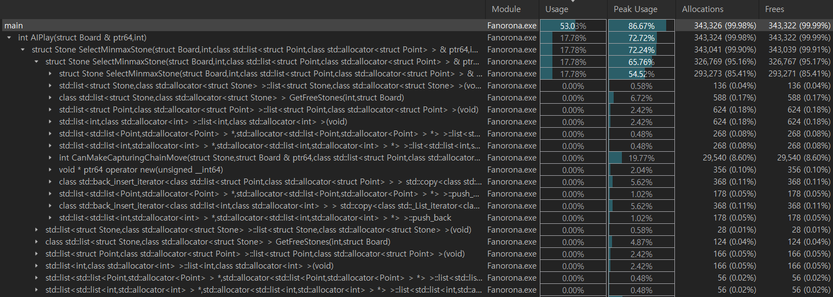
Memory usage analysis using MTuner

Slide 10
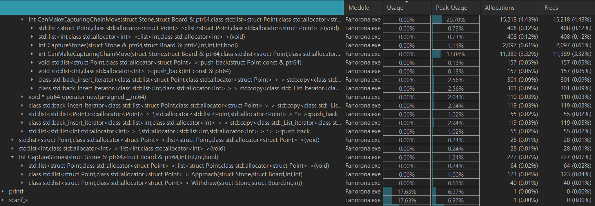
Memory usage analysis using MTuner

