Slide 1
RankQA: Neural Question Answering with Answer Re-Ranking
Rahul Mehta,Siddhant Jain, IIIT Hyderabad

Slide 2
Problem
Current neural QA methods consists of 2 stages : First a text passage retrieval and second, a machine comprehension module to extract likeliest answer.
The modules are isolated and information loss between them happens.
Solution
Introduces a third answer re-ranking module
This module leverages features extracted from text retrieval and machine comprehension modules

Slide 3
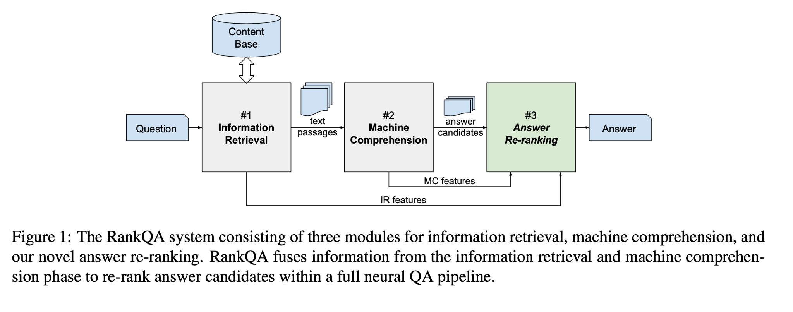

Slide 4
Module 1 : Information Retrieval

Slide 5
Module 1 - Information Retrieval
The first module is the information retrieval module same as of DRQA, it retrieves the top-n documents from the corpus repository for ex wikipedia articles
The retrieval algorithm is TF-IDF based and bigram-hashing algorithm
An incoming query is converted into tf-idf vector and get closest docs by dot product between query and the documents
Bi-gram hashing is used to build fast and efficient feature vectors of predefined length by applying a hash function
For the top-k documents, they are further split into paragraphs and passed on to the second module

Slide 6
Module 1 - Information Retrieval Example
Example Question - What is in front of the Notre Dame Main Building?
Example Candidate - Notre Dame Fighting Irish football,Clark Memorial Fountain,Architecturally, the school has a Catholic character. Atop the Main Building’s gold dome is a golden statue of the Virgin Mary. Immediately in front of the Main Building and facing it, is a copper statue of Christ with arms upraised with the legend ""Venite Ad Me Omnes"" (Come to me, all ye). Next to the Main Building is the Basilica of the Sacred Heart. Immediately behind the basilica is the Grotto, a Marian place of prayer and reflection. It is a replica of the grotto at Lourdes, France where the Virgin Mary reputedly appeared to Saint Bernadette Soubirous in 1858. At the end of the main drive (and in a direct line that connects through 3 statues and the Gold Dome), is a simple, modern stone statue of Mary.
Actual Answer - a copper statue of Christ.

Slide 7
Module 2 : Machine Comprehension using BERTQA

Slide 8
Module 2 - Machine Comprehension
The machine comprehension module extracts and scores one candidate answer for every paragraph of all top-k documents.
We have used k=20 because of memory constraints. The authors have used k=40.
There are 2 different implementations.
One is based on a DRQA document reader.
Second implementation is based on BERT based document reader
We implement a BERT based document reader
Next, we pair the question and all its top-n paragraphs and pass them into a BERT pre-trained on the dataset - SQUAD or WikiMovies.
The we get Get top-k candidate answers, ranked by unnormalized BERT scores.
We aggregate all the top-k answers and perform feature extraction for re-ranking of candidate answers.

Slide 9
Module 3 : Answer Re-Ranking
Let’s start with the first set of slides

Slide 10
Feature Extraction
Feature | Definition
span Score | Score for the answer based on Machine Comprehension module
sum_span_score,min_span_score max_span_score,avg_span_score | aggregated features for span score
doc_score | score of the document the answer was extracted from
min_doc_score,max_doc_score avg_doc_score,sum_doc_score | aggregated document scores
first_occ | first position the answer occurred in the original ranking
num_occ | how often did the answer occur before aggregation
context_len | length of the context
question_len | length of the question

Slide 11
Feature Extraction Example
[{"text": "solo star", "span_score": 14.75855541229248, "start_logit": 7.3796539306640625, "end_logit": 7.378901481628418, "doc_score": 136.96479185226866, "doc_pos": 3, "in_doc_pos": 0, "paragraph_score": 0.09090909090909091, "context_len": 46, "span_len": 2, "first_occ": 1, "num_occ": 1, "avg_span_score": 14.75855541229248, "max_span_score": 14.75855541229248, "min_span_score": 14.75855541229248, "avg_doc_score": 136.96479185226866, "max_doc_score": 136.96479185226866, "min_doc_score": 136.96479185226866, "avg_doc_pos": 3, "max_doc_pos": 3, "min_doc_pos": 3, "avg_start_logit": 7.3796539306640625, "max_start_logit": 7.3796539306640625, "min_start_logit": 7.3796539306640625, "avg_end_logit": 7.378901481628418, "max_end_logit": 7.378901481628418, "min_end_logit": 7.378901481628418, "avg_paragraph_score": 0.09090909090909091, "max_paragraph_score": 0.09090909090909091, "min_paragraph_score": 0.09090909090909091, "avg_in_doc_pos": 0, "max_in_doc_pos": 0, "min_in_doc_pos": 0, "target": 0, "question": "Beyonce's first album by herself was called what?", "question_len": 8},

Slide 12
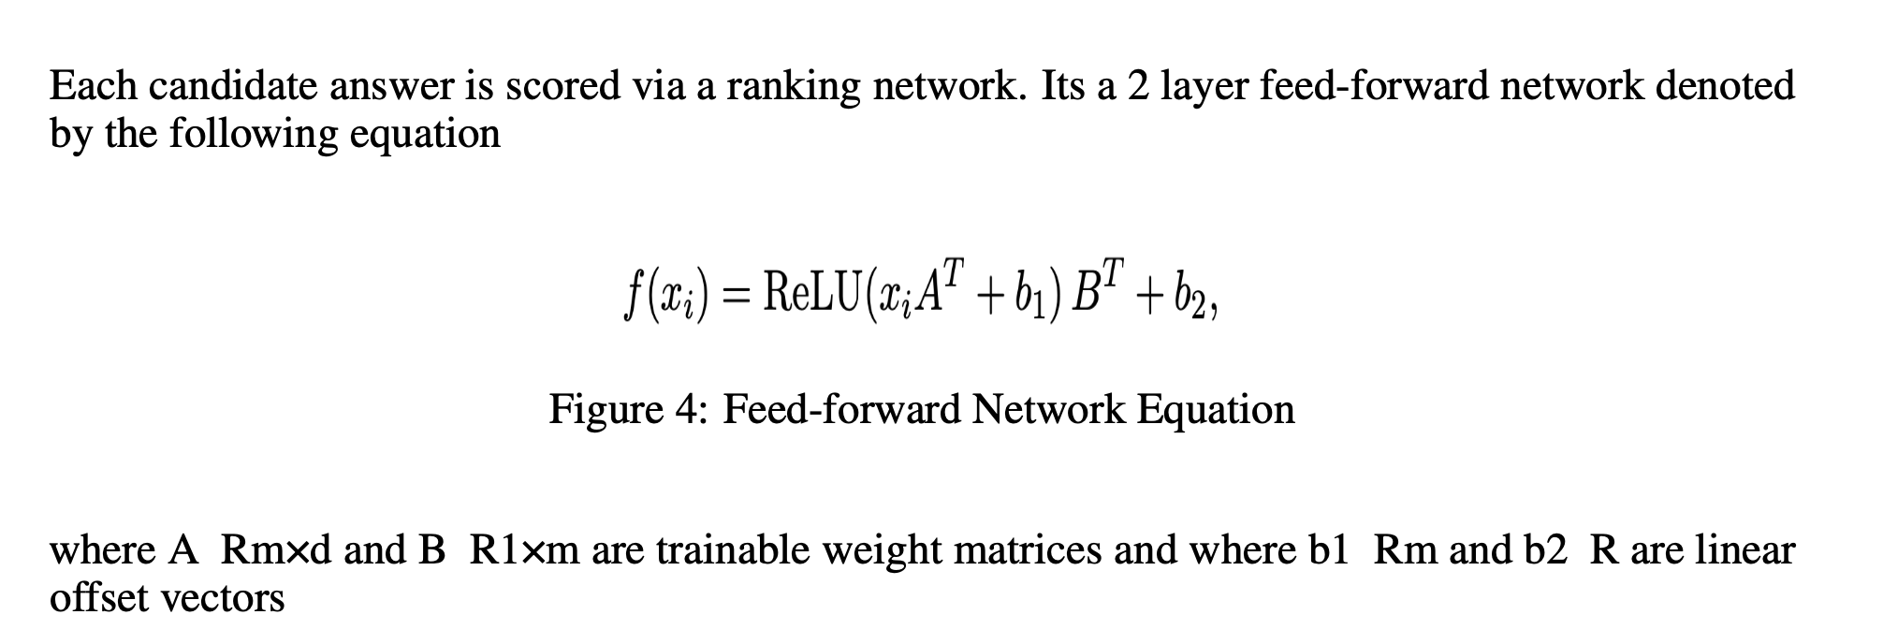
Reranking model

Slide 13
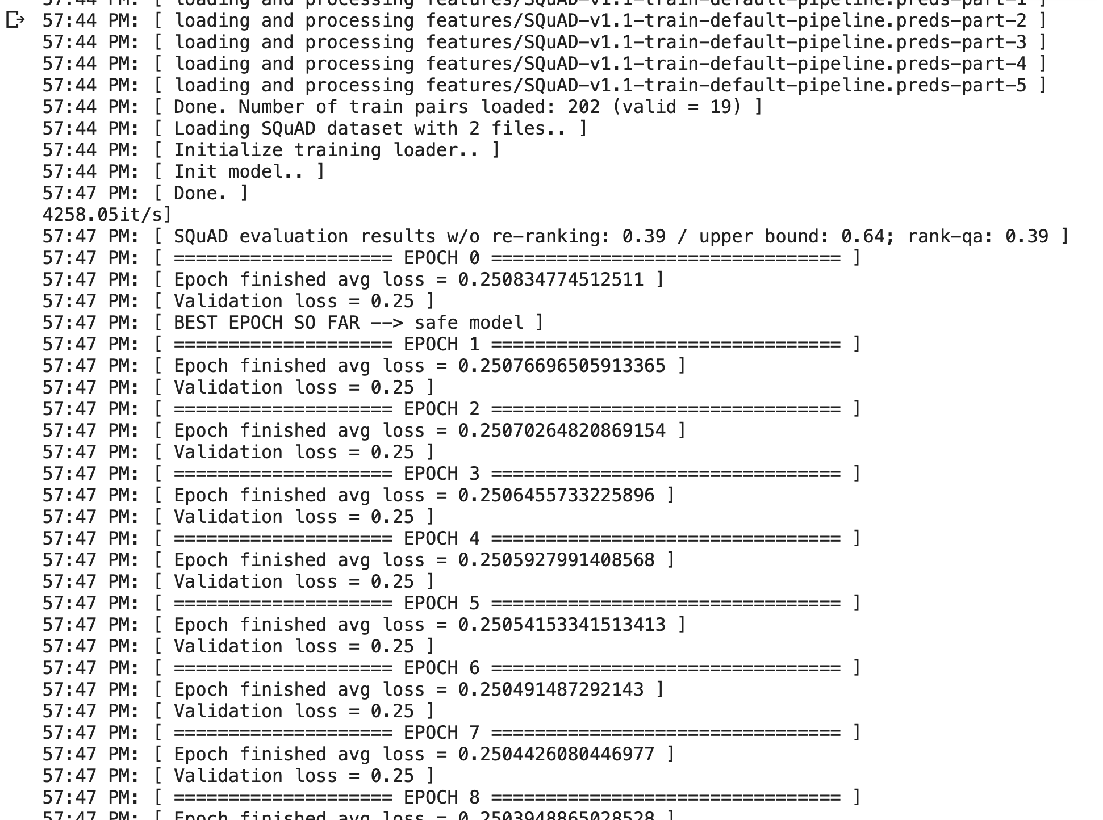
Model Training - Bert QA + Reranking
We train the re-ranking model for 10 epochs with early stopping for a train-dev split of 70:30.
HYPERPARAMETERS -
Learning Rate : 0.0005, Training Batch Size - 4, Max Depth : 2

Slide 14
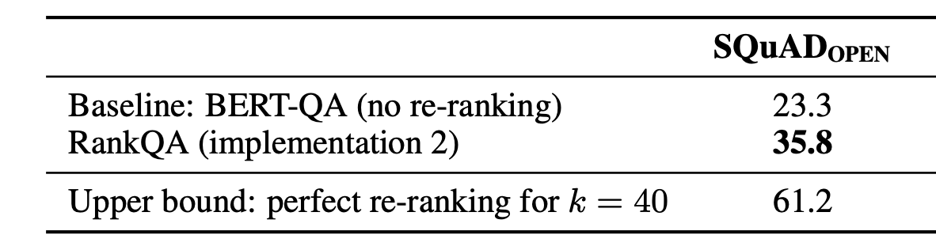
Model Results - BertQA + Reranking
 | Our results | Author’s results
Fraction of correct results | 39 | 35.8

Slide 15
Paper Comparison
Comparison of RankQA with 2 papers of Question Answering

