Slide 1
A New Ideal Multi-Use Multi-Secret Sharing Scheme for General Access Structure
Prepared by :
Neel Choudhury
Chitradeep Dutta Roy
Under the Guidance of :
Himadrinath Saha
Avishek Adhikari

Slide 2
Secret Sharing
We have a secret S
We want to share it among n participants
We don’t trust any participants fully

Slide 3
Two Different Model
Secret s can be divided into n shares in a way so that when all n of them combine we get back the secret
A more general model would be dividing the secret into n shares so that any k or more shares when combined can unravel the secret

Slide 4
Definition
( k, n ) threshold secret sharing is the process by which we can regenerate the secret by combining any k out of n shares where k<n
It was developed independently by Adi Shamir and George Blakley in 1975

Slide 5
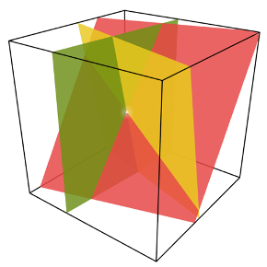
Blakeley’s Approach
Blakley considered the secret as a point in k dimensional space and each share as a k^{th} dimensional hyperplane passing through the secret point

Slide 6
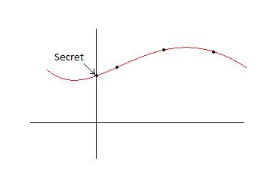
Shamir’s Approach
In Shamir’s scheme a (k-1)^{th} degree polynomial is constructed. He considered the secret as the y-intercept of the polynomial and considered shares as other points on that polynomial

Slide 7
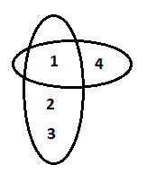
General Access Structure
Those subsets of participants whose shares can be combined to form the secret are called Qualified Sets
Set of all Qualified Sets form the General Access Structure

Slide 8
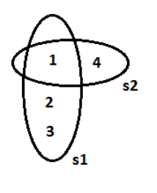
Multi Secret Sharing
A participant can combine his share in different Qualified Sets to construct different secrets

Slide 9
Our Work
We have developed a multi-use multi-secret
sharing scheme for general access structure
Moreover we have added provision of Combiner
verification as well as Participant verification

Slide 10
Theories Used
We have used One-way Hash Function
In our implementation we used md5 in
particular.
Another thing we used is Lagrange’s
Interpolation in prime field which Adi
Shamir used in his scheme

Slide 11
The Real Scenario
Participants p₁, p₂ , ….. p_{n}
Multiple Secrets s₁,s₂, ……s_{k}
For each secret there is a General Access Structure T= {A₁,A₂, …..A_{l}}.
A_{i} is a Qualified Set which is a subset of Set of all Participants i.e.
A₁= {p₁,p₃,p₇}

Slide 12

Implementation ….. (initial stage)
We select a prime number p which is
bigger than number of Participants.
We take h, a hash function which takes a
binary string as input and produces an
output of length log₂(p)
ID_{j} are unique id given to participants
where j=1…n and

Slide 13



Dealer Stage 1
The dealer chooses distinct and
sends it secretly to each of the participants P_{j} for
j=1…..n
For the q^{th} qualified set of
the dealer constructs the polynomial
where

Slide 14


Dealer Stage II
Let l = max{l₁, l₂, …l_{k}}, u = (log₂k) and
v = (log₂l)
For the participant
the Dealer computes Pseudo Secret
Share
where || is the concatenation operator and h is the Hash function

Slide 15



Dealer Stage III
The Dealer computes
for all i = 1….k , q = 1……l_{i}
and b = 1….
Finally Dealer computes and publishes

Slide 16


Prerequisites for verification stage
For verification of the participants by the
combiner dealer computes and publishes
for all i = 1…k , q = 1…l_{i} and b = 1….
For verification of the combiner by the
participants dealer computes and publishes
For all secrets

Slide 17
Participant Phase
Let all participants of i^{th} secret’s q^{th} Qualified Set accumulate to reveal s_{i.} They have to follow the following step :
Each member compute his pseudo secret share
from publicly available value of h, i_{u} ,q_{v} and send their secret share to the combiner

Slide 18



Combiner Phase :1
Participation verification :
Combiner receives pseudo secret share
from each of the participants of
The combiner verifies each participant by computing the value of
and checking it with the published value of the dealer

Slide 19

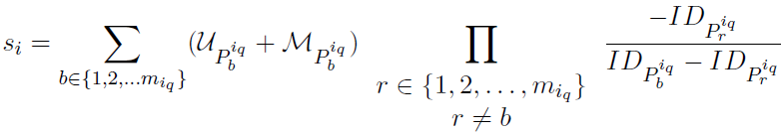
Combiner Phase :11
Secret Recovery:
Using the fact that
combiner computes the secret share s_{i} as follows:

Slide 20


Combiner Verification
After getting the secret from combiner, each participant verifies whether the revealed s_{i} is correct or not with the help of publicly available information h and
as :

Slide 21
Scope of the topic
Defense organizations
High Secutiry Research Labs
E-Voting

