Slide 1
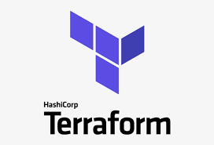
UNIT 1
INTRODUCTION TO TERRAFORM
Notes:
1

Slide 2

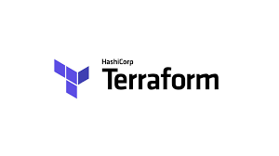
Introduction to Terraform
Introduction to Terraform
Infrastructure Automation
Install Terraform
Providers
Resources
Basic Syntax

Slide 3
Introduction
It is a HASHI CORP Product.
It’s a tool for building, changing, and versioning infrastructure.
Configuration files describe to Terraform the components needed to run
Terraform generate an execute plan describing what it will do to reach the desired state and then executes it

Slide 4
Key Features
Infrastructure as Code
Execution Plans
Resource Graph
Change Automation

Slide 5
Infrastructure as a Code
Infrastructure as code (IaC) tools allow you to manage infrastructure with configuration files rather than through a graphical user interface.
IaC allows you to build, change, and manage your infrastructure in a safe, consistent, and repeatable way by defining resource configurations that you can version, reuse, and share.
Terraform is HashiCorp’s infrastructure as code tool. It lets you define resources and infrastructure in human-readable, declarative configuration files, and manages your infrastructure’s lifecycle.

Slide 6
Infrastructure as a Code
Terraform plugins called providers let Terraform interact with cloud platforms and other services via their application programming interfaces (APIs).
Providers define individual units of infrastructure, into reusable Terraform configurations called modules, and manage them with a consistent language and workflow.

Slide 7
Infrastructure as a Code
Provisioning Infrastructure through software to achieve consistent and predictable environments
Core concept:
Defined in code
Stored in source control
Declarative or Imperative
Idempotent and consistent
Push or pull

Slide 8
Infrastructure as a Code
Benefits:
a) Automated deployment
b) Consistent environments
c) Repeatable process
d) Reusable components
e) Documented architecture

Slide 9
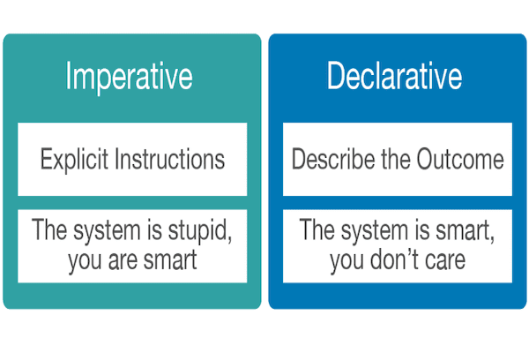
Infrastructure as a Code

Slide 10
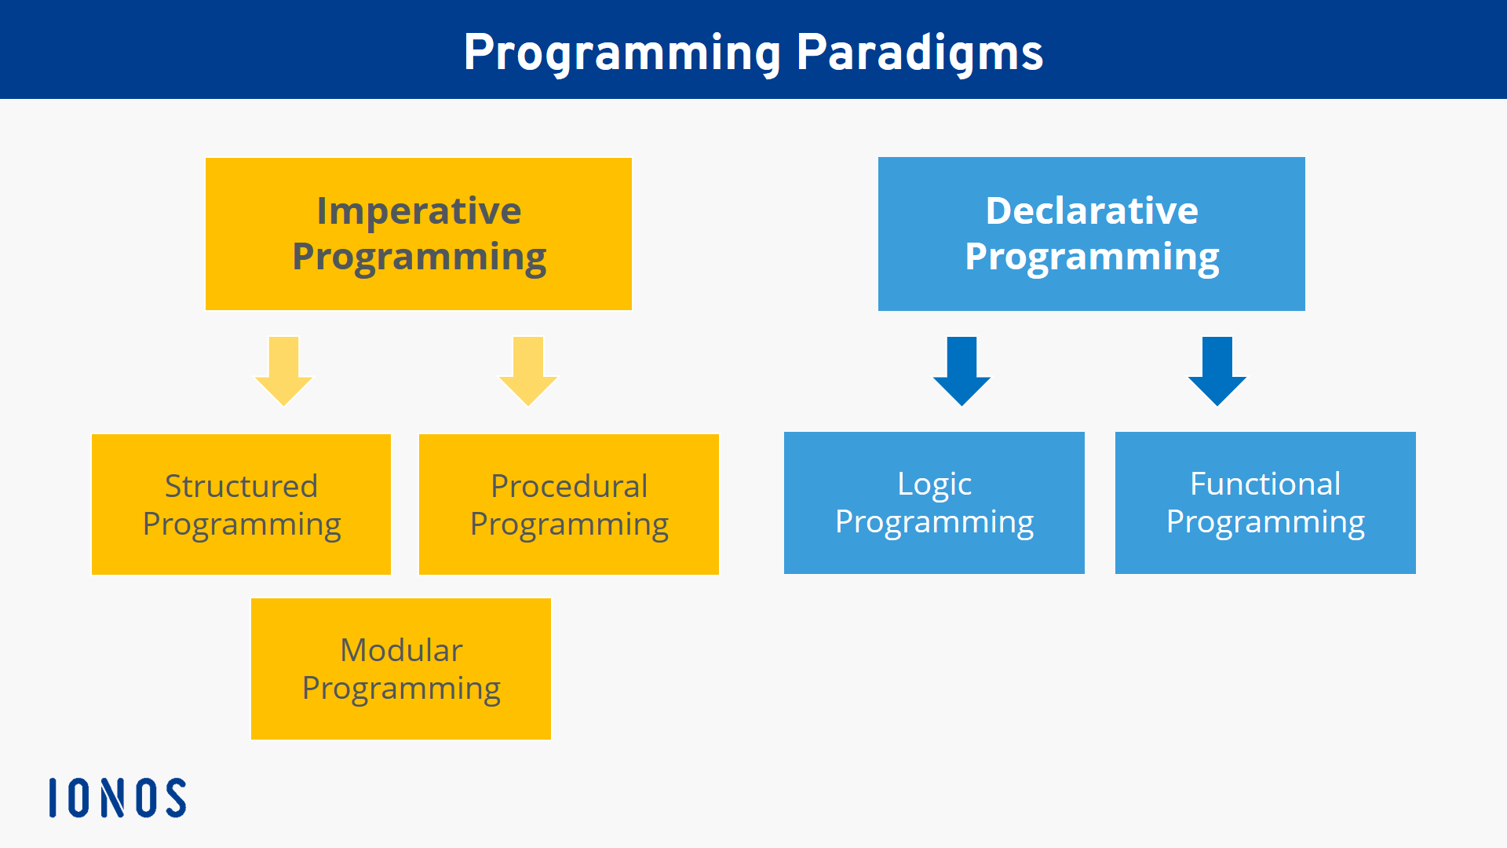
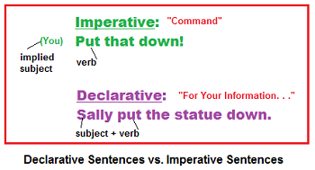
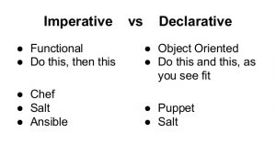
Infrastructure as a Code
expresses the logic of a computation without describing its control flow
uses statements that change a program's state.

Slide 11
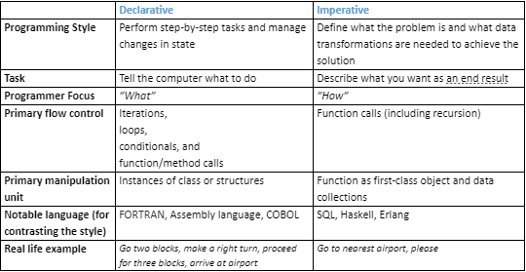
Infrastructure as a Code

Slide 12
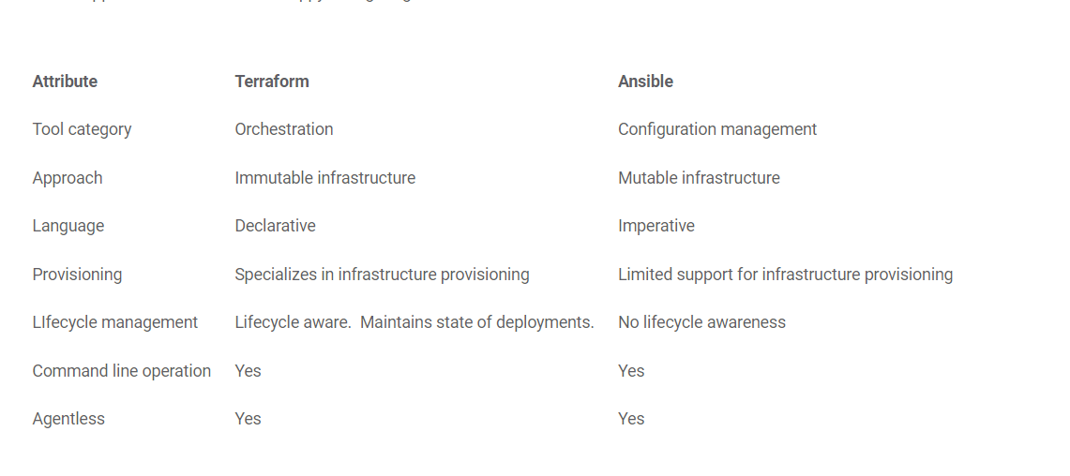
Infrastructure as a Code

Slide 13
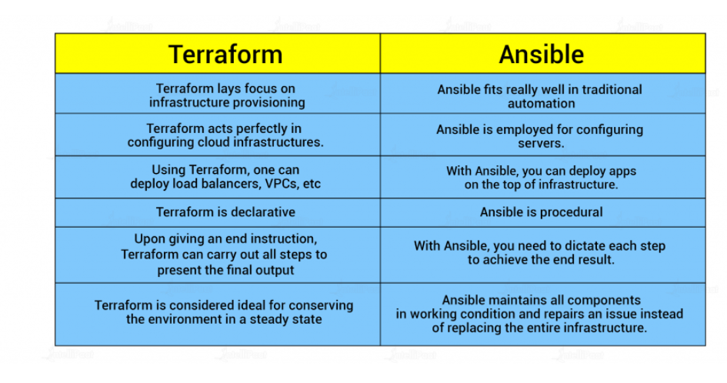
Infrastructure as a Code

Slide 14
Infrastructure as a Code
Orchestration - ensures the right number of instruments are there and that all of them are playing correctly. If there is an issue, an orchestration tool will generally remove the misbehaving instrument and replace it with another. Orchestration tools are usually focused on the end result and help to ensure the environment is always in that “state”.
Configure management - configure each instrument to ensure it is on key, free of damage, and is working properly. If there is a problem with an instrument, the CM tool will work to repair the issue rather than just replace the instrument entirely.

Slide 15
Infrastructure as a Code

Slide 16
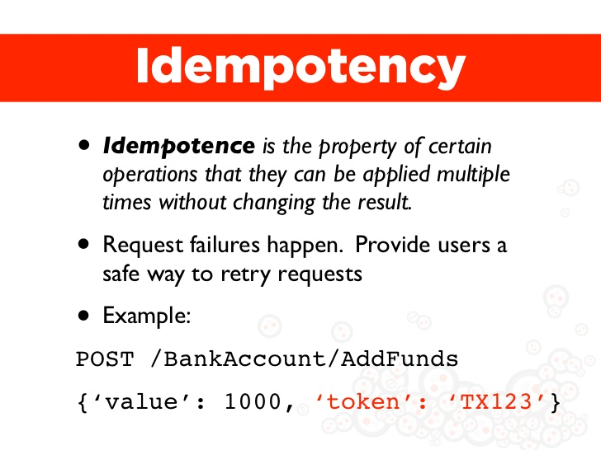
Infrastructure as a Code

Slide 17
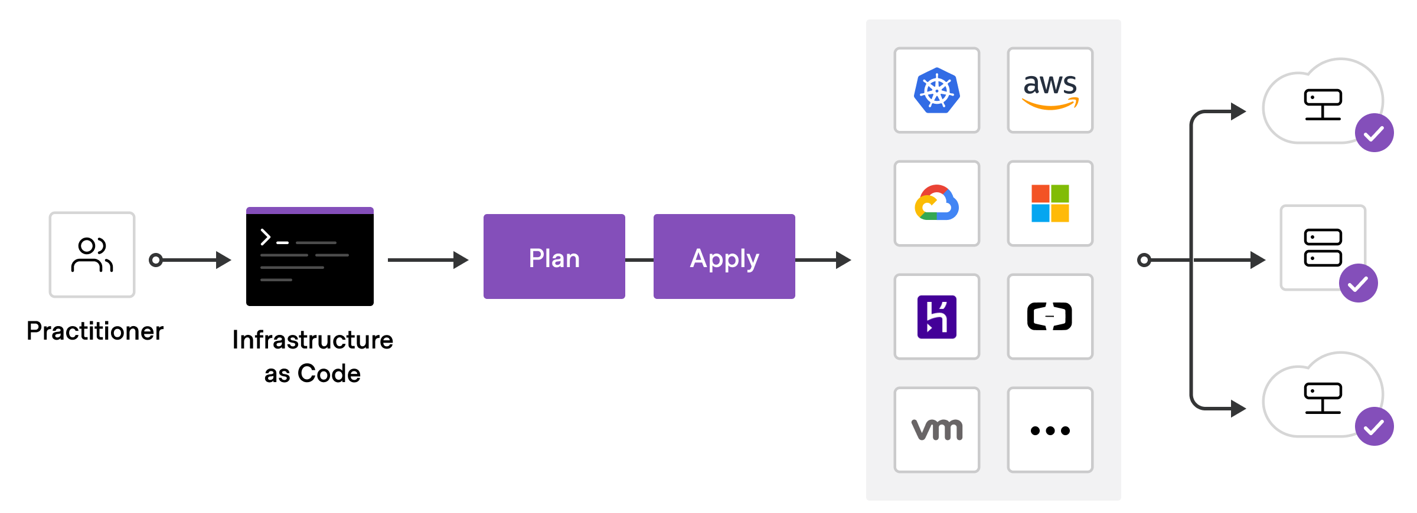
Infrastructure as a Code

Slide 18
Infrastructure as a Code
To deploy infrastructure with Terraform:
Scope - Identify the infrastructure for your project.
Author - Write the configuration for your infrastructure.
Initialize - Install the plugins Terraform needs to manage the infrastructure.
Plan - Preview the changes Terraform will make to match your configuration.
Apply - Make the planned changes.

Slide 19
Terraform components
Terraform executable
Terraform files
Terraform plugins
Terraform state

Slide 20
Installation
Install basic packages:
sudo apt-get update && sudo apt-get install -y gnupg software-properties-common curl
Add HashiCorp GPG Key:
curl -fsSL https://apt.releases.hashicorp.com/gpg | sudo apt-key add -

Slide 21
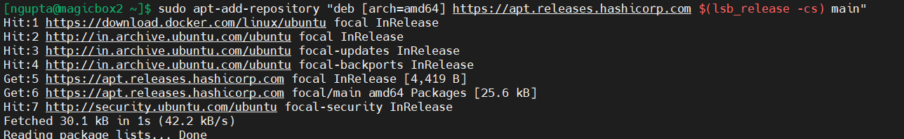
Installation
Add Linux repository
sudo apt-add-repository "deb [arch=amd64] https://apt.releases.hashicorp.com $(lsb_release -cs) main"

Slide 22
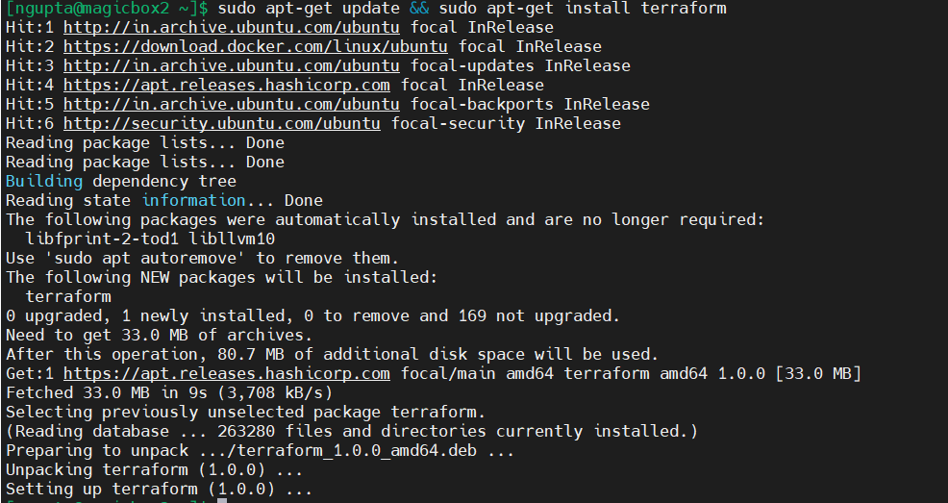
Installation
Update and Install Terraform CLI
sudo apt-get update && sudo apt-get install terraform

Slide 23
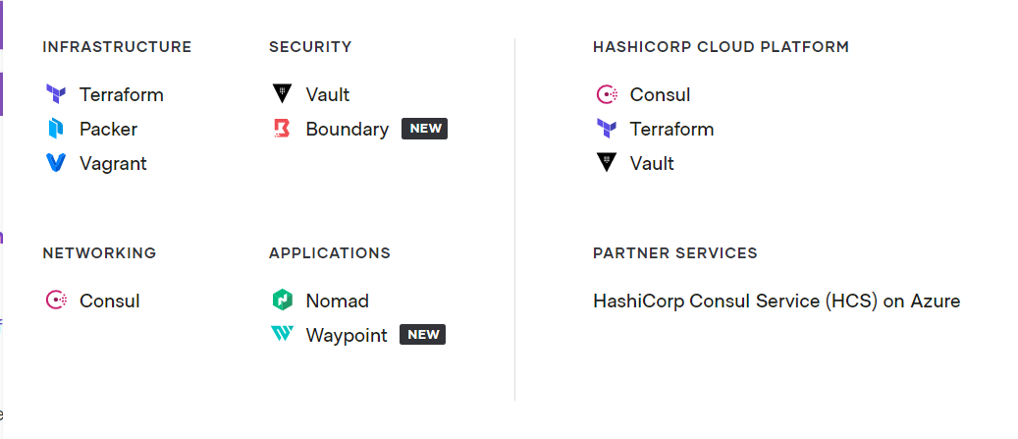
Other Products

Slide 24
Providers
Each provider adds a set of resource types and/or data sources that Terraform can manage. Every resource type is implemented by a provider; without providers, Terraform can't manage any kind of infrastructure. Most providers configure a specific infrastructure platform (either cloud or self-hosted).

Slide 25
Resource
Resources are the most important element in the Terraform language. ... Each resource block describes one or more infrastructure objects, such as virtual networks, compute instances, or higher-level components such as DNS records. Resource Blocks documents the syntax for declaring resources.

Slide 26
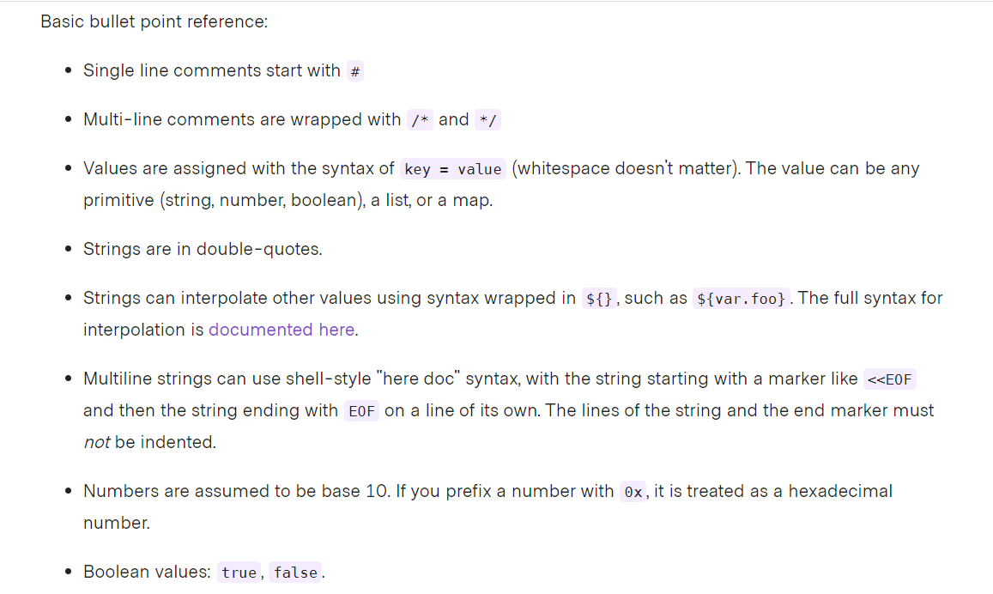
Basic Syntax

Slide 27
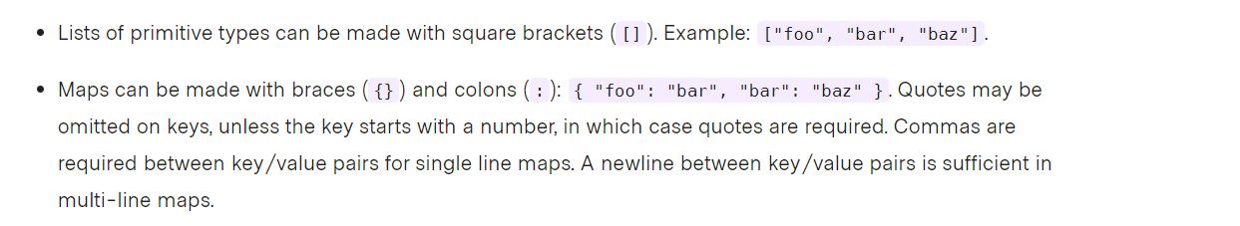
Basic Syntax
Terraform also supports reading JSON formatted configuration files.
https://www.terraform.io/docs/language/syntax/configuration.html
https://www.terraform.io/docs/language/index.html

Slide 28
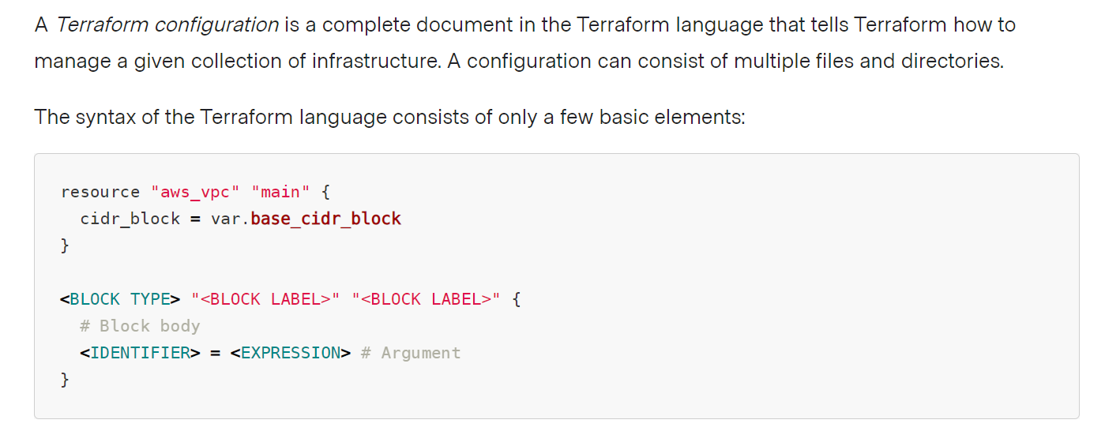
Basic Syntax

Slide 29
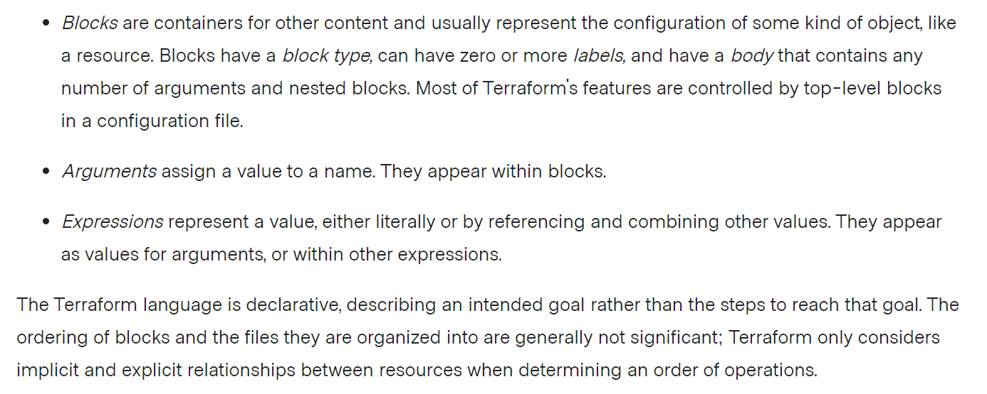
Basic Syntax

Slide 30
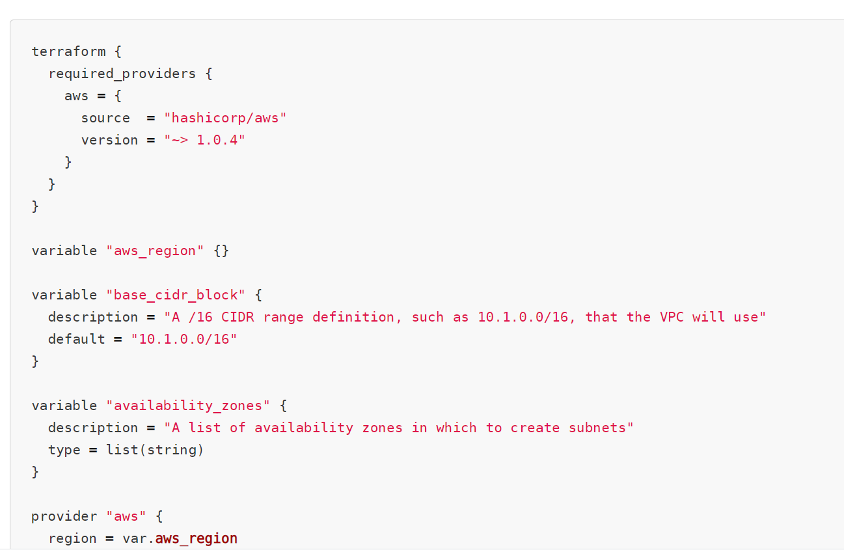
Basic Syntax

Slide 31
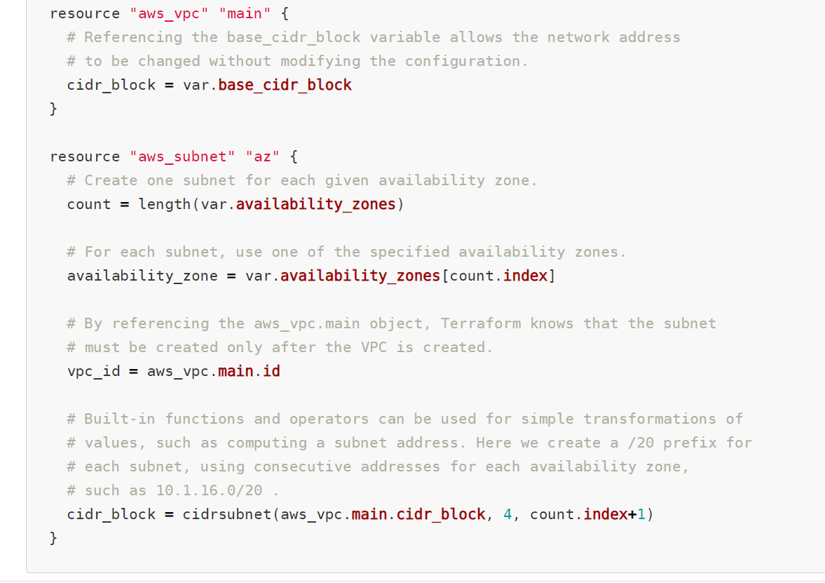
Basic Syntax

Slide 32
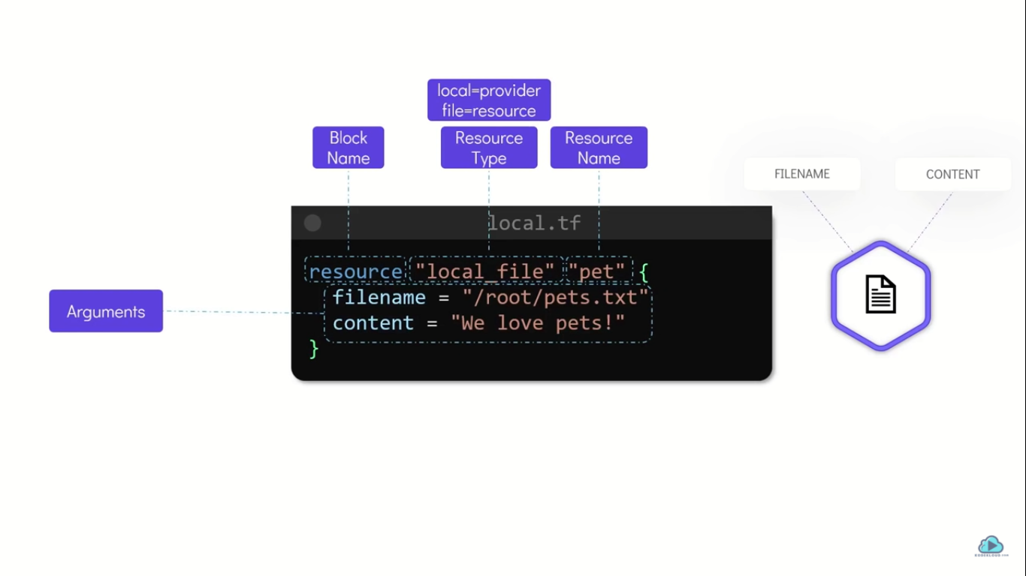

Slide 33
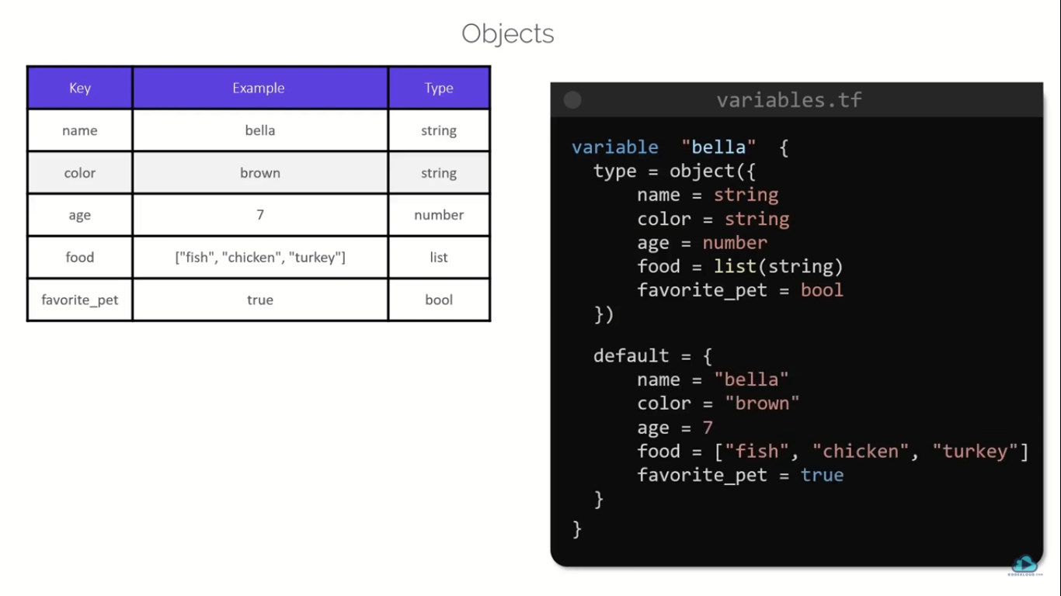

Slide 34
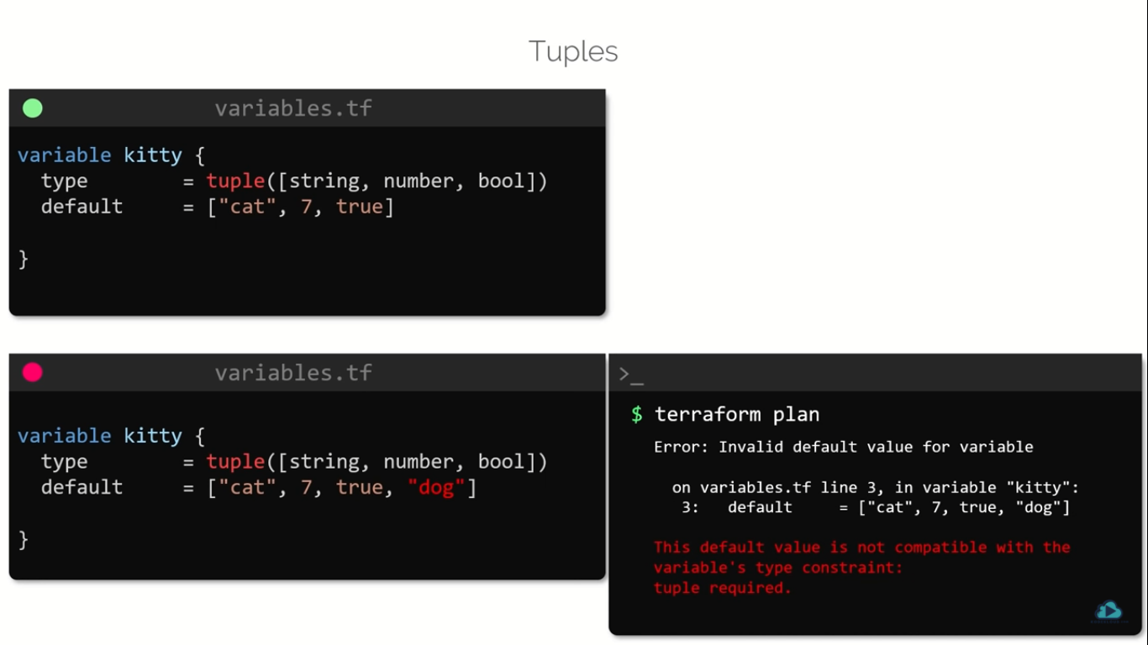

Slide 35

Thanks for using Lifeliqe's lesson plan!
Excite your students in learning science with 1,000+ more 3D models and lesson plans at online.lifeliqe.com

