Slide 1
Large Language Models
NUST
LLM231
Lecturer: Raheel Anwar

Slide 2

Large Language Models
How Machines Understand and Generate Language
Concepts, Mechanisms, and Applications
Course: LLM231 – Advanced Topics in Natural Language Processing
Notes:
Welcome the class and introduce the lecture series. Emphasise that LLMs are the backbone of modern NLP and will be explored from theory to practice. Mention the relevance to research and industry, and outline the agenda for the next ten slides.

Slide 3
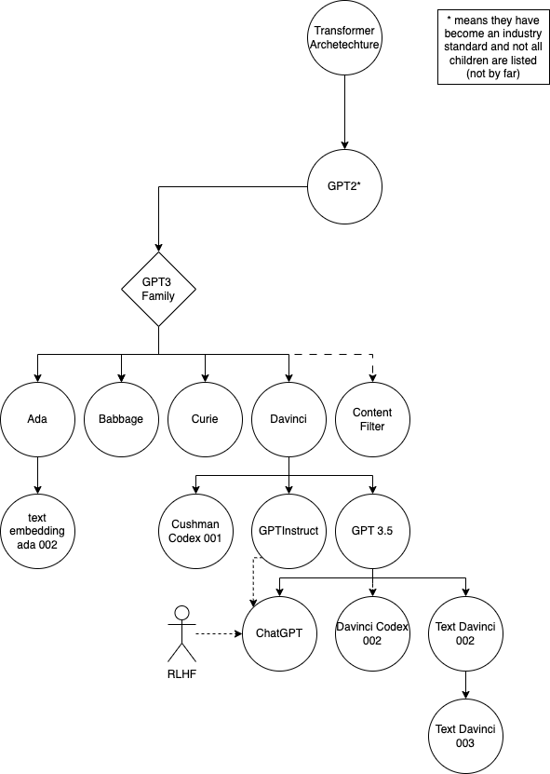
What Are LLMs?
AI models trained on massive, heterogeneous text corpora (hundreds of billions of tokens)
Capable of generation, summarisation, translation, question answering, and reasoning
Representative families: GPT‑4, Claude, LLaMA‑2, Gemini; all built on the transformer paradigm
Notes:
Define LLMs formally as statistical language models with billions of parameters. Highlight the diversity of training data (web pages, books, code) and the breadth of downstream tasks they can perform without task‑specific architecture changes. Briefly compare the listed examples in terms of scale and licensing.

Slide 4
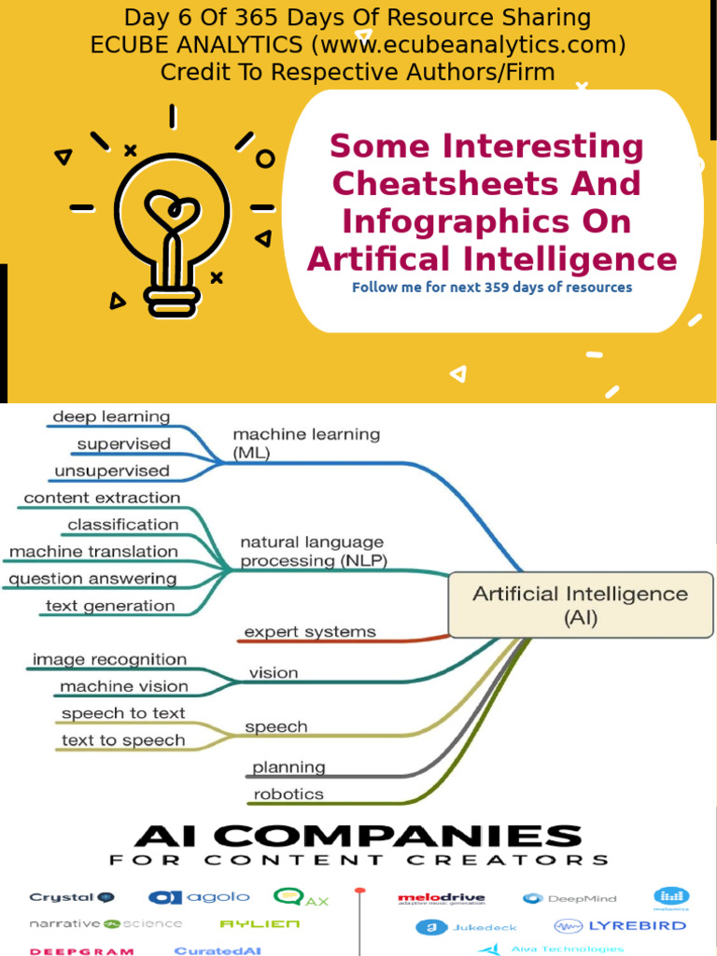
Why LLMs Matter
Enable natural, conversational human–computer interaction at scale
Automate knowledge‑intensive tasks: drafting, coding, data extraction
Provide a general‑purpose reasoning substrate across scientific, legal, and creative domains
Serve as foundational models for downstream specialised systems
Notes:
Discuss the societal and economic impact of LLMs. Cite case studies where LLMs have reduced manual effort (e.g., code assistants, legal contract review). Stress the shift from narrow AI to foundation models that can be adapted to many problems, reducing development time and data requirements.

Slide 5
The Transformer Architecture
Self‑attention: each token attends to every other token, learning context‑dependent representations
Parallelizable computation enables training on very long sequences
Two main configurations: encoder‑decoder (e.g., T5) and decoder‑only (e.g., GPT)
Positional encodings inject order information into otherwise permutation‑invariant attention
Notes:
Walk through the core components of the transformer: multi‑head attention, feed‑forward layers, layer normalisation, residual connections. Explain why self‑attention replaces recurrence and why this leads to better scaling properties. Show a schematic diagram to visualise data flow.

Slide 6
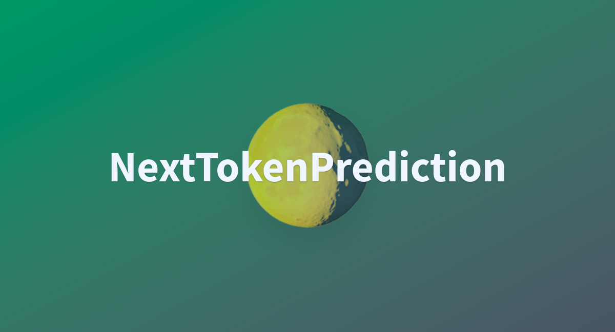
How LLMs Learn
Pre‑training objective: next‑token prediction (autoregressive) or masked token reconstruction (encoder‑decoder)
Optimization via stochastic gradient descent on massive corpora (web crawl, Common Crawl, books, code)
Emergent abilities arise from statistical regularities: grammar, world facts, multi‑step reasoning
No hand‑crafted rules; knowledge is implicit in the weight matrix
Notes:
Explain the loss function (cross‑entropy) and why predicting the next token forces the model to capture syntactic and semantic patterns. Mention scaling laws (model size, data, compute) and how they correlate with performance. Highlight that emergent behaviours are not programmed but discovered during training.

Slide 7

Tokens and Embeddings
Tokenisation strategies: byte‑pair encoding (BPE), WordPiece, SentencePiece – subword granularity balances vocabulary size and coverage
Each token mapped to a dense vector (embedding) that encodes lexical semantics
Positional embeddings (learned or sinusoidal) add sequence order information
Embedding matrix is jointly learned with the rest of the model, enabling semantic compositionality
Notes:
Detail how raw text is converted into discrete tokens and then into continuous vectors. Discuss trade‑offs of vocabulary size versus token length, and show examples of how a word like 'unbelievable' is split. Explain the role of embeddings as the interface between discrete language and continuous neural computation.

Slide 8
Inference: How LLMs Generate Text
At inference time the model computes a probability distribution over the vocabulary for the next token
Decoding strategies: greedy (max‑probability), stochastic sampling (top‑k, nucleus), beam search (explores multiple hypotheses)
Temperature parameter controls distribution sharpness – higher values increase randomness/creativity
Attention mechanism retains long‑range context, allowing coherent multi‑sentence generation
Notes:
Demonstrate a step‑by‑step generation example, showing probability scores and how different decoding methods affect output quality. Explain practical considerations: latency, token limits, and how to enforce constraints (e.g., stop tokens). Mention recent advances such as contrastive decoding.

Slide 9
Fine‑Tuning and Alignment
Supervised Fine‑Tuning (SFT): task‑specific datasets refine the base model for higher accuracy
Reinforcement Learning from Human Feedback (RLHF): reward model trained on preference data, policy updated via PPO
Preference optimisation methods (DPO, RPO) reduce reliance on reinforcement loops while preserving alignment
Goal: improve safety, factuality, and adherence to user intent without degrading language competence
Notes:
Outline the pipeline from a pre‑trained LLM to an assistant‑grade model. Explain how human annotations are transformed into a reward signal and the role of proximal policy optimisation. Discuss evaluation metrics for alignment (e.g., helpfulness, harmlessness) and current research challenges.

Slide 10

Applications of LLMs
Conversational agents and virtual assistants (customer support, mental‑health chatbots)
Code synthesis and debugging tools (Copilot, Code Llama)
Document summarisation, information extraction, and semantic search in enterprise settings
Personalised tutoring, language learning, and automated assessment
Creative domains: story generation, design ideation, music lyric composition
Notes:
Provide concrete case studies for each application area, citing recent deployments and performance numbers where available. Emphasise the distinction between zero‑shot usage and fine‑tuned specialised solutions. Highlight interdisciplinary impact – e.g., how LLMs assist in scientific literature review.

Slide 11

Challenges & Future Directions
Hallucination: generation of plausible but factually incorrect statements; mitigation via retrieval‑augmented generation
Bias & fairness: systemic biases inherited from training data; need for debiasing techniques and diverse corpora
Security & privacy: model leakage, prompt injection attacks, and compliance with data regulations
Multimodal reasoning: integrating vision, audio, and structured data to achieve true AI understanding
Efficiency: distillation, quantisation, and on‑device inference for greener, accessible AI
Notes:
Conclude with an honest appraisal of open problems. Discuss current research avenues such as retrieval‑augmented models (RAG), instruction‑tuned safety layers, and parameter‑efficient fine‑tuning (PEFT). Invite students to consider thesis topics that address these gaps, and preview the next lecture on evaluation methodologies.

