Slide 1
Pizza Store Management System
WIPRO CAPSTONE PROJECT
GREAT LEARNING
NAME : SHAIK RAHIM
PROGRAM: FULL STACK MERN
EMAIL: RAHEEMSHAIK2149@GMAIL.COM
MENTOR: ABHISHEK SHARMA
PROJECT ID: PIZZA STORE
WIPRO NGA–MERN-FY26

Slide 2
Agenda
Introduction
Technologies Used
System Architecture
Overview Of Application
Conclusion

Slide 3
Introduction
The Pizza Store Management System is a web application that allows customers to order pizzas online and helps administrators manage restaurant operations.
Customers can browse menu items, place orders, track order status, and view billing information easily.
The system is built using React, Node.js, Express.js, and MongoDB with secure authentication using JWT
It is designed as a Single Page Application (SPA) to provide a fast and smooth user experience.

Slide 4
Technologies Used
Frontend: HTML5, CSS3, JavaScript (ES6), React.js, React Router, Axios,
Backend: Node.js, Express.js, RESTful API Architecture, JSON Web Tokens (JWT), and Password Encryption.
Database: MongoDB, Mongoose ODM, and MongoDB Compass.
Testing: Mocha, Chai, Supertest.

Slide 5
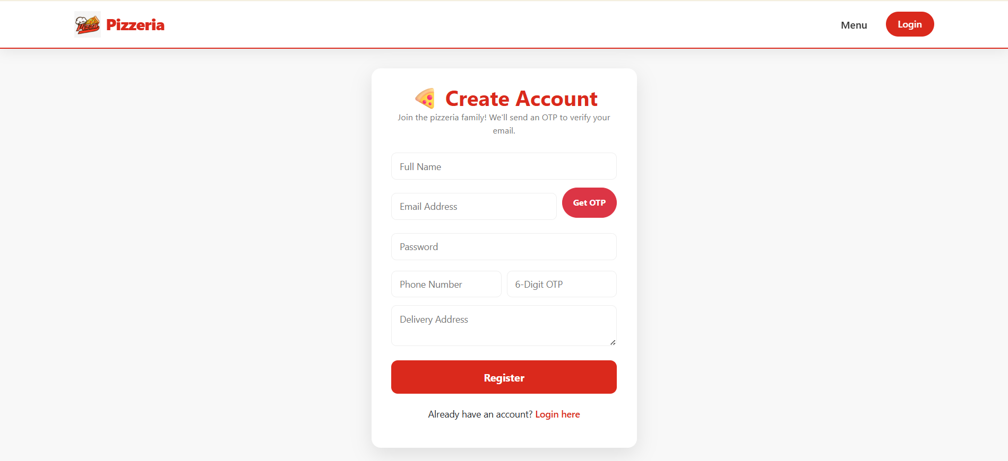
Overview Of The Application
Register Page

Slide 6
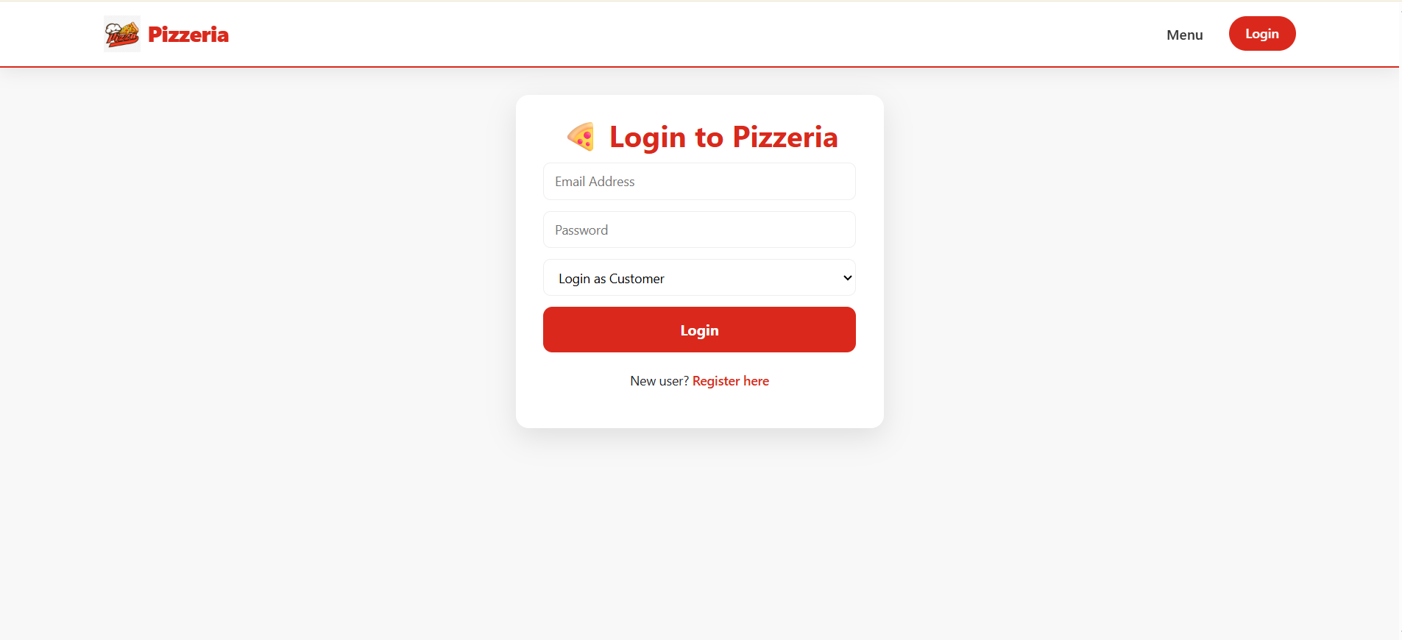
Overview Of The Application
Login Page

Slide 7
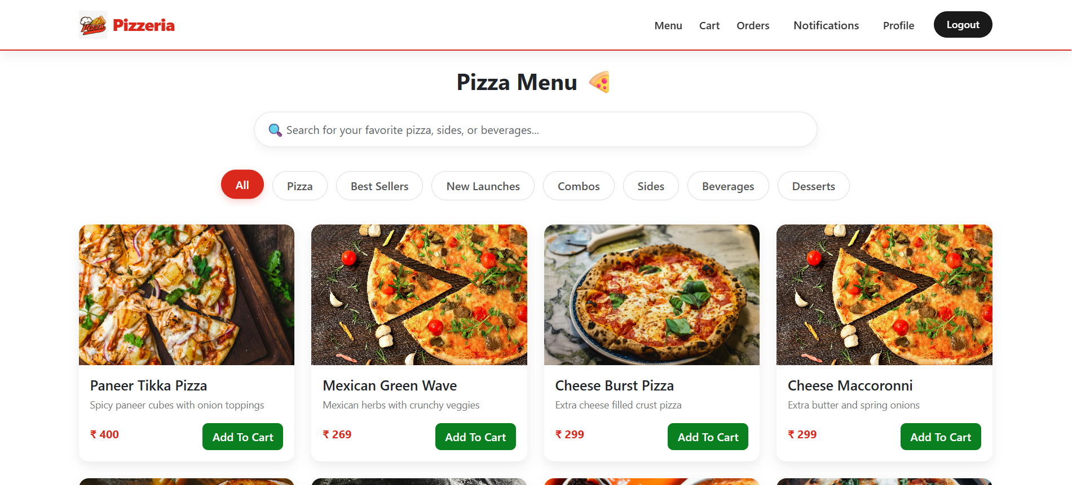
Overview Of The Application
Menu Page

Slide 8
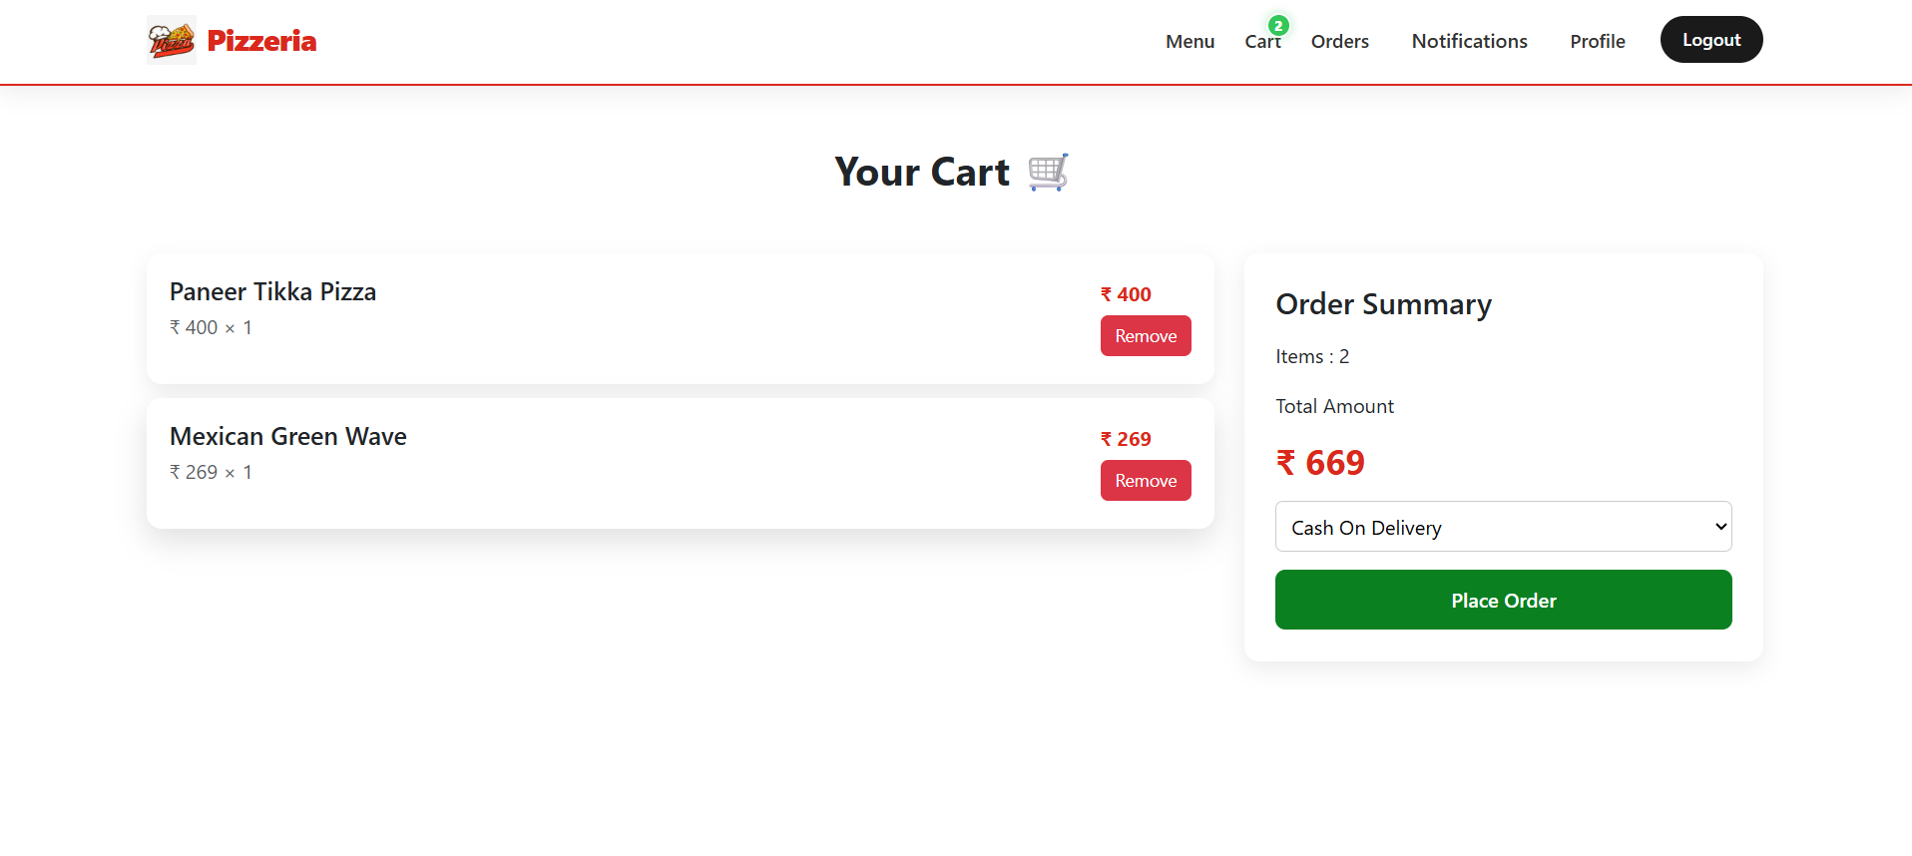
Overview Of The Application
Cart Page

Slide 9
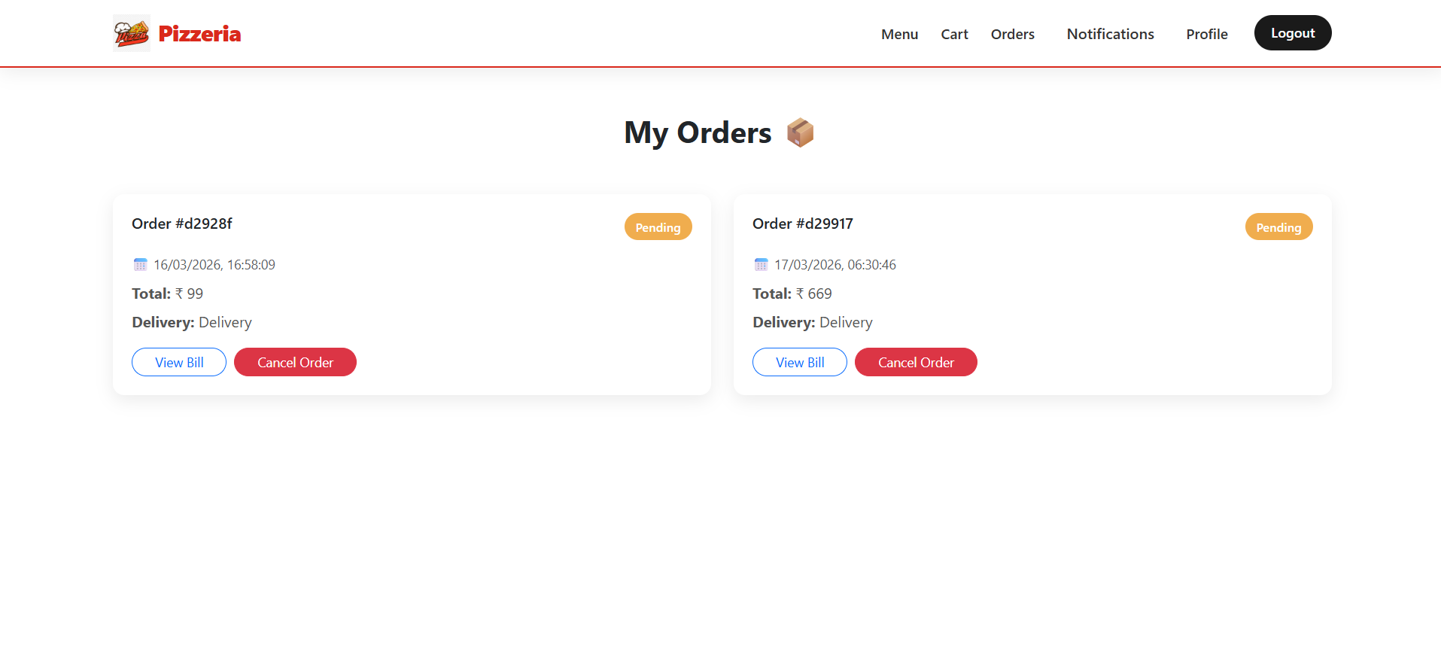
Overview Of The Application
My Orders Page

Slide 10
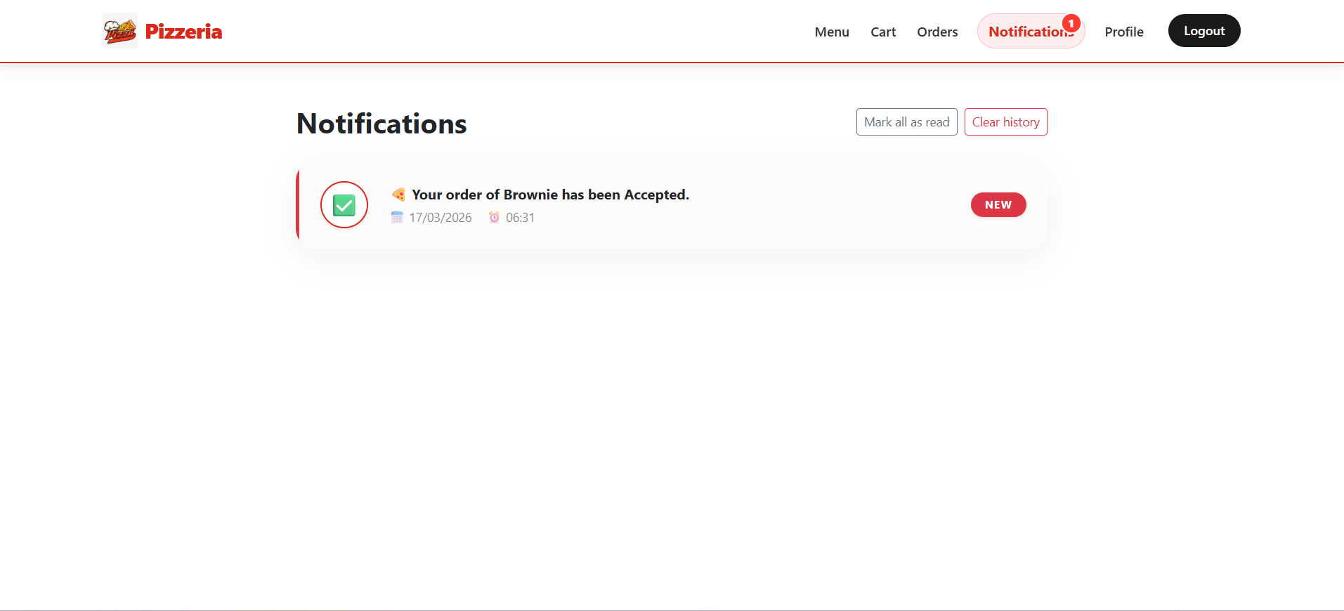
Overview Of The Application
Notifications Page

Slide 11
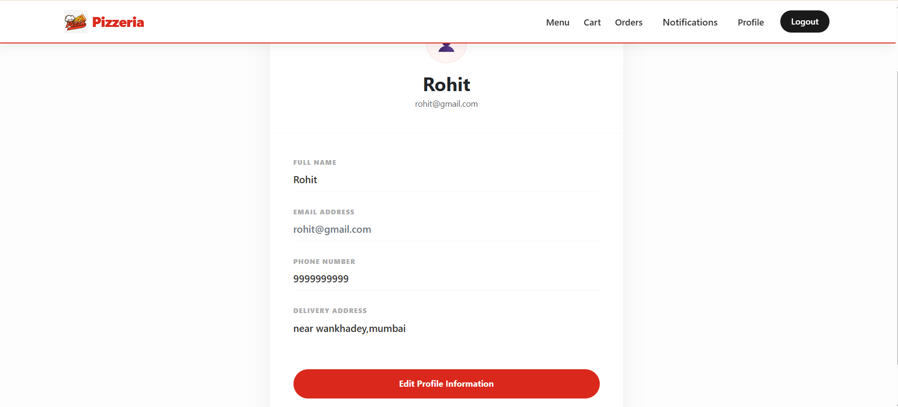
Overview Of The Application
Profile Page

Slide 12
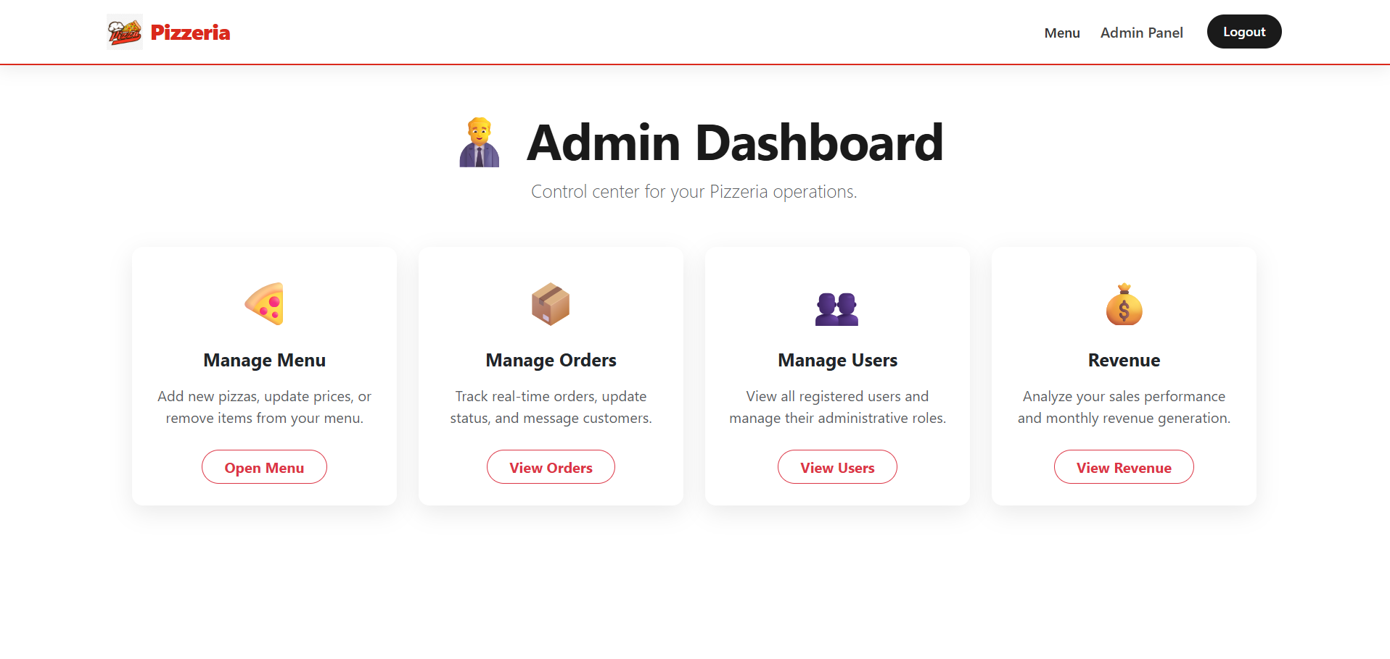
Overview Of The Application
Admin Dashboard Page

Slide 13
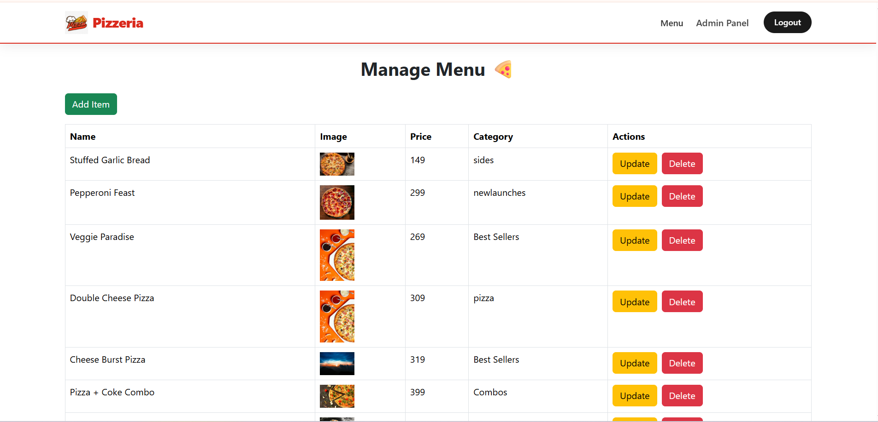
Overview Of The Application
Manage Menu

Slide 14
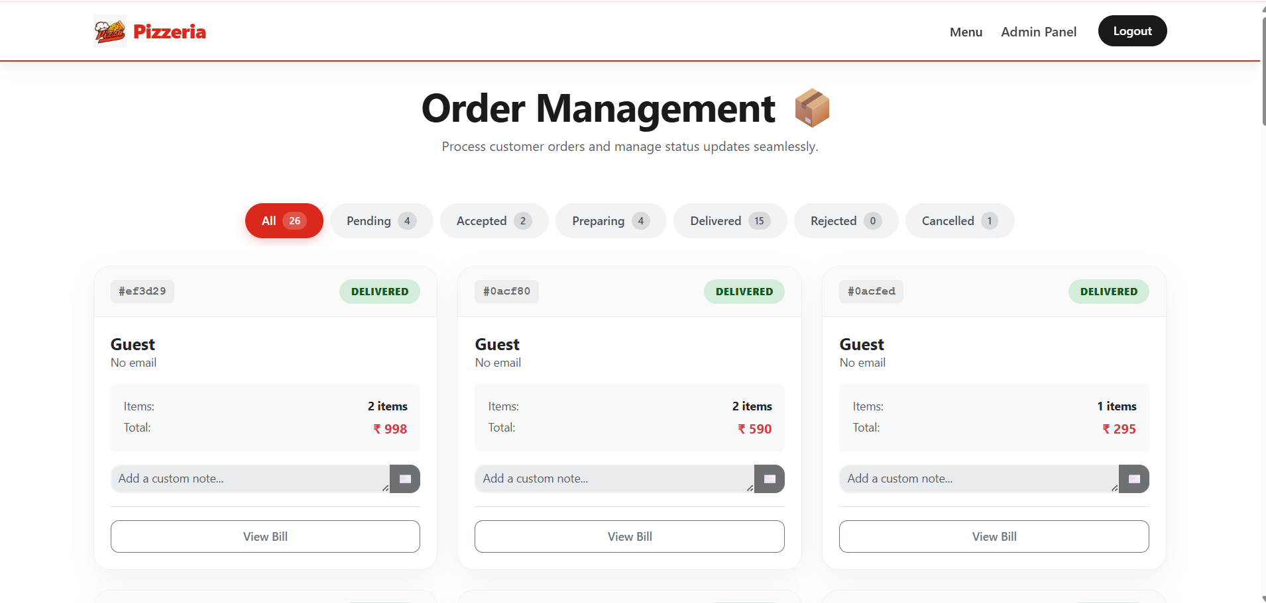
Overview Of The Application
Manage Orders

Slide 15
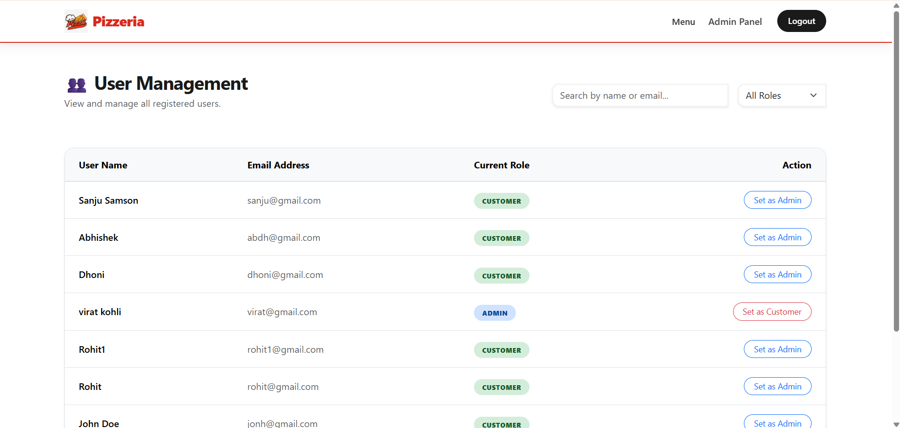
Overview Of The Application
Manage Users

Slide 16
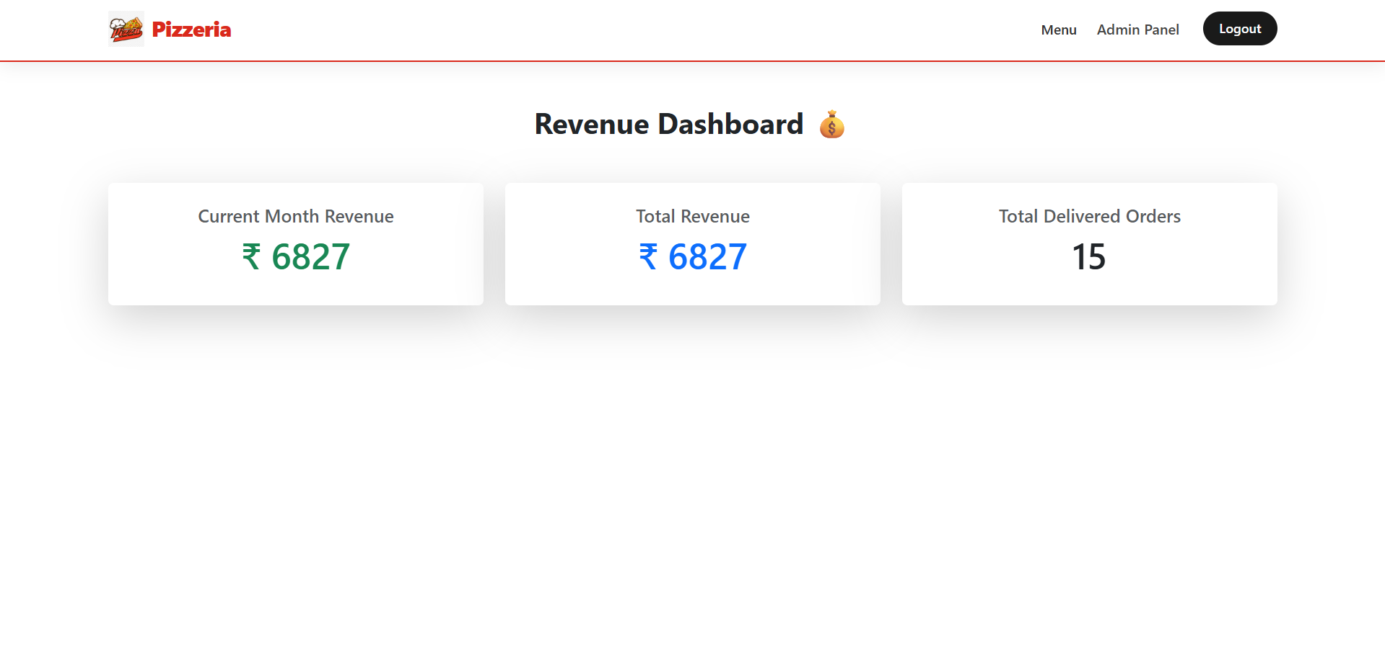
Overview Of The Application
Revenue Page

Slide 17
Thank you
raheemshaik2149@gmail.com
http://localhost:3000
Project ID: Pizza Store
Batch: Wipro NGA –MERN-FY26

