Slide 1
Drug Development Process
From Discovery to Market
Understanding Clinical Trials Enrollment Forecasting

Slide 2
The Drug Development Timeline
10-12 years average from discovery to FDA approval
$2.6+ billion average total cost per drug
Only 8-10% of drugs entering preclinical phase reach FDA approval
5 major stages in the development pathway

Slide 3
Five Major Stages of Development
Discovery
Identifying disease targets and lead compounds
05
Post-Market
Long-term safety monitoring (Phase IV)
01
04
FDA Review
Regulatory approval process
Preclinical
Lab and animal testing for safety and efficacy
02
03
Clinical Trials
Testing safety and efficacy in humans (Phase I, II, III)

Slide 4
Clinical Trials: Three Key Phases
Phase I: Safety testing in 20-100 healthy volunteers
Phase II: Safety and Efficacy testing in 100-500 patient volunteers
Phase III: Large-scale pivotal trials in 1,000-5,000 patients to confirm safety and efficacy
A trial’s success largely depends on the recruitment of patients.

Slide 5
Clinical Trials: Patient Recruitment Challenges
Awareness & Stigma - Limited patient awareness of trials; treatment apprehension
Strict Criteria - Restrictive inclusion/exclusion requirements narrow eligible pool
Site Accessibility - Geographic distance and frequent visit burden deter participation
Trial Competition - Multiple concurrent trials fragment limited patient populations
Physician Gatekeeping - Clinicians may not prioritize or refer eligible patients
Diversity Gaps - Underrepresented populations face barriers (language, distrust, logistics)
Impact: Enrollment shortfalls → trial delays, increased costs, reduced success rates

Slide 6
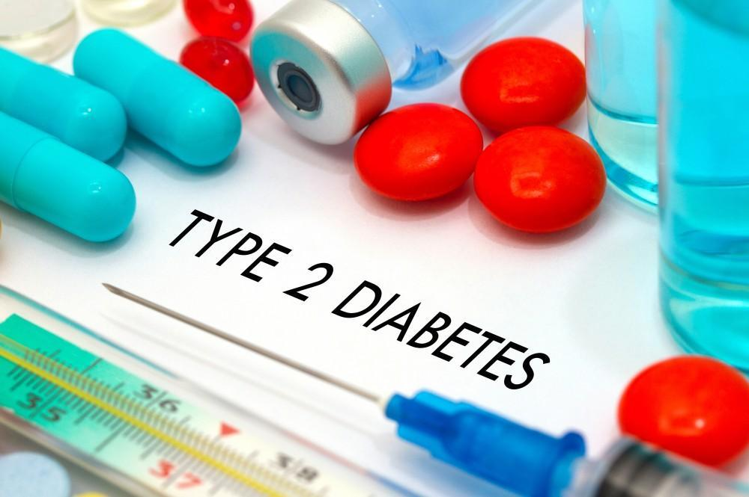
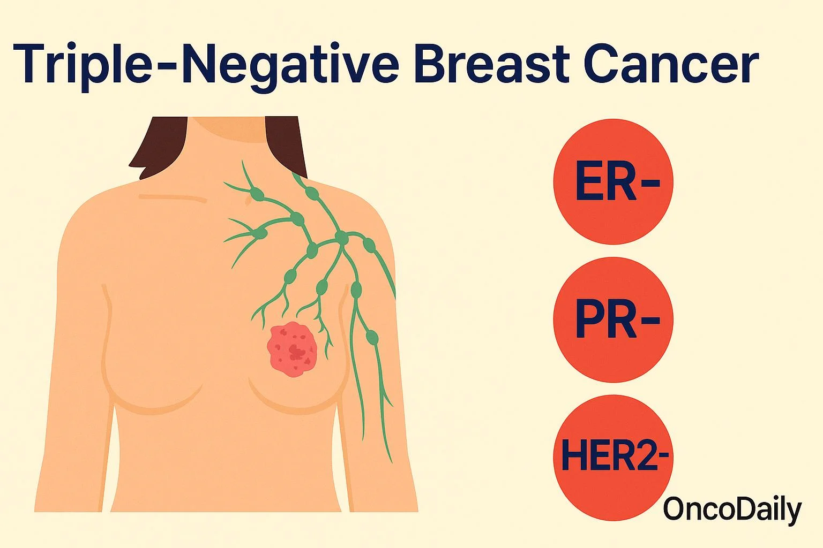
Clinical Trials: Patient Recruitment Challenges

Slide 7
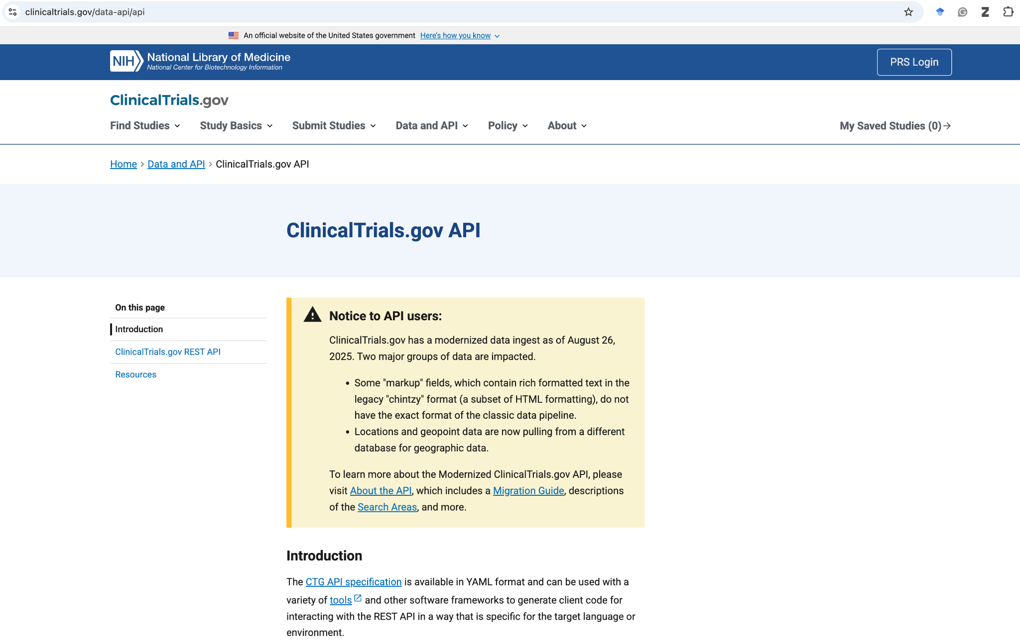
ClinicalTrials.gov: Rich Data Source
Public dataset with trial metadata and outcomes for analysis
Trial attributes: enrollment, phases, conditions, duration, study type
Outcome data: completion status, primary outcomes met/not met
Rich features enable machine learning prediction models

Slide 8
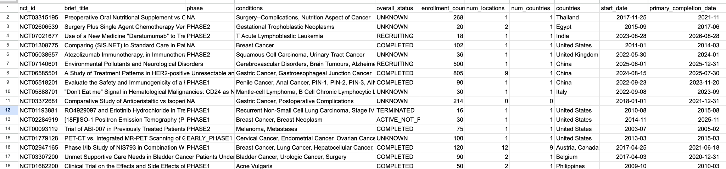
ClinicalTrials.gov: Rich Data Source
Public dataset with trial metadata and outcomes for analysis

Slide 9
Features Driving Trial Success
Study design (randomized, blinded, phase level)
Enrollment size and trial duration
Disease condition and patient population characteristics
See the list of features available in the ClinicalTrials.gov
And many more…

Slide 10
Two Modeling Approaches
Classification
Predict enrollment success/failure using median as threshold
Regression
Predict actual enrollment numbers and identify key drivers

Slide 11
Data-Driven Trial Success
Using ClinicalTrials.gov to predict outcomes and optimize trial design

Slide 12
The Prediction Challenge
Binary Classification: Can we predict successful enrollment?
Success = Enrollment meets or exceeds median enrollment threshold
Failure = Enrollment falls below median (struggles to recruit)
Based on ClinicalTrials.gov historical enrollment data

Slide 13
https://github.com/raheems/icasds2025

