Slide 1
AICON’26 · BUILD WITH AI · EDTECH & WORKFORCE
Roshni
روشنی
One page. Every learner.
A photo of a textbook page becomes a lesson that blind, dyslexic and deaf students can use, and a second AI proves no fact was lost.
404 Team Not Found
Notes:
[0:00–0:20] Hi, we are 404 Team Not Found. This is Roshni, which means light. One page, every learner: we turn a photo of any textbook page into a lesson that blind, dyslexic and deaf students can use, and a second AI proves no fact was lost.

Slide 2



Bilal is blind
He can’t read the page or see its diagrams. Most textbooks have no accessible version.
01 · THE PROBLEM
One printed page fails three students
Sara is dyslexic
Long sentences and hard words lose her, and Urdu-medium students hit the same wall in English.
Why it matters: about 1 in 6 people live with a significant disability (WHO, 2023). Teachers have no time to adapt every page three ways, so it never happens.
Hamza is deaf
He misses everything the teacher says while explaining the page.
Notes:
[0:20–0:50] Three students, one class, one printed page. Bilal is blind, Sara is dyslexic, Hamza is deaf. The page works for none of them, and their teacher has no time to adapt every page three ways. About 1 in 6 people live with a significant disability, so this happens in every school.

Slide 3




02 · OUR SOLUTION, AND WHERE AI IS USED
One photo in. Three ways to learn out.
Read
AI
Rewrite
AI
Check
AI
Transcribe
AI
Gemini reads the photo and describes every figure
Qwen rewrites it simply and explains hard words in Urdu
Fact Guard, a different AI, verifies every fact
Whisper transcribes the lecture; voices read it all aloud
Listen
Read Easy
Captions
For Bilal: the page read aloud section by section, every figure described in words, full keyboard control.
For Sara: simpler text beside the original, Urdu help for hard words, read-aloud that highlights each sentence.
For Hamza: the lecture as a transcript synced to the audio, plus a summary checked against what was said.
Notes:
[0:50–1:30] Our solution: one photo in, three ways to learn out. AI is the pipeline, not a chat box. Gemini reads the page and describes every figure. Qwen rewrites it at an easier level with Urdu help. Fact Guard, a different AI family, checks every fact. Whisper captions the lecture. Bilal gets Listen, Sara gets Read Easy, Hamza gets Captions.

Slide 4
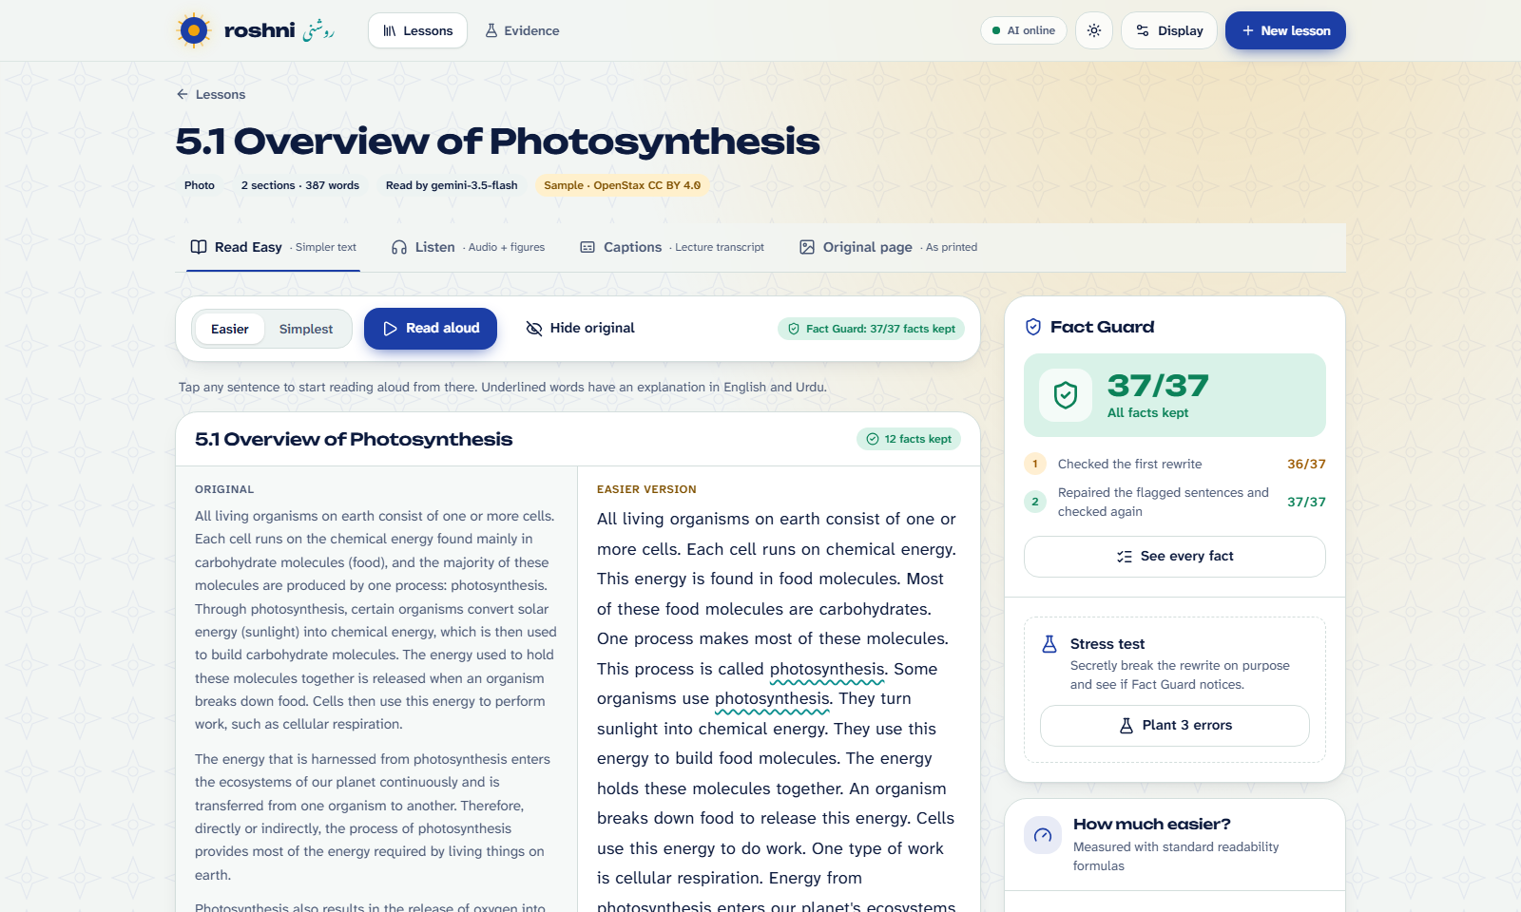
03 · LIVE DEMO · 2 MINUTES
Watch a real page become a lesson
1
Photograph a printed page
Gemini reads it in about 5 seconds
2
Read Easy
Read-aloud highlighting, Urdu help, Fact Guard badge
Plant 3 errors
Backup if the Wi-Fi fails: the same pipeline on cached sample lessons (demo mode).
3
Fact Guard catches them and repairs the rewrite
4
Listen and Captions
Figures described, lecture transcript synced
Notes:
[1:30–3:30] SWITCH TO THE APP. 1) Photograph the printed page and upload it (about 5 s). 2) Read Easy: press Read aloud, tap an underlined word for the Urdu explanation and audio, point at the Fact Guard badge. 3) Press Plant 3 errors: the cards flip to Caught, then the rewrite is repaired back to green. 4) Listen tab: Alt+N jumps sections, show a figure description. Captions tab: click a line to jump the audio. If anything is slow, open the cached physics sample instead.

Slide 5




04 · WHY YOU CAN TRUST IT
Fact Guard: a second AI checks the first
A different AI family checks
STRESS TEST
28/28
It can’t simply agree with the model that rewrote the page.
Quote or it didn’t happen
Every kept fact must be quoted from the rewrite, and code confirms the quote.
planted errors caught: changed numbers, deleted facts, invented claims
Numbers checked by plain code
“50 min” can never quietly become “100 min”.
0/142
Repair, then re-check
false alarms on unchanged facts
Only flagged sentences are rewritten. Anything left stays visibly amber.
Notes:
[3:30–4:00] Simplifying text can quietly drop a fact or change a number, so we built Fact Guard. A different AI family checks the rewrite, every kept fact must be quoted, numbers are checked by plain code, and anything missing is repaired. You just saw it live. In testing it caught all planted errors with zero false alarms.

Slide 6
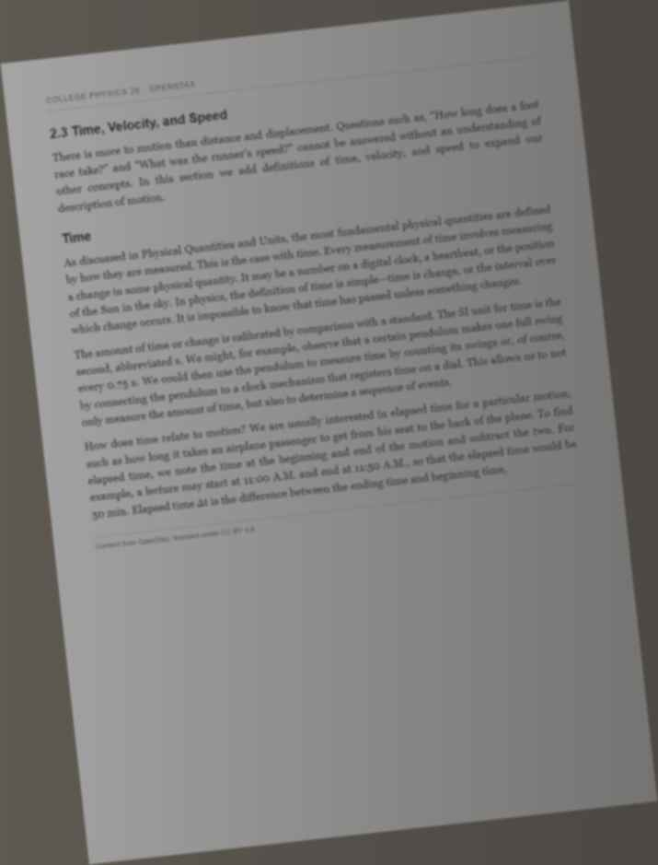
05 · MEASURED, NOT CLAIMED
Real textbook pages, real numbers
28/28
0/142
99%
planted errors caught by Fact Guard
false alarms on unchanged facts
facts verifiably kept in the rewrite
11.0 → 6.3
99.98%
26 s
reading grade, original → Easier
page reading, even on this hard photo
to make a lesson, on free tiers
OpenStax textbook pages (CC BY 4.0) · every number comes from a script in our repo’s eval/ folder · synthetic test data is labelled
Notes:
[4:00–4:35] Everything here is measured on real OpenStax textbook pages by scripts in our repo. Fact Guard caught every planted error with no false alarms. 99% of facts are verifiably kept. Reading level drops from grade 11 to about 6. It reads even this blurry, tilted photo almost perfectly, and a lesson takes under half a minute on free tiers.

Slide 7
06 · WHO ADOPTS IT, AND WHAT WE BUILT
One page. Every learner.
Special-education schools and inclusive-education NGOs
Textbook boards and publishers making accessible editions
School chains with Urdu-medium students in English classes
Employers: accessible training manuals and safety notices
PKR 0
SDG 4.5
Built here
to run, on free tiers
equal access to education
all during AICON’26
Next: a pilot with a special-education school. Thank you! Questions?
Notes:
[4:35–5:00] Who adopts it: special-education schools and NGOs, textbook boards, school chains with Urdu-medium students, and employers making training accessible. It costs nothing to run today and serves SDG 4.5. Everything you saw was built during AICON’26, with an AI coding assistant as the rules allow; our commit history shows it. Next is a pilot with a special-education school. Thank you!

