Slide 1
Roshni
AICON’26 · BUILD WITH AI · EDTECH & WORKFORCE
روشنی
One page. Every learner.
A photo of a textbook page becomes a lesson for blind, dyslexic and deaf students, and a second AI proves no fact was lost.
404 Team Not Found
Notes:
Problem in one line: a printed page works for almost nobody who needs help. Roshni turns one photo into three accessible versions, and Fact Guard proves the facts survived.

Slide 2



One printed page fails three students
Bilal is blind
Sara is dyslexic
Hamza is deaf
He can’t read the page or see its diagrams. Most Urdu and science textbooks have no accessible version.
Long sentences and hard words lose her, and Urdu-medium students hit the same wall with English textbooks.
He misses everything the teacher says while explaining the page.
Their teacher would have to adapt every page three different ways. There is never time, so it doesn’t happen. About 1 in 6 people live with a significant disability (WHO, 2023).
Notes:
Keep this human: three named students, one page. The teacher has no time. WHO estimates 1.3 billion people, about 1 in 6, live with significant disability.

Slide 3




From one photo to three ways to learn
01
02
03
04
Read the page
→
Rewrite it simply
→
Fact Guard
→
Learn your way
Gemini reads the photo, keeps headings and tables, and describes every diagram.
Qwen rewrites at an easier level and explains hard words in Urdu.
GPT-OSS, a different AI family, audits every fact and repairs gaps.
Read Easy, Listen or Captions, with the original always one tap away.
Read Easy
Listen
Captions
Simpler text side by side with the original, Urdu glossary, read-aloud that highlights each sentence, adaptive quiz
Section-by-section audio, every figure described in words, full keyboard and screen-reader control
Lecture transcript synced to the audio, plus a summary Fact Guard checks against what was said
Notes:
AI is the pipeline, not a chat box: vision reading, rewriting, an independent checker, speech-to-text and speech. Remove the AI and nothing works.

Slide 4





Fact Guard: a second AI checks the first
Independent model family
The checker is never from the same family as the rewriter, so it can’t simply agree with itself.
Quote or it didn’t happen
STRESS TEST
A fact counts as kept only when the checker quotes it from the rewrite, and code confirms the quote states it.
28/28
Numbers checked by plain code
planted errors caught: changed numbers, deleted facts and invented claims, slipped into real rewrites by code.
“50 min” can’t quietly become “100 min”. Units, formulas and symbols are compared without AI.
Repair, then re-check
False alarms on unchanged text: 0.0%
Only flagged sentences are rewritten, up to two rounds. Anything still wrong stays visibly amber.
Notes:
Live in the demo: click Plant 3 errors and the cards flip to show what was caught. The false-alarm test audits each original page against itself, where nothing should be flagged.

Slide 5
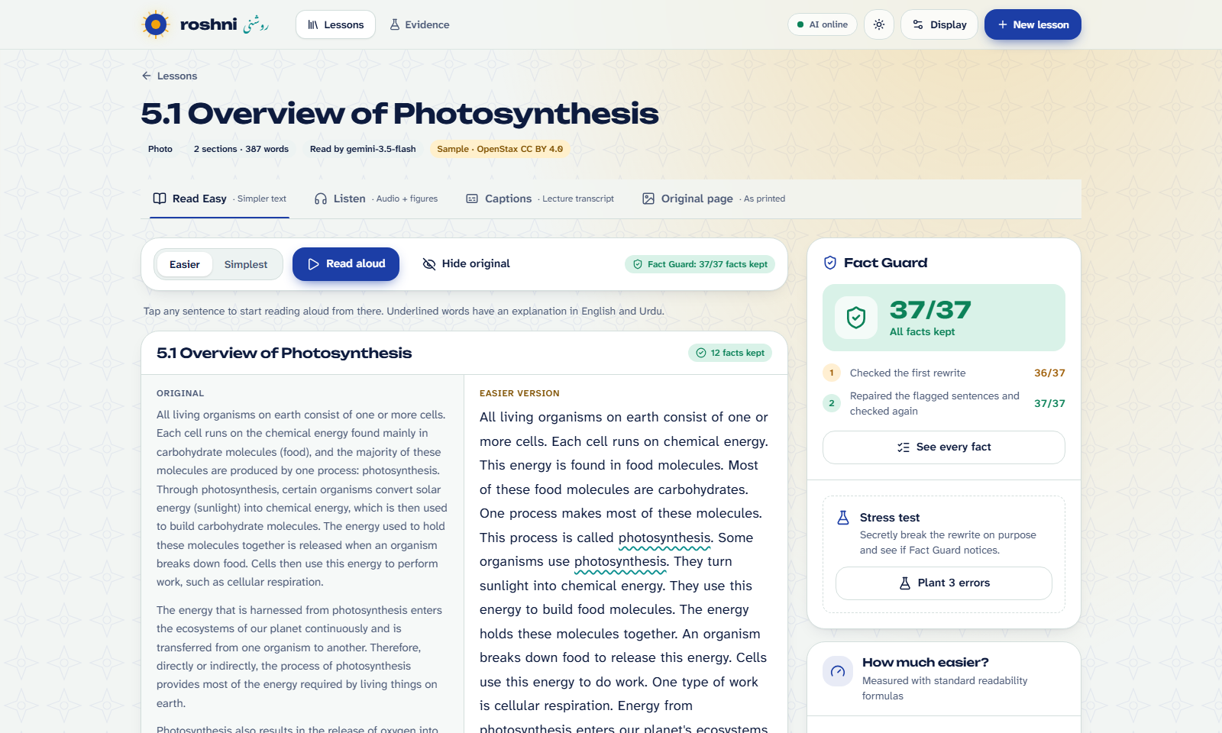
What Sara sees: the same page, easier, with proof
Original beside the rewrite
Nothing is hidden: the printed text is always next to the easier version.
Read-aloud with highlighting
Each sentence lights up as it is read. Tap any sentence to start there.
Urdu where it helps
Hard terms stay in English, with a short Urdu explanation and Urdu audio.
Fact Guard on every page
A badge per section, the full fact list, and a live stress test.
Notes:
Switch to the live app here. Read aloud, tap an underlined word for Urdu, then run the stress test.

Slide 6
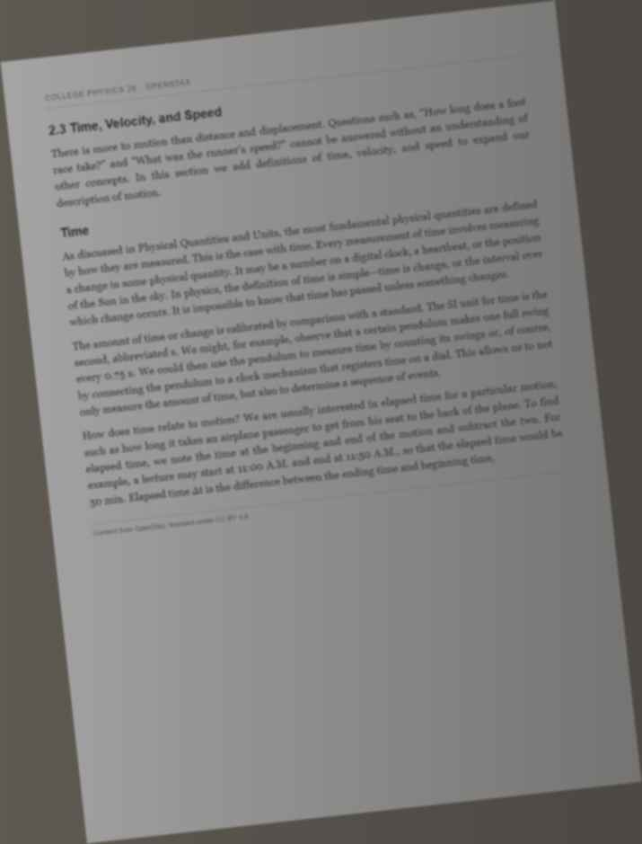
Measured, not claimed
99%
11.0 → 6.3
28/28
Facts kept after Fact Guard
Reading grade, original → Easier
Planted errors caught
291 facts, 10 rewrites
10 rewrites of 5 pages
synthetic errors in real rewrites
0.0%
99.98%
26 s per page
False alarms on unchanged text
Page reading accuracy
Time to make a lesson
142 facts on 5 pages
even on this hard photo
on free tiers, incl. rate-limit waits
Every number comes from a script in eval/ on OpenStax pages (CC BY 4.0). Synthetic test data is labelled. Run them yourself.
Notes:
Stress honesty: real OpenStax text, scripted tests, sample sizes on the Evidence page. Not yet tested with disabled students; that is the pilot.

Slide 7





Who adopts it, and why it scales
Special-education schools
Adapt any page for blind, dyslexic and deaf students in minutes.
PKR 0 to run today
Inclusive-education NGOs
Run accessible classes without a team of specialists.
Free tiers with automatic fallback across 8 models, caching and an offline demo mode.
Textbook boards and publishers
Produce accessible editions and see which pages are too hard.
SDG 4.5 · 4.1 · 10.2
Next: a pilot with one special-education school, testing with blind, dyslexic and deaf students, then printed Urdu pages.
Employers and training providers
Make manuals, safety notices and job material accessible to staff with disabilities.
Notes:
Industrial impact: clear adopters, near-zero running cost, and a workforce angle for accessible training material.

Slide 8
Built during AICON’26
Everything you saw was built in this event: the commit history is the record.
Gemini, Qwen, GPT-OSS and Whisper, all on free tiers. React + FastAPI. OpenStax pages, CC BY 4.0.
We used an AI coding assistant, as the rules allow. Disclosures are in docs/DISCLOSURES.md.
One page. Every learner.
Notes:
Close on the tagline and invite questions. Have the Evidence page open for follow-ups.

