Slide 1

LaNet
YOUR BRIDGE TO LANGUAGE AND CULTURE
Rahel Yekoye-Founder & CEO
Tigist Negussie-Marketing Manager
Thiobista Gedegaw-Full stack developer
Language
Network

Slide 2
Adam grew up in Amhara, speaking Amharic. When he moved to Wolaita for work, he struggled with daily tasks and communication because he didn’t speak Wolaitigna. With no quick way to learn, he felt isolated at work and in the community—just like thousands of others facing the same challenge every day.
Language
Network

Slide 3
THE PROBLEM
Language Barriers in Daily Life
Workplace Challenges
Lack of Local Language Learning Resources
Social Isolation
Slow & Ineffective Learning Methods
Language
Network

Slide 4

SOLUTION
Beginner-Friendly Approach.
AI-Powered Learning
Audio-visual resources
Gamified lessons
Prototype : Alphabet Explorer with audio pronunciations.
Language
Network

Slide 5
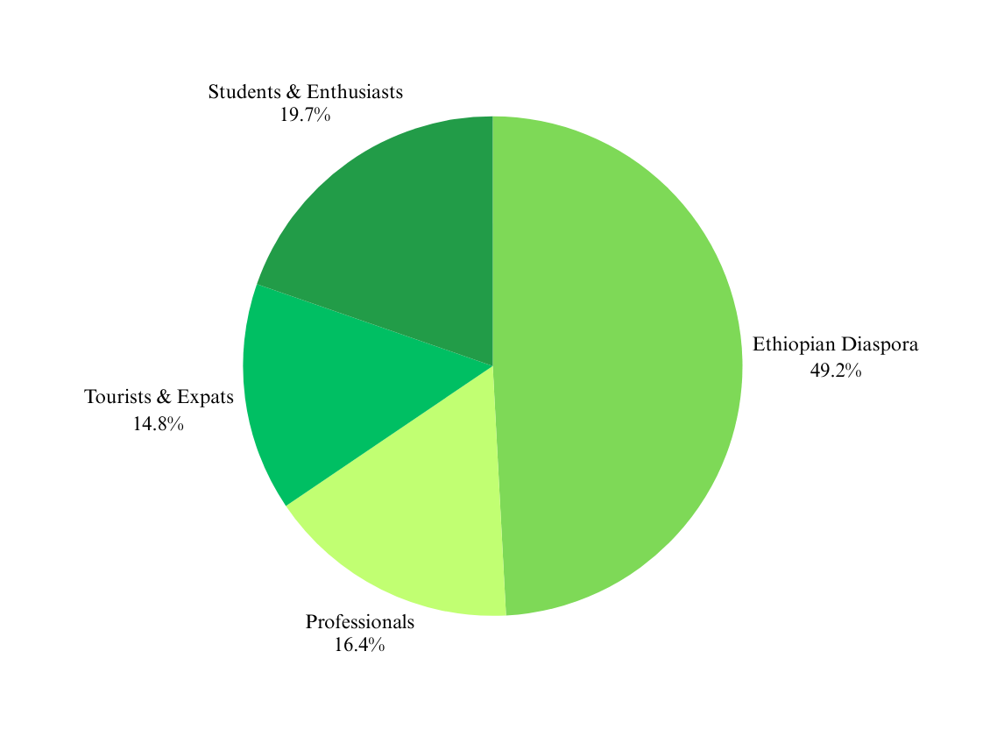
THE TARGET MARKET / OPPORTUNITY
Market Opportunity
Who Needs Lanet?
Millions of Ethiopians face language barriers daily
First tech-driven local language platform.
Language
Network

Slide 6
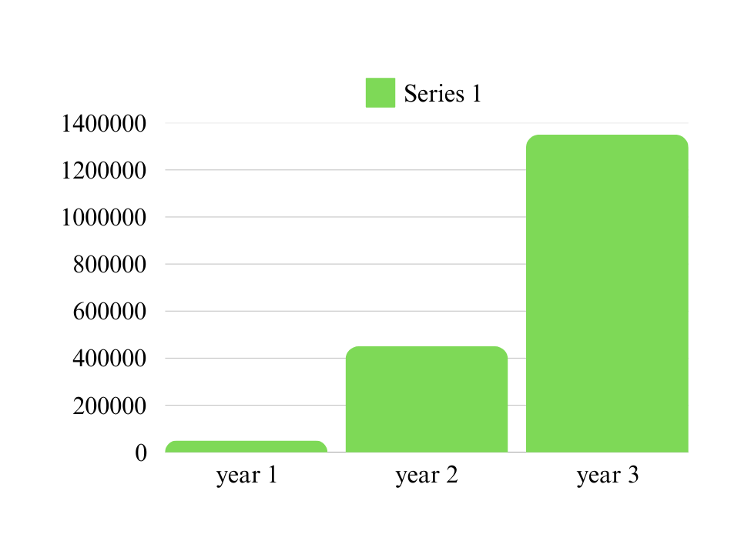
REVENUE / BUSINESS MODEL
Primary Revenue Streams:
Subscription Model
Freemium Model
Corporate Partnerships
Advertisement
In-app Purchases
Language
Network

Slide 7
Next Steps
TRACTION
dataset collection
prototype development
Market Validation
Full platform launch
Expand user base & partnership
Targeting $150,000 in revenue
Language
Network

Slide 8
COMPETITION
Competitor | Duolingo | Memrise | Local Language Schools | Lanet
Focus on local Languages | ❌ | ❌ | ✅ | ✅
AI-driven Translation & Pronunciation | ✅ | ✅ | ❌ | ✅
Gamified Learning | ✅ | ✅ | ❌ | ✅
Target Audience | ✅ | ✅ | ✅ | ✅
Scalability | ✅ | ✅ | ❌ | ✅
Cultural Relevance | ❌ | ❌ | ❌ | ✅
Language
Network

Slide 9
FINANCE
Unit Economics:
Cost per user: $10
Revenue per user: $30
Profit margin: 67%
Break-even Point:
5,000 paying users (reached in Year 1)
Language
Network

Slide 10
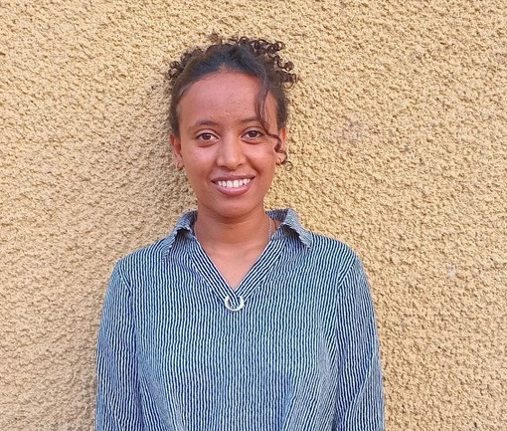

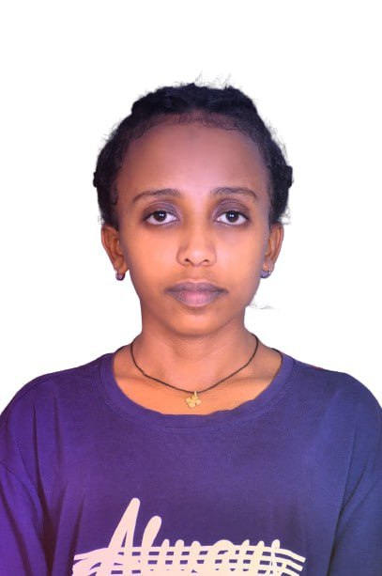
WHY YOU?
Founder & CEO
Marketing manager
Rahel Yekoye
Tigist Negussie
full stack developer
Thiobista Gedefaw
Visionary leader passionate about language preservation and accessibility.
Expert in digital marketing and user acquisition, driving growth and engagement.
Skilled in building scalable, interactive platforms for seamless user experience.
Language
Network

Slide 11
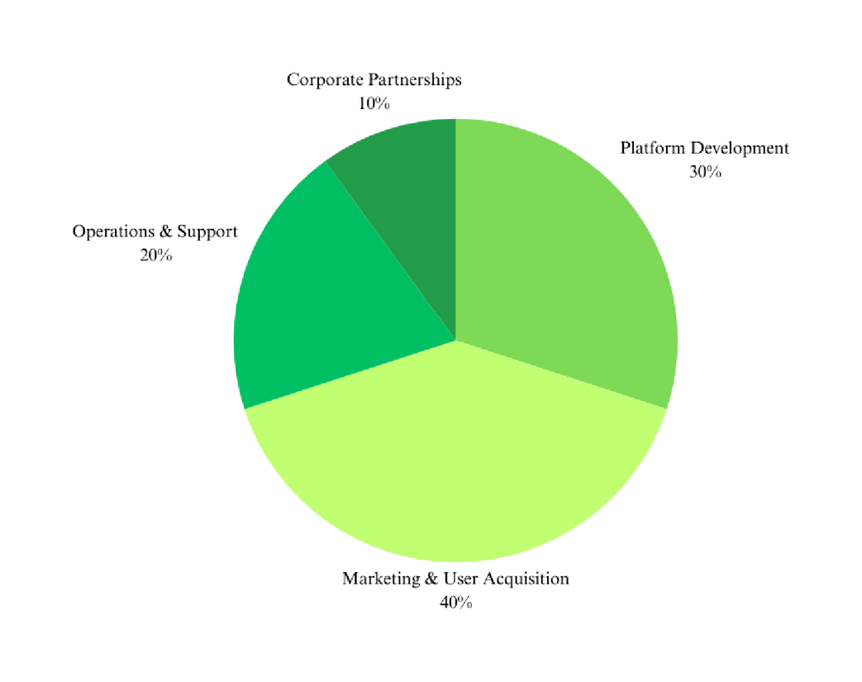
YOUR ASK
We are seeking a $1M investment to scale our platform and transform language learning for millions
Language
Network

Slide 12
CONTACT
- Email: lanet@gmail.com
- Phone: +25196027271
Lets Make Local languages Easy, Engaging, and Accessible
Language
Network

Slide 13

Thank you!
Language
Network

Slide 14
REFERENCES
Market Research Reports:
Global Online Language Learning Market Report
Ethiopian Diaspora & Language Demand Study
Industry Articles & Publications:
“The Growth of Online Learning” – Forbes
“The Role of AI in Language Education” – TechCrunch
Primary Data & Surveys:
Internal survey of 500 Ethiopian language learners
Interviews with 10+ educators and linguists in Ethiopia
Competitor & Market Analysis:
Duolingo Financial Reports
African Language Learning App Comparisons – EdTech Journal
Language
Network

