Slide 1
Artificial Intelligence

Slide 2
Artificial Intelligence
AI is one of the newest sciences.
Work started in earnest soon after World War II, and the name itself was coined in 1956, Along with molecular biology.
AI is regularly cited as the "field I would most like to be in" by scientists in other disciplines.
Definitions of artificial
intelligence according to eight textbooks are shown in Figure 1.1. These definitions vary along two main dimensions.

Slide 3
Roughly, the ones on top are concerned with thought processes and reasoning, whereas the ones on the bottom address behavior.
The definitions on the left measure success in terms of fidelity to human performance, whereas the ones on the right

Slide 4
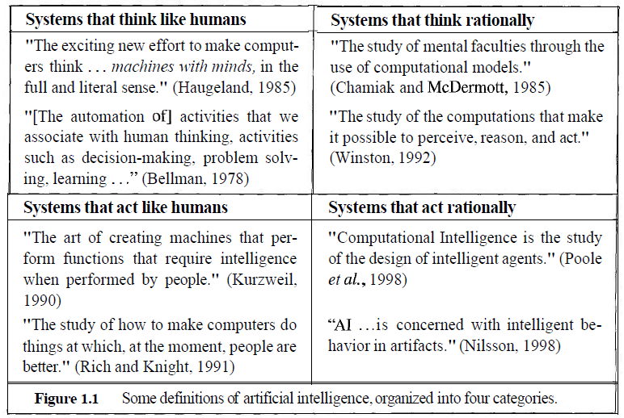


Slide 5
Thinking humanly: The Cognitive Modeling
Reasons like humans do
  Programs that behave like humans
Requires understanding of the internal activities of the brain
  see how humans behave in certain situations and see if you could make computers behave in that same way.
  Protocol analysis (think aloud) can help in understanding how human beings solve a given problem
Example. write a program that plays chess.
  Instead of making the best possible chess-playing program, you would make one that play chess like people do.

Slide 6
Acting humanly: The Turing Test
Can machines act like human do? Can machines behave intelligently?
Turing Test: Operational test for intelligent behavior
  do experiments on the ability to achieve human-level performance,
  Acting like humans requires AI programs to interact with people
Suggested major components of AI: knowledge, reasoning, language understanding, learning

Slide 7
How to make computers act like humans?
The following sub-fields are emerged
Natural Language processing (enable computers communicate in human language, English, Amharic, ..)
Knowledge representation (schemes to store information, both facts and inferences, before and during interrogation)
Automated reasoning (use stored information to answer questions and to draw new conclusions)
Machine learning (adapt to new circumstances and accumulate knowledge)
Computer vision (recognize objects based on patterns in the same way as the human visual system does)
Robotics (produce mechanical device capable of controlled motion; which enable computers to see, hear & take actions)
Is AI equals human intelligence ?

Slide 8
Thinking Rationally: The Laws of Thought
A system is rational if it thinks/does the right thing through correct reasoning.
Aristotle: provided the correct arguments/ thought structures that always gave correct conclusions given correct premises.
  Abebe is a man; all men are mortal; therefore Abebe is mortal
  These Laws of thought governed the operation of the mind and initiated the field of Logic.

Slide 9
Acting rationally: The rational agent
Doing the right thing so as to achieve one’s goal, given one’s beliefs.
AI is the study and construction of rational agents (an agent that perceives and acts)
Rational action requires the ability to represent knowledge and reason with it so as to reach good decision.
  Learning for better understanding of how the world works

Slide 10
History of AI
Formally initiated in 1956 and the name AI was coined by John McCarthy.
The advent of general purpose computers provided a vehicle for creating artificially intelligent entities.
  Used for solving general-purpose problems
Which one is preferred?
  General purpose problem solving systems
  Domain specific systems

Slide 11
History of AI
Development of knowledge-based systems: the key to power
  Performance of general-purpose problem solving methods is weak for many complex domains.
  Use knowledge more suited to make better reasoning in narrow areas of expertise (like human experts do).
  Early knowledge intensive systems include:
    The Dendral program (1969): solved the problem of inferring molecular structure (C₆H₁₃NO₂).
    MYCIN (1976): used for medical diagnosis.
    etc.

Slide 12
History of AI
Shifts from procedural to declarative programming paradigm.
  Rather than telling the computer how to compute a solution, a program consists of a knowledge base of facts and relationships.
  Rather than running a program to obtain a solution, the user asks question so that the system searches through the KB to determine the answer.
Simulate human mind and learning behavior (Neural Network, Belief Network, Hidden Markov Models, etc. )

Slide 13
Intelligent Agent
I want to build a robot that will
  Clean my house
  Information filtering agents
  Cook when I don’t want to
  Wash my clothes
  Cut my hair
  Fix my car (or take it to be fixed)
  Take a note when I am in a meeting
  Handle my emails
  i.e. do the things that I don’t feel like doing…
AI is the science of building machines (agents) that act rationally with respect to a goal.

Slide 14
Strong AI vs. Weak AI
Artificial Intelligence (or AI) is the concept that it is possible for a computer to think in the same sense as humans do.
Strong AI argues that it is possible that one day a computer will be invented which can be called a mind in its fullest sense.
  Strong AI aims to create an agent that can replicate humans intelligence completely; i.e.., it can think, reason, imagine, etc., and do all the things that we currently associate with the human brain.
Weak AI, on the other hand, argues that computers can only appear to think and are not actually conscious in the same way as human brains are.
  The weak AI position holds that AI should try to develop systems which have facets of intelligence, but the objective is not to build a completely sentient entity. For example, weak AI researchers see their contribution as things like expert systems used for medical diagnosis, speech recognition and data mining, which use "intelligent" models, but they do not help create a conscious agent

Slide 15
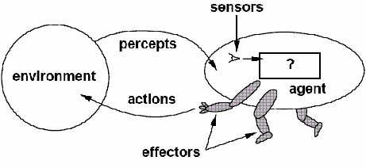
Agent
Agent is something that perceives its environment through SENSORS and acts upon that environment through EFFECTORS.
The agent is assumed to exist in an environment in which it perceives and acts
An agent is rational since it does the right thing to achieve the specified goal.

Slide 16
Agent
 | Human beings | Agents
Sensors | Eyes, Ears, Nose | Cameras, Scanners, Mic, infrared range finders
Effectors | Hands, Legs, Mouth | Various Motors (artificial hand, artificial leg), Speakers, Radio

Slide 17
Examples of agents in different types of applications
Agent type
Percepts
Actions
Goals
Environment
Healthy patients, minimize costs
Medical diagnosis system
Symptoms, patient's answers
Questions, tests, treatments
Patient, hospital
Interactive English tutor
Typed words, questions, suggestions
Write exercises, suggestions, corrections
Maximize student's score on exams
Set of students, materials
Part-picking robot
Pixels of varying intensity
Pick up parts and sort into bins
Place parts in correct bins
Conveyor belts with parts
Pixels intensity, color
Satellite image analysis system
Print a categorization of scene
Correct categorization
Images from orbiting satellite
Refinery controller
Temperature, pressure readings
Open, close valves; adjust temperature
Maximize purity, yield, safety
Refinery

Slide 18
Rationality vs. Omniscience
Rational agent acts so as to achieve one's goals, given one's beliefs (one that does the right thing).
  What does right thing mean? one that will cause the agent to be most successful and is expected to maximize goal achievement, given the available information
An Omniscient agent knows the actual outcome of its actions, and can act accordingly, but in reality omniscience is impossible.
Rational agents take action with expected success, where as omniscient agent take action with 100% sure of its success
Is human beings Omniscient or Rational agent?

Slide 19
Example
You are walking along the road to Giorgis; You see an old friend across the street. There is no traffic.
So, being rational, you start to cross the street.
Meanwhile a big banner falls off from above and before you finish crossing the road, you are flattened.
Were you irrational to cross the street?
This points out that rationality is concerned with expected success, given what has been perceived.
  Crossing the street was rational, because most of the time, the crossing would be successful, and there was no way you could have foreseen the falling banner.
  The EXAMPLE shows that we can not blame an agent for failing to take into account something it could not perceive. Or for failing to take an action that it is incapable of taking.

Slide 20
Rational agent
In summary what is rational at any given point depends on four things.
  Perception: Everything that the agent has perceived so far concerning the current scenario in the environment
  Knowledge: What an agent already knows about the environment
  Action: The actions that the agent can perform back to the environment
  Performance measure: The performance measure that defines degrees of success of the agent
Therefore in designing an intelligent agent, one has to remember PEAS (Performance, Environment, Actuators, Sensors) framework.

Slide 21
Performance measure
How do we decide whether an agent is successful or not?
  Establish a standard of what it means to be successful in an environment and use it to measure the performance
  A rational agent should do whatever action is expected to maximize its performance measure, on the basis of the evidence provided by the percept sequence and whatever built-in knowledge the agent has.
What is the performance measure for “crossing the road”?
What about “Chess Playing”?

Slide 22
Assignment 1 Due Date August 10/2009
Consider the need to design a “taxi driver agent” that serves in Addis Ababa City;
  Identify sensors, effectors, goals, environment and performance measure that should be integrated for the agent to be successful in its operation?
  Note: The taxi driver needs to know where it is? What else is on the road? How fast it has to drive? How to communicate with the passengers and other vehicles?

Slide 23
Designing an agent
A physical agent has two parts: architecture + program
Architecture
  Runs the programs
  Makes the percept from the sensors available to the programs
  Feeds the program’s action choices to the effectors
Programs
  Accepts percept from an environment and generates actions
    Before designing an agent program, we need to know the possible percept and actions
  By enabling a learning mechanism, the agent could have a degree of autonomy, such that it can reason and take decision

Slide 24
Program Skeleton of Agent
function SKELETON-AGENT (percept) returns action
static: knowledge, the agent’s memory of the world
knowledge← UPDATE-KNOWLEDGE(knowledge,percept)
action ← SELECT-BEST-ACTION(knowledge)
knowledge← UPDATE-KNOWLEDGE (knowledge, action)
return action
On each invocation, the agent’s knowledge base is updated to reflect the new percept, the best action is chosen, and the fact that the action taken is also stored in the knowledge base. The knowledge base persists from one invocation to the next.
NOTE: Performance measure is not part of the agent

Slide 25
Classes of Environments
Actions are done by the agent on the environment. Environments provide percepts to an agent.
Agent perceives and acts in an environment. Hence in order to design a successful agent , the designer of the agent has to understand the type of the environment it interacts with.
Properties of Environments:
  Fully observable vs. partially observable
  Deterministic vs. stochastic
  Episodic vs. non-episodic
  Static vs. Dynamic
  Discrete vs. continuous

Slide 26
Fully observable vs. partially observable
Does the agent’s sensory see the complete state of the environment?
  If an agent has access to the complete state of the environment, then the environment is accessible or fully observable.
An environment is effectively accessible if the sensors detect all aspects that are relevant to the choice of action.
Taxi driving is partially observable
  Any example of fully observable?

Slide 27
Deterministic vs. stochastic
Is there a unique mapping from one state to another state for a given action?
The environment is deterministic if the next state is completely determined by
  the current state of the environment and
  the actions selected by the agents.
Taxi driving is non-deterministic (i.e. stochastic)
  Any example of deterministic?

Slide 28
Episodic vs. Sequential
Does the next “episode” depend on the actions taken in previous episodes?
In an episodic environment, the agent's experience is divided into "episodes".
  Each episode consists of the agent perceiving and then acting. The quality of its action depends just on the episode itself.
In sequential environment the current decision could affect all future decisions
Taxi driving is sequential
  Any example of Episodic?

Slide 29
Static vs. Dynamic
Can the world change while the agent is thinking?
  If the environment can change while the agent is on purpose, then we say the environment is dynamic for that agent
  otherwise it is static.
Taxi driving is dynamic
  Any example of static?

Slide 30
Discrete vs. Continuous
Are the distinct percepts & actions limited or unlimited?
  If there are a limited number of distinct, clearly defined percepts and actions, we say the environment is discrete.
Taxi driving is continuous
  Any example of discrete?

Slide 31
Environment Types
Below are lists of properties of a number of familiar environments
Problems | Observable | Deterministic | Episodic | Static | Discrete
Crossword Puzzle | Yes | Yes | No | Yes | Yes
Part-picking robot | No | No | Yes | No | No
Web shopping program | No | No | No | No | Yes
Tutor | No | No | No | Yes | Yes
Medical Diagnosis | No | No | No | No | No
Taxi driving | No | No | No | No | No
Hardest case: a environment that is inaccessible, sequential, non-deterministic, dynamic, continuous.

Slide 32
Five types of agents
Simple reflex agents
works by finding a rule whose condition matches the current situation (as defined by the percept) and then doing the action associated with that rule.
E.g. If the car in front brakes, and its brake lights come on, then the driver should notice this and initiate braking,
  Some processing is done on the visual input to establish the condition. If "The car in front is braking"; then this triggers some established connection in the agent program to the action "initiate braking". We call such a connection a condition-action rule written as: If car-in-front-is breaking then initiate-braking.
Humans also have many such conditions. Some of which are learned responses. Some of which are innate (inborn) responses
  Blinking when something approaches the eye.

Slide 33
Structure of a simple reflex agent
Simple Reflex Agent
sensors
What the world is like now
Environment
Condition - action rules
What action I should do now
effectors
function SIMPLE-REFLEX-AGENT(percept) returns action
static: rules, a set of condition-action rules
state ← INTERPRET-INPUT (percept)
rule ← RULE-MATCH (state,rules)
action ← RULE-ACTION [rule]
return action

Slide 34
Model-Based Reflex Agent
This is a reflex agent with internal state.
  It keeps track of the world that it can’t see now.
It works by finding a rule whose condition matches the current situation (as defined by the percept and the stored internal state)
  If the car is a recent model -- there is a centrally mounted brake light. With older models, there is no centrally mounted, so what if the agent gets confused?
Is it a parking light? Is it a brake light? Is it a turn signal light?
  Some sort of internal state should be in order to choose an action.
  The camera should detect two red lights at the edge of the vehicle go ON or OFF simultaneously.
The driver should look in the rear-view mirror to check on the location of near by vehicles. In order to decide on lane-change the driver needs to know whether or not they are there. The driver sees, and there is already stored information, and then does the action associated with that rule.

Slide 35
Structure of Model-Based reflex agent
State
sensors
How the world evolves
What the world is like now
What my actions do
Environment
Condition - action rules
What action I should do now
effectors
function REFLEX-AGENT-WITH-STATE (percept) returns action
static: state, a description of the current world state
rules, a set of condition-action rules
state ← UPDATE-STATE (state, percept)
rule ← RULE-MATCH (state, rules)
action ← RULE-ACTION [rule]
state ← UPDATE-STATE (state, action)
return action

Slide 36
Goal based agents
Choose actions that achieve the goal (an agent with explicit goals)
Involves consideration of the future:
    Knowing about the current state of the environment is not always enough to decide what to do.
  For example, at a road junction, the taxi can turn left, right or go straight.
    The right decision depends on where the taxi is trying to get to. As well as a current state description, the agent needs some sort of goal information, which describes situations that are desirable. E.g. being at the passenger's destination.
The agent may need to consider long sequences, twists and turns to find a way to achieve a goal.

Slide 37
Structure of a Goal-based agent
State
sensors
How the world evolves
What the world is like now
What my actions do
What it will be like if I do action A
Environment
Goals
What action I should do now
effectors
function GOAL_BASED_AGENT (percept) returns action
state ← UPDATE-STATE (state, percept)
action ← SELECT-ACTION [state, goal]
state ← UPDATE-STATE (state, action)
return action

Slide 38
Utility based agents
Goals are not really enough to generate high quality behavior.
  For e.g., there are many action sequences that will get the taxi to its destination, thereby achieving the goal. Some are quicker, safer, more reliable, or cheaper than others. We need to consider Speed and safety
When there are several goals that the agent can aim for, non of which can be achieved with certainty. Utility provides a way in which the likelihood of success can be weighed up against the importance of the goals.
An agent that possesses an explicit utility function can make rational decisions.

Slide 39
Structure of a utility-based agent
State
sensors
How the world evolves
What the world is like now
What my actions do
What it will be like if I do action A
Environment
Utility
How happy I will be in such as a state
What action I should do now
effectors
function UTILITY_BASED_AGENT (percept) returns action
state ← UPDATE-STATE (state, percept)
action ← SELECT-OPTIMAL_ACTION [state, goal]
state ← UPDATE-STATE (state, action)
return action

Slide 40
Problem solving

Slide 41
Problem
It is a gap between what actually is and what is desired.
  A problem exists when an individual becomes aware of the existence of an obstacle which makes it difficult to achieve a desired goal or objective.
A number of problems are addressed in AI, both:
  Toy problems: are problems that are useful to test and demonstrate methodologies.
    Can be used by researchers to compare the performance of different algorithms
    e.g. 8-puzzle, n-queens, vacuum cleaner world, towers of Hanoi, …
  Real-life problems: are problems that have much greater commercial/economic impact if solved.
    Such problems are more difficult and complex to solve, and there is no single agreed-upon description
    E.g. Route finding, Traveling sales person, etc.

Slide 42
Solving a problem
Formalize the problem: Identify the collection of information that the agent will use to decide what to do.
Define states
  States describe distinguishable stages during the problem-solving process
  Example- What are the various states in route finding problem?
    The various places including the location of the agent
Define the available operators/rules for getting from one state to the next
  Operators cause an action that brings transitions from one state to another by applying on a current state
Suggest a suitable representation for the problem space/state space
  Graph, table, list, set, … or a combination of them

Slide 43
State space of the problem
The state space defines the set of all relevant states reachable from the initial state by (any) sequence of actions through iterative application of all permutations and combinations of operators
State space (also called search space/problem space) of the problem includes the various states
  Initial state: defines where the agent starts or begins its task
  Goal state: describes the situation the agent attempts to achieve
  Transition states: other states in between initial and goal states
Example – Find the state space for route finding problem where the agent wants to go from Poly-Campus to Peda-Campus.
  Think of the states reachable from the initial state until we reach to the goal state.

Slide 44
Example: Coloring problem
  There are 3 rectangles. Both are initially white. The problem is to change all rectangles with white color to black color. Color change is one rectangle at a time. Define state space for coloring problem?

Slide 45
The 8 puzzle problem
Arrange the tiles so that all the tiles are in the correct positions. You do this by moving tiles or space. You can move a tile/space up, down, left, or right, so long as the following conditions are met:
A) there's no other tile blocking you in the direction of the movement; and
B) you're not trying to move outside of the boundaries/edges.
1 | 2 | 3
8 | 4 | 5
7 | 6
1 | 2 | 3
8 |  | 4
7 | 6 | 5

Slide 46
Assignment 2 August 20
Missionary-and-cannibal problem:
Three missionaries and three cannibals are on one side of a river that they wish to cross. There is a boat that can hold one or two people. Find an action sequence that brings everyone safely to the opposite bank (i.e. Cross the river). But you must never leave a group of missionaries outnumbered by cannibals on the same bank (in any place).
Identify the set of states and operators
Show using suitable representation the state space of the problem

Slide 47
Knowledge and types of problems
There are four types of problems:
  Single state problems (Type 1)
  Multiple state problems (Type 2)
  Exploration problems (Type 3)
  Contingency Problems (Type 4)
This classification is based on the level of knowledge that an agent can have concerning its action and the state of the world
Thus, the first step in formulating a problem for an agent is to see what knowledge it has concerning
  The effects of its action on the environment
  Accessibility of the state of the world
This knowledge depends on how it is connected to the environment via its percepts and actions

Slide 48
Example: Vacuum world problem
To simplify the problem (rather than the full version), let;
The world has only two locations
  Each location may or may not contain dirt
  The agent may be in one location or the other
Eight possible world states
Three possible actions (Left, Right, Suck)
  Suck operator clean the dirt
  Left and Right operators move the agent from location to location
Goal: to clean up all the dirt

Slide 49
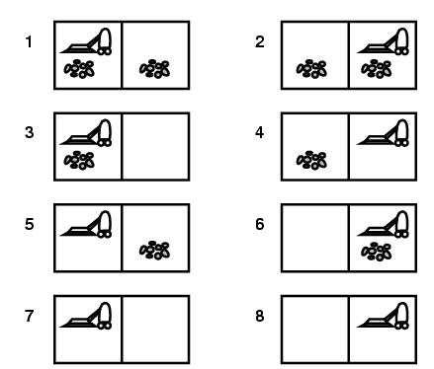
Clean House Task

Slide 50
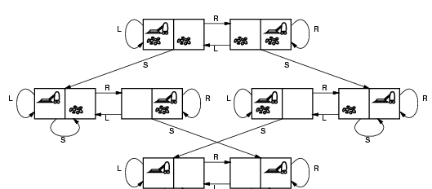
Vacuum Cleaner state Space

Slide 51
Single state problem
Fully observable: The world is accessible to the agent
  It can determine its exact state through its sensors
  The agent’s sensor knows which state it is in
Deterministic: The agent knows exactly the effect of its actions
  It can then calculate exactly which state it will be in after any sequence of actions
Action sequence is completely planned
Example - Vacuum cleaner world
  What will happen if the agent is initially at state = 5 and formulates action sequence - [Right, Suck]?
  Agent calculates and knows that it will get to a goal state
    Right → {6}
    Suck → {8}

Slide 52
Multiple state problems
Partially observable: The agent has limited access to the world state
  It might not have sensors to get full access to the environment states or as an extreme, it can have no sensors at all (due to lack of percepts)
Deterministic: The agent knows exactly what each of its actions do
  It can then calculate which state it will be in after any sequence of actions
If the agent has full knowledge of how its actions change the world, but does not know of the state of the world, it can still solve the task
Example - Vacuum cleaner world
  Agent’s initial state is one of the 8 states: {1,2,3,4,5,6,7,8}
  Action sequence: {right, suck, left, suck}
  Because agent knows what its actions do, it can discover and reach to goal state.
Right → [2.4.6.8.] | Suck → {4,8}
Left → {3,7} | Suck → {7}

Slide 53
Contingency Problems
Partially observable: The agent has limited access to the world state
Non-deterministic: The agent is ignorant of the effect of its actions
Sometimes ignorance prevents the agent from finding a guaranteed solution sequence.
Suppose the agent is in Murphy’s law world
  The agent has to sense during the execution phase, since things might have changed while it was carrying out an action. This implies that
    the agent has to compute a tree of actions, rather than a linear sequence of action
  Example - Vacuum cleaner world:
    action ‘Suck’ deposits dirt on the carpet, but only if there is no dirt already. Depositing dirt rather than sucking returns from ignorance about the effects of actions

Slide 54
Contingency Problems (cont…)
Example - Vacuum cleaner world
  What will happen given initial state {1,3}, and action sequence: [Suck, Right, Suck]?
  {1,3} → {5,7} → {6,8} → {8,6} (failure)
Is there a way to solve this problem?
  Thus, solving this problem requires local sensing, i.e. sensing the execution phase,
  Start from one of the states {1,3}, and take improved action sequence [Suck, Right, Suck (only if there is dirt there)]
Many problems in the real world are contingency problems (exact prediction is impossible)
  For this reason many people keep their eyes open while walking around or driving.

Slide 55
Exploration problem
The agent has no knowledge of the environment
  World Partially observable : No knowledge of states (environment)
    Unknown state space (no map, no sensor)
  Non-deterministic: No knowledge of the effects of its actions
  Problem faced by (intelligent) agents (like, newborn babies)
This is a kind of problem in the real world rather than in a model, which may involve significant danger for an ignorant agent. If the agent survives, it learns about the environment
The agent must experiment, learn and build the model of the environment through its results, gradually, discovering
  What sort of states exist and What its action do
  Then it can use these to solve subsequent (future) problems
Example: in solving Vacuum cleaner world problem the agent learns the state space and effects of its action sequences say: [suck, Right]

Slide 56
Well-defined problems and solutions
To define a problem, we need the following elements: states, operators, goal test function and cost function.
The Initial state: is the state that the agent starts in or begins with.
  Example- the initial state for each of the following:
    Coloring problem
      All rectangles white
    Route finding problem
      The point where the agent start its journey (SidistKilo?)
    8-puzzle problem ??

Slide 57
Operators
The set of possible actions available to the agent, i.e.
  which state(s) will be reached by carrying out the action in a particular state
  A Successor function S(x)
    Is a function that returns the set of states that are reachable from a single state by any single action/operator
    Given state x, S(x) returns the set of states reachable from x by any single action
Example:
  Coloring problem: Paint with black color
  paint (color w, color b)
  Route finding problem: Drive through cities/places
  drive (place x, place y)
  8-puzzle ??

Slide 58
Goal test function
The agent execute to determine if it has reached the goal state or not
  Is a function which determines if the state is a goal state or not
Example:
  Route finding problem: Reach Addis Ababa airport on time
  → IsGoal(x, Addis_Ababa)
  Coloring problem: All rectangles black
  → IsGoal(rectangle[], n)
  8-puzzle ??

Slide 59
Path cost function
A function that assigns a cost to a path (sequence of actions).
  Is often denoted by g. Usually, it is the sum of the costs of the individual actions along the path (from one state to another state)
  Measure path cost of a sequence of actions in the state space. For example, we may prefer paths with fewer or less costly actions
Example:
  Route finding problem:
    Path cost from initial to goal state
  Coloring problem:
    One for each transition from state to state till goal state is reached
  8-puzzle?

Slide 60
Steps in problem solving
Goal formulation
  is a step that specifies exactly what the agent is trying to achieve
  This step narrows down the scope that the agent has to look at
Problem formulation
  is a step that puts down the actions and states that the agent has to consider given a goal (avoiding any redundant states), like:
    the initial state
    the allowable actions etc…
Search
  is the process of looking for the various sequence of actions that lead to a goal state, evaluating them and choosing the optimal sequence.
Execute
  is the final step that the agent executes the chosen sequence of actions to get it to the solution/goal

Slide 61
Assignment (End Class)
Consider one of the following problem:
  Missionary-and-cannibal problem
  Towers of Hanoi
  Tic-Tac-Toe
  Travelling sales person problem
  8-queens
Identify the set of states and operators and construct the state space of the problem
write goal test function
Determine path cost

Slide 62
Uninformed Search

Slide 63
Searching
Examine different possible sequences of actions & states, and come up with specific sequence of operators/actions that will take you from the initial state to the goal state
  Given a state space with initial state and goal state, find optimal sequence of actions leading through a sequence of states to the final goal state
Searching in State Space
  choose min-cost/max-profit node/state in the state space,
  test the state to know whether we reached to the goal state or not,
  if not, expand the node further to identify its successor.

Slide 64
Search Tree
The searching process is like building the search tree that is super imposed over the state space
  A search tree is a representation in which nodes denote paths and branches connect paths. The node with no parent is the root node. The nodes with no children are called leaf nodes.
Example: Route finding Problem
Partial search tree for route finding from Poly to Kebele14
goal test
(a) The initial state
Poly
Poly
(b) After expanding poly
generating a new state
Papyrus
Hospital
Abay-Mado
choosing one option
Hospital
(c) After expanding papyrus
papyrus
Poly
Airport
Kebele14
Peda
Hospital

Slide 65
Search algorithm
Two functions needed for conducting search
  Generator (or successors) function: Given a state and action, produces its successor states (in a state space)
  Tester (or IsGoal) function: Tells whether given state S is a goal state IsGoal(S) → True/False
  IsGoal and Successors functions depend on problem domain.
Two lists maintained during searching
  OPEN list: stores the nodes we have seen but not explored
  CLOSED list: the nodes we have seen and explored
  Generally, search proceeds by examining each node on the OPEN list, performing some expansion operation that adds its children to the OPEN list, and moving the node to the CLOSED list.
Merge function: Given successor nodes, it either append, prepend or arrange based on evaluation cost
Path cost: function assigning a numeric cost to each path; either from initial node to current node and/or from current node to goal node

Slide 66
Search algorithm
Input: a given problem (Initial State + Goal state + transit states and operators)
Output: returns optimal sequence of actions to reach the goal.
function GeneralSearch (problem, strategy)
  open = (initialState); //put initial state in the List
  closed = {}; //maintain list of nodes examined earlier
  while (not (empty (open)))
  f = remove_first(open);
  if IsGoal (f) then return (f);
  closed = append (closed, f);
  succ = Successors (f)
  left = not-in-closed (succ, closed );
  open = merge (rest(open), left); //append or prepend l to open list
  end while
  return ('fail')
  end GeneralSearch

Slide 67
Algorithm Evaluation: Completeness and Optimality
Is the search strategies find solutions to problems with no solutions
  Is it produces incorrect solutions to problems
Completeness
  Is the algorithm guarantees in finding a solution whenever one exists
  Think about the density of solutions in space and evaluate whether the searching technique guaranteed to find all solutions or not.
Optimality
  is the algorithm finding an optimal solution; i.e. the one with minimum cost
    how good is our solution?

Slide 68
Algorithm Evaluation: Time & Space Tradeoffs
With many computing projects, we worry about:
  Speed versus memory
  Time complexity: how long does it take to find a solution
  Space complexity: how much space is used by the algorithm
Fast programs can be written
  But they use up too much memory
Memory efficient programs can be written
  But they are slow
We consider various search strategies
  In terms of their memory/speed tradeoffs

Slide 69
Searching Strategies
Search strategy gives the order in which the search space is examined
Uninformed (= blind) search
  they do not need domain knowledge that guide them to the right direction towards the goal
  Have no information about the number of steps or the path cost from the current state to the goal
  It is important for problems for which there is no additional information to consider
Informed (= heuristic) search
  have problem-specific knowledge (knowledge that is true from experience)
  Have knowledge about how far are the various state from the goal
  Can find solutions more efficiently than uninformed search

Slide 70
Search Methods:
Uninformed search
  Breadth first
  Depth first
  Uniform cost, …
  Depth limited search
  Iterative deepening
  etc.
Informed search
  Greedy search
  A*-search
  Iterative improvement,
  Constraint satisfaction
  etc.

Slide 71
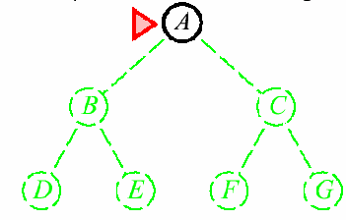
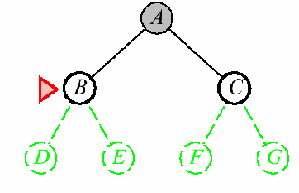
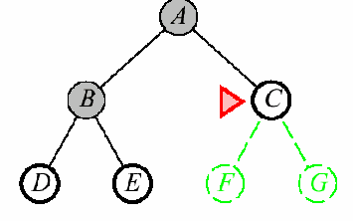
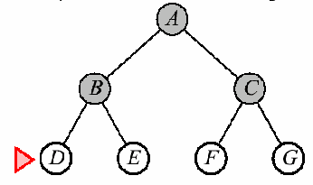
Breadth first search
Expand shallowest unexpanded node,
  i.e. expand all nodes on a given level of the search tree before moving to the next level
Implementation: use queue data structure to store the list:
  Expansion: put successors at the end of queue
  Pop nodes from the front of the queue
Properties:
  Takes space: keeps every node in memory
  Optimal and complete: guarantees to find solution

Slide 72
Algorithm for Breadth first search
function BFS (problem){
  open = (C_0); //put initial state C_0 in the List
  closed = {}; /maintain list of nodes examined earlier
  while (not (empty (open))) {
  f = remove_first(open);
  if IsGoal (f) then return (f);
  closed = append (closed, f);
  l = not-in-set (Successors (f), closed );
  open = merge ( rest(open), l); //append to the list
  }
  return ('fail')
  }

Slide 73
Uniform cost Search
The goal of this technique is to find the shortest path to the goal in terms of cost.
  It modifies the BFS by always expanding least-cost unexpanded node
Implementation: nodes in list keep track of total path length from start to that node
  List kept in priority queue ordered by path cost
Properties:
  This strategy finds the cheapest solution provided the cost of a path must never decrease as we go along the path
  g(successor(n)) ≥ g(n), for every node n
  Takes space since it keeps every node in memory
A
1
10
S
S
S
B
S
S
5
5
G
0
A
B
C
A
B
C
A
B
C
1
5
15
5
15
15
15
5
G
G
G
C
11
11
10

Slide 74
Algorithm for Uniform Cost search
function uniform_cost (problem){
  open = (C_0); //put initial state C_0 in the List
  g(s) = 0;
  closed = {}; /maintain list of nodes examined earlier
  while (not (empty (open))) {
  f = remove_first(open);
  if IsGoal (f) then return (f);
  closed = append (closed, f);
  l = not-in-set (Successors (f), closed );
  g(f,l_{i}) = g(f) + c(f,l_{i});
  open = merge(rest(open), l, g(f,l_{i})); //keep the open list sorted in ascending order by edge cost
  }
  return ('fail')
  }

Slide 75
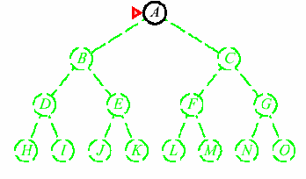
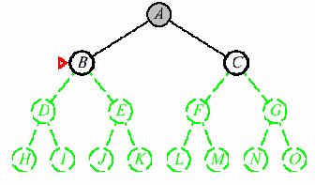
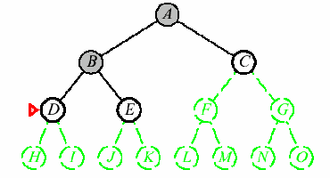
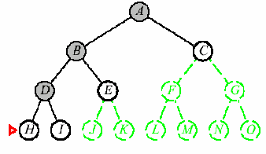
Depth-first search
Expand one of the node at the deepest level of the tree.
  Only when the search hits a non-goal dead end does the search go back and expand nodes at shallower levels
Implementation: treat the list as stack
  Expansion: push successors at the top of stack
  Pop nodes from the top of the stack
Properties
  Incomplete and not optimal: fails in infinite-depth spaces, spaces with loops.
    Modify to avoid repeated states along the path
  Takes less space (Linear): Only needs to remember up to the depth expanded

Slide 76
Algorithm for Depth first search
function DFS (problem){
  open = (C_0); //put initial state C_0 in the List
  closed = {}; /maintain list of nodes examined earlier
  while (not (empty (open))) {
  f = remove_first(open);
  if IsGoal (f) then return (f);
  closed = append (closed, f);
  l = not-in-set (Successors (f), closed );
  open = merge ( rest(open), l); //prepend to the list
  }
  return ('fail')
  }

Slide 77
Iterative Deepening Search (IDS)
IDS solves the issue of choosing the best depth limit by trying all possible depth limit:
  Perform depth-first search to a bounded depth d, starting at d = 1 and increasing it by 1 at each iteration.
Example: for route finding problem we can take the diameter of the state space. In our example, at most 9 steps is enough to reach any node
This search combines the benefits of DFS and BFS
  DFS is efficient in space, but has no path-length guarantee
  BFS finds min-step path towards the goal, but requires memory space
  IDS performs a sequence of DFS searches with increasing depth-cutoff until goal is found
Limit=0
Limit=1
Limit=2

Slide 78
Algorithm for IDS
function IDS (problem){
  open = (C_0); //put initial state C_0 in the List
  closed = {}; /maintain list of nodes examined earlier
  while (not reached maxDepth) {
  while (not (empty (open))) {
  f = remove_first(open);
  if (IsGoal (f)) then return (f);
  closed = append (closed, f);
  l = not-in-set (Successors (f), closed);
  if (depth(l) < maxDepth) then
  open = merge (rest(open), l); //prepend to the list
  }
  }
  return ('fail')
}

Slide 79
Bidirectional Search
Simultaneously search both forward from the initial state to the goal and backward from the goal to the initial state, and stop when the two searches meet somewhere in the middle
  Requires an explicit goal state and invertible operators (or backward chaining).
  Decide what kind of search is going to take place in each half using BFS, DFS, uniform cost search, etc.
Start
Goal

Slide 80
Bidirectional Search
Advantages:
  Only need to go to half depth
  It can enormously reduce time complexity, but is not always applicable
Difficulties
  Do you really know solution? Unique?
  Cannot reverse operators
  Memory requirements may be important: Record all paths to check they meet
    Memory intensive
Note that if a heuristic function is inaccurate, the two searches might miss one another.

Slide 81
Comparing Uninformed Search
Strategies | Complete | Optimal | Time complexity | Space complexity
Breadth first search | yes | yes | O(b^{d}) | O(b^{d})
Depth first search | no | no | O(b^{m}) | O(bm)
Uniform cost search | yes | yes | O(b^{d}) | O(b^{d})
Depth limited search | if l >= d | no | O(b^{l}) | O(bl)
Iterative deepening search | yes | yes | O(b^{d}) | O(bd)
bi-directional search | yes | yes | O(b^{d/2}) | O(b^{d/2})
b is branching factor,
d is depth of the shallowest solution,
m is the maximum depth of the search tree,
l is the depth limit

Slide 82
Heuristic Search? Informed Search
blind search are not always possible (they require too much time or memory).
Weak techniques can be effective if applied correctly on the right kinds of tasks.
  Typically require domain specific information.

Slide 83
Example: 8 Puzzle
1
2
3
1
2
3
7
8
4
8
4
6
5
7
6
5

Slide 84
Which move is best?
1
2
3
GOAL
1
2
3
8
4
7
8
4
7
6
5
6
5
left
up
right
1
2
3
1
2
3
1
2
3
7
8
4
7
8
4
7
4
6
5
6
5
6
8
5

Slide 85
8 Puzzle Heuristics
Blind search techniques used an arbitrary ordering (priority) of operations.
Heuristic search techniques make use of domain specific information - a heuristic.
What heurisitic(s) can we use to decide which 8-puzzle move is “best” (worth considering first).

Slide 86
Heuristic s Information /Manhattan Distance/
Number of tiles in the incorrect position.
  This can also be considered a lower bound on the number of moves from a solution!
  The “best” move is the one with the lowest number returned by the heuristic.
  Is this heuristic more than a heuristic (is it always correct?).
    Given any 2 states, does it always order them properly with respect to the minimum number of moves away from a solution?

Slide 87
Heuristic For Sales Man Problem
The straight line distance between the goal node and different places in which the sales man person possibly can pass through.
PEDA
Newroad2
Siraamerar
Kebele 17
Kebele8
Wisdom
Papyrus
Textile
Astedader
Giorgis
Poly

Slide 88
Evaluation-function driven search
• A search strategy can be defined in terms of a node
evaluation function
• Evaluation function
– Denoted
– Defines the desirability of a node to be expanded next
• Evaluation-function driven search: expand the node (state)
with the best evaluation-function value
• Implementation: priority queue with nodes in the decreasing
order of their evaluation function value

Slide 89
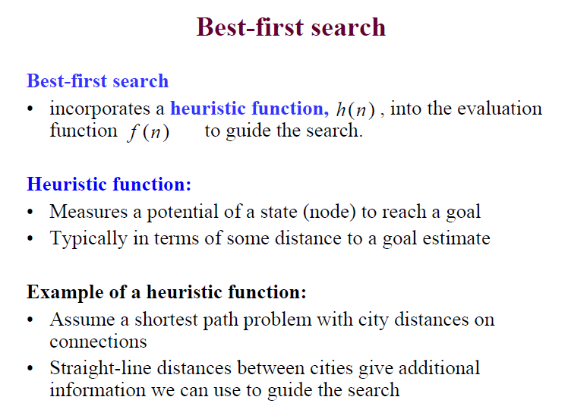

Slide 90
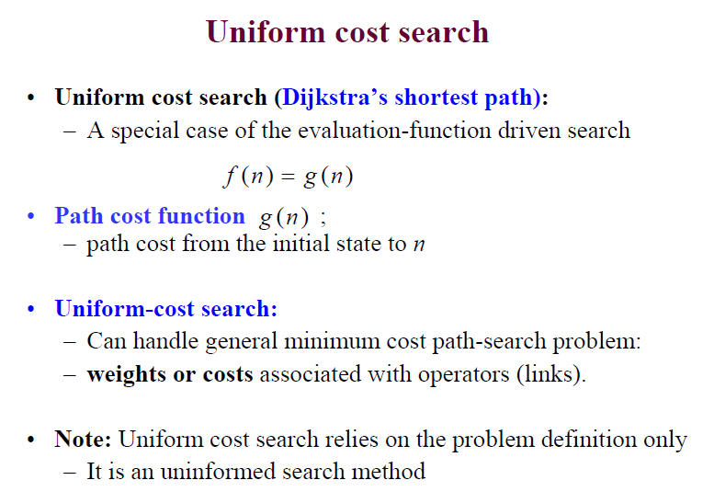

Slide 91
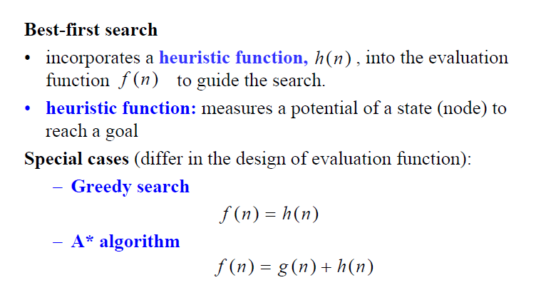

Slide 92
Exercises Greedy Search
PEDA
Goal | Nodes | Disance
Peda | Poly | 780m
Peda | textile | 800m
Peda | astedader | 760m
Peda | giorgis | 890m
Peda | papyrus | 650m
Peda | Kebele 17 | 520m
Peda | siramerar | 200m
Peda | Kebele 8 | 700m
Peda | wisdom | 510m
Peda | newroad1 | 310m
Newroad2
Siraamerar
Kebele 17
Kebele8
Wisdom
Papyrus
Textile
Astedader
Giorgis
Poly

Slide 93
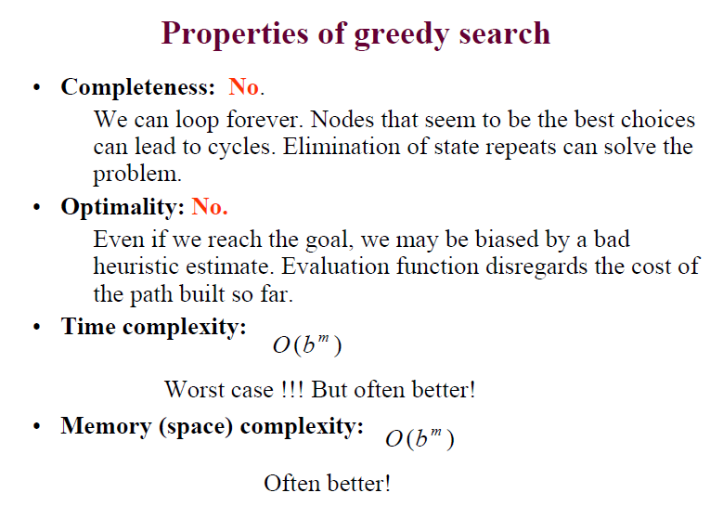

Slide 94
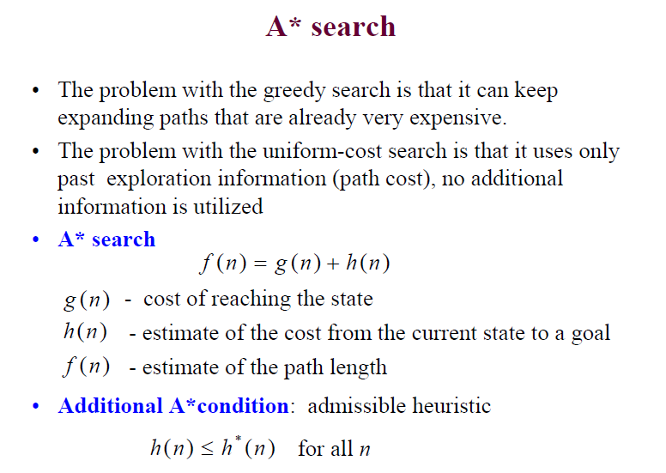

Slide 95
Exercises A* search
PEDA
Goal | Nodes | Disance
Peda | Poly | 780m
Peda | textile | 800m
Peda | astedader | 760m
Peda | giorgis | 890m
Peda | papyrus | 650m
Peda | Kebele 17 | 520m
Peda | siramerar | 200m
Peda | Kebele 8 | 700m
Peda | wisdom | 510m
Peda | newroad1 | 310m
Newroad2
180m
Kebele 17
300m
Siraamerar
500m
300m
300m
300m
Kebele8
300m
Wisdom
500m
Papyrus
250m
300m
300m
Giorgis
Textile
Astedader
200m
290m
70m
Poly

Slide 96
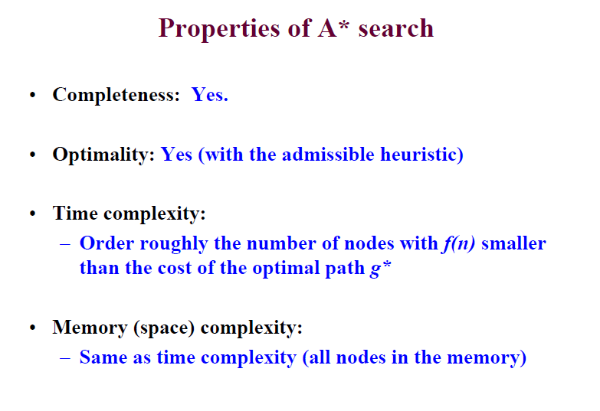

Slide 97
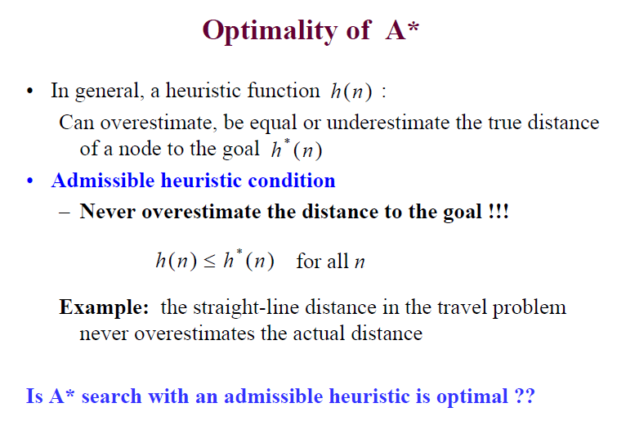

Slide 98
Knowledge Representation
Prepositional Logic

Slide 99
Knowledge-based agent
Any Knowledge base agent should have two important component
  Knowledge base
  Inference engine
Knowledge base (KB):
– A set of sentences that describe facts about the world in some formal (representational) language. It is hard two represent all general knowledge in one KB. Most of the time it is domain specific
• Inference engine:
– A set of procedures that use the representational language to infer new facts from known ones or answer a variety of KB queries. Inferences typically require search. It is domain independent

Slide 100

Example: MYCIN
• MYCIN: an expert system for diagnosis of bacterial infections
• Knowledge base represents
– Facts about a specific patient case
– Rules describing relations between entities in the bacterial infection domain
• Inference engine:
– manipulates the facts and known relations to answer diagnostic queries (consistent with findings and rules)

Slide 101
Knowledge representation
• The objective of knowledge representation is to express the knowledge about the world in a computer tractable form
• Key aspects of knowledge representation languages:
– Syntax: describes how sentences are formed in the language
– Semantics: describes the meaning of sentences, what is it. the sentence refers to in the real world
– Computational aspect: describes how sentences and
objects are manipulated in concordance with semantically conventions
Many KB systems rely on some variant of logic

Slide 102
Logic
A formal language for expressing knowledge and ways of reasoning.
Logic is defined by:
• A set of sentences: A sentence is constructed from a set of primitives according to syntax rules.
• A set of interpretations: An interpretation gives a semantic to primitives. It associates primitives with values.
• The valuation (meaning) function V
– Assigns a value (typically the truth value) to a given sentence under some interpretation
V : sentence × interprétation → {True , False }

Slide 103
Example of logic
Language of numerical constraints:
• A sentence:
• An interpretation:
• Valuation (meaning) function V:
x + 3 ≤ z
x , z - variable symbols (primitives in the language)
x = 5, z = 2
Variables mapped to specific real numbers
V ( x + 3 ≤ z , I ) is False for I: x = 5, z = 2
is True for I: x = 5, z = 10
I:

Slide 104
Types of logic
• Different types of logics possible:
– Propositional logic
– First-order logic
– Temporal logic
– Numerical constraints logic
– Map-coloring logic
In the following:
• Propositional logic.
– Formal language for making logical inferences
– Foundations of propositional logic: George Boole (1854)

Slide 105
• Propositional logic P:
– defines a language for symbolic reasoning
• Proposition: a statement that is either true or false
• Examples of propositions:
– Abay is the largest river in Ethiopia.
– Ethiopia is in Europe.
– It rains outside.
– 2 is a prime number and 6 is a prime
– How are you? Not a proposition.

Slide 106
Propositional logic. Syntax
• Formally propositional logic P:
– Is defined by Syntax + interpretation + semantics of P
Syntax:
• Symbols (alphabet) in P:
– Constants: True, False
– Propositional symbols
Examples:
• P
• Abay is the largest river in Ethiopia.,
• It rains outside, etc.
– A set of connectives:
¬,∧ ,∨ ,⇒ ,⇔

Slide 107
Propositional logic. Syntax
Sentences in the propositional logic:
• Atomic sentences:
– Constructed from constants and propositional symbols
– True, False are (atomic) sentences
– or Light in the room is on, It rains outside are
(atomic) sentences
• Composite sentences:
– Constructed from valid sentences via connectives
– If are sentences then
or
are sentences
P , Q
A, B
¬ A ( A ∧ B ) ( A ∨ B ) ( A ⇒ B ) ( A ⇔ B )
( A ∨ B ) ∧ ( A ∨ ¬ B )

Slide 108
Propositional logic. Semantics.
The semantic gives the meaning to sentences.
the semantics in the propositional logic is defined by:
1. Interpretation of propositional symbols and constants
– Semantics of atomic sentences
2. Through the meaning of connectives
– Meaning (semantics) of composite sentences

Slide 109
Semantic: propositional symbols
A propositional symbol
• a statement about the world that is either true or false
Examples:
– Abay is The largest river in Ethiopia
– It rains outside
– Light in the room is on
• An interpretation maps symbols to one of the two values:
True (T), or False (F), depending on whether the symbol is
satisfied in the world
I: Light in the room is on -> True, It rains outside -> False
I’: Light in the room is on -> False, It rains outside -> False

Slide 110
The meaning (value) of the propositional symbol for a specific interpretation is given by its interpretation
I: Light in the room is on -> True, It rains outside -> False
V(Light in the room is on, I) = True
I’: Light in the room is on -> False, It rains outside -> False
V(Light in the room is on, I’) = False

Slide 111
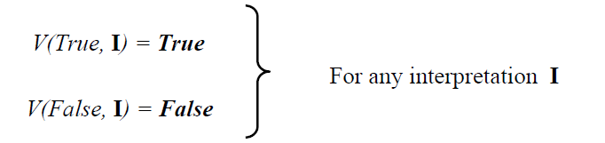
Semantics: constants
• The meaning (truth) of constants:
– True and False constants are always (under any
interpretation) assigned the corresponding True,False

Slide 112
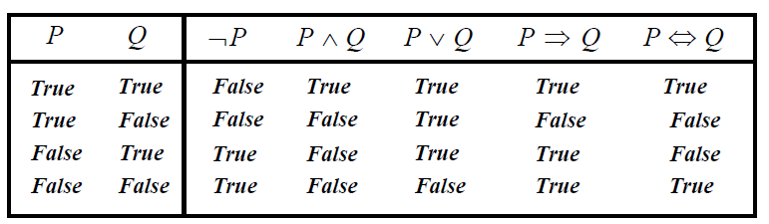
Semantics: composite sentences.
• The meaning (truth value) of complex propositional
sentences.
– Determined using the standard rules of logic:

Slide 113
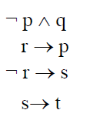
Translation
Assume the following sentences:
• It is not sunny this afternoon and it is colder than yesterday.
• We will go swimming only if it is sunny.
• If we do not go swimming then we will take a canoe trip.
• If we take a canoe trip, then we will be home by sunset.
Denote:
• p = It is sunny this afternoon
• q = it is colder than yesterday
• r = We will go swimming
• s= we will take a canoe trip
• t= We will be home by sunset

Slide 114
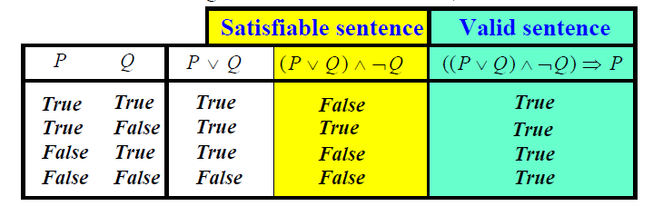
Model, validity and satisfiability
• A model (in logic): An interpretation is a model for a set of
sentences if it assigns true to each sentence in the set.
• A sentence is satisfiable if it has a model;
– There is at least one interpretation under which the
sentence can evaluate to True.
• A sentence is valid if it is True in all interpretations
– i.e., if its negation is not satisfiable (leads to contradiction)

Slide 115
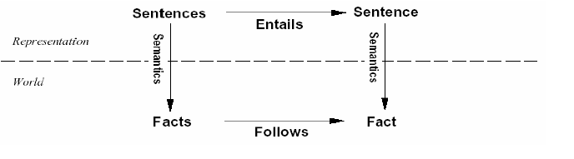

Entailment
Entailment reflects the relation of one fact in the world
following from the others
Entailment
Knowledge base KB entails sentence if and only if is true in all worlds where KB is true

Slide 116

Sound and complete inference.
Inference is a process by which conclusions are reached.
• We want to implement the inference process on a computer !!
Assume an inference procedure i that
• derives a sentence α from the KB :
Properties of the inference procedure in terms of entailment
• Soundness: An inference procedure is sound
• Completeness: An inference procedure is complete

Slide 117

Logical inference problem:
• Given:
– a knowledge base KB (a set of sentences) and
– a sentence α (called a theorem),
• Does a KB semantically entail
In other words: In all interpretations in which sentences in the
KB are true, is also α true?
Question: Is there a procedure (program) that can decide this
problem in a finite number of steps?
Answer: Yes. Logical inference problem for the propositional
logic is decidable.

Slide 118

Solving logical inference problem
In the following:
How to design the procedure that answers:
Three approaches:
• Truth-table approach
• Inference rules
• Conversion to the inverse SAT problem
– Resolution-refutation

Slide 119

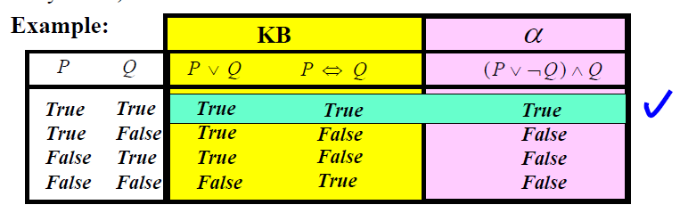
Truth-table approach
Problem:
• We need to check all possible interpretations for which the KB is true (models of KB) whether α is true for each of them
Truth table:
• enumerates truth values of sentences for all possible
interpretations (assignments of True/False to propositional
symbols)

Slide 120
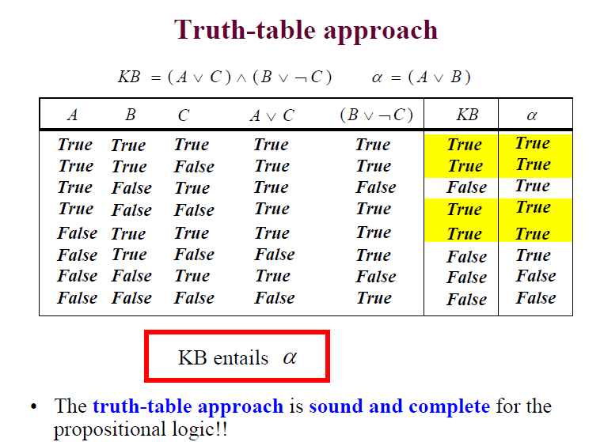

Slide 121
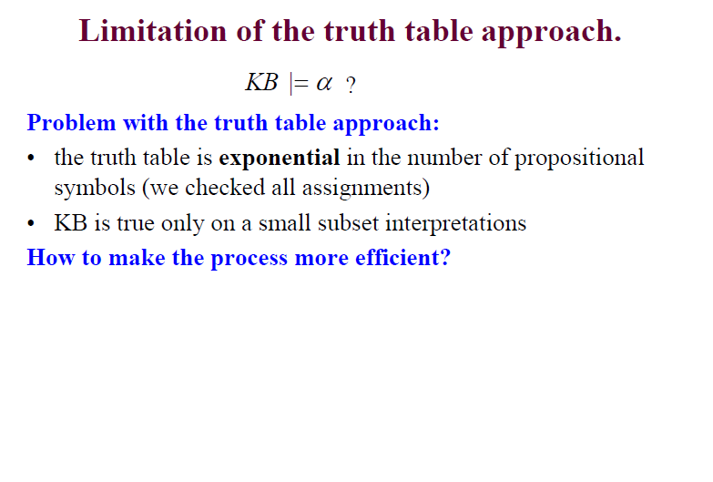

Slide 122
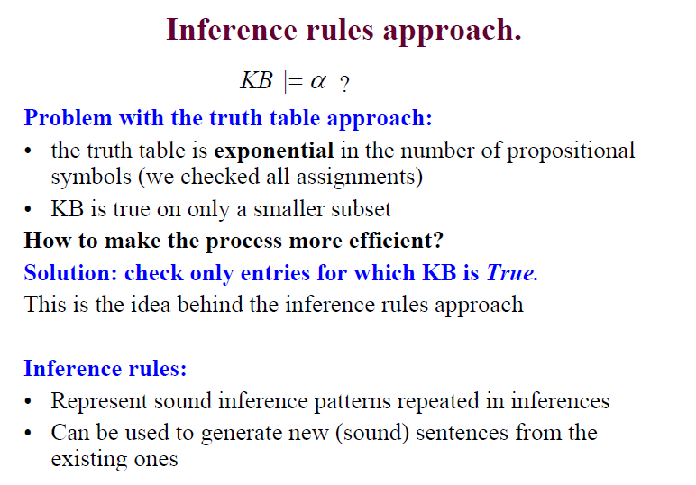

Slide 123
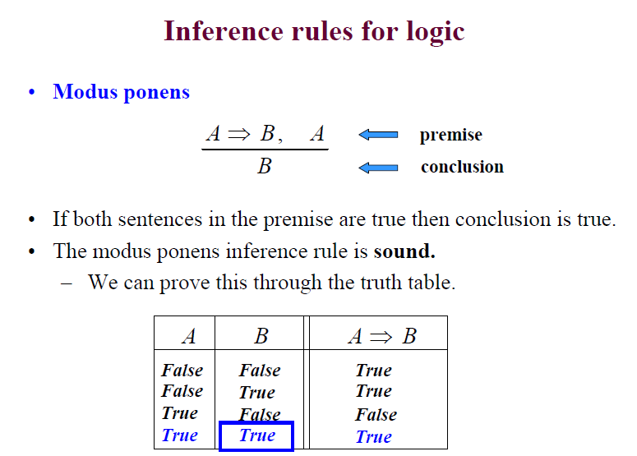

Slide 124
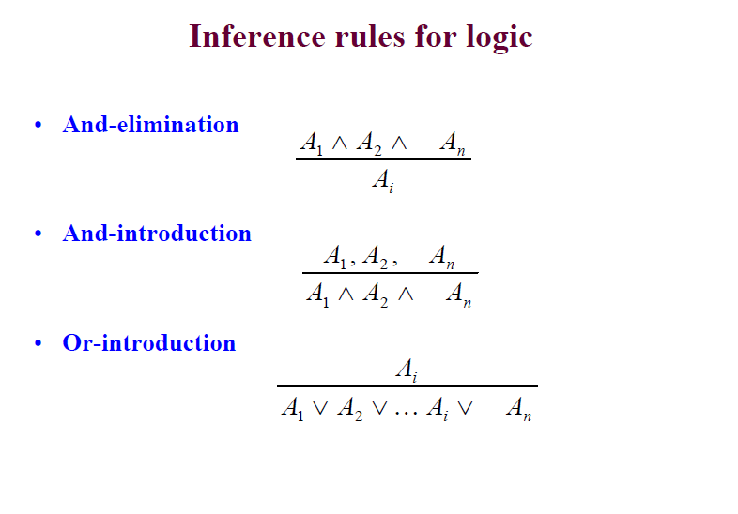

Slide 125
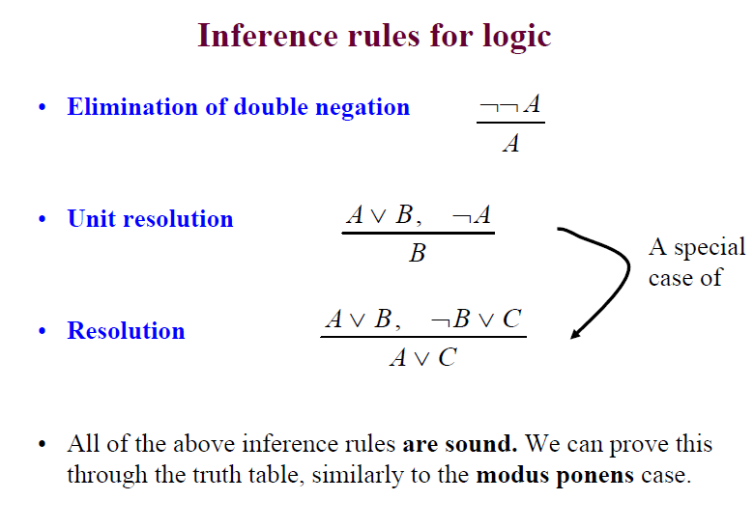

Slide 126
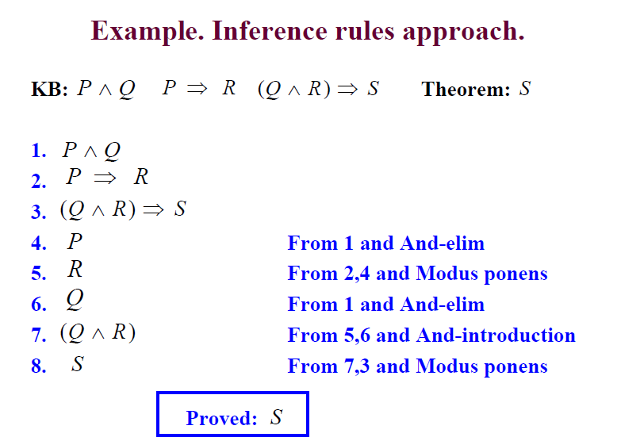

Slide 127
First Order Logic
Representing knowledge with symbolic representation has many draw backs, since the representation doesn’t have any facility that can represents objects and relations between objects, variables and quantifiers in addition to prepositions.

Slide 128
FOL represents objects and relations between objects, variables and quantifiers in addition to prepositions.
Example
Every elephant is gray
in prepositional logic we can represent with some symbol either G or Q as far as the sentences have either a true or false value. Or in prepositional logic we can represent only facts. How ever in FOL the sentence can be represented as :
  ∀x elephant(x)→gray(x).
There is a white dog
  ∃x dog(X)  white(X)

Slide 129
It makes it possible to say that a certain property holds of all objects, of some objects, or of no object.
In predicates logic there are three additional notations.
Terms: terms in first-order logic are used to represent objects or individuals.
Terms can be :
  a constant (designate specific object) For e.g. A, B, Smith, Blue, john kebede etc,
  variable (designate unspecified object): x, y, z, etc, and
  Functions (designate a specific object related in a certain way to another object, or, objects):Father Of, Colour Of, sqrroot.
  Function can also return values
  Connectives retain connectives in prepositional logic

Slide 130
Predicates: Predicates is defined as a relation that binds two atoms have a value of true or false. Used to relate one object with the other.
A predicate can take arguments, which are terms.
  A predicate with one argument expresses a property of an object for e.g. Student(Bob).
  A predicate with two or more arguments expresses a relation between objects for e.g .likes(Bob, Mary).
  Predicate with no arguments is just a simple proposition logic.

Slide 131
Quantifiers: specify whether some or all objects satisfy properties of relations between objects .
Two standard quantifier : Universal(For all quantifier)
For all quantifier
  ∀=all quantifier and ∀ X stands for all X
  For e.g. ∀x P(x) means “for all x, P of x is true”. Example: ∀ Person Happy (Person)
  For all Person, Happy of person is true
  that means everyone is happy.

Slide 132
Universal quantifier make statement about every object
  ∀<variables><sentence>
Example
Every one at Computer Science is smart.
  ∀X at(X,Computer Science)→ smart(X)
All cats are mamal
∀X cat(X)→ mammal(X)
∀X sentence P is true iff P is true with X being each possible object in a given universe.

Slide 133
The above statement is equivalent to the conjunction
    At(Jonas, Computer Science)→smart(Jonas) 
    At(alemu, Computer Science)→smart(alemu) 
    At(abebe, Computer Science)→smart(abebe) 
    At(aster, Computer Science)→smart(aster) ……..
Common Mistakes to avoid
Typically → is the main connective with ∀ Quantifier
    Common Mistakes: The use of  as the main connective with ∀
Example
  Correct: ∀ x (StudiesAt(x;BDU))Smart(x))
  “Everyone who studies at BDU is smart”

Slide 134
Wrong: ∀x (StudiesAt(x;BDU) ^ Smart(x))
“Everyone studies at BDU and is smart”, i.e.,
“Everyone studies at Koblenz and everyone is smart”

Slide 135
Existential Quantifier: Makes statement about some object in the universe
  ∃ <variables><sentence>
Existential Quantifier: if the statement is ∃ x P(x) means
“there exists at least one x for which P of x is true”.
Example: ∃x Happy(x),
If the universe of discourse is people, then this means there is at least one happy person

Slide 136
Example: FOL Sentence
“Every rose has a thorn”
For all X
  if (X is a rose)
  then there exists Y
    (X has Y) and (Y is a thorn)

Slide 137
Every one at computer science Department is smart.
  ∃x at(X,Computer Science) ^ samrt(X)
Spot has sister who is cat
  ∃x sister(Spot,X) ^ cat(X)
  ∃x Sentence P is true if and only if P is true with X being some possible object. ∃x at(X,Computer Science) ^ samrt(X) equivalent to the disjunction
  At(jones, Computer Science) Samrt(Jones) ^
  at(Kebede,Computer Science) smart(Kebede) ^……

Slide 138
Common mistakes to avoid
Note
^ is the main connective with ∃
Common mistake →Using ) as the main connective with ∃
Example
Correct: ∃ x (StudiesAt(x;computer science) ^ Smart(x))
“There is someone who studies computer science and is smart”

Slide 139
Nested Quantifier
The two quantifier may nested one over the other.
Example for all Children Y and Parent X if X is a parent of Y then Y is a child of X.
  ∀XY parent(X,Y)→child(Y,X)
∃ x ∀Y loves(X,Y)
  May be interpreted as . There is a person X who laves every one of Y in the world
∀Y ∃ X loves(Y,X)
  Every one in the world have some x to love in the world

Slide 140
Property of Quantifier
∀X∀Y= ∀Y∀X
∃ X ∃ Y= ∃ Y ∃ X
∃ X ∀ Y is not equal to ∃ Y ∀ X
Eaxmples
∃ x ∀ yLoves(x; y)
“There is a person who loves everyone in the world”
∀ y ∃ xLoves(x; y)
“Everyone in the world is loved by at least one person”

Slide 141
Quantifier Duality
∀xLikes(x,Bread) is the same as ¬ ∃ x¬Likes(x, Bread)
  “Every body likes Bread” is equivalent to the expression “there is no one who dislike Bread”
∃ xLikes(x,Injera) is the same as ¬∀¬Likes(x,Injera)
“There is some one who likes injera is equivalent to the expression “ not all person dislikes injera”

Slide 142
Sentence structure
In the first order formal language the basic unit is predicate(argument/terms) structure called sentence of predicate facts.
Terms refer to objects
Example – likes(aster, chocolate)= mulu likes chocolate
Tall(abebe)= abebe is tall
Terms or arguments can be any of constant symbols such as Mulu variable symbol such as X function such as Motherof(abebe), fatherof(fatherof(aster)

Slide 143
Example represent the following in first order logic
Everything in some garden is lovely.
Every onle likes Cake
Peter has some friends.
John palys Piano or Violinn
Some people Likes snake.
Winston Didn’t write hamlet
Aster has an engineer Brother.
Every soldier has its own gun

Slide 144
Inference Rules
All inference rules that works for Prepositional logic also works for First Order Logic

Slide 145
First Order Logic Inference rules
Variable substitutions
  Variables in the sentences can be substituted with terms. (terms = constants, variables, functions)
  Substitution:
    Is represented by a mapping from variables to terms
  {x1 / t1 , x2 / t2 ,K}
    Application of the substitution to sentences
  SUBST({x / Sam, y / Pam}, Likes(x, y)) = Likes(Sam, Pam)
  SUBST ({x / z, y / fatherof ( John)}, Likes ( x, y)) =
  Likes ( z, fatherof ( John))

Slide 146
Universal elimination
      ∀ x f ( x )
      ________
      f (a )
a - is a constant symbol
– substitutes a variable with a constant symbol
∀ x Likes(x, IceCream) Likes(Ben, IceCream)
Existential elimination.
      ∃ x f ( x )
      __________
      f (a )
– Substitutes a variable with a constant symbol that does not appear elsewhere in the KB
∃ x Kill(x,Victim) Kill(Murderer,Victim)

Slide 147
Inference with resolution rule
Proof by refutation:
  Prove that KB , Ø a is unsatisfiable
  resolution is refutation-complete
Main procedure (steps):
  Convert KB , Ø a to CNF with ground terms and universal variables only
  Apply repeatedly the resolution rule while keeping track and consistency of substitutions
  Stop when empty set (contradiction) is derived or no more new resolvents (conclusions) follow

Slide 148
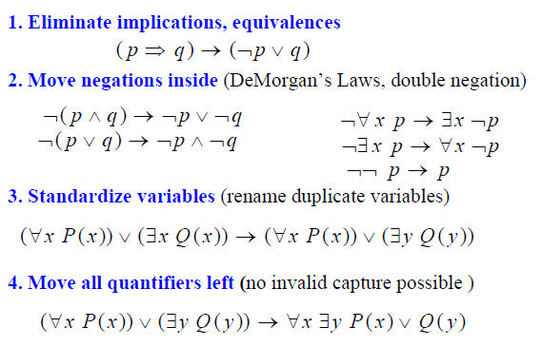
Conversion to CNF

Slide 149
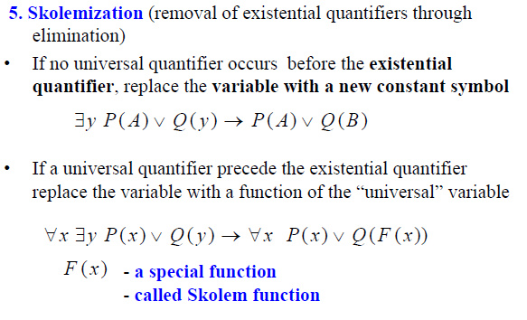

Slide 150
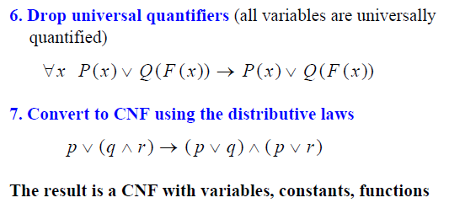

Slide 151
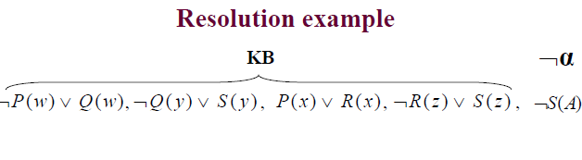
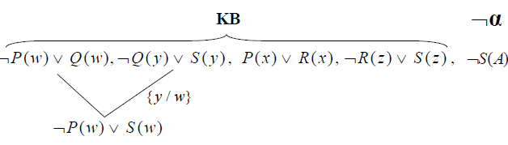

Slide 152
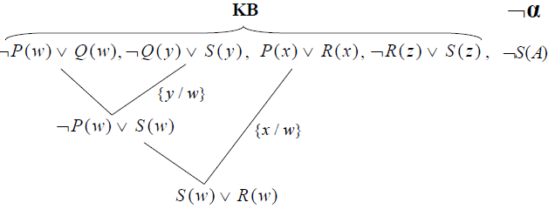

Slide 153
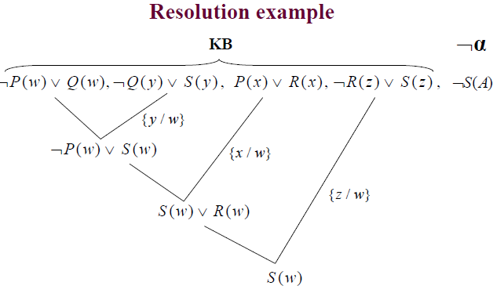

Slide 154
