Slide 1
WOUNDS

Slide 2
Wound...
Outline
Introduction
Classification of wound
Risk fators for wound develpment
Approach to awounded patient

Slide 3
Introduction
Defintion: A wound is a break in the integrity of the skin or tissues, associated with disruption of the structure and function.
it can involve any tissue or organ.
involves varies mechanisms and aetiology

Slide 4
Classification of wound
wound can be classified by:
Based on Time frame(duration) as acute and chronic wound.
Acute wounds
Inury within 3-4 weeks
Heal in a predictable manner and time frame. e.g
laceration
abrasion
puncture
avulsion

Slide 5
continue...
chronic wounds
wounds which have not healed in 3 months.
wound beyond 4-6 weeks and wounds that have not shown 20–40% reduction in area after 2–4 weeks of optimal therapy.
Non healing,recalcitrant,delayed healing wound.
e.g venous and arterial ulcers,
• diabetic ulcers, and
• pressure ulcers

Slide 6
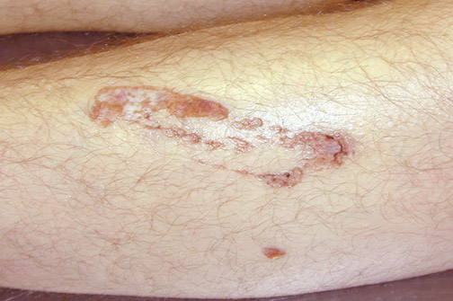
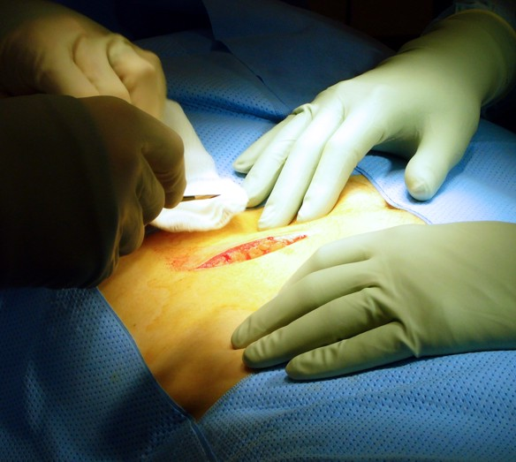
continue...
Based on origin(cause) as
Mechanical,Chemical,Radation,Thermal,Special wounds .
Mechanical wounds
Abrasion: made by a scraping injury to the skin surface,
typically in an irregular fashion
Incised wound: defined as a very regular cut made by a sharp object such as a knife, glass or blade.
Has sharp edge and is less contaminated.

Slide 7
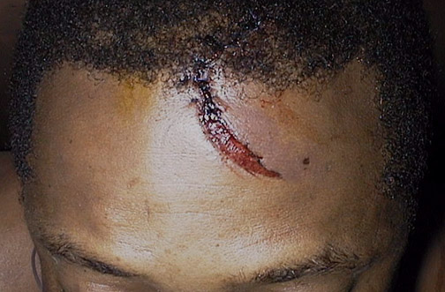
continue...
Lacerations which are deeper than abrasions
and more irregular than incised wounds.

Slide 8
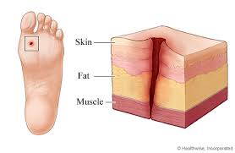
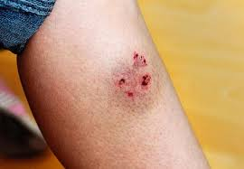
Continue...
Punctured wound:Caused by sharp, pointed objects like nails, needles, or animal bites. These wounds are deeper than they are wide.

Slide 9
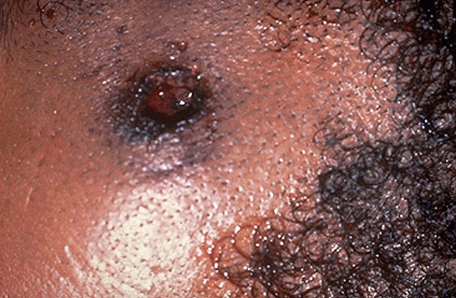
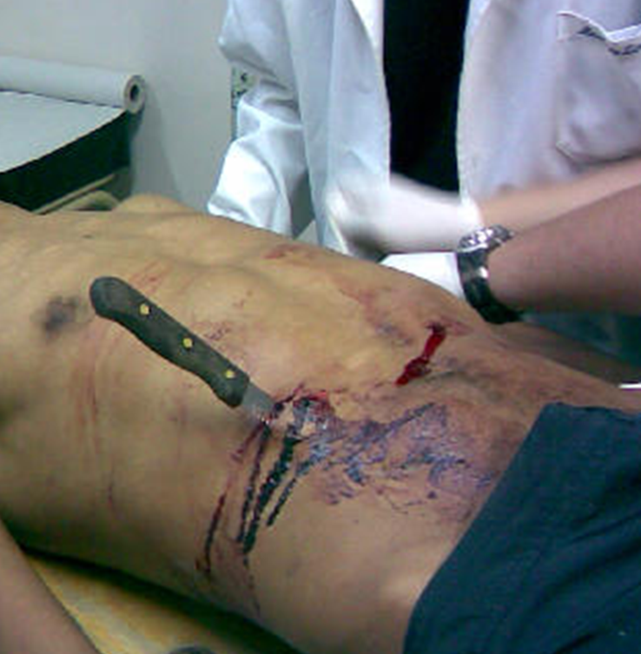
continue...
Penetrating wound:stab injury,bullet injury

Slide 10
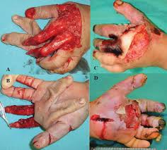
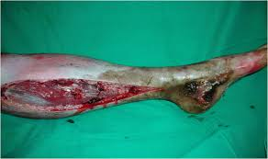
Continue...
Crushed wounds Occur when a body part is compressed or crushed, leading to both soft tissue damage and potential bone fractures

Slide 11
continue...
Thermal Wounds:burn or frostbite
chemical wounds:chemical burn and poisoning
electrical wounds:burn
radiation wound:burn
due to underlying chronic conditions
diabetic foot ulcer
arterial and venous ulcer
pressure ulcer
Notes:
Burns: Caused by exposure to heat, chemicals, electricity, or radiation.
Frostbite: Caused by freezing of the skin and underlying tissues due to extreme cold

Slide 12
continue...
Classification based on bactrial infection:
1) Clean Wound:
Operative incisional wounds thatfollow nonpenetrating (blunt) trauma.
2) Clean/Contaminated Wound:
• uninfected wounds in which no inflammation is encountered but the respiratory, gastrointestinal, genital, and/or urinary tract have been entered.

Slide 13
conti...
3) Contaminated Wound:
• open, traumatic wounds or surgical wounds involving a major break in sterile technique that show evidence of inflammation.
4) Infected Wound:
• old, traumatic wounds containing dead tissue and wounds with evidence of a clinical infection (e.g., purulent drainage).

Slide 14
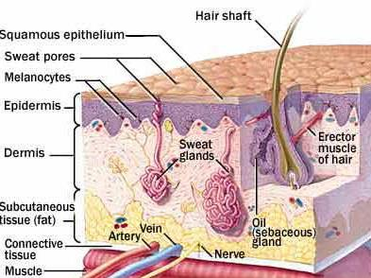

Continue...
Classification based on the depth of injury as
• Superficial
• Partial thickness
• Full thickness
• Deep wound
Including bone, opened cavities, organs…etc

Slide 15
Continue...
Classification based on clinical healing pattern( Wounds Closure)
Healing by Primary tention:All Layers are closed.
The incision that heals by first intention does so in a minimum amount of time, with no separation of the wound edges, and with minimal scar formation.
Healing by Secondary Intention :Deepn layers are closed but superficial layers are left to heal from the inside out.

Slide 16
conti....
Appropriate in cases of infection, excessive trauma, tissue loss, or imprecise approximation of tissue.
Healing by Tertiary Intention: referred to as delayed primary closure.
Occurs in wounds which are left open initially and closed later
too heavily contaminated for primary closure but appear clean and well vascularized after 4 to 5 days of open observation
more rapid closure could be achieved rather than waiting healing by secondary intention.

Slide 17
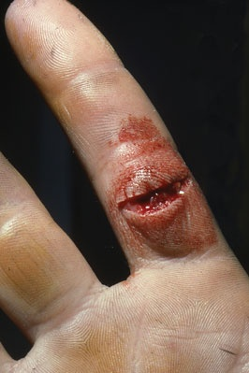
Rank and wakefield wound classification
Tidy wounds
By sharp instrument E.g: surgical incisions, cut from glass or knives
Skin would be sharp and clean
Tendons,arteries and nerves can be involved but repair is usually possible.
Fragments are not common
Contain no devitalized tissue
Can be closed immediately with expectation of primary healing(Well vascularized edges)

Slide 18
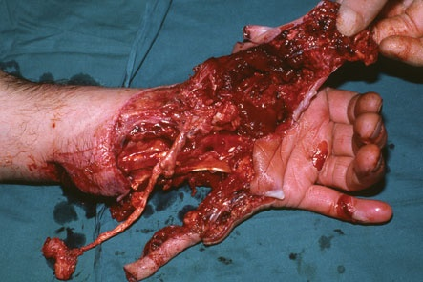
Untidy wounds
Result from crushing, tearing, avulsion or burn
Skin wounds would be multiple and irregular
Fractures are common
Contain devitalized tissue
Healing is unlikely to occur and if it does there will be wound complications

Slide 19
Risk factors for wound development.
Risk factors for wound development
age
trauma or injury
diabetes
HTN
Cardiovascular disease (peripheral arterial diseases,venous insufficiency)
immunosuprression
obesity and smoking
malnutrition
occupation

Slide 20
Risk factors for wound development
Chronic illness that require bed rest
Immobility (bedridden and wheelchair bound indifiduals)
paralysis and mental impairement i. e coma
Infection
Chronic Health Conditions such as liver disease,kidney disease
Previous Wounds/recurrentwounds
Environmental factors such as extreme temperatures (hot or cold), high humidity, and exposure to chemicals can also increase the risk of developing wounds.

Slide 21
Approach to awounded patient
History Taking in Wound Assessment
A. Mechanism of Injury (Nature of Wound)
Cause of Injury:Was the wound caused by trauma (e.g., fall, cut, abrasion, animal bite, burn) or a surgical procedure?
Was it caused by a sharp object (e.g., knife, glass, metal), blunt trauma (e.g., fall), or penetrating injury (e.g., nail, bullet, or puncture)?
For burns: Was the burn caused by heat, chemicals, electricity, or radiation?
Location of Injury:
Where is the wound located on the body? (e.g., head, chest, limbs, etc.)

Slide 22
Time of Injury:
When did the injury occur?
How much time has passed since the injury
Duration of Wound: Is it an acute wound (recent injury), or is it a chronic wound ?
Environmental Factors:
Was the injury caused by exposure to contaminants, such as dirt, chemicals, or animal bites?
Was the wound sustained in a clean environment (e.g., surgical incision) or a potentially dirty environment (e.g., construction site, outdoor injury)?
Notes:
How much time has passed since the injury (important for determining the potential for infection, the healing process, and the need for tetanus prophylaxis)?

Slide 23
B. Clinical Symptoms and Wound Characteristics
Bleeding: Has there been any significant bleeding? If so, has it been controlled, or is it still ongoing?
If the bleeding was severe, did the patient experience signs of shock
Pain: Assess the severity of pain on a scale of 1-10, if possible.
Associated Symptoms:Is any swelling, redness, or warmth around the wound ?
Has the wound been draining fluid (pus, clear fluid, or blood)? If so, what is the color, amount, and consistency of the drainage?
Are there any signs of fever or systemic symptoms (which might indicate infection)

Slide 24
Tetanus Exposure Risk:
If the wound is a puncture wound, animal bite, or caused by a dirty object, inquire about the patient's tetanus vaccination history. Tetanus prophylaxis may be necessary.
Previous Treatment:
Has the wound been cleaned, dressed, or treated in any way since the injury occurred?
Has the patient taken any medications for the wound, such as pain relievers, antibiotics, or antiseptics?

Slide 25
C Medical and Surgical History
Medical Conditions:
Diabetes: Is the patient diabetic?
Cardiovascular Disease
Immunosuppression: E.g hx RVI,corticosteroides,anti cancer drugs
CKD and CLD...
Notes:
Diabetes can impair wound healing and increase the risk of infection.
peripheral artery disease (PAD) can impact circulation and healing.

Slide 26
Medications:
Is the patient taking medications that could affect wound healing, such as anticoagulants (e.g., warfarin, aspirin)?
Does the patient have any allergies to medications, dressings, or other substances (e.g., latex)?
Past Surgical History:
Has the patient had any prior surgeries that could impact wound healing (e.g., poor scarring, chronic infections, previous wounds that didn’t heal properly)?

Slide 27
Social History and Risk Factors
Smoking: Smoking impairs circulation and can delay wound healing.
.
Occupation and Activities: If the patient is exposed to certain environments or work hazards (e.g., farming, construction), they may have a higher risk of certain types of injuries or infections

Slide 28
P/E
B. Local Wound Examination
Inspection:
Location: Note the exact location of the wound on the body.
shape and size of wound
type of wound
Laceration(jaggedor irregular),abrasiion,burn,penetrating etc...

Slide 29
Wound edges: Check if the wound edges are clean, or ragged.
Foreign bodies: Look for any foreign material embedded in the wound (dirt, glass, metal, etc.).
Presence of dead tissue: Black or yellowish tissue indicates necrosis that may need debridement.
Notes:
Clean edges may indicate a surgical wound, while ragged edges could suggest a traumatic injury.

Slide 30
Palpation:
Gently press around the wound to assess for:
the level of tenderness and whether it’s localized to the wound or spreading.
Pulses: Check for distal pulses (e.g., in the hands/feet) to assess for vascular injury, especially in deep or penetrating wounds.
Tissue involvement: Palpate the surrounding tissue to determine if there’s involvement of deeper structures (nerves, tendons, muscles, or bones).

Slide 31
measure dimensionof wound (length,width,depth)
Exudate and Drainage:
Amount and Type: Is the wound producing a clear, serous, or purulent (pus) discharge?
.
Odor: An unpleasant odor can indicate a chronic or infected wound
Notes:
Clear fluid typically suggests a normal inflammatory response.
Purulent or foul-smelling fluid could indicate an infection.

Slide 32
signs of Infection:
Redness (erythema), warmth, swelling, and increased pain around the wound may suggest localized infection.
Lymphadenopathy: Swollen lymph nodes near the wound may suggest infection or inflammation.

Slide 33
Assessing Wound Healing:
Granulation Tissue: In healing wounds, the formation of pink, moist tissue signifies healing.
Epithelialization: Look for new skin growth at the edges of the wound, which is an indicator that the wound is healing

Slide 34
Functional Assessment
If the wound involves joints, tendons, or nerves, assess the range of motion and neurological function to determine the extent of damage.
For example, in hand injuries, check for grip strength and sensation.
For leg wounds, check for ambulation and circulation

Slide 35
Surgical Site Infections
Surgical site infections (SSIs) are infections of the tissues, organs, or spaces exposed by surgeons during performance of an invasive procedure
They are classified into three types based on the depth and tissue involvement.

Slide 36
1. Superficial Incisional SSI
• Involves only the skin and subcutaneous tissue
• Occurs within 30 days post-surgery.
• Symptoms: Redness, swelling, pain, pus drainage.
• Common pathogens: Staphylococcus aureus, Streptococcus species.

Slide 37
1. Superficial Incisional SSI
• Involves only the skin and subcutaneous tissue
• Occurs within 30 days post-surgery.
• Symptoms: Redness, swelling, pain, pus drainage.
• Common pathogens: Staphylococcus aureus, Streptococcus species.

Slide 38
2. Deep Incisional SSI
• Involves deep soft tissues (fascia and muscle).
• Occurs within 30–90 days post-surgery.
• Symptoms: Fever, deep wound pain, pus drainage, wound dehiscence.
3. Organ/Space SSI
• Involves organs or body spaces affected during surgery.
• Occurs within 30–90 days post-surgery.
• Symptoms: Fever, abscess formation, purulent drainage.

Slide 39
Risk Factors for Surgical Site Infections (SSIs)
1. Preoperative Risk Factors (Patient-Related)
• Diabetes, obesity, malnutrition, smoking.
• Immunosuppression (chemotherapy, HIV, corticosteroids).
• Preexisting infections (UTI, respiratory infections, MRSA).
• Older age, poor hygiene, inadequate skin preparation.

Slide 40
2. Intraoperative Risk Factors (Procedure-Related)
• Prolonged surgery (>2 hours), excessive bleeding.
• Contaminated surgical environment, poor sterilization.
• Use of implants (prosthetics, catheters).
• Emergency surgeries, contaminated wounds (e.g., bowel perforation).

Slide 41
3. Postoperative Risk Factors
• Poor wound care and dressing changes.
• Delay in removing drains or catheters.
• Failure to follow antibiotic prophylaxis.
• Hospital environment (nosocomial infections, overcrowding).

Slide 42
Diagnosis of Surgical Site Infections
Surgical Site Infections (SSIs) are diagnosed using clinical signs, laboratory tests, and imaging studies. Early detection is crucial to prevent complications.
1. Clinical Signs and Symptoms
• Superficial SSI: Redness, swelling, pus drainage, pain.
• Deep Incisional SSI: Wound dehiscence, persistent pain, fever.
• Organ/Space SSI: Abscess, persistent fever, purulent drainage from drains.

Slide 43
2. Laboratory Tests
• Wound culture and sensitivity test.
• Complete Blood Count (CBC) – Elevated WBC count.
• C-reactive Protein (CRP) & Procalcitonin – Inflammatory markers.
• Blood cultures – Detects systemic infection.
3. Imaging Studies
• Ultrasound – Detects abscess and fluid collection.
• X-ray – Identifies deep tissue infections.
• CT Scan/MRI – Locates deep or organ/space infections.

Slide 44
Prevention of surgical site infection
1.Preoperative prevention
• Optimize blood sugar control, nutrition, and smoking cessation.
• Preoperative antiseptic bathing (chlorhexidine wash).
• Administer antibiotics 30–60 minutes before surgery.

Slide 45
2. Intraoperative Prevention Strategies
• Maintain strict sterile techniques and hand hygiene.
• Minimize tissue trauma and use proper wound closure.
• Reduce surgical duration when possible.
• Keep the operating room clean and well-ventilated.

Slide 46
3. Postoperative Prevention Strategies
• Keep surgical sites clean and dry.
• Use sterile wound dressings and monitor for infection signs.
• Educate patients on proper wound care at home.
• Avoid unnecessary prolonged antibiotic use.

Slide 47
Treatment Principles of Surgical Site Infections (SSI)
1. Antibiotic Therapy
Empiric Antibiotics: Initiated immediately based on common pathogens (e.g., Staphylococcus aureus).
Tailored Therapy: Adjust according to culture results.
Goal: Eradicate infection and prevent resistance.

Slide 48
CONT…
2. Surgical Intervention
Drainage: To remove abscesses or pus collections.
Debridement: Removal of necrotic tissue if infection is deep.
Revision Surgery: May be required if infection is severe or recurrent.

Slide 49
CONT…
3. Wound Care
Proper Cleaning: Regular wound cleansing to reduce contamination.
Dressing: Change dressings regularly and maintain a sterile environment.
Monitor: For signs of worsening infection.

Slide 50
CONT…
4. Supportive Care
IV Fluids: For hydration and maintaining blood pressure.
Nutrition: Ensure adequate protein and energy for tissue healing.
Pain Management: To improve patient comfort and recovery.

Slide 51
Necrotizing infection of soft tissue

Slide 52
Infection of skin and soft tissue
Is infection that affect the skin, the underling tissue ,fat and muscle.is typically caused by bacteria though fungi and viruses can also causes it.

Slide 53
Skin and soft tissue infection is classified as
Uncomplicated Skin and Soft Tissue
➢small surface area (<75 cm2) a
➢invasion limited to the skin and its
appendages.
✓ Impetigo
✓Erysipelas
✓ Cellulitis
✓ Folliculitis
✓simple abscess
✓Lymphangitis
➢Usually no need of surgical intervention
Complicated Skin and Soft Tissue
➢large surface area (>75 cm2)
➢deeper infections extending below the dermis
✓ Extensive cellulitis
✓ Necrotizing infection
➢surgical intervention is a must

Slide 54
Necrotizing soft tissue infection
Is life threatening rapidly processing bacterial infection that destroy the skin ,fat , muscle and facisa associated with high mortality and morbidity.
require immediate surgical intervention plus administration of antimicrobial agents.
Failure to rapidly recognize and treat these infections results in an extremely high mortality rate ( ∼80–100%)

Slide 55
Risk factors
Trauma
Immunosuppressed(AIDS, Chemotherapy, Diabetes, cancer, steroid)
Elderly
peripheral vascular disease
Alcoholism
intravenous drug abuse
discoid lupus- SLE
Extremely aggressive necrotizing soft tissue infections among healthy individuals due to streptococci have been described as well
The common thread among these host factors appears to be compromise of the fascial blood supply, and if this is coupled with the introduction of exogenous microbes, the result can be devastating.

Slide 56
CONT…
The extremities, perineum, trunk, and torso are most commonly affected, in that order
Approximately 50% of such infections are polymicrobial, the remainder being caused by a single organism such as
Pseudomonas aeruginosa
Streptococcus pyogenes
Clostridium perfringens

Slide 57
CONT…
Necrotizing soft tissue infections (NSTIs) are classified based on the site of infection as follows:
1. Necrotizing Fasciitis – Infection spreads along the fascial planes, typically affecting the limbs, perineum, or trunk. It is further classified based on ethiology into:
Type I: Polymicrobial (common in diabetics and immunocompromised patients).
Type II: Monomicrobial, usually caused by Streptococcus pyogenes or Staphylococcus aureus.
Type III: Caused by Clostridium species (gas gangrene).

Slide 58
CONT…
4.Fournier's Gangrene – A subtype of necrotizing fasciitis affecting the perineum and genital area, often seen in diabetics or immunocompromised individuals.
5. Meleney and Synergistic Gangrene
A rare, slowly progressive necrotizing infection, usually post-surgical, caused by mixed aerobic and anaerobic bacteria.

Slide 59
CONT…
Diagnosis
Clinical features
High degree of clinical suspicion
The patient often develops pain at the site of infection that appears to be out of proportion to any of the physical manifestations
Careful examination should be undertaken for an entry site such as a small break or sinus in the skin from which grayish, turbid semipurulent material(“dishwater pus”) can be expressed, as well as for the presence of skin changes (bronze hue or brawny induration), blebs, or crepitus

Slide 60
IMAGING
MRI
CT-scan
standard x ray
LABRATORY INVESTIGATIONS
C reactive protein
Leukocyte count
Hb,createnin,Na ,and glucose level
Others: creatin kinase
:procalcitonin
:lactataemia

Slide 61
IMAGING
MRI
CT-scan
standard x ray
LABRATORY INVESTIGATIONS
C reactive protein
Leukocyte count
Hb,createnin,Na ,and glucose level
Others: creatin kinase
:procalcitonin
:lactataemia

Slide 62
CONT…
principles of management
➢source control with wide surgical debridement
➢broad-spectrum intravenous antibiotics
➢supportive care and resuscitation.
1.Surgery
Urgent extensive surgical removal of necrotic tissue until health tissue is seen.

Slide 63
CONT…
2.Antiobiotic coverage
✓directed against Gram positive and Gram-negative aerobes and anaerobes(e.g., vancomycin plus a carbapenem) or
✓gram positives (Staphylococcus and Streptococcus) -cephalosporin or MRSA by vancomycin
✓gram negatives – gentamicin or metconazole
✓ anaerobic organisms- penicillin

Slide 64
CONT…
3.Suportive care and resscucation
.Hemodynamic Resuscitation
.Oxygenation and Ventilation Support
.Pain Management & Sedation
.Glycemic Control
.Nutritional Support
.Hyperbaric Oxygen Therapy (HBO)
.Preventing and Managing Complications

Slide 65
Rational Use of Antimicrobials

Slide 66
Cont...
For prevention of surgical infection use a maneuver prophylaxis. The basic principles in prophylaxis are,
skin preparation
antimicrobial therapy
patient physiological management
For the treatment of already established surgical infections use source control asprimary therapy and antimicrobial agents as secondary therapy.

Slide 67
Cont....
Therefore, antimicrobial agents can be used as :
Prophylaxis
Empiric therapy
Therapy of established surgical infections.
Administration of antibiotics as a prophylaxis and therapy of surgical infection has to be based up on
✓The right drug
✓For the right microorganism
✓At the right dose

Slide 68
Cont....
Through the appropriate route
For the appropriate duration
Employing antibiotics considering the above scenario is called rational use of antibiotics.

Slide 69
Prophylaxis
✓ administration of an antimicrobial agent or agents prior to initiation of certain
specific types of surgical procedures in order to reduce the number of microbes that
enter the tissue or body cavity
✓agents selected according to their activity against microbes likely to be present at the
surgical site, based on knowledge of host microflora
✓limited to the time prior to and during the operative procedure

Slide 70
Cont.....
✓only a single dose of antibiotic is required, except …….
• Prolonged procedure
• Excessive blood loss
• Excessive burns
• Unexpected contamination (therapy)
• Implanted prosthesis in septic source (therapy)

Slide 71
Cont.....
✓prophylaxis merges into empiric therapy in situations in which the risk ofinfection increases markedly because of intraoperative findings

Slide 72
Empiric therapy
✓is the use of antimicrobial agents when the risk of a surgical infection is high,
▪ ruptured appendicitis
▪ inadequate bowel preparation or considerable spillage of colon contents
✓ is often employed in critically ill patients with severe sepsis or septic shock
✓should be limited to a short course of treatment (3 to 5 days) & modified based on microbiological data and clinica course of the patient.
Empiric therapy can merge into therapy of established surgical infection in some patients.

Slide 73
Cont....
✓should be limited to a short course of treatment (3 to 5 days) & modified based on microbiological data and clinica course of the patient.
Empiric therapy can merge into therapy of established surgical infection in some patients.

Slide 74
Therapy of established surgical infection
employed particularly in relation to the use of microbiologic data like culture and antibiotic sensitivity pattern,
differs depending on monomicrobial vs polymicrobial state.
Monomicrobial infections frequently are nosocomial infections occurring in postoperative patients, such as UTIs, pneumonia, or bacteremia.
Monomicrobial infections evidenced by SIRS and local infection should be treated with empiric antibiotic therapy

Slide 75
Cont.....
Empiric therapy for established infection-Initial drug selection must be based on
✓initial evidence (gram-positive vs. gram negative microbes, yeast)
✓ coupled with institutional protocol
✓ unit-specific drug sensitivity patterns
✓The least toxic, least expensive agent to which the organism is most sensitive should be selected

Slide 76
Cont.....
Duration of antibiotic administration –Monomicrobial
✓ should be decided at the time the drug regimen is prescribed
✓Empiric therapy limited to 3 to 5 days
✓UTI (3-5 days)
✓Pneumonia (7-8 days)
✓Bacteremia (7-14 days)
✓Osteomyelitis ,endocarditis, prosthetic infection (6-12 wks)

Slide 77
Cont.....
Duration of antibiotic administration polymicrobial
✓patient’s clinical course should direct the surgeon rather than culture result
▪ absence of an elevated white blood cell (WBC) count
▪ lack of band forms of PMNs on peripheral smear
▪ lack of fever (<38 °C) provide close to complete assurance that infection has been eradicated.
▪ procalcitonin level

Slide 78
Principles antimicrobial agents for therapy of serious infection,
• Identify likely sources of infection
• Select an efective agent
• begin therapy rapidly with broader coverage
obtain cultures early
• discontinue the antibiotics if no infection is identified after 3 days,

Slide 79
• Discontinue antibiotics after an appropriate course of therapy
In general rational use of antibiotics includes,
prescribing empirical antibiotic therapy according antibiogram
obtaining at least two sets of blood cultures before starting systemic
antibiotic therapy
obtaining specimen for cultures from suspected infection sites before

Slide 80
Surgical Complications

Slide 81
Wound Complications
• Seroma: Fluid collection in surgical wound
• Hematoma: Blood collection due to incomplete hemostasis
• Acute Wound Failure (Dehiscence): Fascial or superficial wound separation
• Surgical Site Infection (SSI): Major cause of post-surgical morbidity

Slide 82
Seroma
• Causes: Dead space creation, lymphatic disruption
• Presentation: Palpable fluid collection, discomfort
• Management: Aspiration, compression dressings, drainage for persistent cases

Slide 83
Hematoma
• Causes: Incomplete hemostasis, coagulopathy
• Presentation: Swelling, skin discoloration, pressure effects
• Management: Surgical drainage, correction of coagulopathy

Slide 84
Acute Wound Failure (Dehiscence)
• Causes: Inadequate closure, increased abdominal pressure and patient factors
• Presentation: Serosanguinous drainage, sudden evisceration
• Management: Prompt reclosure, negative pressure therapy for large defects

Slide 85
Surgical Site Infection (SSI)
• Classification: Superficial, deep, organ/space
• Risk Factors: Poor glycemic control, smoking, long surgical duration
• Management: Debridement, antibiotic therapy, infection prevention measures

Slide 86
Thermal Regulation
• Hypothermia: Core temperature <35°C
• Causes: Prolonged surgery, cold IV fluids
• Management: Warm IV fluids, active rewarming, monitoring

Slide 87
Malignant Hyperthermia
• Cause: Genetic mutation in calcium regulation
• Presentation: Muscle rigidity, hypercarbia, hyperthermia
• Treatment: Discontinue triggers, administer dantrolene

Slide 88
Postoperative Fever
• Causes: Infectious (e.g., pneumonia) vs. Noninfectious (e.g., drug reaction)
• Timing: Early (48 hours - inflammation), Late (infection-related)
• Management: Identify cause, initiate appropriate therapy

Slide 89
Respiratory Complications
• Atelectasis: Collapse of alveoli, common postoperatively
• Pneumonia: Nosocomial infection, high morbidity
• Aspiration: Lung injury due to inhaled gastric contents

Slide 90
Atelectasis
• Causes: Decreased lung compliance, secretion accumulation
• Presentation: Dyspnea, hypoxemia, reduced breath sounds
• Management: Incentive spirometry, mobilization, pain control

Slide 91
Pneumonia
• Classification: Hospital-acquired vs. Ventilator-associated
• Causes: Aspiration, prolonged ventilation
• Management: Empiric antibiotics, supportive care

Slide 92
Aspiration Pneumonitis & Pneumonia
• Causes: Inhalation of gastric/oropharyngeal contents
• Presentation: Fever, hypoxia, respiratory distress
• Management: Supportive care, antibiotics for pneumonia

Slide 93
Cardiac Complications
• Myocardial Ischemia: Risk postoperatively in high-risk patients
• Management: Monitoring, early intervention
• Postoperative Hypertension: Manage with antihypertensives

Slide 94
Renal & Urinary Complications
• Acute Kidney Injury (AKI): Due to hypoperfusion, nephrotoxins
• Management: Optimize perfusion, monitor electrolytes
• Urinary Retention: Common after pelvic surgery, managed with catheterization

Slide 95
Gastrointestinal Complications
• Ileus: Delayed bowel function recovery
• Anastomotic Leak: Life-threatening, requires prompt intervention
• Management: Bowel rest, drainage, surgical repair if necessary

Slide 96
Neurologic Complications
• Postoperative Delirium: Common in elderly
• Perioperative Stroke: Risk in patients with vascular disease
• Management: Prevention, early identification, supportive care

