Slide 1
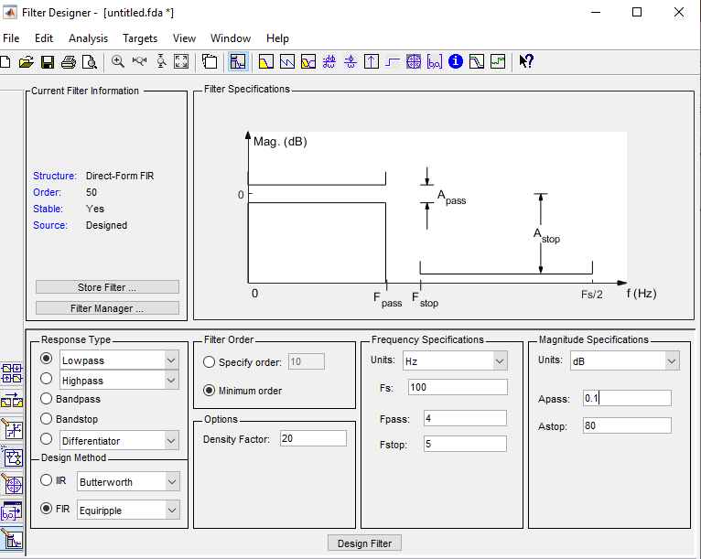
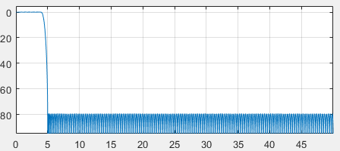
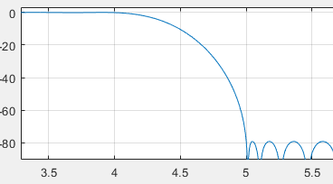
Decimating filter design
Before reducing the sampling rate, you need to filter out the frequencies that will be aliased. This filter will precede a decimation by 10, so it needs a pretty narrow filter. The narrower the bandwidth of a filter, the longer the time span of the impulse response…which means more coefficients, memory, and multipliers. Fortunately, for decimation, we won’t care about 9 of the 10 output samples coming from the filter, since we throw them away during decimation. That allows for different implementations of the filter.
The length of a filter is inversely proportional to the bandwidth, the transition bandwidth (passband to stopband), and directly proportional to the desired attenuation in the stopband. Using the (soon to be obsolete) matlab tool : fdatool we can investigate graphically the design. The latest tool is called filterDesigner
The sampling rate is arbitrary, and won’t change the filter design. So for convenience we pick 100, and we will decimate to a sample rate of 10. That means signals above 5 (half Nyquist) will be aliased, so we want thos signals attenuated. An 80% passband is a typical standard (rule-of-thumb), so we ask for the passband of 4. This gives a 333 tap filter, meaning we have to make 333 multiply-accumulates each input sample time.

Slide 2
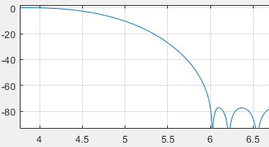
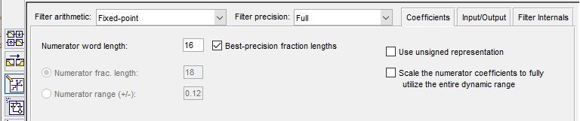
Decimating filter design
Recall we only need to calculate 333 times when we need an output sample…that means the filter would only have to ‘run’ 33.3 times faster than the input rate. The FPGA lets us do hardware parallel implementations, getting the calculation rate down to a feasible level.
We can also accept some aliasing (sometimes). If we don’t care about aliasing in the transition region, that is, we want to preserve the 80% bandwidth, and will ignore (somehow) signals in the transition region, we can change the design parameters to passband of 4 and stopband of 6. This cuts the number of coefficients to 167. Signals present from 5 to 6 will fold over along 5 as an axis to 4 to 5. Signals at 5 are only 10 dB attenuated. We can ‘test’ this with test vectors, and on the hardware (eventually) with test signals. Under the Targets tab, we can export a COE file.
Select this to get quantization, not double precision floating point

Slide 3
Signal in passband (4)
Signal in transition band (5)
Suppressed 10 dB
Signal in stop band (6.35)
Note the delay, and the transient behavior in the transition and stop band signals. That is an artifact of suddenly starting the test signal vector. A sudden amplitude step will have wideband frequency response, and will manifest itself in the time domain as an impulse, which has a full frequency spectrum.
Combined all three into test vector

Slide 4
MSB to LED
I
/
16
I
/
16
I
/
16
I
/
16
FIR Filter
Decimate
By 10
Test Data
(Block ram)
Complex
Multiply
Q
/
16
Q
/
16
Q
/
16
Q
/
16
FIR Filter
Decimate
By 10
/ 16
/ 16
Address
I
Q
1/10 Fclock
/ 10
DDS Table
Address
Fclock
100 MHz
Counter
Counter
/ 10
Fclock
100 MHz
32 bit Accumulator
/ 32
32 bit Register
DDS Phase Increment from PC

