Slide 1

Data Visualization
For Data Scientists using Python
USING OPEN SOURCED TOOLS
Nikhil Widhani
Data Scientist Environment and Climate Change Canada

Slide 2
Agenda
01
Problem Statement
Understand the need for data visualization for data scientists.
02
Prerequisites
Grab knowledge of essential Python libraries which help us to deal with data know which libraries are available in the market
03
Tutorial
Understanding Dash callbacks and Plotly charts,
04
Demo
Demo based on real project done at ECCC.

Slide 3
Problem Statement
Why we need
Visualization ?
B
Data visualization provides us with a quick, clear understanding of the information.
Helps to identify trends and gain insights quickly.
Helps to analyze at various levels of details
Helps to tell our data story
A

Slide 4
PREREQUISITE
Data Structuring
Pandas : For data manipulation and analysis
NumPy : For Mathematical Functions
Data Visualization
Matplotlib : For basic plotting understanding
Plotly : Advanced Python Plotting
Dash : For integrating Plotly plots to frontend applications
LIBRARIES

Slide 5
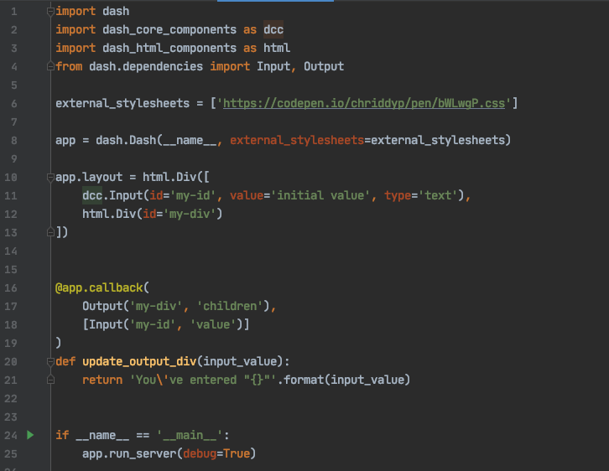
Tutorial - Dash Callbacks
1. Import necessary libraries
2. Define the app layout
3. Program the callbacks

Slide 6
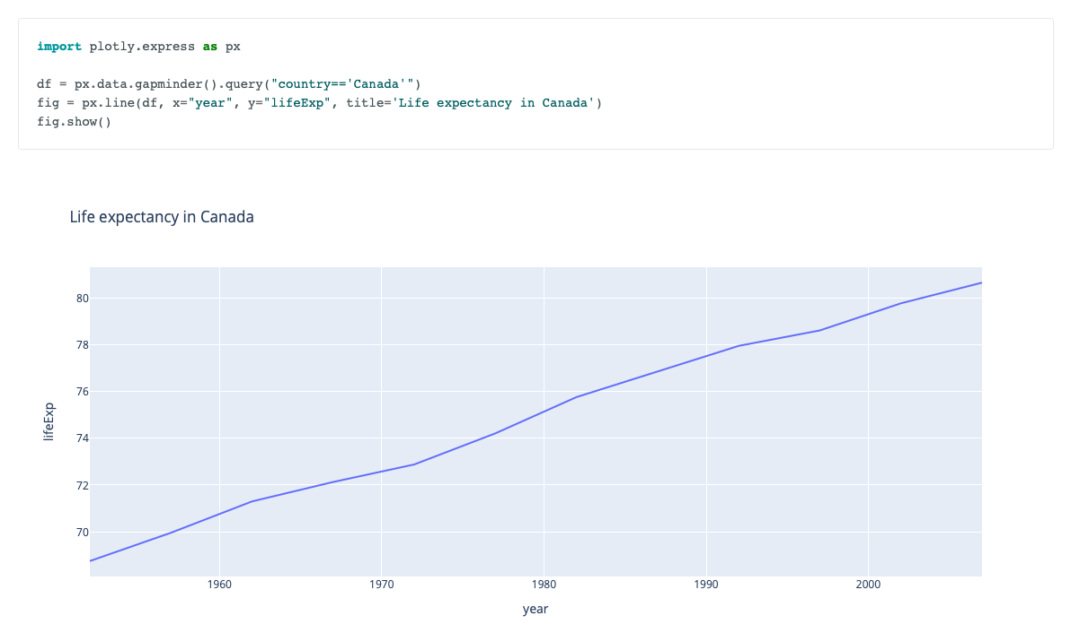
Tutorial – Plotly Charts

Slide 7
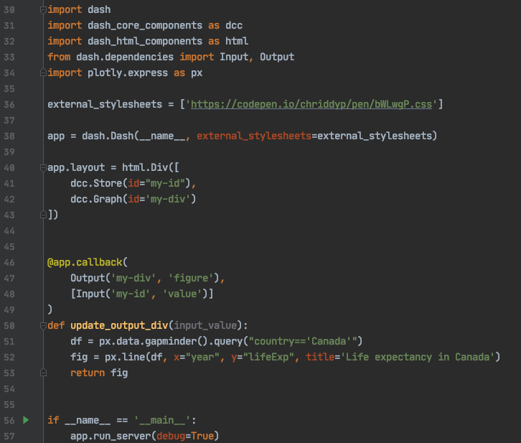
Tutorial – Plotly with Dash
1. Add dcc.Graph component
2. Return Figure to show the plot

Slide 8
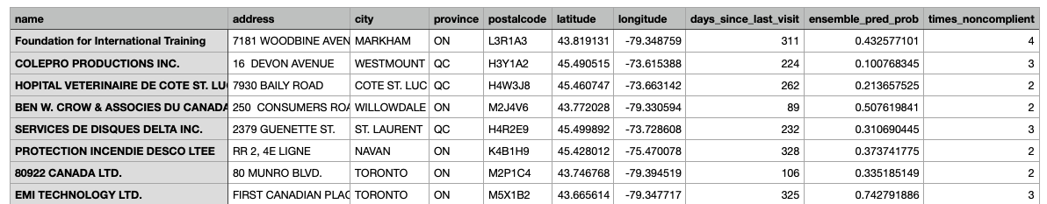
Problem: To create a ML algorithm to predict company noncompliance.
Result: You used complex data science techniques to predict the noncompliance percentage based on historical data and generate results in a csv format.
PROJECT DEMO

Slide 9
Demo

Slide 10
Useful Links
Dash Documentation: https://dash.plotly.com
Dash App Gallery: https://dash-gallery.plotly.host/Portal/
Plotly examples: https://plotly.com/python/
Detailed Dash Tutorial: https://towardsdatascience.com/how-to-build-a-complex-reporting-dashboard-using-dash-and-plotl-4f4257c18a7f
Advanced Techniques and Libraries:
Django
Java Script Chart libraries (Apex Charts, Chart JS)

Slide 11

Thank You
Future Data Scientists ;)

