Slide 1
Image Encryption and Decryption Using AES algorithm in CBC Mode
Shaikh Altamashrahi Shaikh Mozmil (2019BCS057,A27)
Avinash Kailash Rai (2019BCS056,B27)

Slide 2
INTRODUCTION
A digital image is defined as a matrix.
Each element of the matrix represents the intensity values of the pixels of an image.
The cryptographic approaches that work quite well on text data, do not give the same performance on multimedia data.
Need to develop algorithms to encrypt multimedia data.

Slide 3
ABSTRACT
In today’s world data security is the major problem which is to be face. In order
to secure data during communication, data storage and transmission we use
Advance encryption standard (AES).
AES is a symmetric block cipher intended to replace DES for commercial
applications.it uses 128-bit block size and a key size of 128, 192, or 256 bits.
In this project an image is given as input to AES encryption algorithm which gives
encrypted output. This encrypted output is given as input to AES decryption
algorithm and original image is regained as output.

Slide 4
OBJECTIVE…
• Encryption of an Image to unreadable format
• Decryption of encrypted image to original image
• Secure transfer of an image over the network such as internet
• Ensure no modifications are made while transferring over the network.

Slide 5

PROJECT SCOPE
The project works by encrypting the given image using AES algorithm so that this image can be sent securely over the network. At the receiver side, the receiver has code for decrypting the image so that he can get the original image. This helps in sending confidential and sensitive information securely over the internet. Main application of this can be very helpful in medical and military fields.

Slide 6
AES ALGORITHM
An attempt has been made to augment the strengths of AES algorithm for image data encryption.
A preprocessing step has been introduced
In this step the contents of the image are divided into blocks containing some pixels.
Then these blocks are scrambled and randomly passed to the different modes of AES for encryption.

Slide 7
CONTD…
Based on a design principle known as a substitution-permutation network.
It has a fixed block size of 128 bits, and a key size of 128, 192, or 256 bits.
The key size used for an AES cipher specifies the number of repetitions of transformation rounds that convert the input, called the plaintext, into the final output, called the cipher text.

Slide 8
Working of AES…
AES performs operations on bytes of data rather than in bits. Since the block size is 128 bits, the cipher processes 128 bits (or 16 bytes) of the input data at a time
The number of rounds depends on the key length as follows :
128 bit key – 10 rounds
192 bit key – 12 rounds
256 bit key – 14 rounds

Slide 9
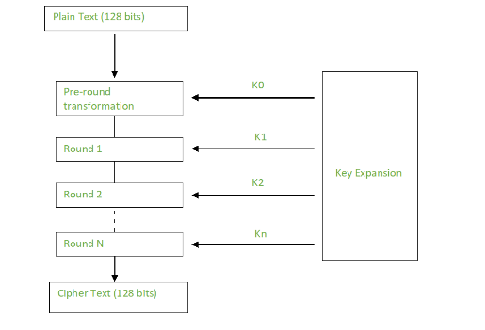
Creation of Round Keys…
A Key Schedule algorithm is used to calculate all the round keys from the key.
So the initial key is used to create many different round keys which will be used in the corresponding round of the encryption.

Slide 10
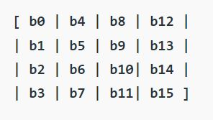
Encryption…
AES considers each block as a 16 byte (4 byte x 4 byte = 128 ) grid in a column major arrangement.
Each round comprises of 4 steps :
SubBytes, ShiftRows, MixColumns, Add Round Key
The last round doesn’t have the MixColumns round.
The SubBytes does the substitution and ShiftRows
and MixColumns performs the permutation in the algorithm.

Slide 11
SUBBYTES…
This step implements the substitution.
In this step each byte is substituted by another byte. Its performed using a lookup table also called the S-box.
This substitution is done in a way that a byte is never substituted by itself and also not substituted by another byte which is a compliment of the current byte. The result of this step is a 16 byte (4 x 4 ) matrix like before.

Slide 12
Table: AES S-Box: Substitution values in hexadecimal notation for input byte (xy)

Slide 13
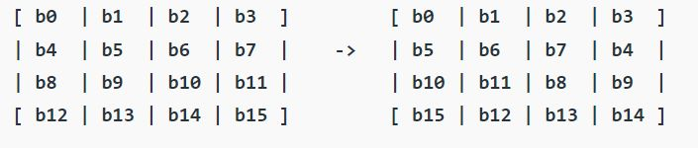
SHIFTROWS…
This step is just as it sounds. Each row is shifted a particular number of times.
The first row is not shifted
The second row is shifted once to the left.
The third row is shifted twice to the left.
The fourth row is shifted thrice to the left.

Slide 14
MIX COLUMNS…
This step is basically a matrix multiplication.
Each column is multiplied with a specific matrix and thus the position of each byte in the column is changed as a result.
This step is skipped in the last round.
The second column of output bytes (c4,c5,c6,c7) is computed by multiplying the four input bytes (b4,b9,b14,b3) by the same constant matrix, and so on.

Slide 15
ADD Round Keys…
Now the resultant output of the previous stage is XOR-ed with the corresponding round key.
After all these rounds 128 bits of encrypted data is given back as output.
This process is repeated until all the data to be encrypted undergoes this process.

Slide 16
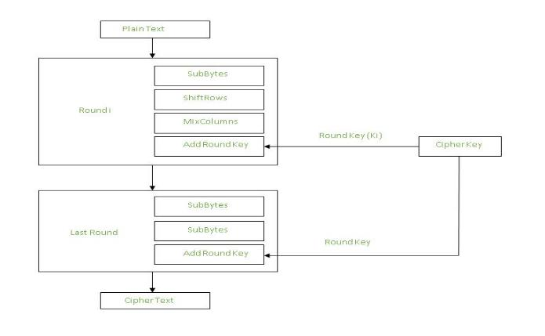

Slide 17
BLOCK DIAGRAM

Slide 18
Modes of AES…
There are five modes of AES as given below:
ECB mode: Electronic Code Book mode
CBC mode: Cipher Block Chaining mode
CFB mode: Cipher FeedBack mode
OFB mode: Output FeedBack mode
CTR mode: Counter mode

Slide 19
Terminologies…
Initialization Vector(IV) :
Block of bits that are used by several modes to randomize the encryption.
Initialization vector is never reused under the same key.
An initialization vector has different security requirements than a key, so the IV usually does not need to be secret.

Slide 20
CONTD…
Padding:
A block cipher works on units of a fixed size (known as a block size), but messages come in a variety of lengths.
So some modes require that the final block be padded before encryption. The simplest is to add null bytes to the plaintext to bring its length up to a multiple of the block size.
We’ve used CBC Mode for the encryption and decryption

Slide 21
CBC (Cipher Block Chaining)
Each block of plaintext is XORed with the previous ciphertext block before being encrypted.
To make each message unique, an initialization vector must be used in the first block
Ciphertext stealing: A one-bit change in a plaintext or IV affects all following ciphertext blocks.

Slide 22
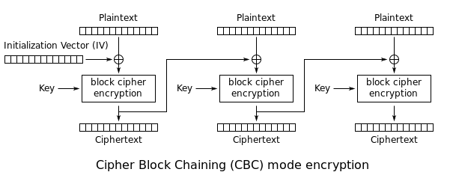
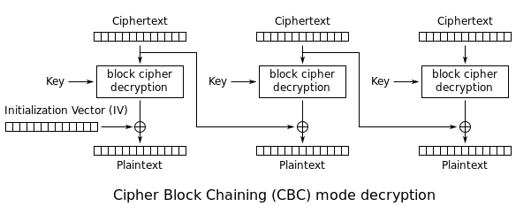
Fig: CBC encryption and decryption block diagram

Slide 23
Decryption…
The stages in the rounds can be easily undone as these stages have an opposite to it which when performed reverts the changes. Each 128 blocks goes through the 10,12 or 14 rounds depending on the key size.
The stages of each round in decryption is as follows :
Add round key
Inverse MixColumns
ShiftRows
Inverse SubByte

Slide 24
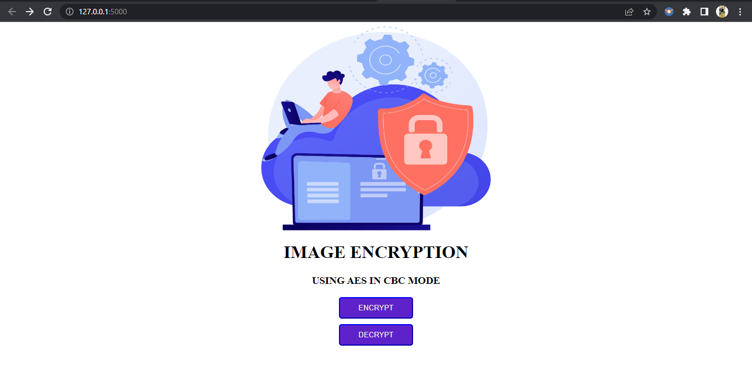
Implementation…
Fig: HOME PAGE

Slide 25
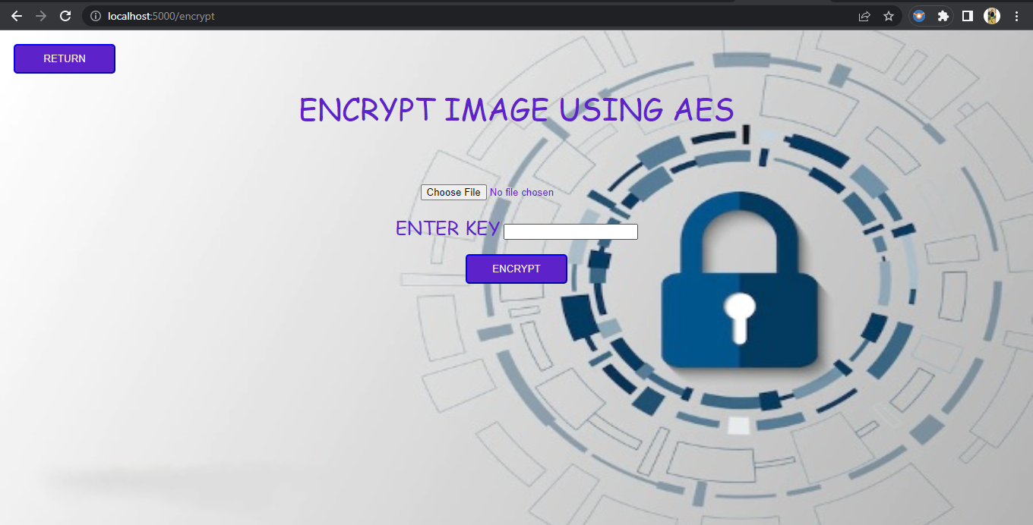
Fig: Encryption Page

Slide 26
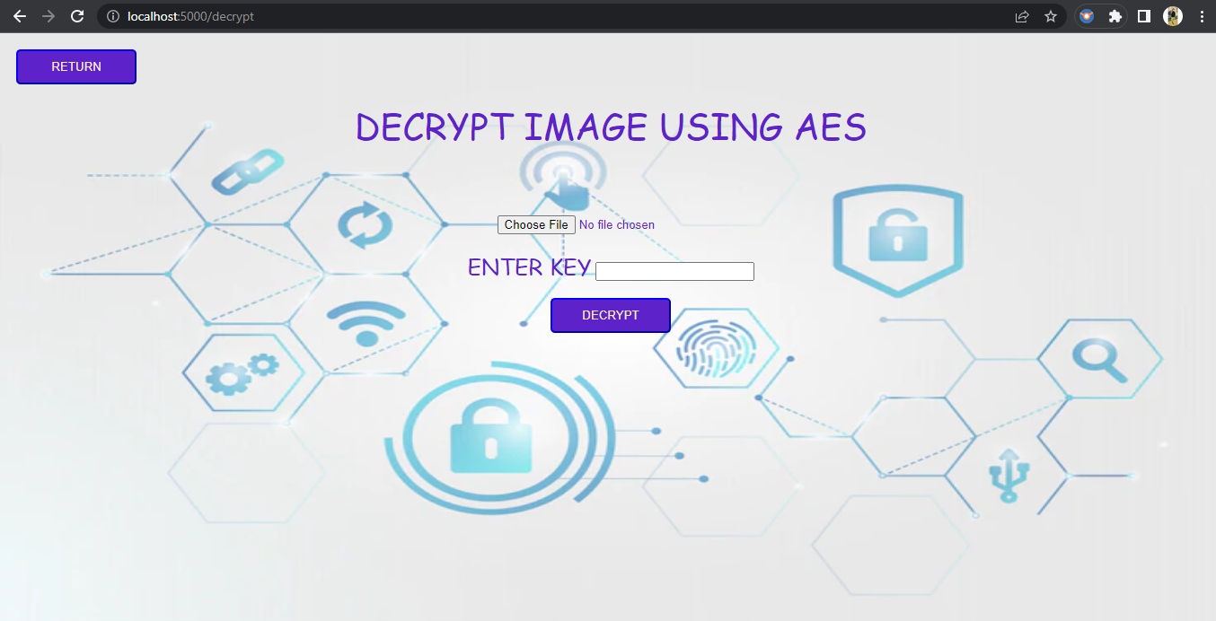
Fig: Decryption Page

Slide 27
CONCLUSION
We have successfully developed a program that encrypts and decrypts the image files accurately. This will help in minimising the problem of data theft and leaks of other sensitive information. The file that we obtained after encryption is very safe and no one can steal data from this file. So, this file can be sent on a network without worrying. Our developed solution is a small contribution that can be very helpful for military or medical fields in future times.

Slide 28
THANK YOU

