Slide 1

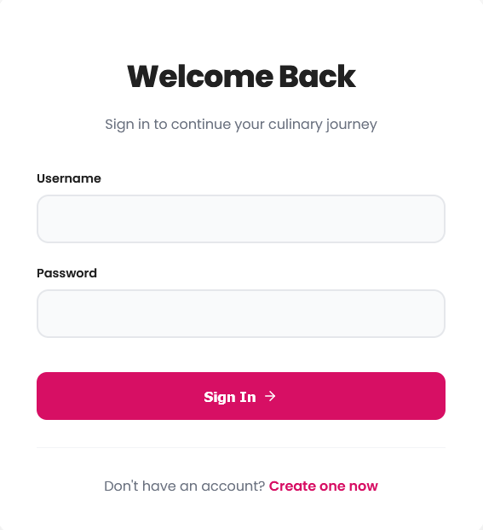
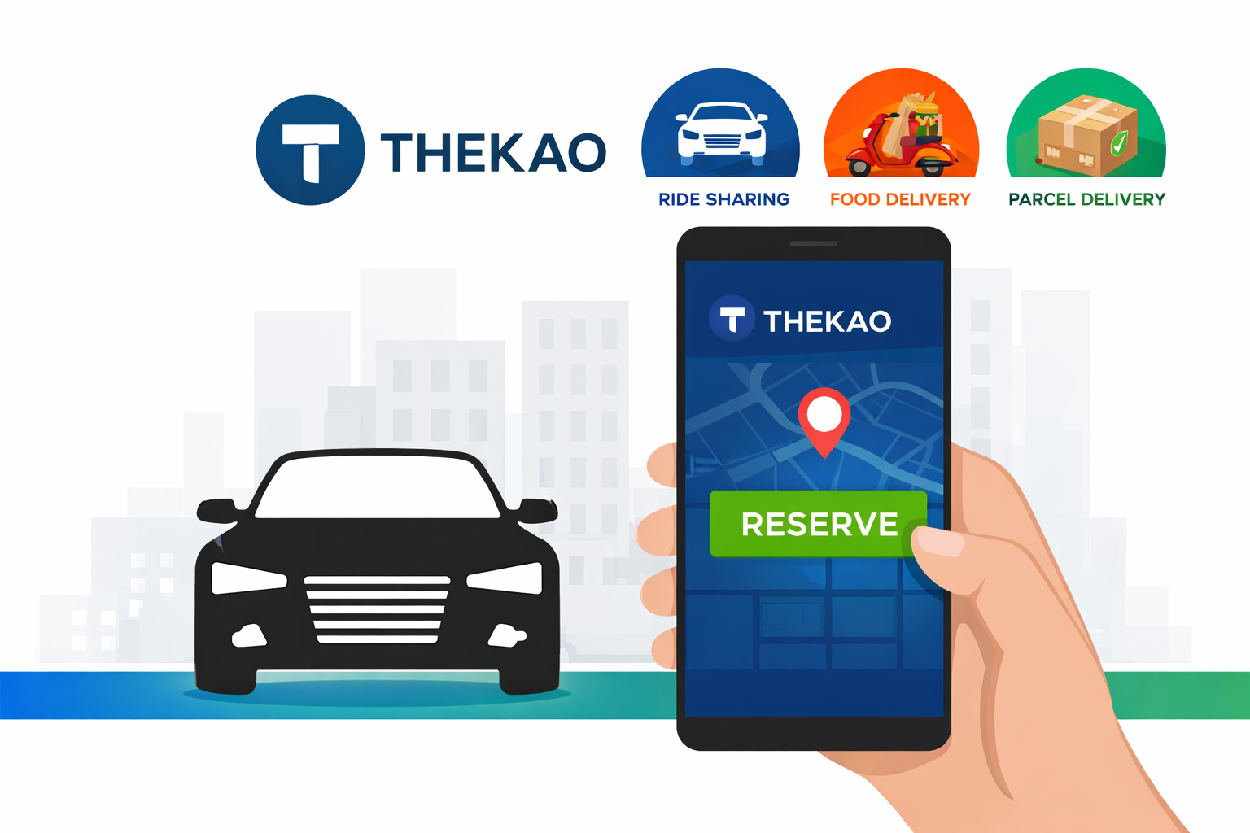
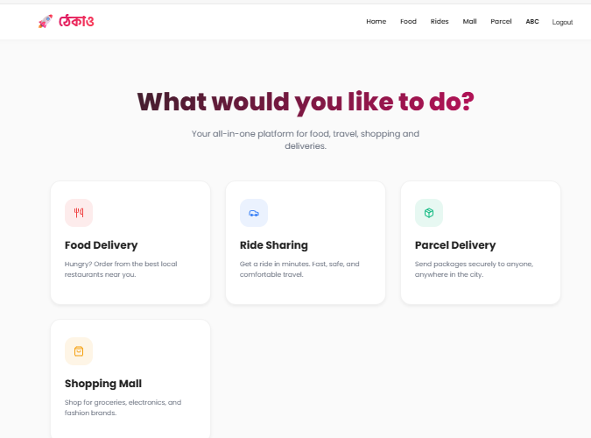
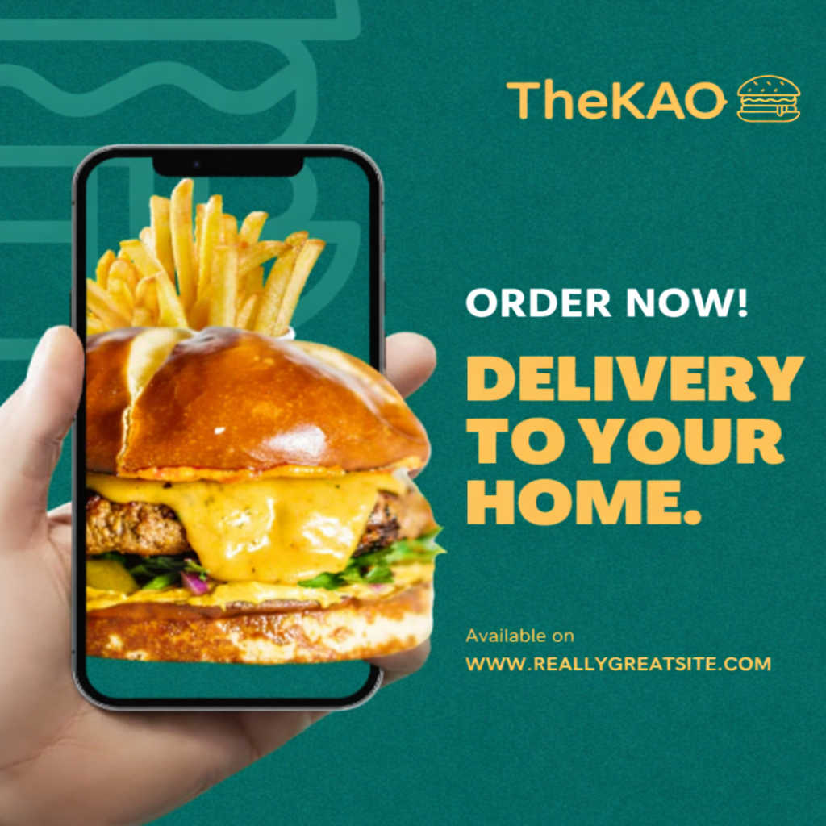

TheKao
Md.Ashikullah(IT22030) and Abdur Rahim (IT22031)
Department of Information and Communication Technology
Mawlana Bhashani Science and Technology University, Santosh, Tangail-1902
1. Project Summary:
4. Working Procedure
4.2. Working Procedure:
5. Results:
Thekao is a web-based service application developed using Django for the graphical user interface and SQLite (db.sqlite3) for database management.
The main purpose of this project is to provide multiple services within a single platform, including user login, user registration, driver registration, ride sharing, food ordering, and parcel delivery.
The application starts with a secure login system using email and password. After successful authentication, users are redirected to the Thekao Dashboard, where they can access and perform various services based on their roles.
This project demonstrates the practical use of Django-based user interfaces, Django ORM for database connectivity, secure database operations, and event-driven user interactions in a real-world web application.
4.1. Working Procedure(visual representation):
Ride-Sharing:
2. Food Ordering :
3. Parcel Delivery:
The working process of the Thekao system is described step by step below:
1.Application Start:
The program starts and connects to the db.sqlite3 database using Django ORM .
2.Login System:
User enters name and password.
If the email already exists, the password is verified.
If the email does not exist, it is saved as a first-time login.
3.Dashboard Display:
After successful login, the Dashboard is shown.
Dashboard uses CardLayout for smooth screen switching.
4.User Registration:
User provides name, phone, email, gender, and password.
Data is stored in the PersonUser table in db.sqlite3 .
5.Driver Registration:
Driver information is collected and saved in the db.sqlite3 .
6. Ride Booking:
User enters user ID and driver ID.
Ride details such as pickup, drop location, distance, and fare are stored in the rides table.
7. Food Ordering:
Food order details are saved in the food_orders table.
8. Parcel Delivery:
Parcel information is stored in the deliveries table.
All operations are handled using PreparedStatement to ensure secure database access
.
After successful execution, the Thekao project provides the following results:
Secure login system with name and password validation
Successfully connected Django with db.sqlite3
User-friendly dashboard interface
Data stored correctly in database tables:
1.personUser
2. Drivers
3.Rides
4. Food order
5.Deliveries
Real-time confirmation messages for:
Registration
Ride booking
Food ordering
Parcel delivery
The application runs smoothly in VS Code,PyCharm without using Maven.
2. Introduction:
Thekao is developed using Django to build an intuitive and responsive graphical user interface. The project uses SQLite (db.sqlite3) as the backend database to ensure efficient data storage, retrieval, and management. Through features such as user authentication, service management, and secure data handling, Thekao demonstrates the core concepts of database connectivity and user interaction.
This project aims to help students gain hands-on experience with Django integration, understand the architecture of service-based applications, and apply theoretical knowledge to a practical software solution. Thekao serves as an educational model for learning web-based application development using Django and SQLite in a real-world context..
3. Objectives:
The main objectives of the Thekao project are:
To design a secure login system using email and password
To connect Django with SQLite (db.sqlite3)
To securely store and retrieve data from the database
To provide multiple services on a single platform, including:
  User Registration
  Driver Registration
  Ride Sharing
  Food Ordering
  Parcel Delivery
6. Conclusion:
The Thekao project successfully demonstrates a complete Web Service application using Django and db.sqlite3
This project helps in understanding how a real-world service-based system works with database integration.
Through this project, knowledge of Django GUI design,, SQL queries, and event-driven programming has been gained.
In the future, this system can be improved by adding features like password encryption, admin panel, online payment, and mobile support.
Overall, Thekao is a simple yet effective project for learning Django.

