Slide 1
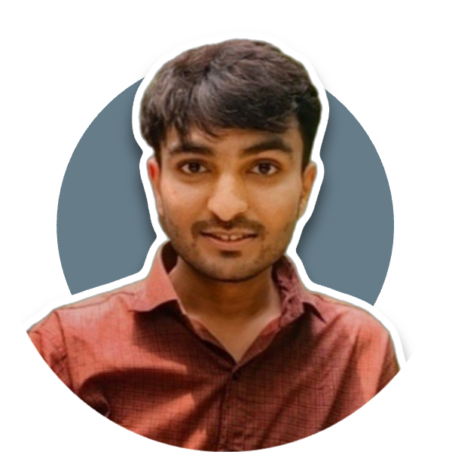
Contact
Project
Number
Pehchaan-Kaksha
7230807675
A geolocation & face recognition-based attendance system preventing proxies.
Tech Stack: HTML/CSS, Node.js, Express.js, MongoDB, Geolocation API, Face Recognition
Email
rahiagarwal080@gmai.com
LinkedIn
www.linkedin.com/in/rahi-agarwal
Rahi Agarwal
Education
Skills
Software Engineer
MERN Stack developer, eager to learn and grow. Passionate about technology, problem-solving, and self-improvement.
Languages: C/C++, SQL
BTECH CSE
Development: HTML/CSS, JavaScript, Bootstrap, React.js, Node.js, Express.js
Jaypee Institute of Information Technology
Developer Tools: MySQL, MongoDB, Git/GitHub, Postman
Soft Skills: Result-Oriented, Analytical Thinking, People Management

Slide 2




Career Goals
Career &
Finance
Personal
Relation
To become a highly skilled and successful Software Engineer
Secure a stable, well-paying job, continuously grow in the tech industry, and eventually achieve financial independence while contributing meaningfully to society.
Working towards financial independence and long-term wealth creationody
Maintaining a meaningful and respectful relationships.
LONG TERM GOALS
Health &
fitness
Spiritual
Mind
Become a highly skilled, stable, and successful engineer
Helping society while maintaining a calm and knowledgeable mindset
Following a disciplined routine for mental and physical well-being.
Developing a calm, focused, and resilient mindset.
SHORT TERM GOALS
Enhance time management and productivity for consistent growth.

