Slide 1

OVERCONFIDENCE BIAS
IN INVESTMENT DECISIONS
How Cognitive Biases Derail Rational Investment Strategy
Notes:
1

Slide 2
AGENDA
01
Introduction to Overconfidence Bias
05
Data Analysis & Evidence
Origins and psychological foundations
Quantitative research and market data
02
Definition & Types
06
Mitigation Strategies
Overestimation, overplacement, overprecision
Practical frameworks to reduce bias
03
Impact on Investment Decisions
07
Conclusions & Recommendations
Portfolio performance consequences
Key takeaways for investors
04
Real-World Case Studies
Famous failures driven by overconfidence
Notes:
2

Slide 3
01
Introduction to
Overconfidence Bias
Understanding the psychology behind investor overconfidence
Notes:
3

Slide 4
What is Behavioral Finance?
Traditional finance assumes that investors are perfectly rational — always making optimal decisions. Behavioral finance challenges this by studying how psychological factors and cognitive biases lead to systematic errors.
80%
of investors believe they're above average
74%
overestimate their stock-picking ability
"People are not irrational — they are predictably irrational."
— Daniel Kahneman
"The purely economic man is indeed close to being a social moron."
2×
more trading due to overconfidence
— Richard Thaler
Key Insight: Overconfidence is the most documented bias in financial markets and one of the most costly for individual investors.
Notes:
4

Slide 5
The Psychology Behind Overconfidence
🧠 Illusion of Knowledge
🎯 Illusion of Control
More information doesn't always improve accuracy — investors believe knowing more makes them better predictors.
Investors believe they can influence market outcomes through skill, analysis, or timing.
📈 Self-Attribution Bias
🔮 Hindsight Bias
Successes are attributed to skill; failures are blamed on external factors like market conditions.
After events occur, investors feel they 'knew it all along,' reinforcing overconfidence in predictions.
Notes:
5

Slide 6
02
Definition & Types
of Overconfidence Bias
Taxonomy and classification of overconfident behavior
Notes:
6

Slide 7
Three Core Types of Overconfidence
1. OVERESTIMATION
2. OVERPLACEMENT
3. OVERPRECISION
Overestimating absolute performance
Better-than-average effect
Excessive confidence in accuracy
Investors overestimate the accuracy of their own knowledge, the precision of their forecasts, and their likelihood of achieving favorable outcomes.
Investors rank themselves above the median investor. Statistically impossible for the majority to be 'above average', yet studies show 90% of drivers — and investors — believe they are better than average.
Investors set overly narrow confidence intervals for their predictions. They are surprised more often than expected when outcomes fall outside their stated range.
Example: Believing a stock will definitely rise 20% based on personal analysis, while ignoring professional consensus.
Example: 'I pick stocks better than most fund managers.'
Example: Predicting the S&P 500 will end the year at exactly 5,200 ± 50 points.
Notes:
7

Slide 8
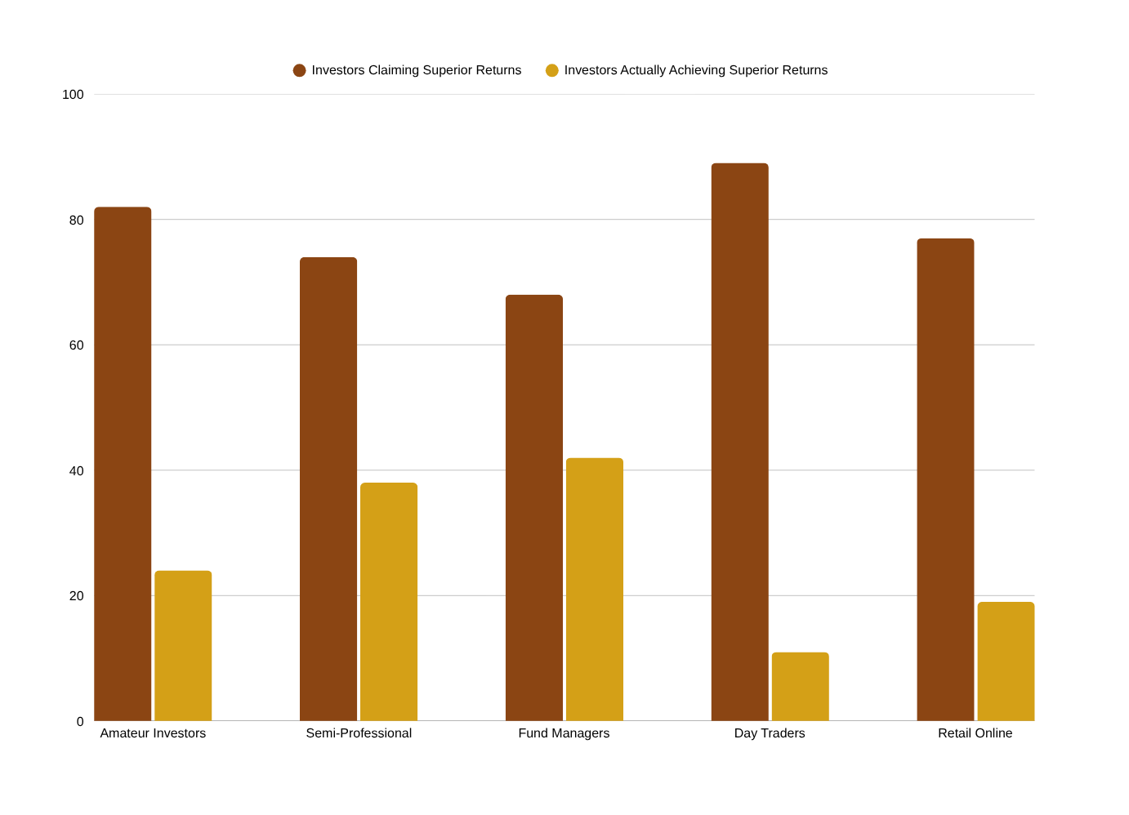
Measuring Overconfidence in Investors
Key Findings
58%
Gap (Amateur)
Perception vs reality
78%
Gap (Day Traders)
Most overconfident group
26%
Gap (Fund Mgrs)
Least overconfident
Source: Barber & Odean (2001), Glaser & Weber (2007), Statman et al. (2006)
Notes:
8

Slide 9
03
Impact on Investment
Decisions & Portfolio Performance
How overconfidence destroys returns
Notes:
9

Slide 10
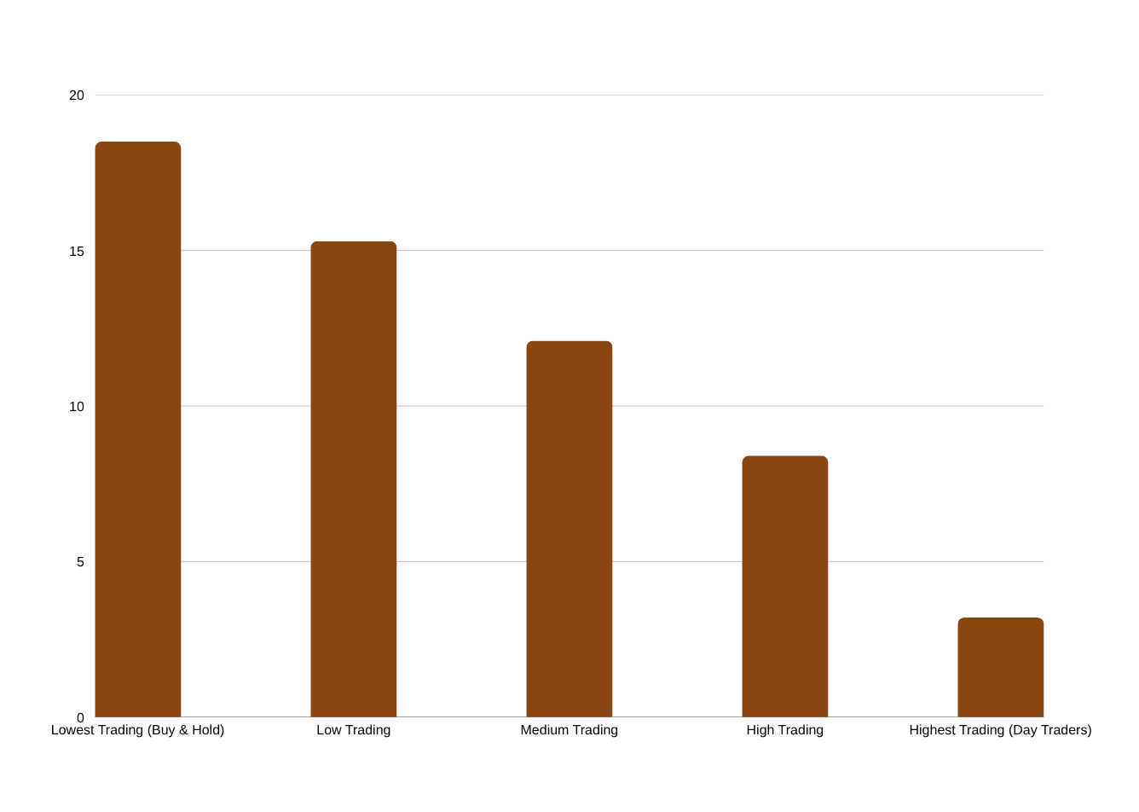
Overconfidence → Excessive Trading
The Trading Trap
📉
Transaction costs erode 2–4% of returns annually for active traders
🔄
Overconfident investors trade 45% more frequently than less confident peers
💸
Tax drag from short-term capital gains further reduces net returns
⚠️
Studies show 70% of day traders lose money net of costs over 3 years
Source: Barber & Odean (2000) — 'Trading is Hazardous to Your Wealth'
Notes:
10

Slide 11
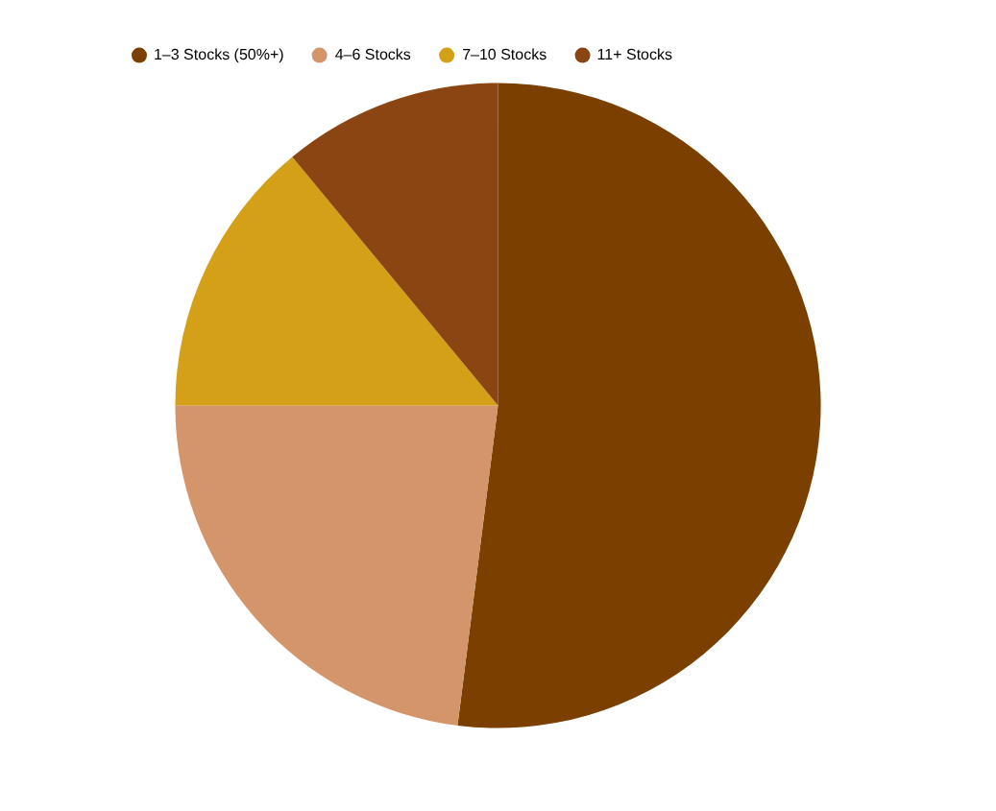
Underdiversification & Concentration Risk
🏠 Home Bias
70% of overconfident investors over-weight domestic stocks, missing global diversification benefits.
🏢 Employer Stock
Employees hold 3× recommended allocation in employer shares, creating concentrated career + market risk.
📊 Volatility Impact
Concentrated 3-stock portfolios show 2.4× higher volatility than diversified 20-stock portfolios.
Typical Overconfident Portfolio
Notes:
11

Slide 12
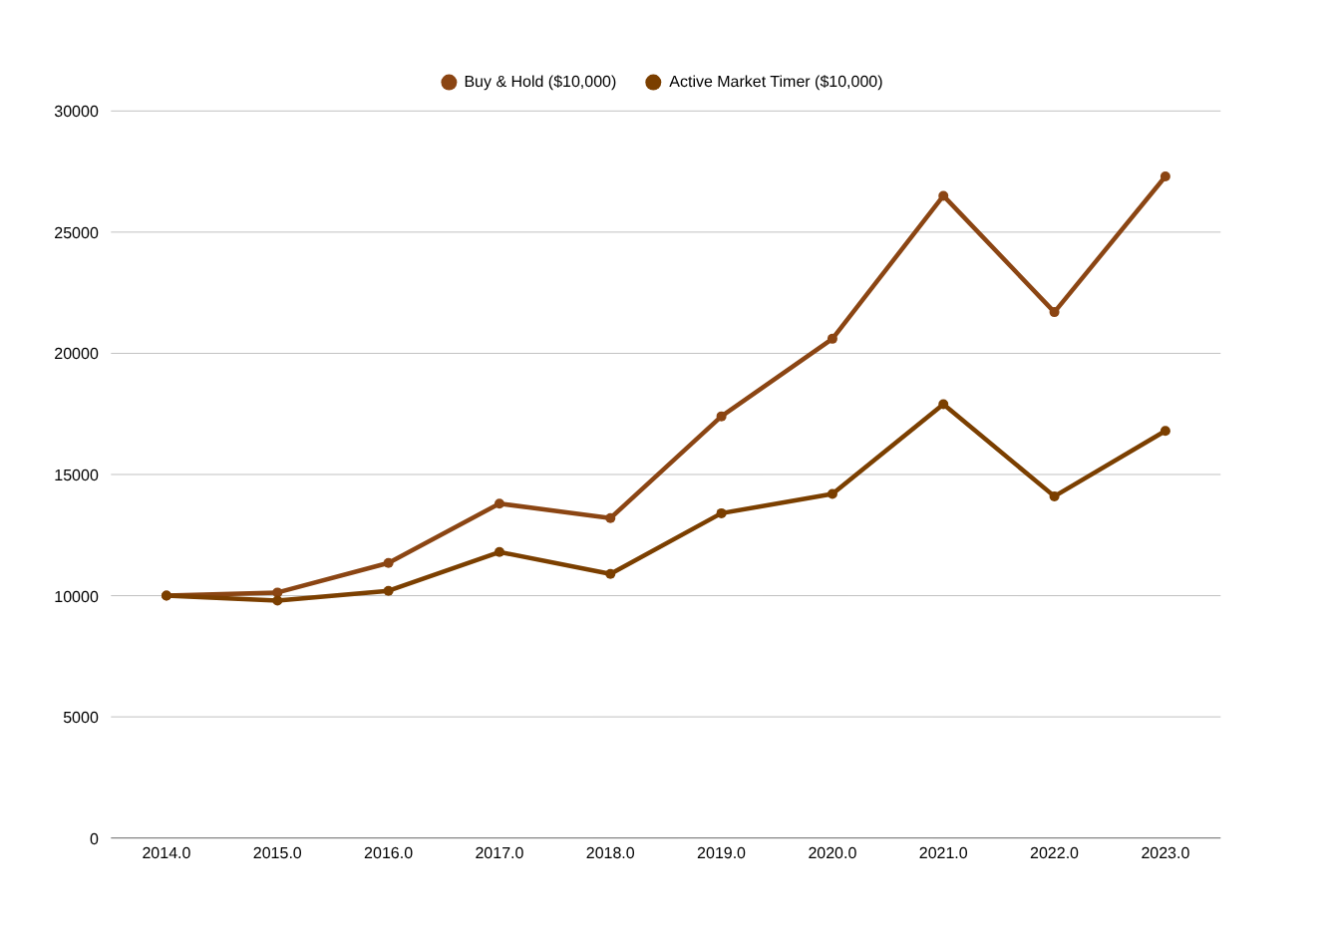
The Illusion of Market Timing
Why Timing Fails
94%
of market timers underperform buy & hold over 10 years
20
best trading days missed = portfolio cut in half (S&P 500, 20yr)
1.7%
average annual return gap between active timers and passive investors
Source: DALBAR Quantitative Analysis of Investor Behavior (2023)
Notes:
12

Slide 13
04
Case Studies:
Overconfidence in Action
Real-world examples and their costly consequences
Notes:
13

Slide 14
Case Study 1: Long-Term Capital Management (LTCM)
COLLAPSE TIMELINE
OVERCONFIDENCE FACTORS
1994
Founded by John Meriwether with 2 Nobel laureates — extreme overconfidence in models
Model Overconfidence
Believed quantitative models could perfectly predict price convergence, ignoring black swan events.
1997
Peak AUM: $125B, leverage ratio: 28:1. Model assumed they had mastered risk.
Expert Overplacement
Having 2 Nobel Prize winners created institutional overconfidence — academic credentials ≠ market mastery.
Aug 1998
Russian debt default — models fail catastrophically. Loses $4.6B in 4 months.
Excessive Leverage
Sep 1998
Federal Reserve orchestrates $3.6B emergency bailout to prevent global contagion.
28:1 leverage ratio shows extreme overconfidence in risk models and certainty of outcomes.
Narrow Confidence Intervals
2000
LTCM fully dissolved. The 'smartest minds' lost nearly everything.
Risk models underestimated tail risk by over 10×, a classic overprecision error.
Notes:
14

Slide 15
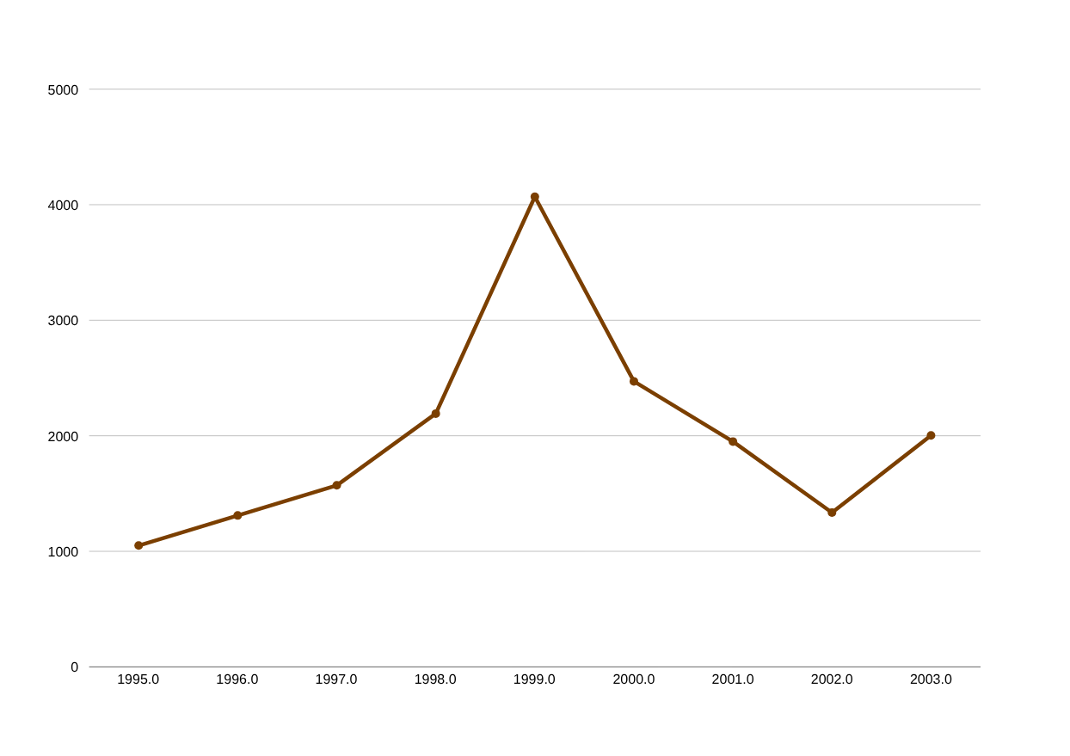
Case Study 2: The Dot-Com Bubble (1995–2002)
−78%
NASDAQ peak-to-trough decline (2000–2002)
$5T
Market cap destroyed in 18 months
52%
Individual investors increased tech exposure at peak
NASDAQ Composite — Dot-Com Bubble & Crash
Notes:
15

Slide 16
Case Study 3: The Individual Investor — Jesse Livermore
Jesse Livermore: America's greatest speculator — and greatest example of overconfidence destroying a fortune
Career Highs
Overconfidence Failures
Key Lessons
Made $3M shorting the 1907 panic
Profited $100M during 1929 crash (equal to $1.5B today)
Called 'Boy Plunger' — celebrity status
Wrote influential trading book 'Reminiscences of a Stock Operator'
Went bankrupt 3 times despite legendary wins
Violated own trading rules after string of successes
Took enormous concentrated positions beyond risk tolerance
Refused to use stop-losses, believing his judgment was infallible
Past success amplifies overconfidence in future calls
Even genius-level traders need systematic risk controls
Confidence in process ≠ confidence in outcomes
Markets reward humility, not hubris
Notes:
16

Slide 17
05
Data Analysis:
Quantitative Evidence
Research findings and statistical evidence of overconfidence costs
Notes:
17

Slide 18
Research Evidence: Overconfidence & Performance
Study | Year | Sample | Finding | Return Impact
Barber & Odean | 2000 | 66,465 households | High-turnover investors lag market by 6.5%/year | −6.5%
Barber & Odean | 2001 | 35,000 households | Men trade 45% more than women; earn 1.4% less | −1.4%
Glaser & Weber | 2007 | 3,000 investors | Higher self-assessment = higher overconfidence | −2.8%
Statman et al. | 2006 | Market analysis | Market volume spikes after bull markets (overconfidence) | Systemic
Grinblatt & Keloharju | 2009 | Finnish markets | Overconfident investors lose 3.4% more vs. peers | −3.4%
Notes:
18

Slide 19
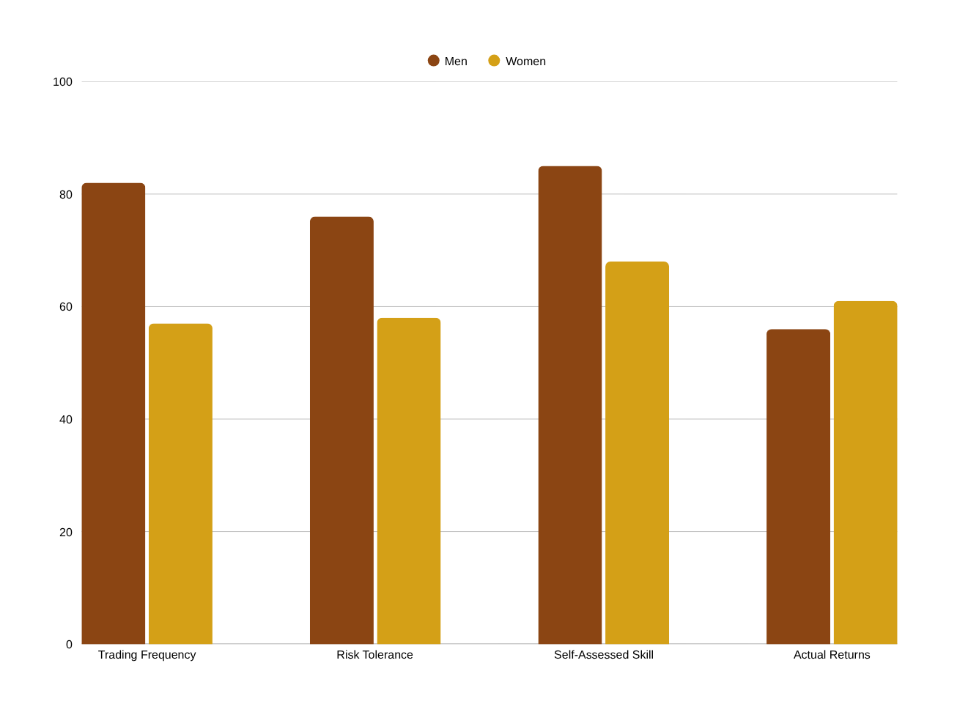
Gender Differences in Overconfidence
Research Insights
Men trade 45% more than women (Barber & Odean, 2001)
Women outperform men by 1.4% net of costs annually
Male overconfidence is particularly pronounced in financial domains
Effect is stronger for single men vs. married men (36% more trading)
Women more likely to seek financial advice and follow it
Notes:
19

Slide 20
06
Strategies to Mitigate
Overconfidence Bias
Practical tools and frameworks for rational investing
Notes:
20

Slide 21
6 Proven Strategies to Combat Overconfidence
📋 Keep a Trading Journal
⚖️ Pre-Mortem Analysis
🎯 Set Probabilistic Goals
Document every trade rationale. Review monthly to identify patterns of overconfidence and recalibrate.
Before any major trade, ask: 'If this fails, why?' Forces consideration of downside scenarios.
Replace specific price targets ('stock will hit $150') with probability ranges ('60% chance above $130').
📊 Rules-Based Investing
🔍 Seek Disconfirming Evidence
🤝 Use Investment Committees
Use systematic rules (e.g., rebalance quarterly, max 5% in any one stock) to override emotional confidence.
Actively look for information that contradicts your thesis. Assign a 'devil's advocate' role.
Group decisions counteract individual overconfidence — diverse perspectives improve forecast accuracy.
Notes:
21

Slide 22
The B.I.A.S. Reduction Framework
B
BASELINE
Establish a performance baseline before making predictions. Compare your forecasts to simple index returns. Most investors beat this baseline far less often than they believe.
I
INVESTIGATE
Investigate the opposing view with equal rigor. For every bull case, build a detailed bear case. Assign explicit probabilities to each scenario.
A
ACCOUNTABILITY
Create accountability mechanisms — share predictions with peers, set calendar reminders to review forecasts, maintain a public track record.
S
SYSTEMATIZE
Replace judgment with systems where possible. Quantitative rules, checklists, and automated rebalancing remove emotional overconfidence from decisions.
Notes:
22

Slide 23
Technology Solutions & Tools
📊 Portfolio Analytics
🤖 Behavioral Coaching
Factor exposure analysis
AI-powered bias detection
Performance attribution
Robo-advisor guardrails
Benchmark comparison tools
Automated rebalancing alerts
Risk-adjusted return calculators
Peer comparison dashboards
🔧 Decision Support
✅ Accountability Systems
Pre-trade checklists
Investment thesis trackers
Scenario analysis tools
Prediction scoring platforms
Monte Carlo simulators
Journal & audit trails
Historical analogue finders
Multi-advisor review workflows
Notes:
23

Slide 24
07
Conclusions &
Recommendations
Key takeaways for investors and portfolio managers
Notes:
24

Slide 25
Key Takeaways
01
Overconfidence is Universal
Research consistently shows that 70–90% of investors overestimate their abilities, regardless of education or experience.
02
The Cost is Measurable
Overconfident investors lose 2–7% of annual returns versus systematic, rules-based approaches — a life-changing difference over decades.
03
Three Types, One Problem
Whether overestimation, overplacement, or overprecision — all forms stem from the same cognitive root and require the same systematic antidotes.
04
Systems Beat Instinct
Pre-committed rules, automated rebalancing, and investment committees consistently outperform gut-feel trading driven by individual confidence.
05
Humility Pays Dividends
The world's best investors — Buffett, Klarman, Dalio — share one trait: they are acutely aware of what they don't know.
Notes:
25

Slide 26
30-60-90 Day Action Plan
30 Days
60 Days
90 Days
Audit your last 12 months of trades
Implement a formal pre-trade checklist
Establish written Investment Policy Statement
Calculate your actual alpha vs. benchmark
Identify your 3 largest portfolio concentrations
Automate rebalancing where possible
Start an investment journal today
Schedule quarterly portfolio reviews
Conduct first full pre-mortem exercise
Take a calibration quiz to measure your biases
Find an accountability partner or mentor
Review and score all open position theses
Notes:
26

Slide 27
References
Barber, B. M., & Odean, T. (2000). Trading Is Hazardous to Your Wealth: The Common Stock Investment Performance of Individual Investors. Journal of Finance, 55(2), 773–806.
Statman, M., Thorley, S., & Vorkink, K. (2006). Investor Overconfidence and Trading Volume. Review of Financial Studies, 19(4), 1531–1565.
Barber, B. M., & Odean, T. (2001). Boys Will Be Boys: Gender, Overconfidence, and Common Stock Investment. Quarterly Journal of Economics, 116(1), 261–292.
Thaler, R. H., & Sunstein, C. R. (2008). Nudge. Yale University Press.
Glaser, M., & Weber, M. (2007). Overconfidence and Trading Volume. Geneva Risk and Insurance Review, 32(1), 1–36.
DALBAR, Inc. (2023). Quantitative Analysis of Investor Behavior. DALBAR Annual Report.
Kahneman, D. (2011). Thinking, Fast and Slow. Farrar, Straus and Giroux.
Grinblatt, M., & Keloharju, M. (2009). Sensation Seeking, Overconfidence, and Trading Activity. Journal of Finance, 64(2), 549–578.
Shiller, R. J. (2000). Irrational Exuberance. Princeton University Press.
Moore, D. A., & Healy, P. J. (2008). The Trouble with Overconfidence. Psychological Review, 115(2), 502–517.
Notes:
27

Slide 28
The most dangerous words in investing:
"I know what I'm doing."
The antidote to overconfidence is not under-confidence.
Thank You
Project By : RAHI BALLU
Notes:
28

