Slide 1

OVERCONFIDENCE BIAS
IN INVESTMENT DECISIONS
A Concise Summary
Notes:
1

Slide 2
Overview: What is Overconfidence Bias?
The most documented and costly cognitive bias in financial markets
Definition
Overestimation
Overconfidence bias is a well-documented cognitive error where investors overestimate the accuracy of their judgments, the quality of their information, and their ability to predict market outcomes — leading to systematically poor decisions.
Overrating own skill & accuracy
Overplacement
Believing you're better than peers
Overprecision
Too-narrow confidence intervals
80%
−6.5%
45%
of investors think they
are above average
annual return lost by
high-turnover investors
more trades made by
overconfident investors
Source: Barber & Odean (2000, 2001); Moore & Healy (2008)
Notes:
2

Slide 3




Root Causes of Overconfidence
Four psychological drivers that fuel investor overconfidence
Illusion of Knowledge
Illusion of Control
More data feels like more certainty — but accuracy rarely improves with volume of information.
Investors believe active decisions influence outcomes, even in largely random markets.
Self-Attribution Bias
Hindsight Bias
Wins = skill. Losses = bad luck. This one-sided accounting inflates confidence over time.
Past events seem obvious in retrospect, creating false belief future events are predictable.
Notes:
3

Slide 4
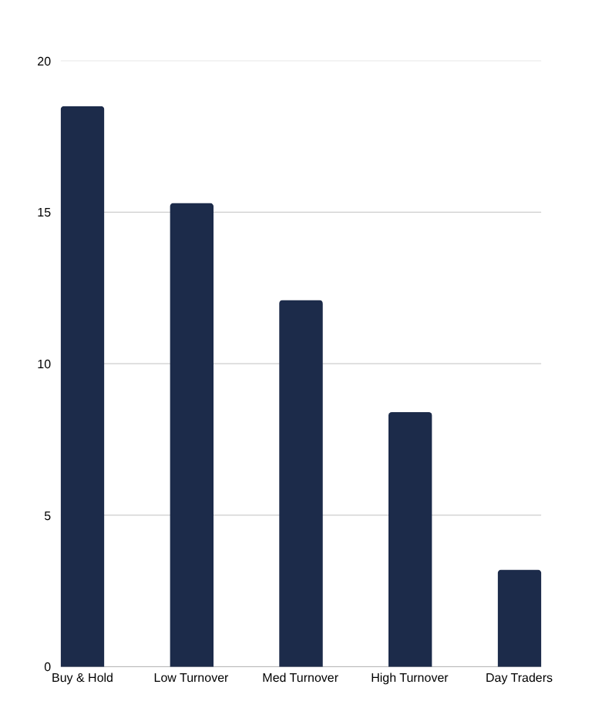




Effects on Investment Decisions
How overconfidence manifests as costly investment behaviour
Excessive Trading
Overconfident investors trade up to 45% more, eroding 2–6% of annual returns through transaction costs alone.
Underdiversification
Conviction in 'sure bets' leads to concentrated portfolios — increasing volatility 2× vs. a diversified approach.
Poor Market Timing
94% of market timers underperform buy-and-hold strategies over a 10-year period.
Ignoring Risk Signals
Overconfident traders dismiss stop-losses, analyst warnings, and portfolio limits — amplifying losses.
Source: Barber & Odean (2000)
Notes:
4

Slide 5
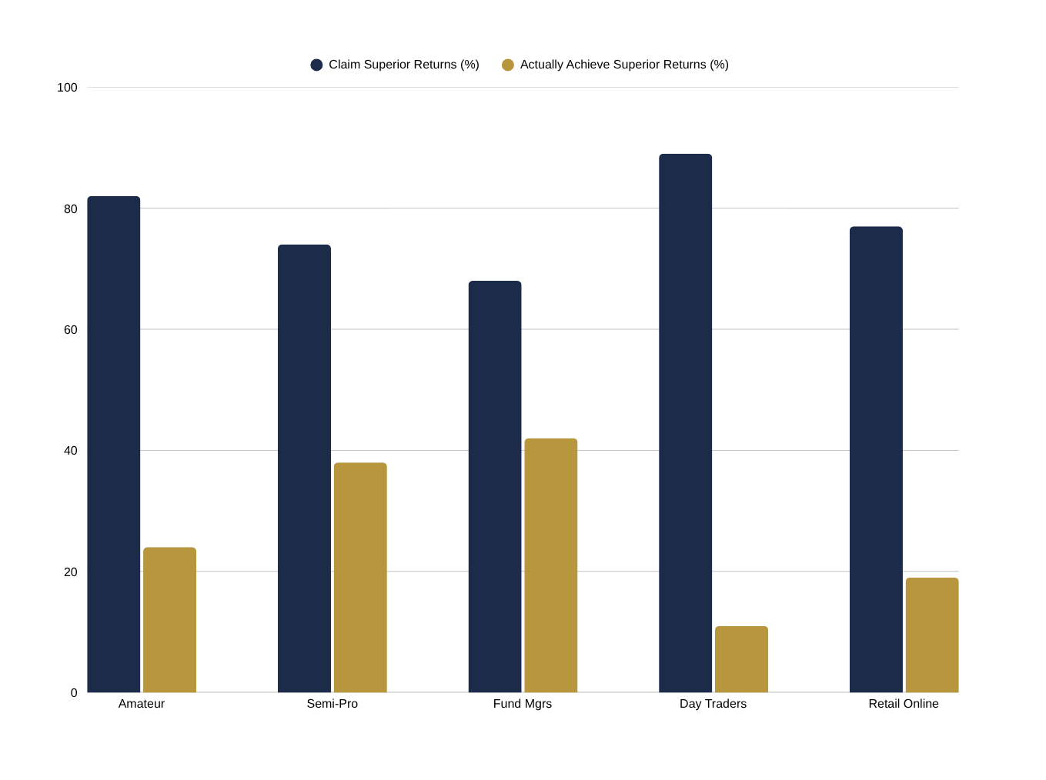
By the Numbers: The Cost of Overconfidence
Research-backed evidence across investor types and markets
58%
Overconfidence gap for amateur investors
78%
Gap for day traders — the worst group
$5T
Wealth destroyed in dot-com crash
1.4%
Extra return women earn over men annually
Perception vs. Reality: Investor Self-Assessment
Notes:
5

Slide 6
Key Takeaways
What every investor must understand about overconfidence
01
It's Universal
Overconfidence affects 70–90% of investors regardless of education or experience. Awareness is the first step.
02
The Cost is Real
Overconfident investors lose 2–7% in annual returns vs. systematic strategies — enormous over a decade.
03
More Data ≠ Better Bets
Additional information increases confidence far more than it improves accuracy — a dangerous mismatch.
04
Past Success Amplifies It
Winning streaks are the biggest confidence booster — and the most dangerous precursor to large losses.
05
Systems Beat Instinct
Rule-based investing consistently outperforms gut-feel trading. Automate discipline to remove emotional bias.
Notes:
6

Slide 7






Strategies to Mitigate Overconfidence
Six practical steps to invest with calibrated confidence
Keep a Trade Journal
Seek Disconfirming Views
Pre-Mortem Analysis
Log every decision & rationale. Monthly review reveals overconfident patterns fast.
Actively challenge your thesis. Assign a devil's advocate before each major trade.
Ask 'If this fails, why?' before every trade. Forces realistic scenario thinking.
Rules-Based Investing
Use Investment Committees
Track a Benchmark
Set max allocation caps and auto-rebalancing triggers to override emotional confidence.
Group review counters individual overconfidence — diverse views improve accuracy.
Measure every decision against a passive index. Real data deflates overconfidence.
Notes:
7

Slide 8
The B.I.A.S. Reduction Framework
A four-step model to build calibrated investment confidence
B
I
A
S
BASELINE
INVESTIGATE
ACCOUNTABILITY
SYSTEMATIZE
Measure your real past performance against a benchmark before making any new prediction.
Actively research the opposing thesis with equal effort. Build explicit bear cases.
Share forecasts with peers, set reminders to review, and keep a public track record.
Replace discretionary calls with rules, checklists, and automated triggers wherever possible.
💡 Investors who journal, pre-mortem, and follow rules consistently outperform peers by 2–4% annually.
Notes:
8

Slide 9
Real-World Case Studies
When overconfidence met reality — three landmark failures
LTCM (1998)
Dot-Com Bubble (2000)
Jesse Livermore
Quantitative Overconfidence
Collective Overestimation
Overplacement After Success
28:1 leverage — extreme overprecision in models
2 Nobel laureates failed to account for tail risk
Lost $4.6B in 4 months; required Fed-led bailout
Lesson: Academic prestige ≠ market infallibility
P/E ratios >100× for zero-earnings companies
52% of retail investors added tech at market peak
NASDAQ fell 78% peak-to-trough (2000–2002)
Lesson: 'This time is different' is always wrong
Made $100M shorting the 1929 crash
Broke own rules after a string of victories
Went bankrupt 3 times despite legendary wins
Lesson: Past success is the root of future overconfidence
Notes:
9

Slide 10
30 · 60 · 90 Day Action Plan
Practical steps to start correcting overconfidence bias today
30 Days
60 Days
90 Days
Audit last 12 months of trades vs. benchmark
Start a decision journal — record every rationale
Take a calibration quiz to assess your bias level
Calculate your actual alpha vs. subjective belief
Draft a pre-trade checklist (5 questions minimum)
Identify your 3 most concentrated positions
Set max allocation rules (e.g. 5% per stock cap)
Find an accountability partner for key decisions
Write a one-page Investment Policy Statement
Automate portfolio rebalancing on a fixed schedule
Conduct first full pre-mortem on open positions
Score all theses: what would prove you wrong?
Notes:
10

Slide 11



Conclusion & Recommendations
Calibrated confidence is the foundation of sound investing
The antidote to overconfidence is calibrated confidence: knowing what you know, knowing what you don't know, and acting accordingly.
Adopt Structured Processes
Measure, Don't Estimate
Build in Accountability
Replace ad hoc decisions with checklists, Investment Policy Statements, and systematic rebalancing schedules that don't flex under market excitement.
Track every prediction against outcomes. Real data is the only reliable antidote to inflated self-assessment and selective memory.
Share decisions with peers, seek contrary views, and treat benchmark underperformance as a signal — not bad luck.
Notes:
11

Slide 12
The most dangerous words in investing:
"I know what I'm doing."
Stay humble. Stay systematic. Stay invested.
Thank You
Project By : RAHI BALLU
Notes:
12

