Slide 1
CSE623 Machine Learning Theory and Practice TheOverFitters
Modelling and Prediction of Athlete Readiness based on Sleep and Recovery Patterns
Rahil Patel AU2240211
Yash Smart AU2240076
Prem Patel AU2240010
Aryan Sukhadia AU2240069
Naitik Shah AU2240047
Btech. CSE, School of Engineering and Applied Sciences
Btech. CSE, School of Engineering and Applied Sciences
Btech. CSE, School of Engineering and Applied Sciences
Btech. CSE, School of Engineering and Applied Sciences
Btech. CSE, School of Engineering and Applied Sciences

Slide 2
Content
Introduction
Problem Statement
Instructor’s Feedback
Approach
Results
Further Improvements
References

Slide 3
Introduction
Athletic performance is influenced by sleep, training, fatigue, and recovery.
This project predicts athletic readiness using sleep and recovery patterns.
Factors include travel, training, academics, and social commitments.
Previous studies used RSI to predict game performance and readiness but it often lacks accuracy in predicting true readiness, especially when external factors like sleep and academic stress are involved.
Insights help athletes and coaches optimize recovery and enhance performance.

Slide 4
Problem Statement
The objective of this project is to assess the impact of athlete sleep patterns on their performance (readiness) and thereby predict RSImod (Reactive Strength Index Modified). RSImod is a readiness measure used in sports science to assess an athlete’s neuromuscular fatigue.
Athletic Readiness & Challenges
Crucial for performance & injury prevention.
Traditional assessments(RSI) lack accuracy in predicting readiness.
Collegiate basketball players experience fatigue due to:
Frequent games & travel.
Academic stress affecting sleep & recovery.

Slide 5

Instructor’s Feedback
How Iterative Imputer(MICE) with XGBoost calculates missing values?
Each feature with missing values is imputed by modeling it as a function of the other features.
Starts with basic imputations (like mean/median), then iteratively refines the predictions.
Used XGBRegressor as the estimator for more accurate, non-linear imputation compared to traditional linear models.
Missing values are updated over several cycles to improve convergence and stability.

Slide 6
Approach
Used MICE (Iterative Imputer) with XGBoost to replace missing values. Scaled data using Standard Scaler.
Data Split: 80% for training, 20% for testing.
Evaluated the performance using Mean Squared Error, Mean Absolute Error and R2 score
Applied RFE with XGBoost to remove less important columns. Selected top 18 features for training.
Trained 3 models: linear regression, random forest regression, and XGBoost Regressor.

Slide 7
Approach
Performed a SHAP analysis to understand the importance of features in the XGBoost Regressor model. Choose the top 12 features
Performed LIME analysis.
Plotted graphs of k vs. inertia and k vs. silhouette score using different values of k to analyze clustering performance.
Evaluated feature importance using permutation importance.
Took top 4 features from permutation importance.

Slide 8
Approach
Calculated the mean RSI value for all the clusters
Characterised all the 4 clusters from the individual plots
Plotted interactive radar plots for all the clusters (combined and individually) using plotly.
Took top 5 features from permutation importance.

Slide 9
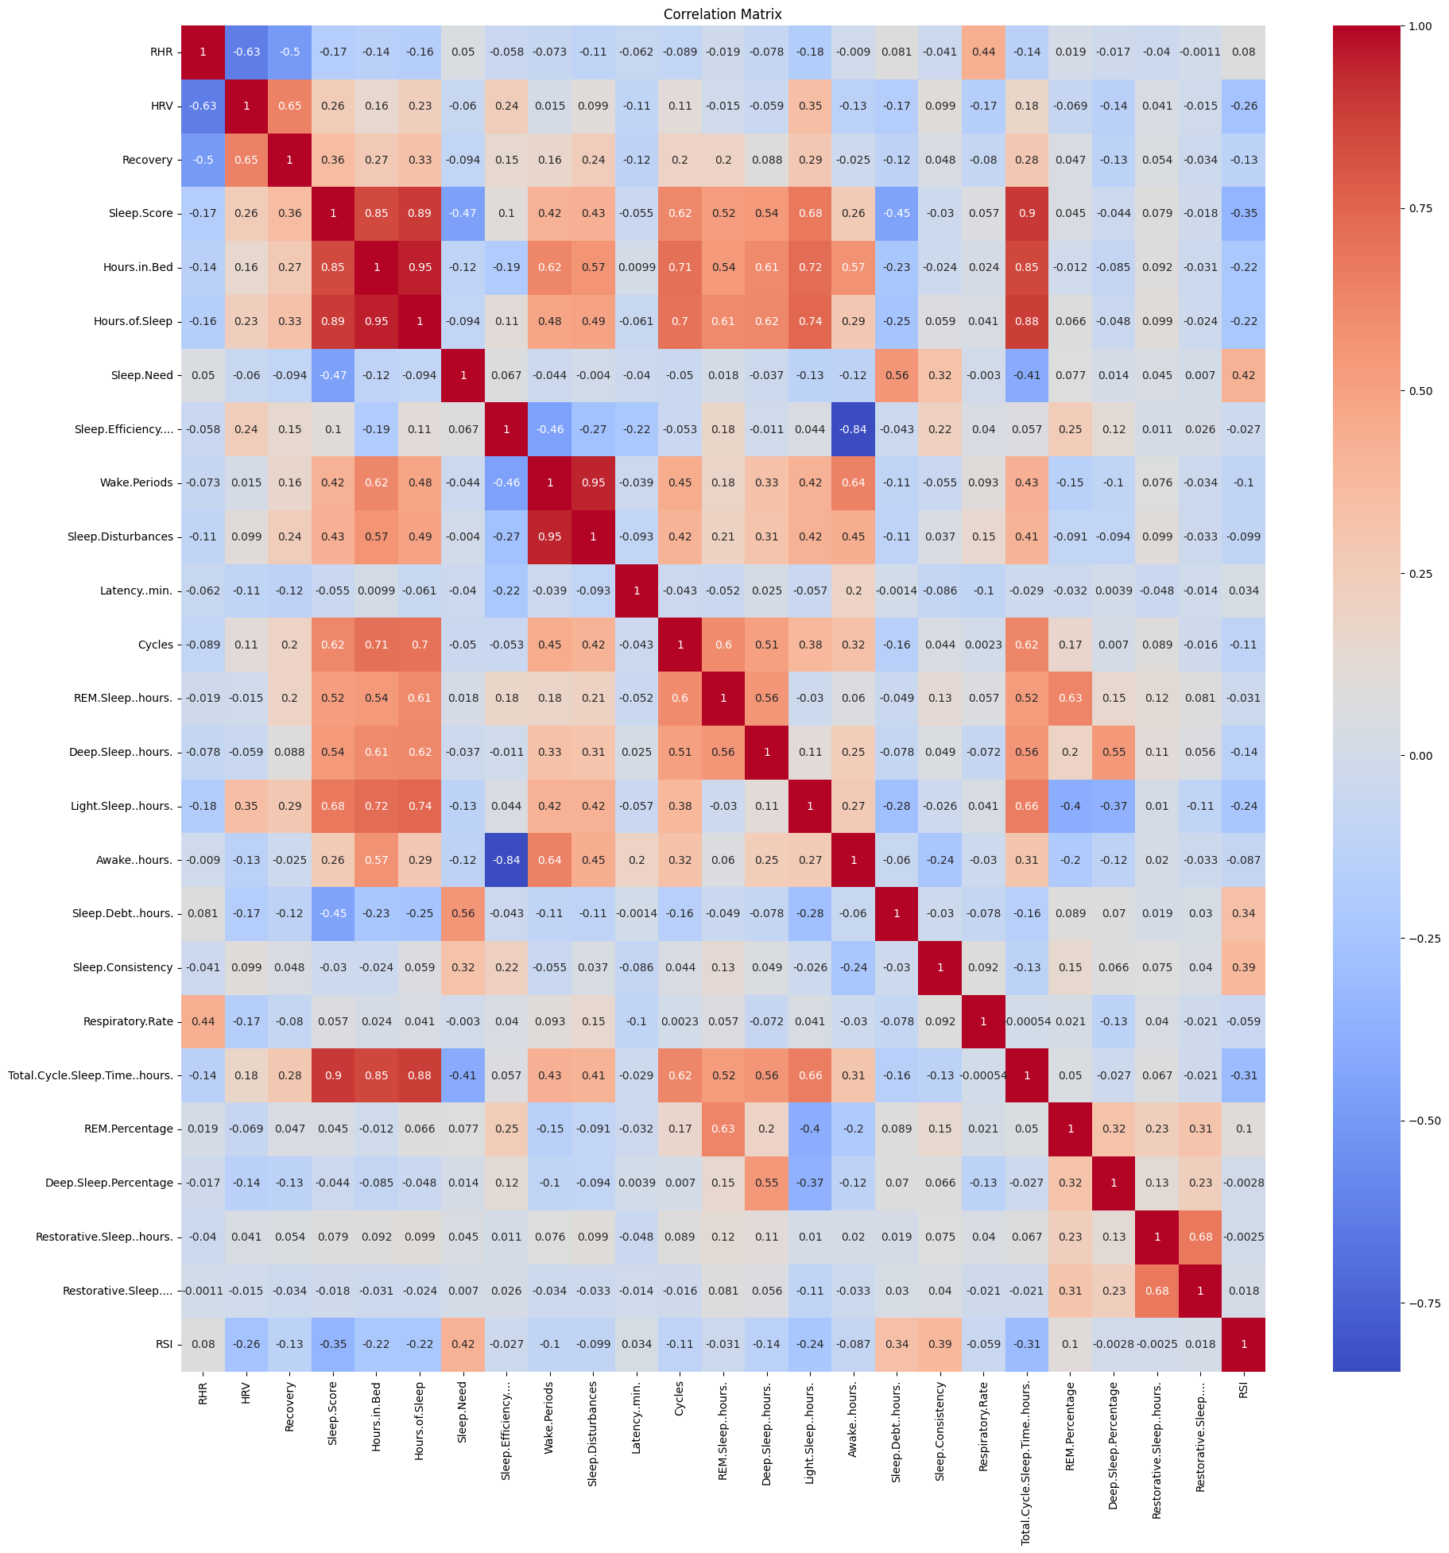
Results
Initial Correlation Matrix

Slide 10
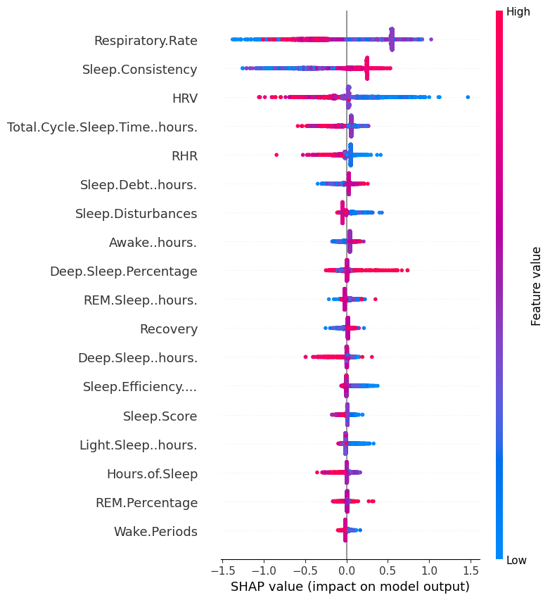
Results
Shap Analysis

Slide 11
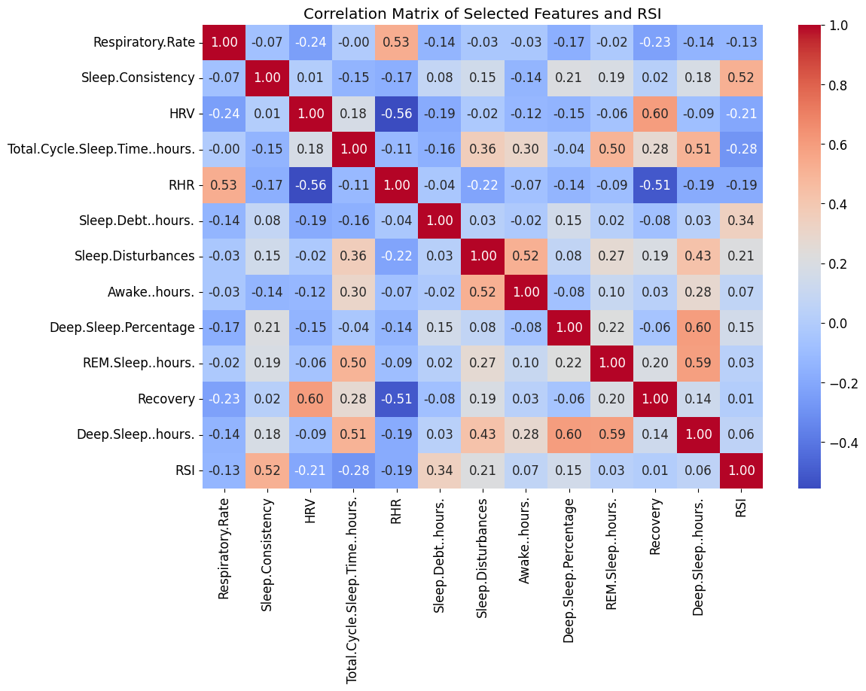
Results
Final Correlation Matrix After Feature Reduction

Slide 12
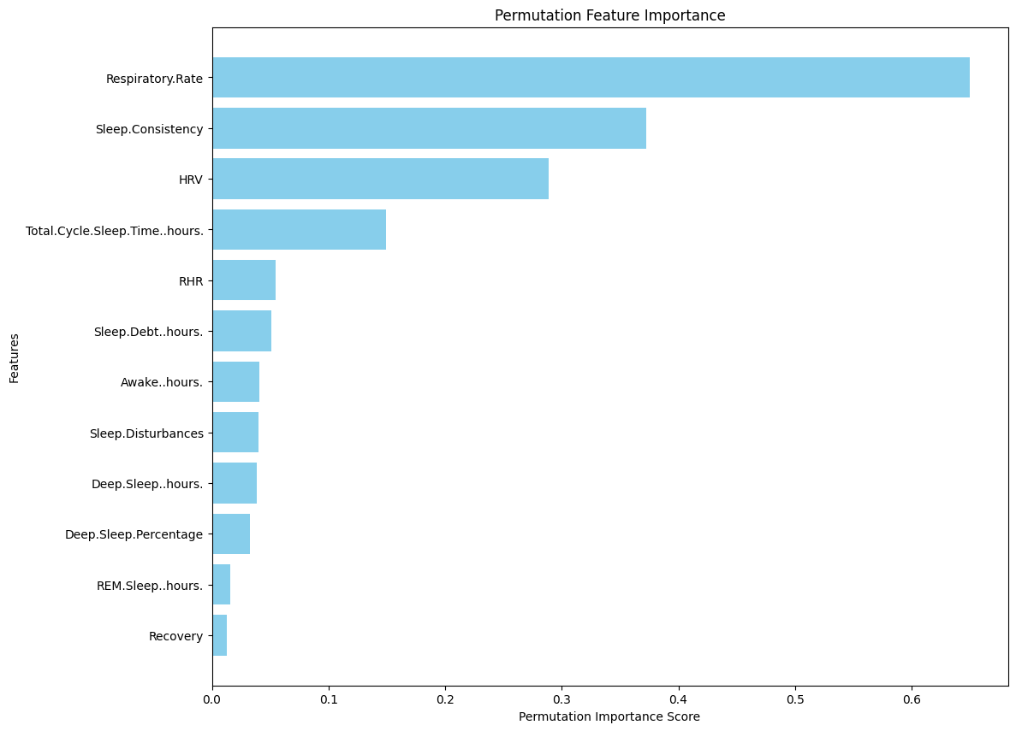
Results
Permutation Importance

Slide 13
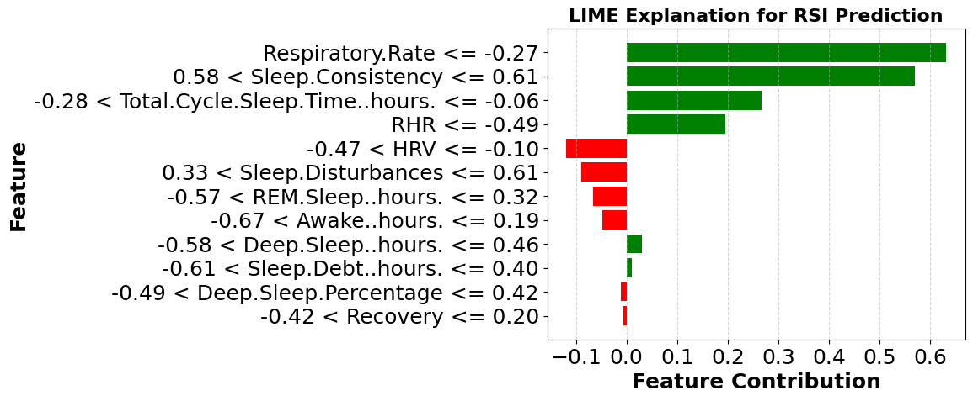
Results
LIME Explanation

Slide 14
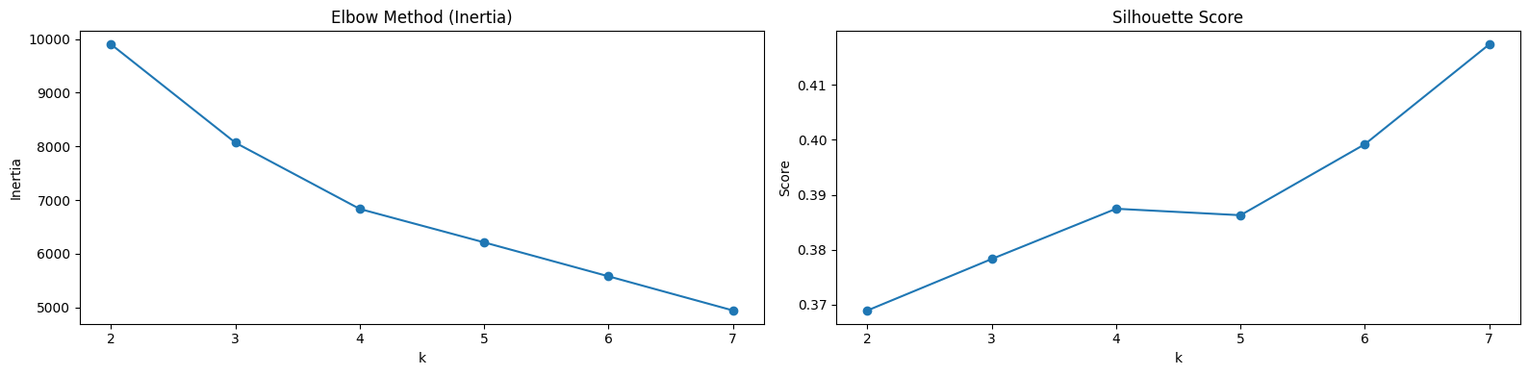
Results
Plots of Elbow Method and Silhouette score

Slide 15
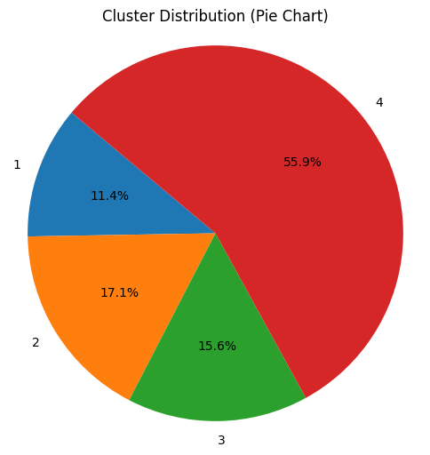
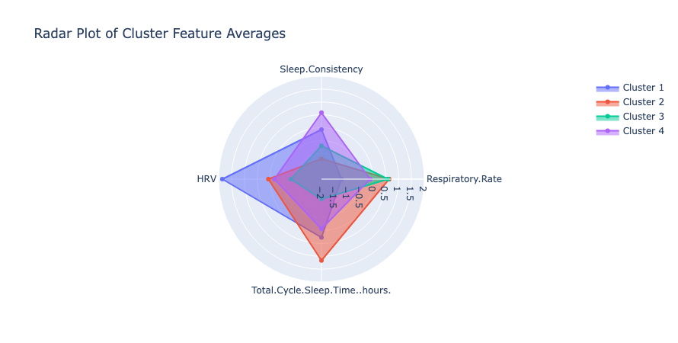
Results
Cluster-wise Athlete Distribution and a Consolidated Radar Plot Representing All Clusters

Slide 16
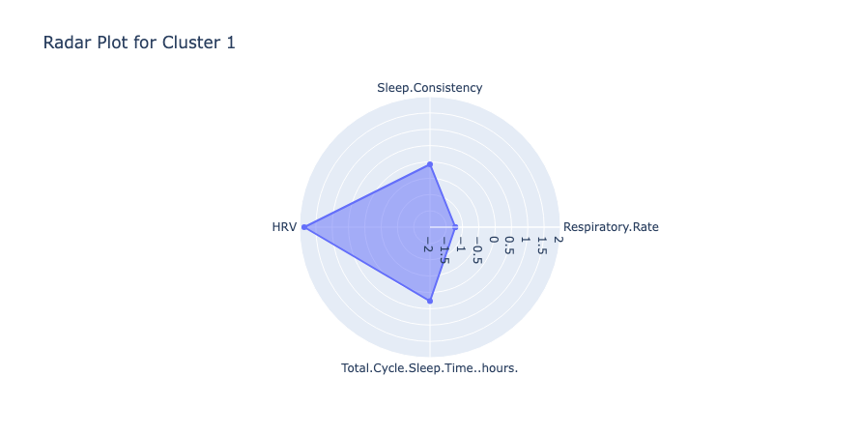
Results

Slide 17
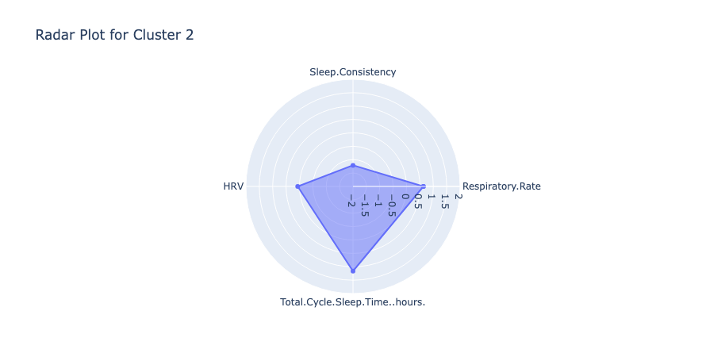
Results

Slide 18
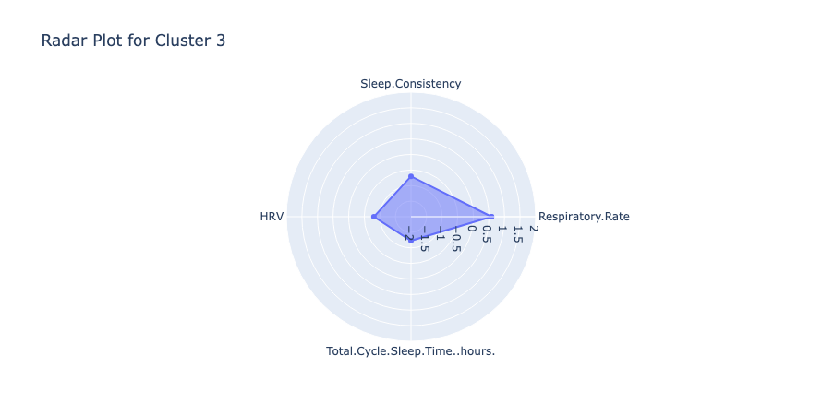
Results

Slide 19
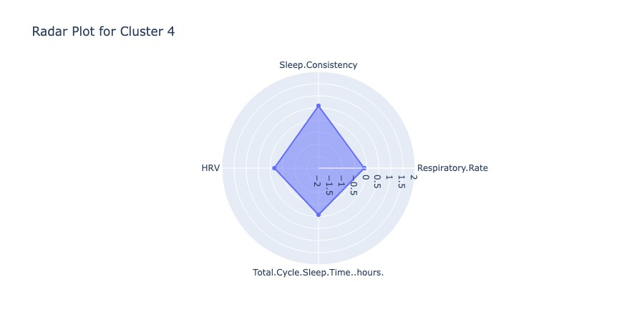
Results

Slide 20
Results
Cluster Interpretation
Cluster | Athlete Type | Interpretation
1 | Elite Endurance | High HRV, low respiratory rate, moderate sleep consistency. Indicates strong recovery and stamina-focused athlete.
2 | Recovering/Resting | High sleep duration and respiratory rate. Likely in recovery phase post-intense training.
3 | Stressed/Overtrained | Low HRV, low sleep, high respiratory rate. Suggests poor recovery or overtraining symptoms.
4 | Well-Balanced | Moderate across all features. Represents balanced, healthy athletic status.

Slide 21
Further Improvements
Using GridSearchCV or RandomizedSearchCV will help identify the optimal model parameters, improving accuracy.
Techniques like Stratified K-Fold and Leave-One-Out Cross-Validation ensure robust and unbiased model evaluation.
Instead of selecting the top four features based on Permutation Importance for clustering, dimensionality reduction techniques like Principal Component Analysis (PCA) could be used.

Slide 22
References
Senbel, S., Sharma, S., Raval, M. S., Taber, C., Nolan, J., Artan, N. S., ... & Kaya, T. (2022). Impact of sleep and training on game performance and injury in division-1 women’s Basketball Amidst the Pandemic. Ieee Access, 10, 15516-15527. https://ieeexplore.ieee.org/abstract/document/9690164/
Taber, C.B., Sharma, S., Raval, M.S. et al. A holistic approach to performance prediction in collegiate athletics: player, team, and conference perspectives. Sci Rep 14, 1162 (2024). https://doi.org/10.1038/s41598-024-51658-8
Sharma, S. U., Divakaran, S., Kaya, T., & Raval, M. (2022, July). A Hybrid Approach for Interpretable Game Performance Prediction in Basketball. In 2022 International Joint Conference on Neural Networks (IJCNN) (pp. 01-08). IEEE. https://ieeexplore.ieee.org/abstract/document/9892583/?casa_token=Ye3GQJ1JpD0AAAAA:GSlyds24pIa__7Od6UBSNs8nugbEwLvCbI8vG6w-YMYrFX2O-TUlUDo4xej3ulJUAvmO_4ij0J36

Slide 23
References
Azur, M. J., Stuart, E. A., Frangakis, C., Leaf, P. J. (2011). Multiple imputation by chained equations: what is it and how does it work?. International journal of methods in psychiatric research, 20(1), 40–49. https://doi.org/10.1002/mpr.329
K means Clustering: GfG. (2023, December 21). K means clustering - introduction. GeeksforGeeks.
SHAP Documentation Team, “An introduction to explainable AI with Shapley values — SHAP latest documentation.” Available:https://shap.readthedocs.io/en/latest/example_notebooks/overviews/An%20introduction%20to%20explainable%20AI%20with%20Shapley%20values.html, Accessed: Apr. 11, 2025.

Slide 24
References
“Radar charts,” Plotly. Available: https://plotly.com/python/radar-chart/
“LIME documentation,” LIME. Available: https://lime.readthedocs.io/en/latest/
“RFE,” Scikit-learn. Available: https://scikit-learn.org/stable/modules/generated/sklearn.feature_selection.RFE.html

Slide 25
Thank You

