Slide 1
Web Programming
Assignment #4: Searching & Notification
Old Dominion University
Department of Computer Science
CS 418/518 Fall 2008
Michael L. Nelson <mln@cs.odu.edu>

Slide 2
Requirements - Searching
Provide search capability:
  search for keywords (with full MySQL boolean operators) in:
    all forums
    some subset of forums
  search for all posts by a particular user
    can be free text search, or pull down menu / pick box, or…
    also provide choice between all forums or subset of forums

Slide 3
Requirements - Notification
Allow users to specify “notification” preferences.
  user specifies to recv email when:
    a post with a certain set of keywords is made (full boolean operators)
    any post by a certain user
  BBS sends the email, along with a description of the condition that was met, and a link to the “location of interest” in the BBS

Slide 4
Requirements - reCAPTCHA
Registering users must solve a reCAPTCHA in addition to the email confirmation process used in A3
The reCAPTCHA can occur anywhere in the registration process, but it is probably best to put it at the front end.

Slide 5
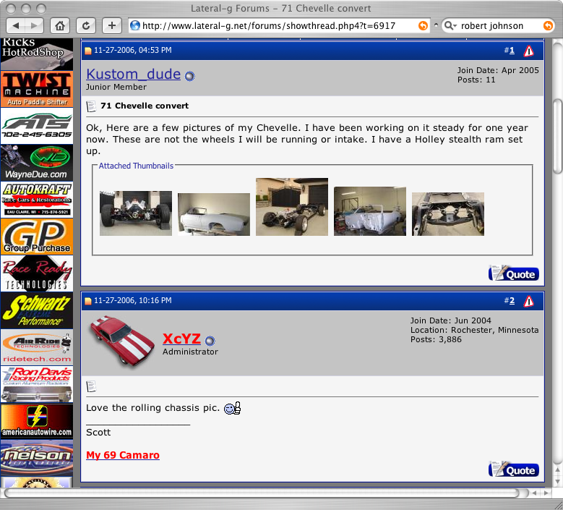
Picture Upload
Most BBSs allow users to upload pictures with their postings
You frequently have to be registered at the BBS to see the pictures, so I’ve provided a screen shot from lateral-g.net:
Clicking on a thumbnail will reveal the original, full-size picture

Slide 6
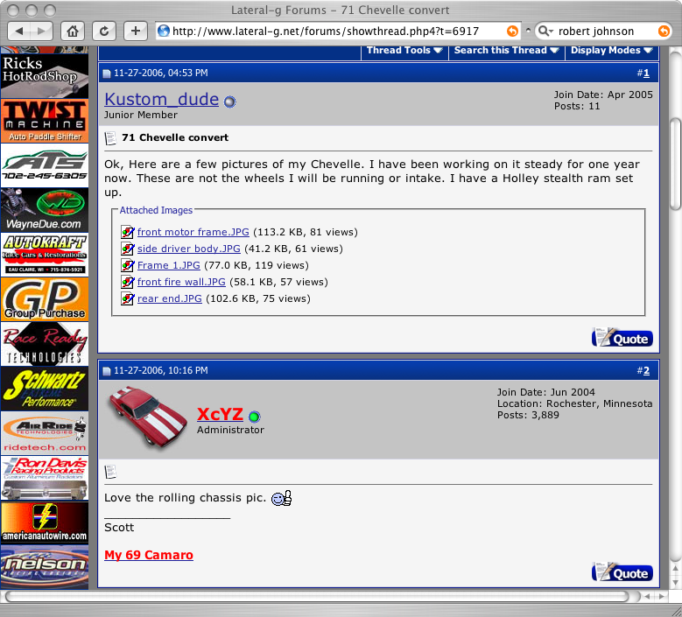
Same Page, Not Logged In
User not logged in
Clicking on a thumbnail will bring up a page prompting the user to log in.

Slide 7
Requirements - Upload
Allow users to upload multiple pictures with their postings
  # of allowable pictures per message is set by the admin
If the user (reader) is logged in:
  Show thumbnails of the images
  clicking on a thumbnail brings up the full size image in a separate window
If the user (reader) is not logged in:
  Show some indicator that thumbnails exist
  Clicking on a thumbnail “placeholder” brings up a log-in page in the same window

Slide 8
baseURL for Submission
http://mln-web.cs.odu.edu/~username/assignment4/
These URLs will be valid for all students
  If you are in a group, only 1 URL will have the actual PHP
  The “other” URL will auto-redirect to the “right” URL

Slide 9
Recommendations
Debug within your group first, then ask for other groups to help debug your operations
Your status report the week before is for the benefit of your peers more than for me…
  status report is not optional

Slide 10
Grading
There will be an in-class demo
Vijetha will assign 20 points based on a detailed examination after the class
  Do not edit the files after mid-night!
Each student will grade the aesthetic appearance of the other groups’ BBSs by emailing Vijetha <vdevaras@cs.odu.edu> (and cc’ing me) a score of 0-3; each group will recv the average value (rounded up)
  subject = “CS 418/518 A4 Appearance Grades”
  If you do not send your grades in within 24 hours, you will lose 3 points from your assignment
Grades should be available before the next class

