Slide 1
Web Server Design
Week 6
Old Dominion University
Department of Computer Science
CS 495/595 Spring 2009
Michael L. Nelson <mln@cs.odu.edu>
2/16/09

Slide 2
History…
In the prehistoric days, we used “inetd”
  http://en.wikipedia.org/wiki/Inetd
In the very early days, web pages had few images, so 1 TCP connection per URL was not so bad
HTTP/1.0
  Keep-Alive extension added (but not officially supported) to say “don’t hang up”
HTTP/1.1
  Persistent connections (as they are now called) are the norm
  (see section 19.7.1, RFC 2068; section 19.6.2, RFC 2616)

Slide 3
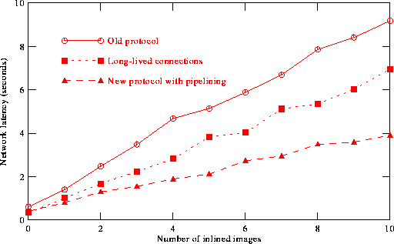
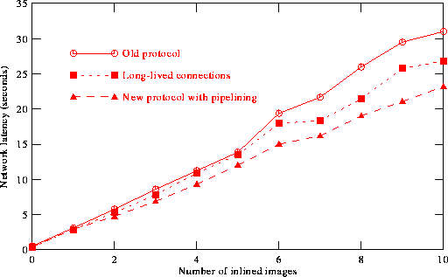
Latency in HTTP/1.0
image size = 2.5k
image size = 45k
Figs 6-1 & 6-2 from Padmanabhan & Mogul, “Improving HTTP Latency”,Proceedings of 2nd WWW Conference, 1994
http://dx.doi.org/10.1016/0169-7552(95)00106-1
http://www.geocities.com/archu_s_r/itp/httplatency.pdf

Slide 4
Long-Lived Connections
If the client does not send a “Connection: close” header, the server can assume the client wishes to maintain the TCP connection
If the server sends a “Connection: close” header, the session is over

Slide 5
Long-Lived Connections
AIHT:~/Desktop/cs595-s06 mln$ telnet www.cs.odu.edu 80 | tee 6-1.out
Trying 128.82.4.2...
Connected to xenon.cs.odu.edu.
Escape character is '^]'.
HEAD /~mln/teaching/cs595-s06/a1-test/ HTTP/1.1
Host: www.cs.odu.edu
HTTP/1.1 200 OK
Date: Sun, 12 Feb 2006 20:58:49 GMT
Server: Apache/1.3.26 (Unix) ApacheJServ/1.1.2 PHP/4.3.4
Content-Type: text/html
HEAD /~mln/teaching/cs595-s06/a1-test/1/ HTTP/1.1
Host: www.cs.odu.edu
HTTP/1.1 200 OK
Date: Sun, 12 Feb 2006 20:58:55 GMT
Server: Apache/1.3.26 (Unix) ApacheJServ/1.1.2 PHP/4.3.4
Content-Type: text/html
HEAD /~mln/teaching/cs595-s06/a1-test/2/ HTTP/1.1
Host: www.cs.odu.edu
HTTP/1.1 200 OK
Date: Sun, 12 Feb 2006 20:59:01 GMT
Server: Apache/1.3.26 (Unix) ApacheJServ/1.1.2 PHP/4.3.4
Last-Modified: Sun, 29 Jan 2006 18:43:15 GMT
ETag: "1f4de2-790-43dd0cc3"
Accept-Ranges: bytes
Content-Length: 1936
Content-Type: text/html
X-Pad: avoid browser bug
Connection closed by foreign host.
request
response
request
response
request
response

Slide 6
Pipelining Requests
Section 8.1.2.2
“A client that supports persistent connections MAY "pipeline" its requests (i.e., send multiple requests without waiting for each response). A server MUST send its responses to those requests in the same order that the requests were received.”

Slide 7
Pipelined Requests
AIHT:~/Desktop/cs595-s06 mln$ telnet www.cs.odu.edu 80 | tee 6-2.out
Trying 128.82.4.2...
Connected to xenon.cs.odu.edu.
Escape character is '^]'.
HEAD /~mln/teaching/cs595-s06/a1-test/ HTTP/1.1
Host: www.cs.odu.edu
HEAD /~mln/teaching/cs595-s06/a1-test/1/ HTTP/1.1
Host: www.cs.odu.edu
HEAD /~mln/teaching/cs595-s06/a1-test/2/ HTTP/1.1
Host: www.cs.odu.edu
HTTP/1.1 200 OK
Date: Sun, 12 Feb 2006 21:08:44 GMT
Server: Apache/1.3.26 (Unix) ApacheJServ/1.1.2 PHP/4.3.4
Content-Type: text/html
HTTP/1.1 200 OK
Date: Sun, 12 Feb 2006 21:08:44 GMT
Server: Apache/1.3.26 (Unix) ApacheJServ/1.1.2 PHP/4.3.4
Content-Type: text/html
HTTP/1.1 200 OK
Date: Sun, 12 Feb 2006 21:08:44 GMT
Server: Apache/1.3.26 (Unix) ApacheJServ/1.1.2 PHP/4.3.4
Last-Modified: Sun, 29 Jan 2006 18:43:15 GMT
ETag: "1f4de2-790-43dd0cc3"
Accept-Ranges: bytes
Content-Length: 1936
Content-Type: text/html
X-Pad: avoid browser bug
Connection closed by foreign host.
3 requests
3 responses

Slide 8
Error Responses in Pipeline
AIHT:~/Desktop/cs595-s06 mln$ telnet www.cs.odu.edu 80 | tee 6-3.out
Trying 128.82.4.2...
Connected to xenon.cs.odu.edu.
Escape character is '^]'.
HEAD /~mln/teaching/cs595-s06/a1-test/ HTTP/1.1
Host: www.cs.odu.edu
HEAD /~mln/teaching/cs595-s06/a1-test/XASDFASDASDF/ HTTP/1.1
Host: www.cs.odu.edu
HEAD /~mln/teaching/cs595-s06/a1-test/2/ HTTP/1.1
Host: www.cs.odu.edu
HTTP/1.1 200 OK
Date: Sun, 12 Feb 2006 21:19:37 GMT
Server: Apache/1.3.26 (Unix) ApacheJServ/1.1.2 PHP/4.3.4
Content-Type: text/html
HTTP/1.1 404 Not Found
Date: Sun, 12 Feb 2006 21:19:37 GMT
Server: Apache/1.3.26 (Unix) ApacheJServ/1.1.2 PHP/4.3.4
Content-Type: text/html; charset=iso-8859-1
HTTP/1.1 200 OK
Date: Sun, 12 Feb 2006 21:19:38 GMT
Server: Apache/1.3.26 (Unix) ApacheJServ/1.1.2 PHP/4.3.4
Last-Modified: Sun, 29 Jan 2006 18:43:15 GMT
ETag: "1f4de2-790-43dd0cc3"
Accept-Ranges: bytes
Content-Length: 1936
Content-Type: text/html
X-Pad: avoid browser bug
Connection closed by foreign host.
this error does not
terminate the session

