Slide 1
The 6811
Serial Communication Interface
ECE 346 – Spring 2009

Slide 2
6811 and Serial Communications
The 6811 has a built in device that is used in serial communications
  Asynchronous Serial Communications Interface (SCI)
Receiver, transmitter, control, status, and data registers
Primarily, the SCI system is configured and controlled by five registers:
BAUD, SCCR1, SCCR2, SCSR, and SCDR
M68HC11 Reference Manual Rev. 6, Chapter 9
Miller §7.10

Slide 3
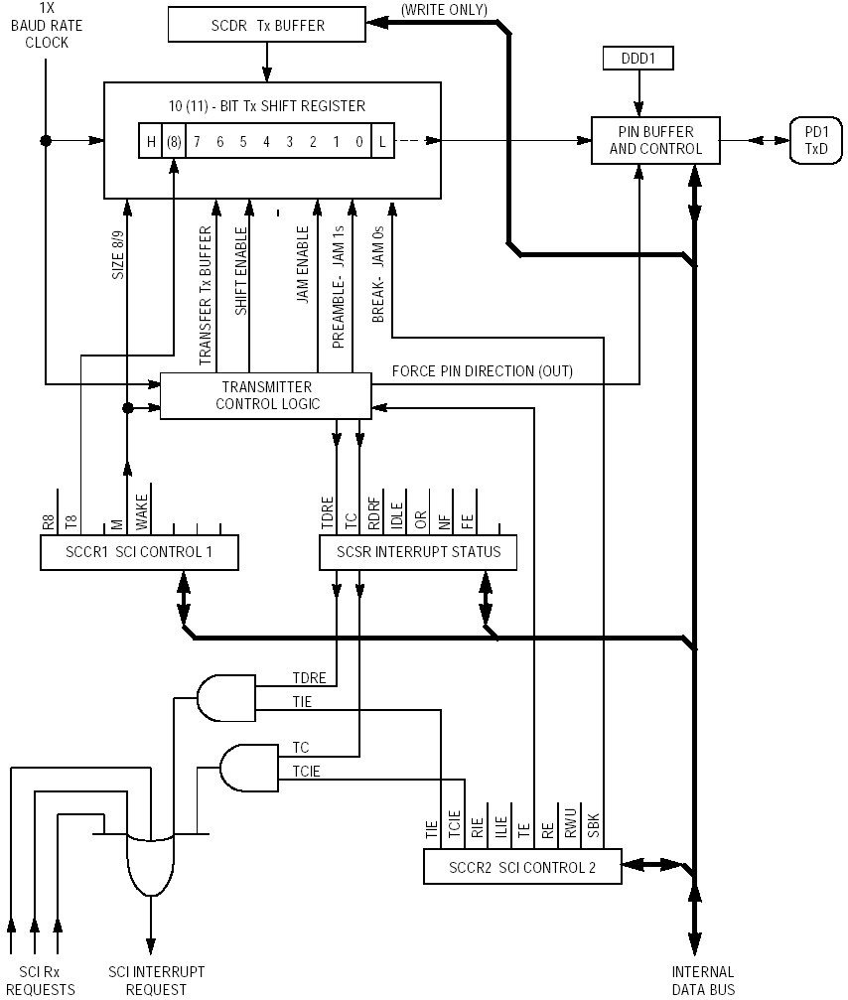
Asynchronous SCI Transmitter

Slide 4
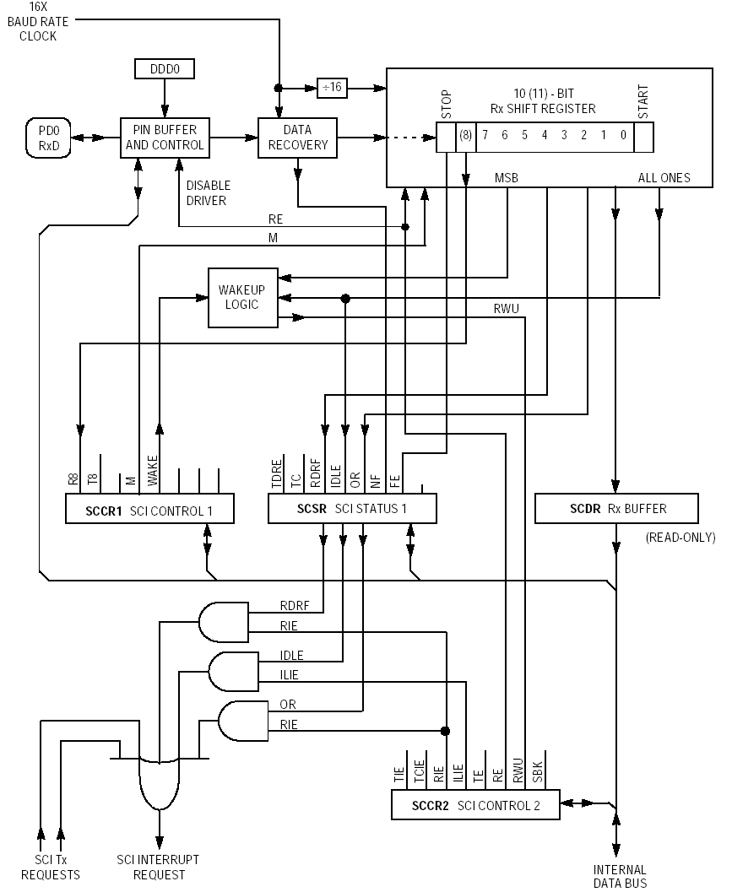
Asynchronous
SCI Receiver

Slide 5
General Comments
The 6811 has many registers to support transmitting and receiving characters
The SCI can be enabled or disabled
The 6811 takes care of serial to parallel and parallel to serial conversions
The 6811 can be configured to interrupt when a character has been received or transmitted
All characters transmitted have start and stop bits

Slide 6
General Comments (cont.)
Can handle 8 and 9 bit characters
Transmit register double buffered
  One register active in transmitting information
  Second register to hold next character to transmit

Slide 7
SCI and Port D
Serial communications uses PORTD bits 0 and 1
  TxD is bit 1 and RxD is bit 0
  DDRD bit 1 is overridden when asynchronous SCI is enabled

Slide 8
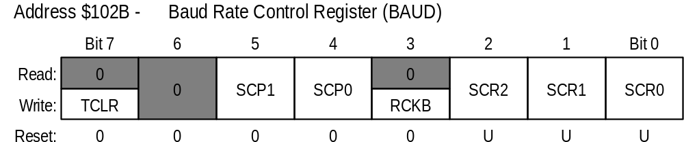
BAUD
BAUD Register controls data transmit/receive speed
TCLR, RCKB—intended for factory testing
SCP1, SCP0—SCI Baud-rate prescale select bits
SCR2-SCR0—SCI Baud-Rate select bits

Slide 9
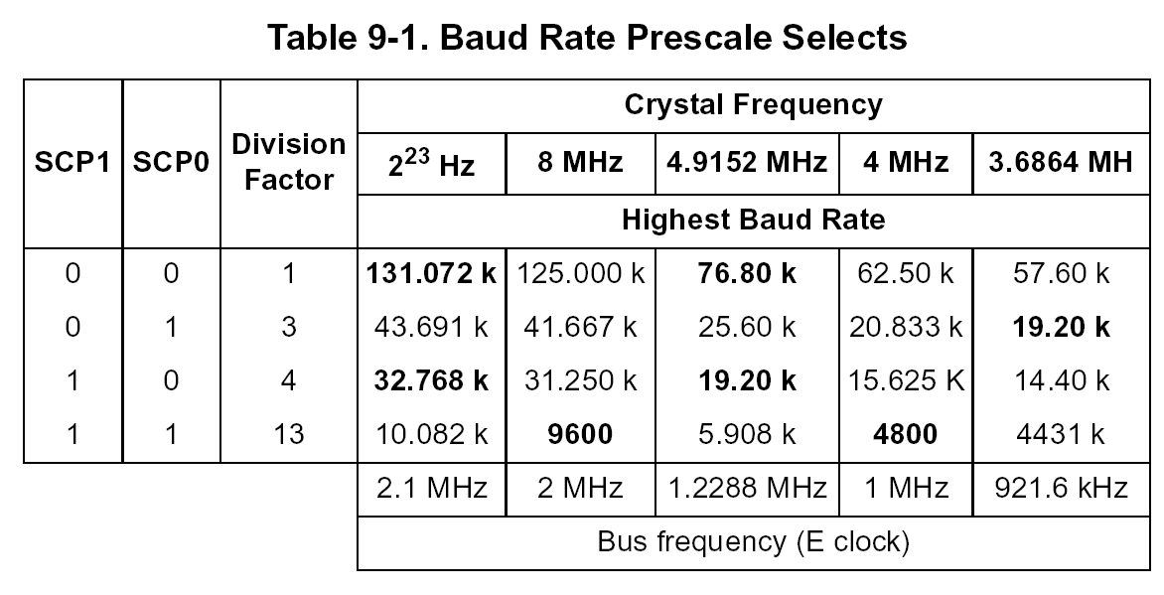
Baud Rate Prescale Selects

Slide 10
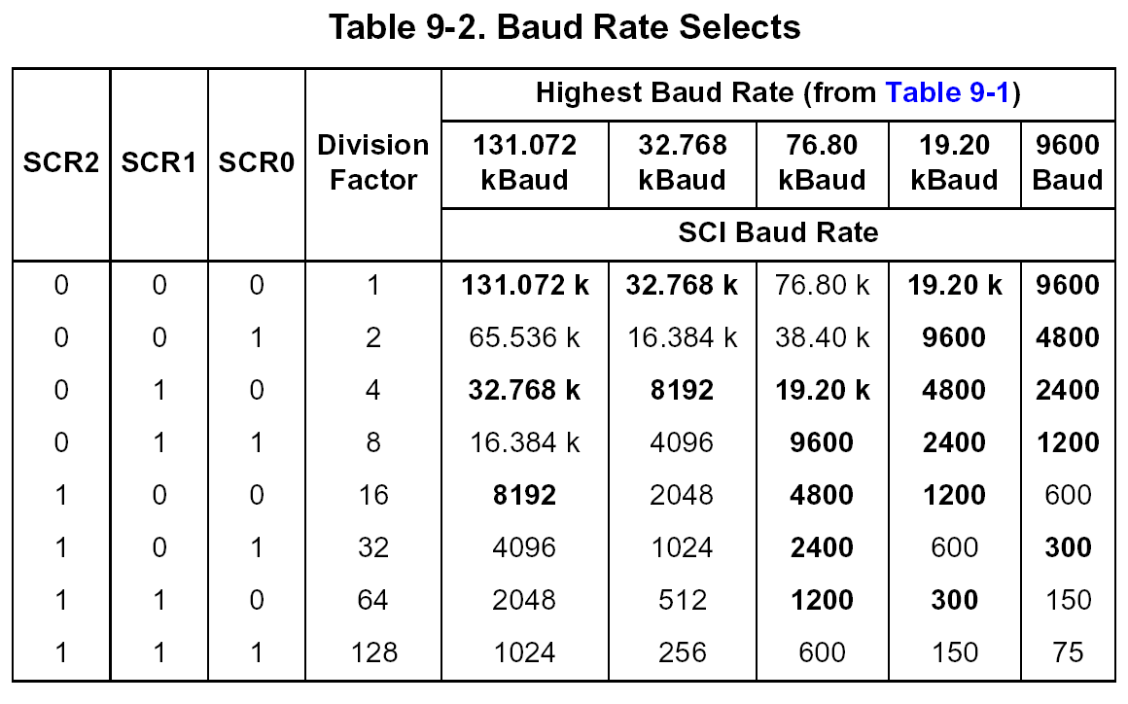
Baud Rate Select Bits

Slide 11
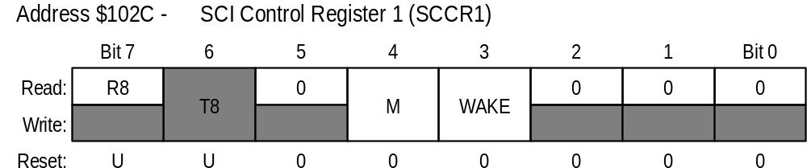
SCI Control Register 1 (SCCR1)
R8—receive eighth bit
T8—transmit eighth bit
M—select 8/9 bit characters.
WAKE—wakeup method select
  0—receiver wakes up after 1 character of idle time
  1—receiver wakes up if MSB of character is 1

Slide 12
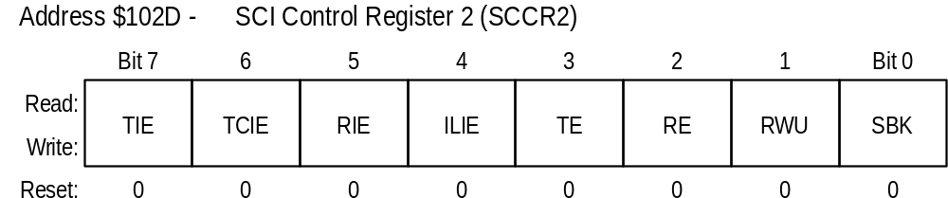
SCI Control Register 2 (SCCR2)
TIE—Transmit interrupt enable
TCIE—Transmit complete interrupt enable
RIE—Receive interrupt enable
ILIE—Idle line interrupt enable

Slide 13
SCCR2 (cont.)
TE—Transmit enable
RE—Receive enable
RWU—Receiver wakeup enable
  If 1, wakeup mode enabled
SBK—Send break—character of all zeros

Slide 14
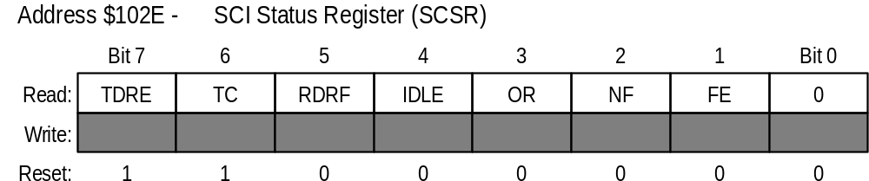
SCI Status Register (SCSR)
TDRE—transmit data register empty
  0, not empty, 1 empty. Used when polling
  Because of double buffering, does not mean transmission stops
TC—Transmit complete
  0, sending character, 1 completed sending
  No more data to send (transmit buffer empty too)

Slide 15
SCI Status Register (SCSR)
RDRF—Receive data register full
  Indicates full character received and can be read
IDLE—Idle line detect
OR—Overrun error bit
NF—Noise flag—set if receiver logic detects bad data
FE—framing error—set if 0 detected at stop bit

Slide 16
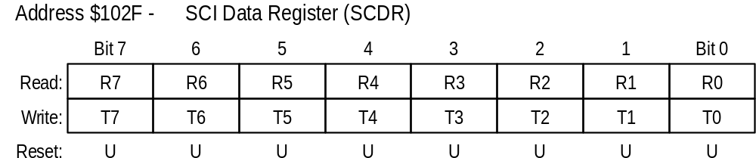
SCI Data Register (SCDR)
Read lower 8 bits of received data
Write lower 8 bits of transmitted data

