Slide 1
Russia
A brief look of

Slide 2
History
Russian revolution of 1917 – communist party, Red Army, won – Soviet Union formed
Stalin continued with communism – rapid industrialization – stopped Nazis that the Battle of Satlingrad in 1943 – lost 27 million people
Both, the U.S. and russia helped Western Europe sought to achieve dominance over the third world – resulting in the Cold War
Yetslin became 1st president in 1991, but communists still controlled most of Congress
Now, Russia is recovering with high price oil exports, yet increasing military spending and retains nuclear weapons

Slide 3
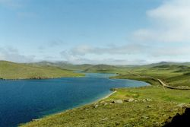
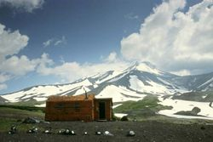
Geography
largest country in the world by land mass
Mosty plains known as Siberia-------------------→
Capital – Moscow
Economy dependent on oil, natural gas, metals and timber

Slide 4
Demographics
The Russian Federation is home to as many as 160 different ethnic groups but 79.8% of the population is ethnically Russian
The Russian language is the only official state language
The Cyrillic alphabet is the only official script
The Russian Orthodox Church is the dominant Christian religion in the country. Islam is the second most widespread religion.

Slide 5
Culture
Russia is extremely culturally diverse, so is their music and food.
Music includes folk, popular and classic
Notable cuisine: Pelmini – dough filled with meat, Blini - pancakes, Shashlyk – shish kebab
Cinema of the Soviet Union contains quality cinema such as Solyaris (1972)

Slide 6
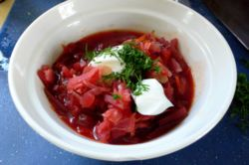
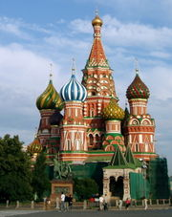
Culture pics
Borsch soup, mainly consists of beets
Saint Basil's Cathedral is a showcase of medieval Russian architecture.

Slide 7
Tatyana Tolstaya
Born into a family of writers
She published a volume of short stories, On the Golden Porch in 1983
Co-host of a very successful TV show called The School for Scandal (Школа злословия)
She said that she writes about the ordinary individual who meets with the disappointments of life

Slide 8
Fire and Dust
uhhh

