Slide 1

NETFLIX CONTENT ANALYSIS:
Data Visualization Project Milestone - 3
Group members:
Rahil Ansari
Parth Shah
Arvind Neelkantan

Slide 2
INTRODUCTION
Movies and TV Shows streamed on Netflix since the year 2007 to Jan 2021
Attributes – Titles, Cast, Country, Director, Release year, etc.
Analysis:
Growth of Content over the years
The number of titles produced in each country that Netflix is present in
Content Releases Per Month
Most Popular Genres
Top Content Ratings Available on Netflix

Slide 3
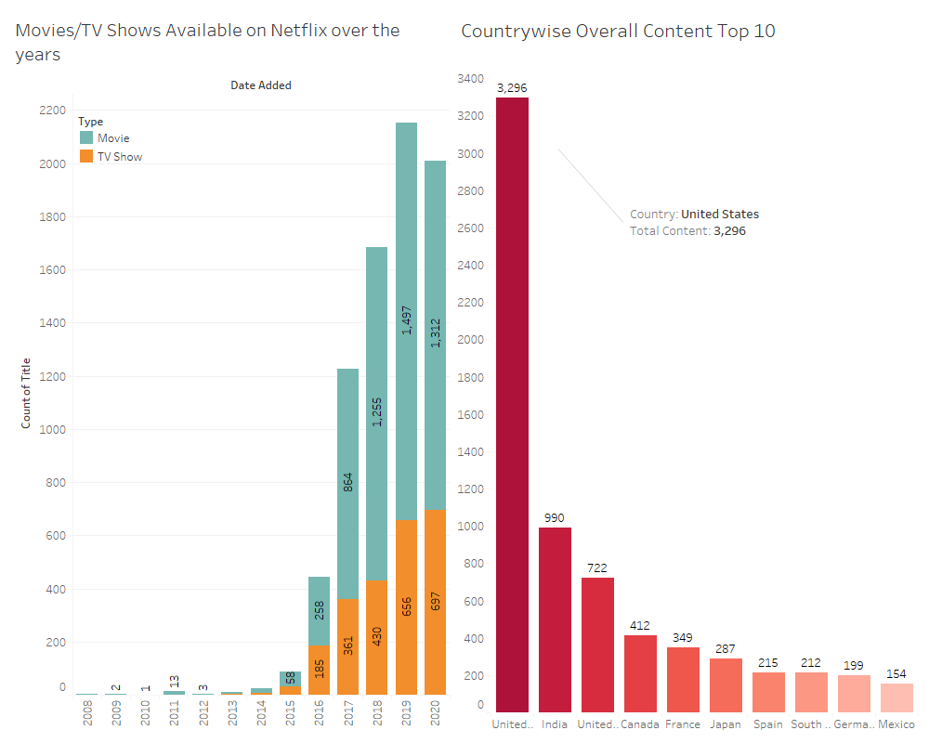
Focus Areas:
Content Added on Netflix over the years
Overall Movies/Tv Shows added on Netflix country wise (Top 10)

Slide 4
What the Content Dashboard Tells Us
Number of movies and tv shows added to Netflix yearly from 2007 to 2020.
Movies – 69 %, Tv Shows – 31 % out of the entire library
The year 2015 saw a considerable rise in the number of movies and tv shows added.
Thereafter, the yearly addition of new movies and tv shows to the Netflix library saw an exponential growth.
We see a slight decrease in the trend in 2020. This was because of the Covid-19 Pandemic.
The largest producer of content is the USA, followed by India.
Netflix needs to adapt to the new norm that Covid Pandemic has brought.
They need to produce more content in high return area.

Slide 5
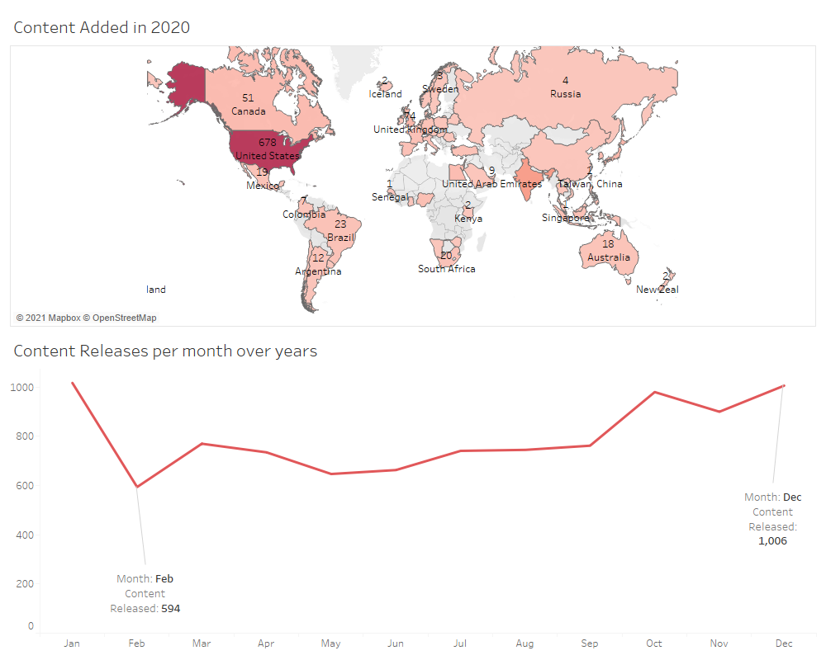
Focus Areas:
Content added in the year 2020, Country wise.
Content Released Per Month

Slide 6
Our Understanding and Recommendations
The Map chart shows us the content added to Netflix in 2020.
The Line graph shows us the number of Titles added every month.
US, India, UK and Canada are largest consumers. hence, Netflix need to increase the speed of content addition in these countries
Looking at the Line graph we can say that most of the content is added in December & January, which is the holiday season.
Moreover, February is the month with the least content.
So, in addition to adding content in the Holiday season, Netflix should also consider adding more content in the summer this year (2021) as most people will be in their homes due to Covid – 19.

Slide 7
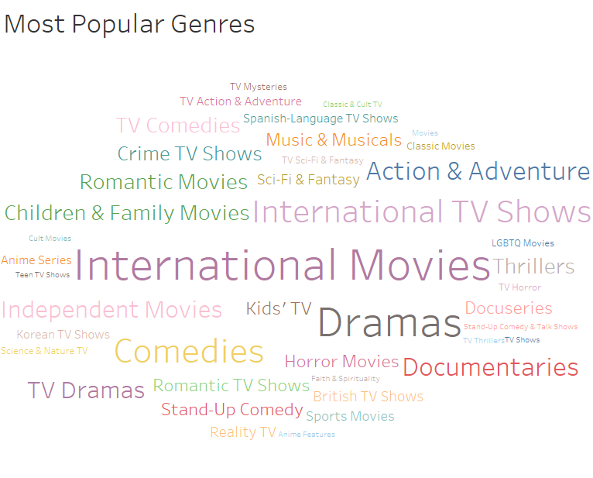
Top 5 Genres:
International Movies/Tv Shows
Dramas
Comedies
Action & Adventure
Children & Family Movies

Slide 8
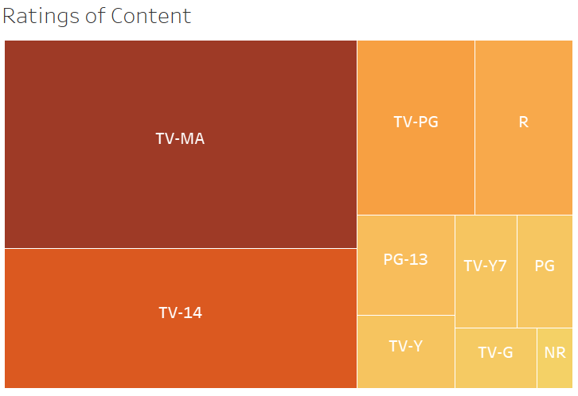
Top 5 Content Ratings available on Netflix:
TV-MA
TV-14
TV-PG
R
PG-13

Slide 9
Our Understanding and Recommendations
The Tree Map shows us the prevailing ratings of the movies and TV shows available.
Most of the content available on Netflix is meant for Mature Audiences.
The content available for Kids is comparatively very less than for Mature Audiences.
In my opinion Netflix should keep a fair balance between the two type of contents to attract all sorts of audiences.

Slide 10

Most Popular Movies/TV Shows on Netflix Worldwide
Top 5 Movies on Netflix:
Murder Mystery – 83 million views.
The Old Guard – 78 million views.
Enola Holmes – 76 million views.
Project Power – 75 million views.
The Kissing Booth 2 — 66 million views.
The Irishman — 64 million views.
Top 5 TV shows on Netflix:
The Witcher - 76 million.
Lupin - 70 million.
Money Heist - Season 4: 65 million
Stranger Things Season 3: 64 million
Tiger King - 64 million

Slide 11
Conclusion
Netflix rose in popularity in the year 2015 and has grown exponentially since.
Netflix usually releases their content in December & January.
Most of the content available on Netflix is Meant for Mature Audiences.
The Covid – 19 pandemic has affected the release of content on the platform.
As of today, Netflix is the most popular streaming service in the World.

Slide 12


