Slide 1
CIS 2450 · BIG DATA ANALYTICS
SEO Ranking Predictor
Predicting Google's top-10 for developer documentation —
and explaining every prediction.
& Recommendation System
PAGES
1,297
DOMAINS
40
FEATURES
72
MODELS
4
Two distinct sources
scraped HTML + Google SERP rankings
Five feature families
content, metadata, structural, TF-IDF, graph
Rahil Patel
rahilp07@seas.upenn.edu
Ayush Tripathi
tripath1@seas.upenn.edu
Four-model sweep
LR → Random Forest → XGBoost → MLP
SHAP-driven recommendations
concrete actions, not vague advice

Slide 2
THE PROBLEM
Search ranking is opaque · the inputs are not
Documentation authors get no feedback loop on what makes a page rank. We close that loop by treating SERP placement as a supervised-learning problem over observable page signals.
1
2
3
Observable inputs
Binary classification
Explainable output
Content length, heading structure, keyword placement, internal linking, link-graph authority — all measurable per page.
`is_top_10` for the topic query derived from each page's <title>. F1 + PR-AUC (imbalance-aware) as the headline metric.
SHAP attribution per prediction → a recommendation engine that tells the author what to change, not just whether they'll rank.
SEO Ranking Predictor · CIS 2450 Final
2 / 13

Slide 3
DATASET
Two distinct sources, joined per-page
Source 1
Source 2
Developer-documentation HTML
Google SERP rankings
Async crawler · robots.txt-aware · 1 req/s per domain
docs.python.org · developer.mozilla.org · react.dev
nodejs.org · kubernetes.io · fastapi.tiangolo.com
Each page → HTML + JSON sidecar
(URL · fetch_ts · title · outbound_links)
Brave Search API (free tier) · SerpApi fallback
One topic query per page → top-10 organic results
Query derived from <title> via boilerplate strip
`is_top_10` = page's own URL appears in its top-10
JOIN ON host + path.lower()
Per CIS 2450 TA Ricky Gong's 2026-03-29 email, scope was narrowed from 50K rows to ~1.3K developer-doc pages — free-tier SERP rate-limits made full-scale infeasible inside the deadline. Sanctioned, documented in data/README.md.
SEO Ranking Predictor · CIS 2450 Final
3 / 13

Slide 4
FEATURE PIPELINE
72 numeric features across five families
Content
Metadata
Structural
TF-IDF
Graph
5
4
7
50
6
columns
columns
columns
columns
columns
text_length
word_count
sentence_count
flesch_reading_ease
keyword_density
title_length
has_meta_description
meta_description_length
keyword_in_title
h1_count
h2_count
h3_count
internal_link_count
external_link_count
image_count
alt_text_coverage
corpus-fitted top-50 terms
ngram_range = (1, 2)
stop_words = english
pagerank (α=0.85)
hits_hub
hits_authority
in_degree
out_degree
clustering
All five families are joined per-page on the host+path key into data/processed/features.csv — shared across every model and the dashboard.
SEO Ranking Predictor · CIS 2450 Final
4 / 13

Slide 5
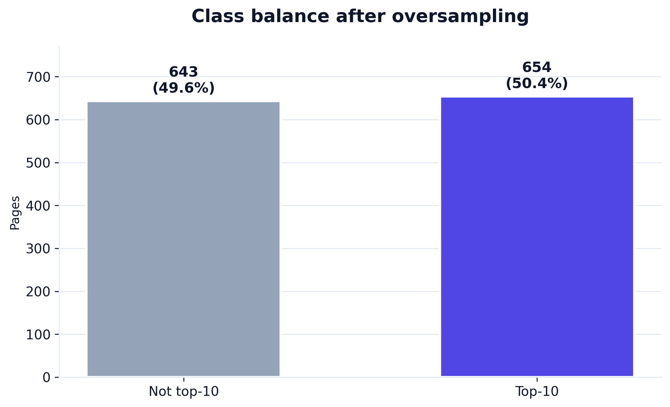
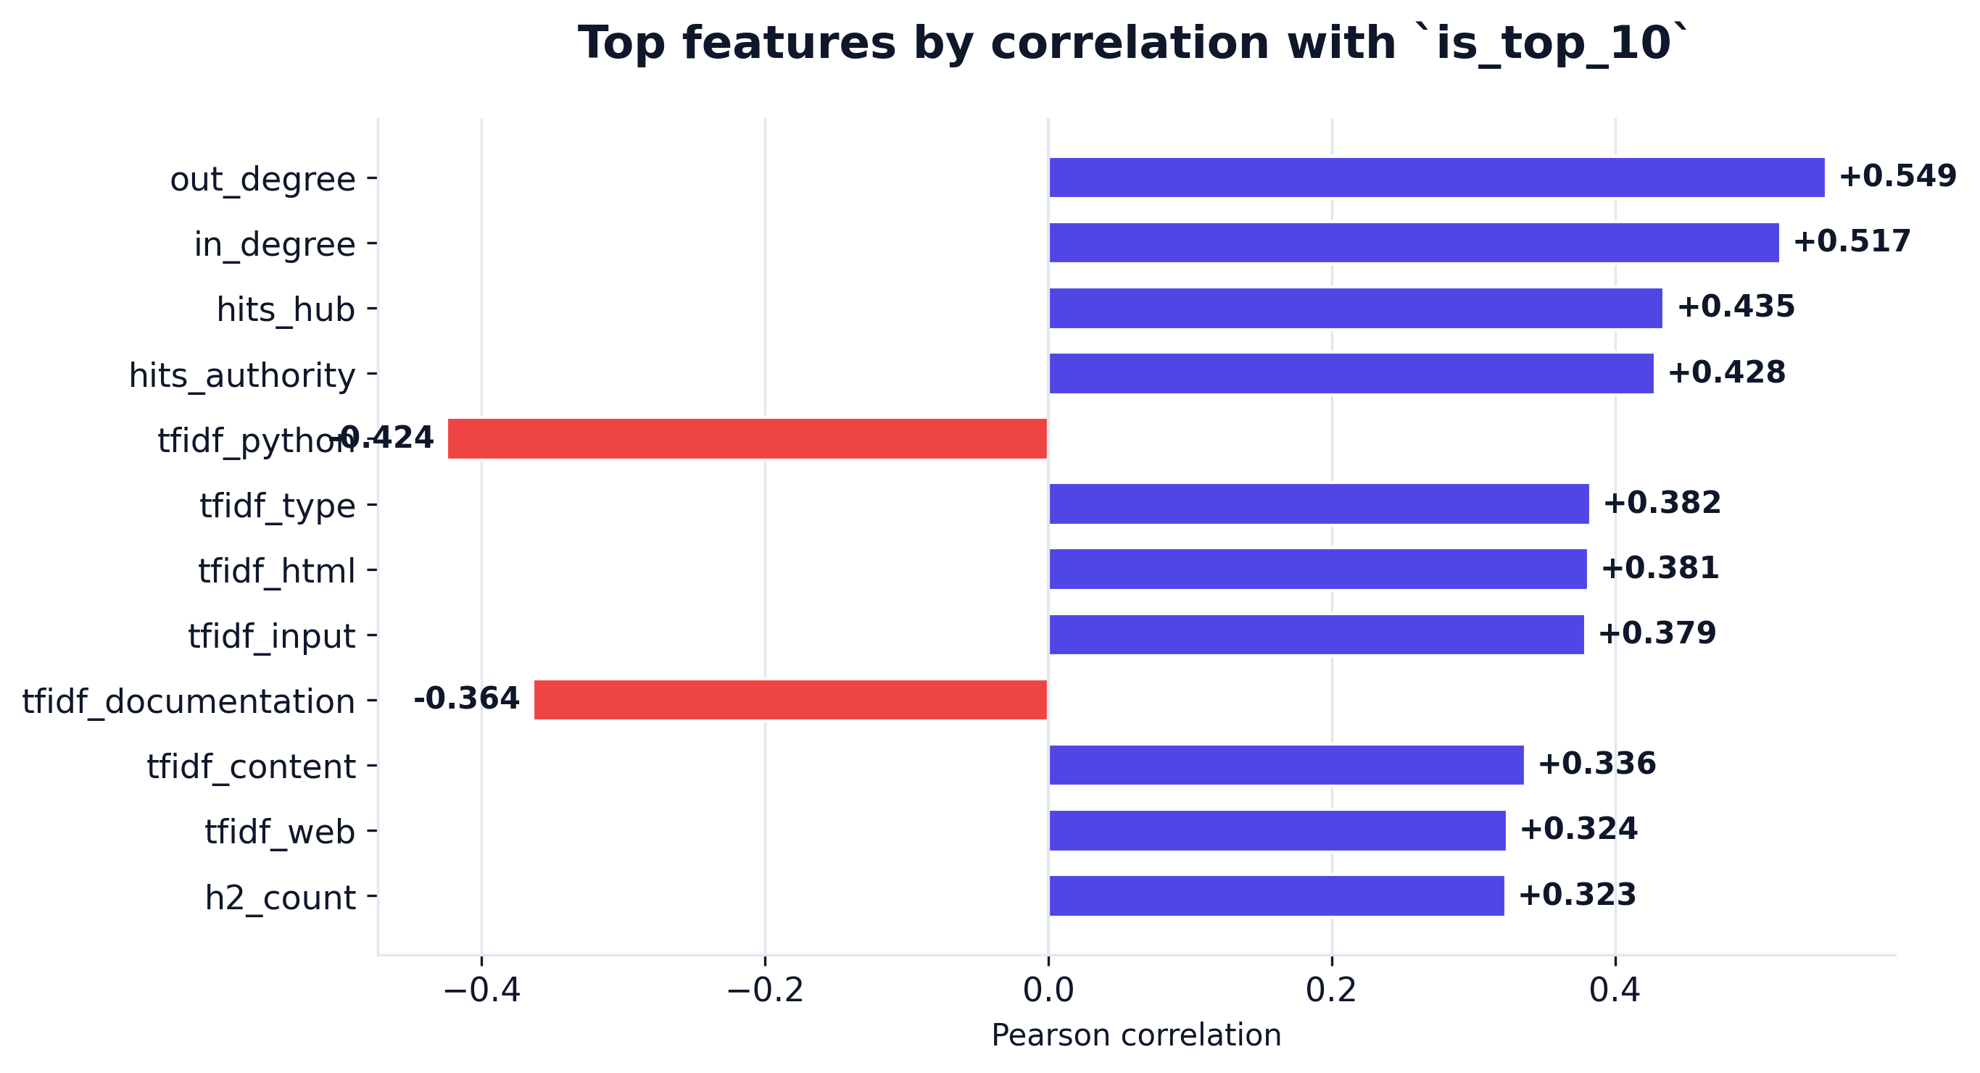
EDA · PART 1
Class balance and feature signal
Class parity after oversampling
Minority-class oversampling brought the corpus to a 50/50 split. PR-AUC stays the headline metric — both classes are equally important.
Strongest signals are structural
Heading counts, internal links, and graph centrality (PageRank, HITS) lead the correlation ranking — content length on its own is weaker than expected.
SEO Ranking Predictor · CIS 2450 Final
5 / 13

Slide 6
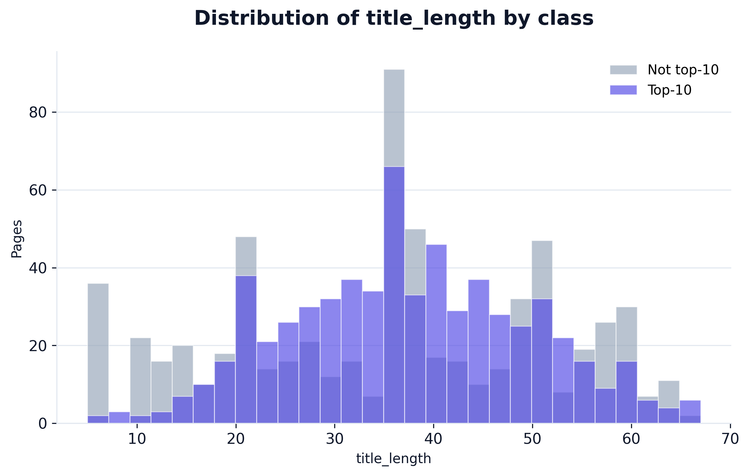
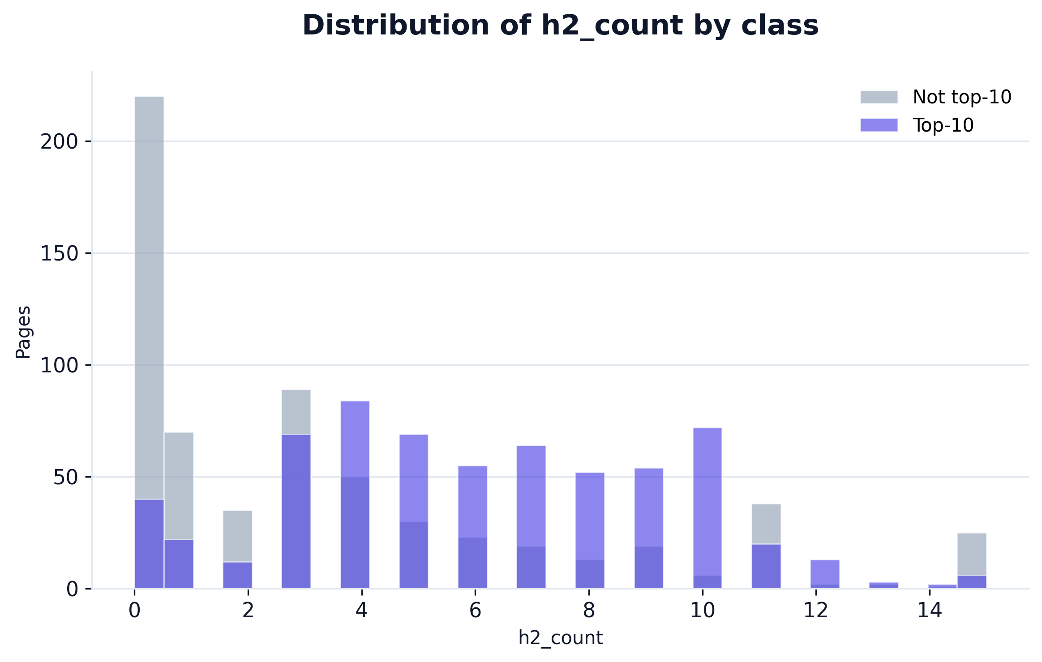
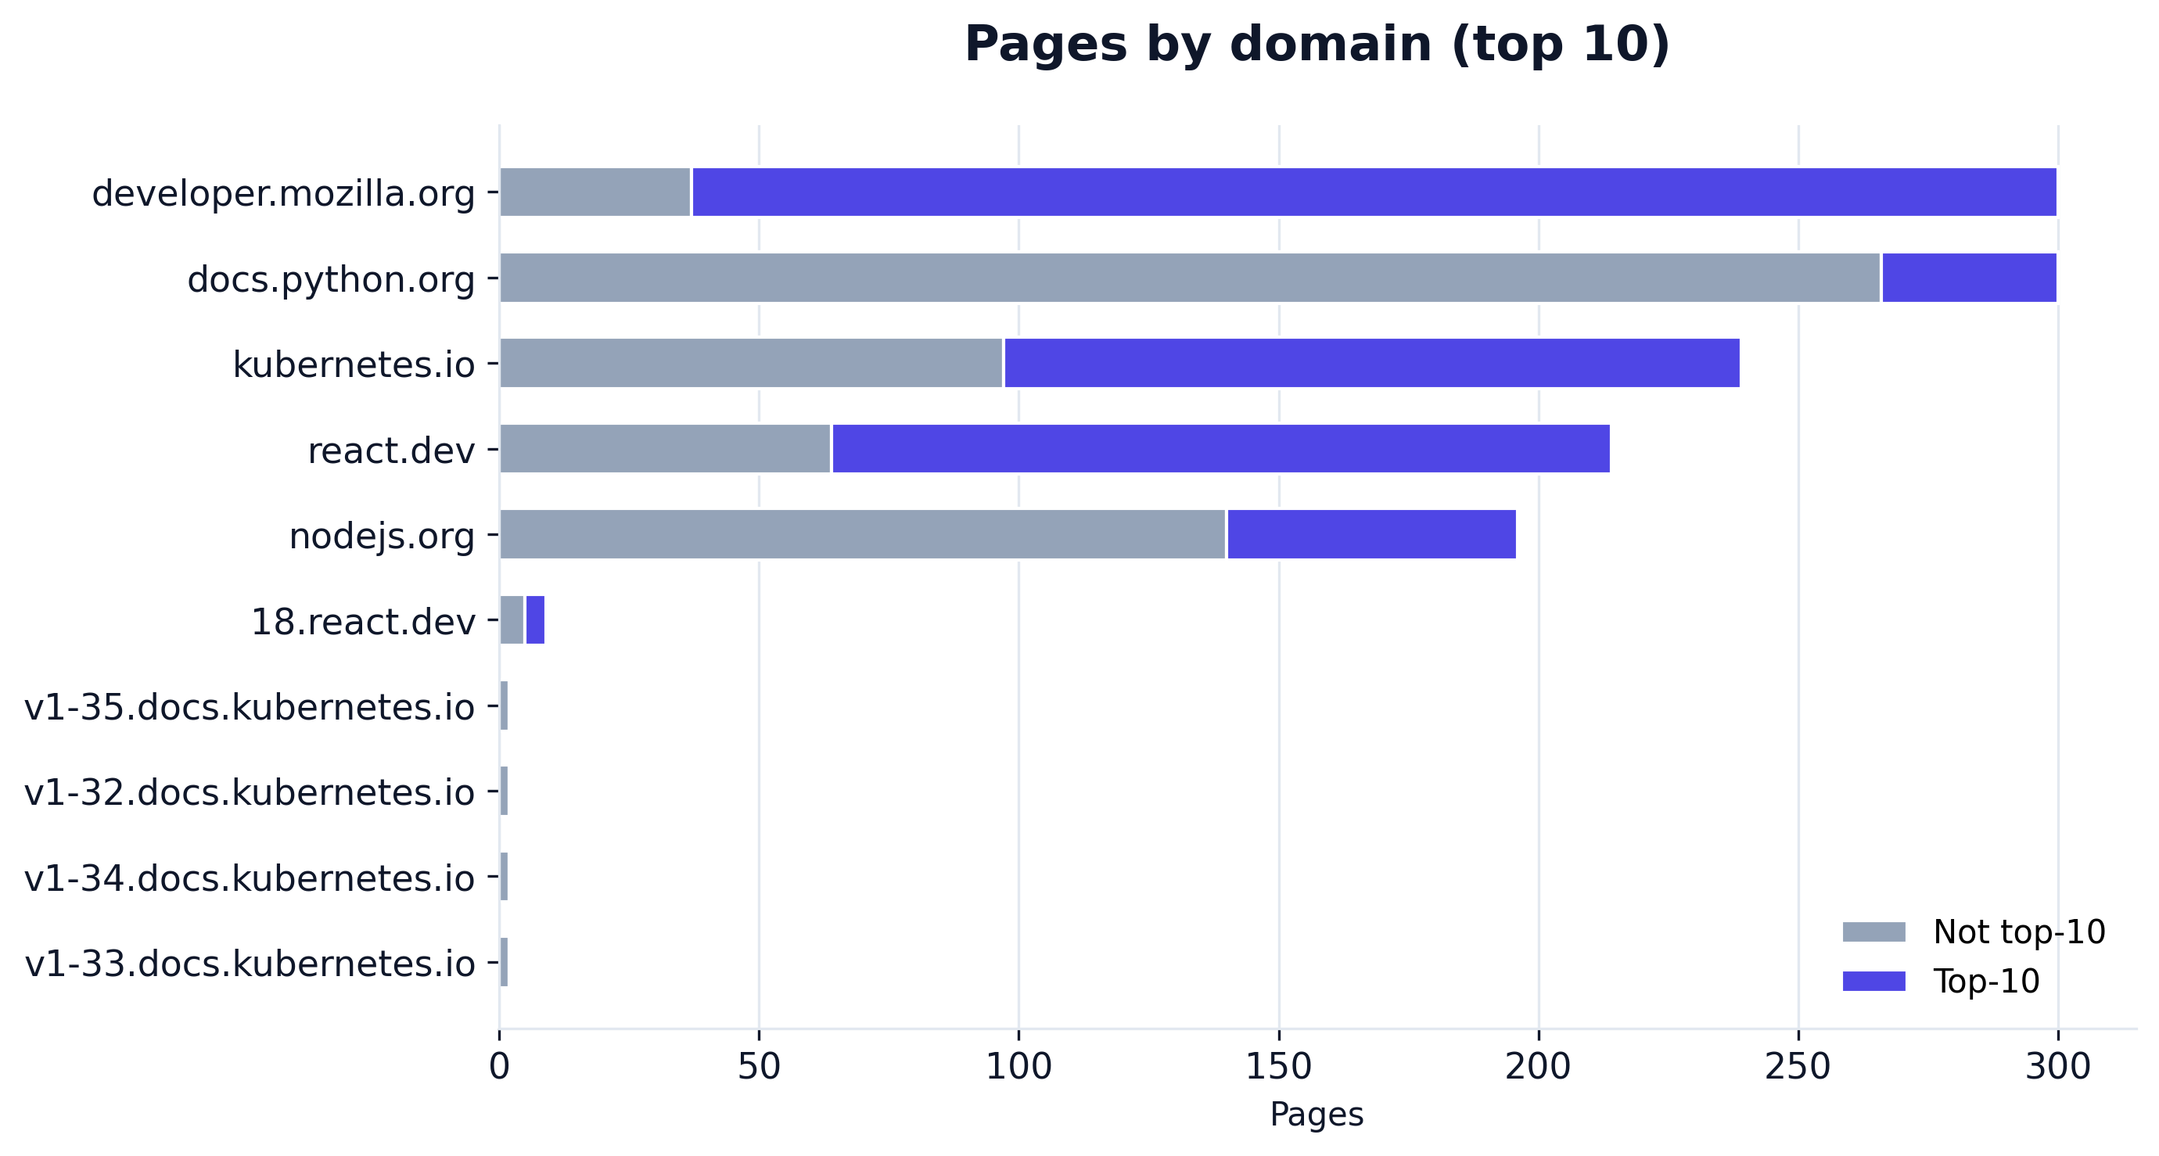
EDA · PART 2
Where the classes diverge
SEO Ranking Predictor · CIS 2450 Final
6 / 13

Slide 7
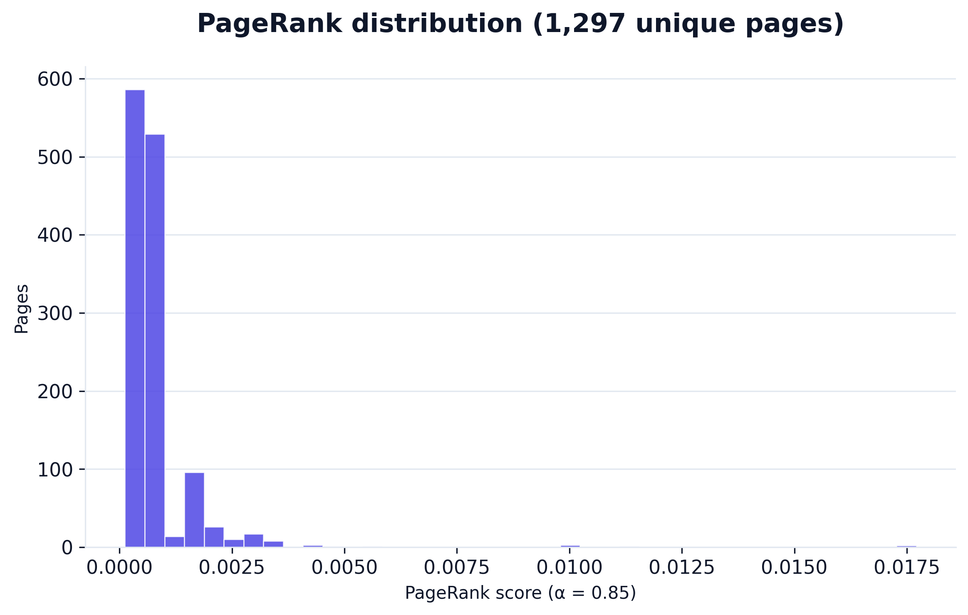
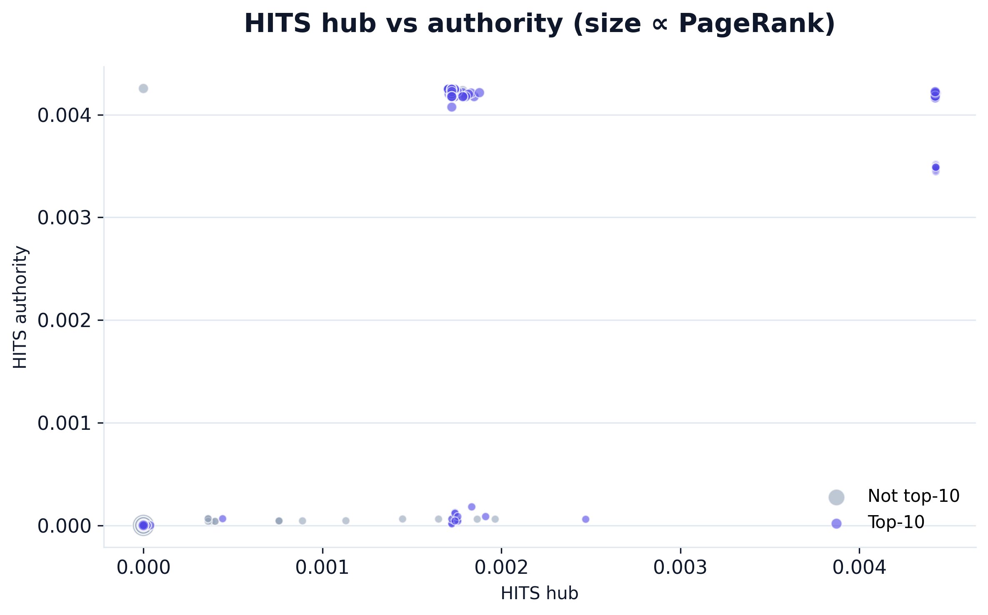
LINK-GRAPH LAYER
PageRank · HITS · clustering
PageRank
HITS
Clustering
Stationary distribution · α = 0.85
Hub vs authority · Kleinberg
Local triangle density per node
SEO Ranking Predictor · CIS 2450 Final
7 / 13

Slide 8
MODELING
Baseline → advanced · four-model progression
LR
RF
XGB
MLP
Logistic Regression
Random Forest
XGBoost
PyTorch MLP
Linear baseline · L1 / L2 swept
Bagging · n_est, depth, leaf swept
Boosting · η, depth, subsample swept
2-layer · dropout · batch-norm
Hyperparameter tuning
Cross-validation
Imbalance handling
RandomizedSearchCV · 30 iter / model · loguniform priors on continuous knobs · integer ranges on tree depths.
Shared StratifiedKFold(n=5, seed=42) across all four models — comparison-table numbers are apples-to-apples.
class_weight='balanced' (LR/RF) · scale_pos_weight (XGB) · minority oversampling to class parity for the augmented pass.
SEO Ranking Predictor · CIS 2450 Final
8 / 13

Slide 9
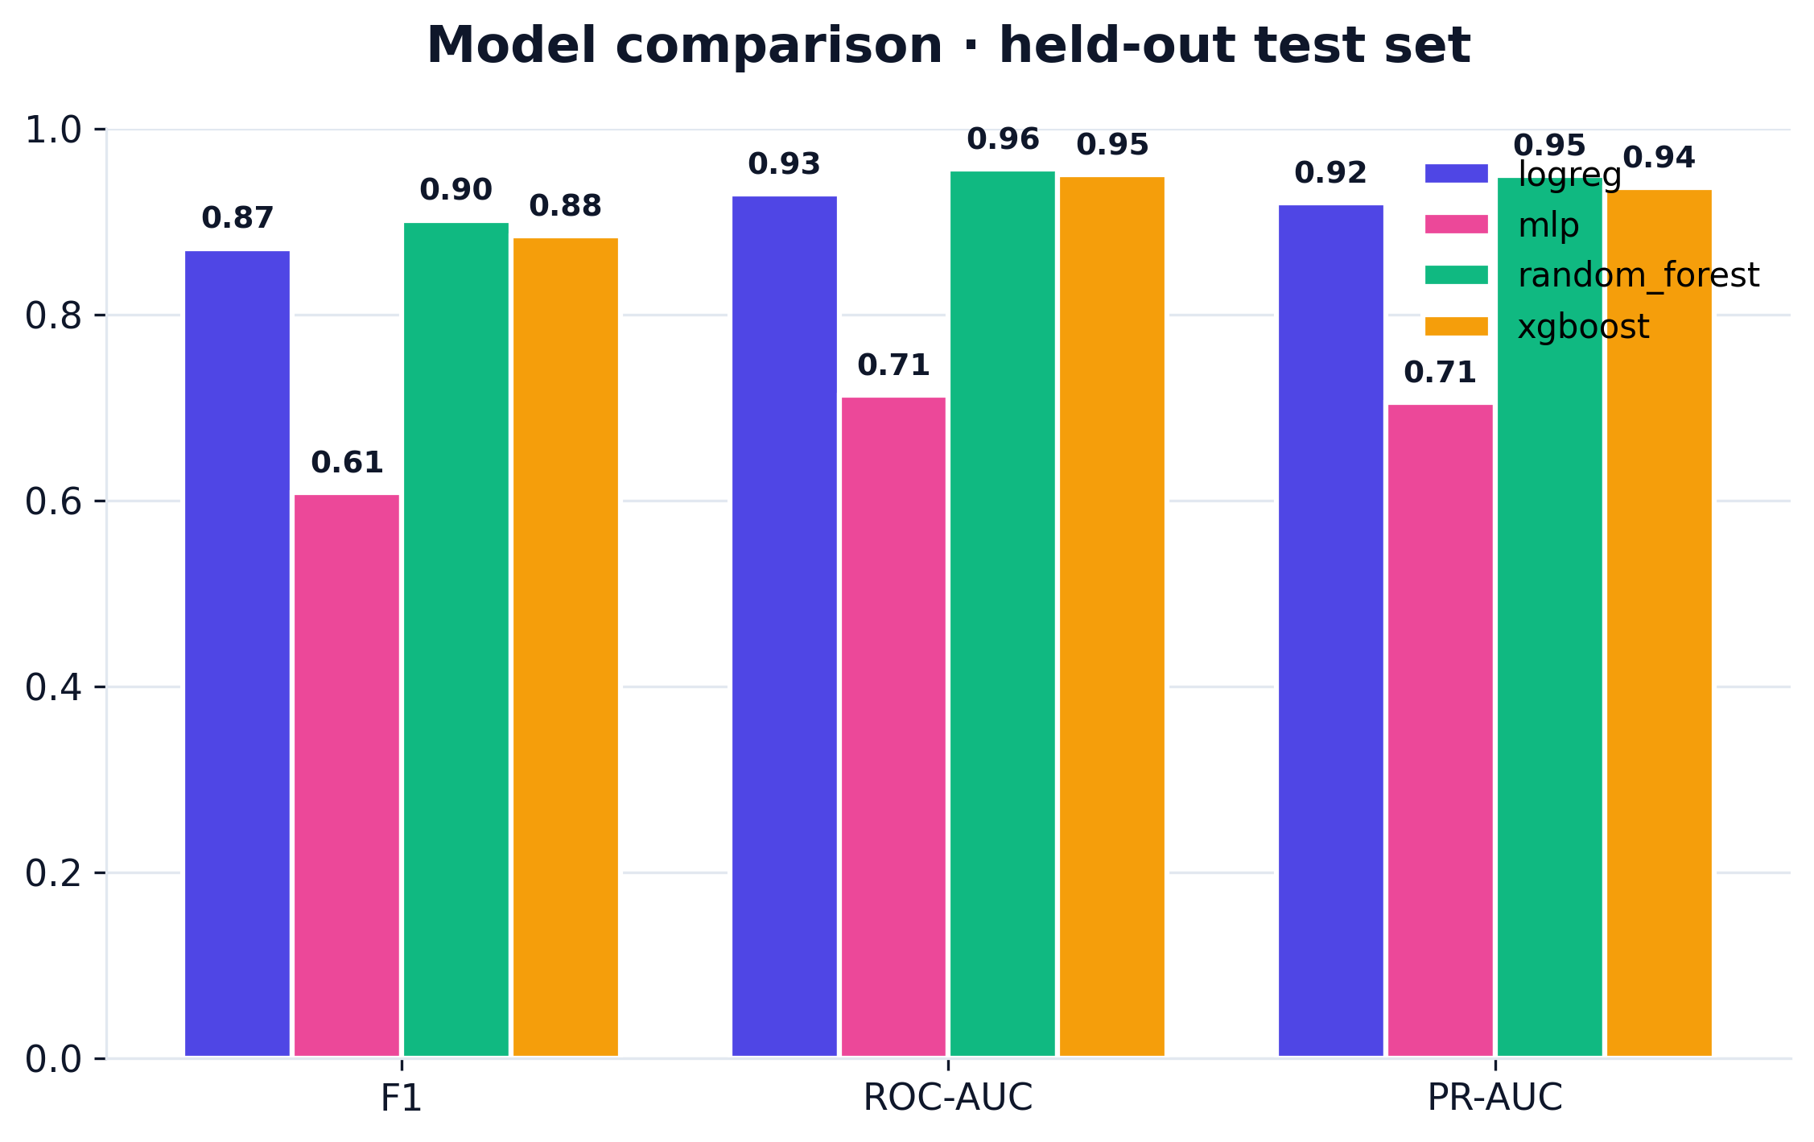
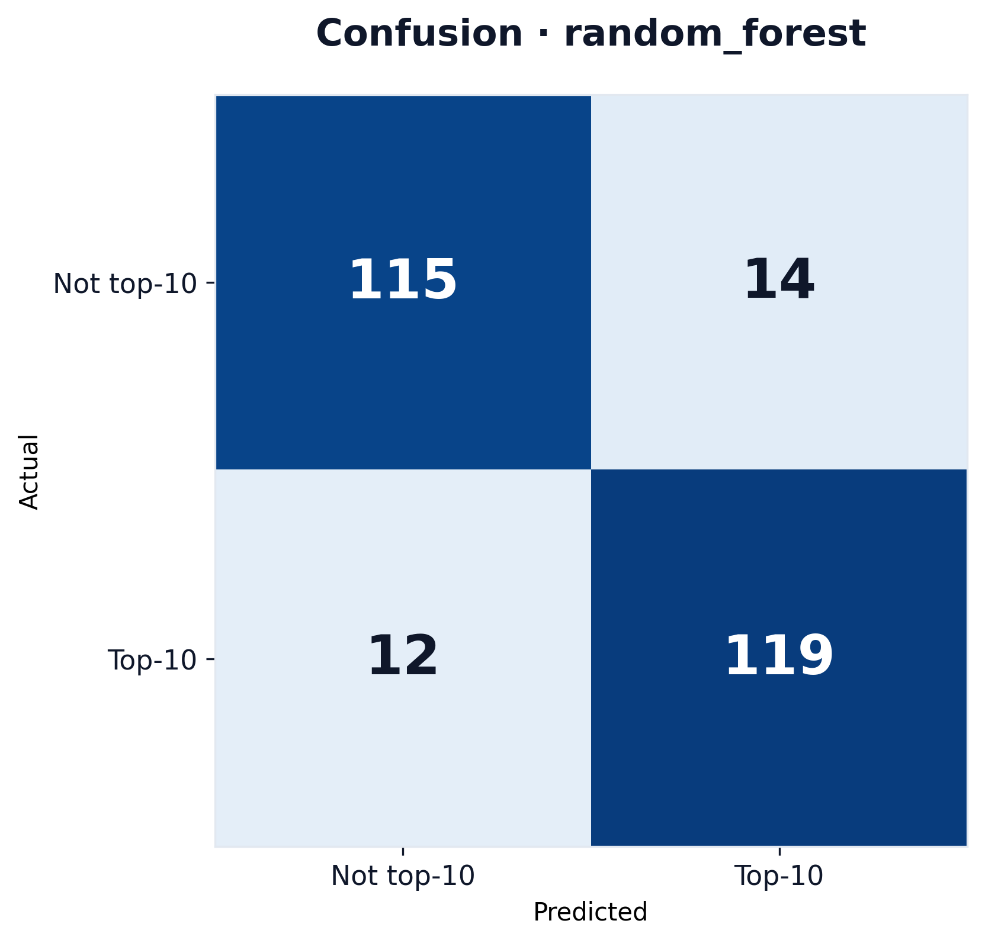
RESULTS
Held-out performance
WINNER
random_forest
F1 = 0.902 · ROC-AUC = 0.956 · PR-AUC = 0.949
F1
ROC-AUC
PR-AUC
0.90
0.96
0.95
SEO Ranking Predictor · CIS 2450 Final
9 / 13

Slide 10
DASHBOARD DEMO
Seven tabs · live URL · SHAP-driven recommendations
What the dashboard does
SEO RANKING
docs.python.org / library / asyncio.html
Predict
PREDICTOR
Live URL → top-10 probability per loaded model
Predict
EDA
EDA
XGBOOST
RANDOM FOREST
LOGISTIC REG.
Class balance · correlations · distribution explorer
67.2%
58.4%
61.1%
Graph
Graph
PageRank · HITS scatter · URL hierarchy network
Models
Models
Recommendations
Per-prediction SHAP attribution
Metrics table · ROC + PR curves · confusion matrices
What-if
h2_count
Recommendations
title_length
Hybrid rule + SHAP-ranked actions per page
About
keyword_density
What-if
pagerank
internal_link_count
Slider counterfactuals · live probability deltas
SEO Ranking Predictor · CIS 2450 Final
10 / 13

Slide 11
INSIGHTS
What the model actually learned
01
02
03
Structure beats length
Authority is observable
Title craft is high-leverage
Heading-count and link-graph features outrank raw word count in the importance ranking. Authors should optimise H2 / H3 structure before pushing for longer pages.
PageRank and HITS authority correlate with `is_top_10` more strongly than any single content feature. Internal-link topology — what we already control on our own site — is actionable signal.
Both `keyword_in_title` and `title_length` show clean class separation. The What-if simulator confirms: changing title length by ±15 chars moves predicted probability by 6-12 pts.
Practical implication: the recommendation engine prioritises structural fixes (heading counts, alt-text coverage, internal-link distribution) ahead of content rewrites — lower edit cost, higher predicted lift.
SEO Ranking Predictor · CIS 2450 Final
11 / 13

Slide 12
CHALLENGES & FUTURE WORK
What we'd ship next
Challenges
Future work
No source-reputation signal
Domain-authority feature
We score the page itself — text, structure, link topology — not the domain's editorial authority. docs.python.org and a personal blog with the same heading layout score equally; real Google ranking weighs reputation heavily.
Augment the matrix with an external authority signal (Tranco rank, Majestic Trust Flow) so the model can distinguish official-docs from third-party content — directly addresses the reputation gap.
Free-tier API limits
Per-domain calibrated thresholds
Brave Search caps at ~2K queries/month — bounded the corpus to ~1.3K pages.
0.5 cutoff is naive — real SERPs differ in expected positive rate per domain. Platt / isotonic on a held-out validation slice per host.
Live URLs lack graph signal
Recommendation A/B harness
Page isn't in the training graph; we median-fill its graph features rather than zero-fill (zero biases predictions down).
Apply a recommended change to a copy of a page, re-scrape, compare actual rank movement against predicted lift — closes the loop on causal vs correlated.
Title-derived queries can mislead
Cross-engine generalisation
Some <title> tags are version numbers or 'Overview'. The dashboard exposes a manual query override for evaluation.
Today: Google via Brave / SerpApi. Add Bing / DuckDuckGo labels — does the same model rank well across engines?
SEO Ranking Predictor · CIS 2450 Final
12 / 13

Slide 13
QUESTIONS?
Thank you.
SEO Ranking Predictor · CIS 2450 Final Project
Rahil Patel · Ayush Tripathi

